Slide 1


Global Strategy for the Diagnosis, Management, and Prevention of
Chronic Obstructive Pulmonary Disease (GOLD) teaching slide set 2026
Title slide
Teaching
Slide Set
Global Strategy for the Diagnosis, Management, and Prevention of
Chronic Obstructive Pulmonary Disease
This slide set is restricted for academic and educational purposes only. Use of the slide set, or of individual slides, for commercial or promotional purposes requires approval from GOLD.

Slide 2
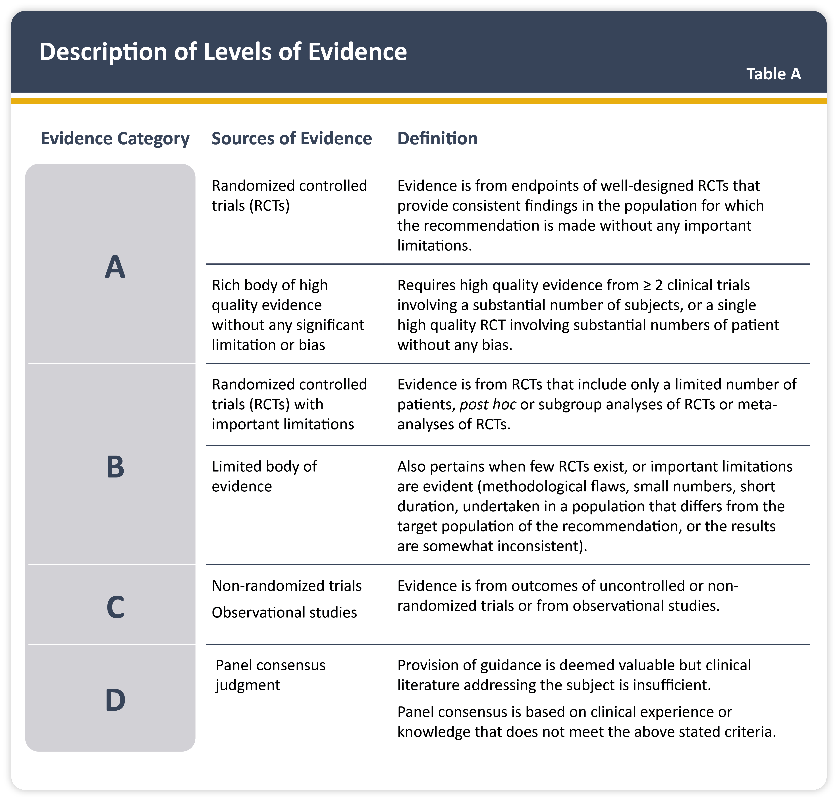
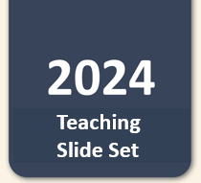

Description of levels of evidence
Teaching
Slide Set
Teaching
Slide Set
Teaching
Slide Set

Slide 3
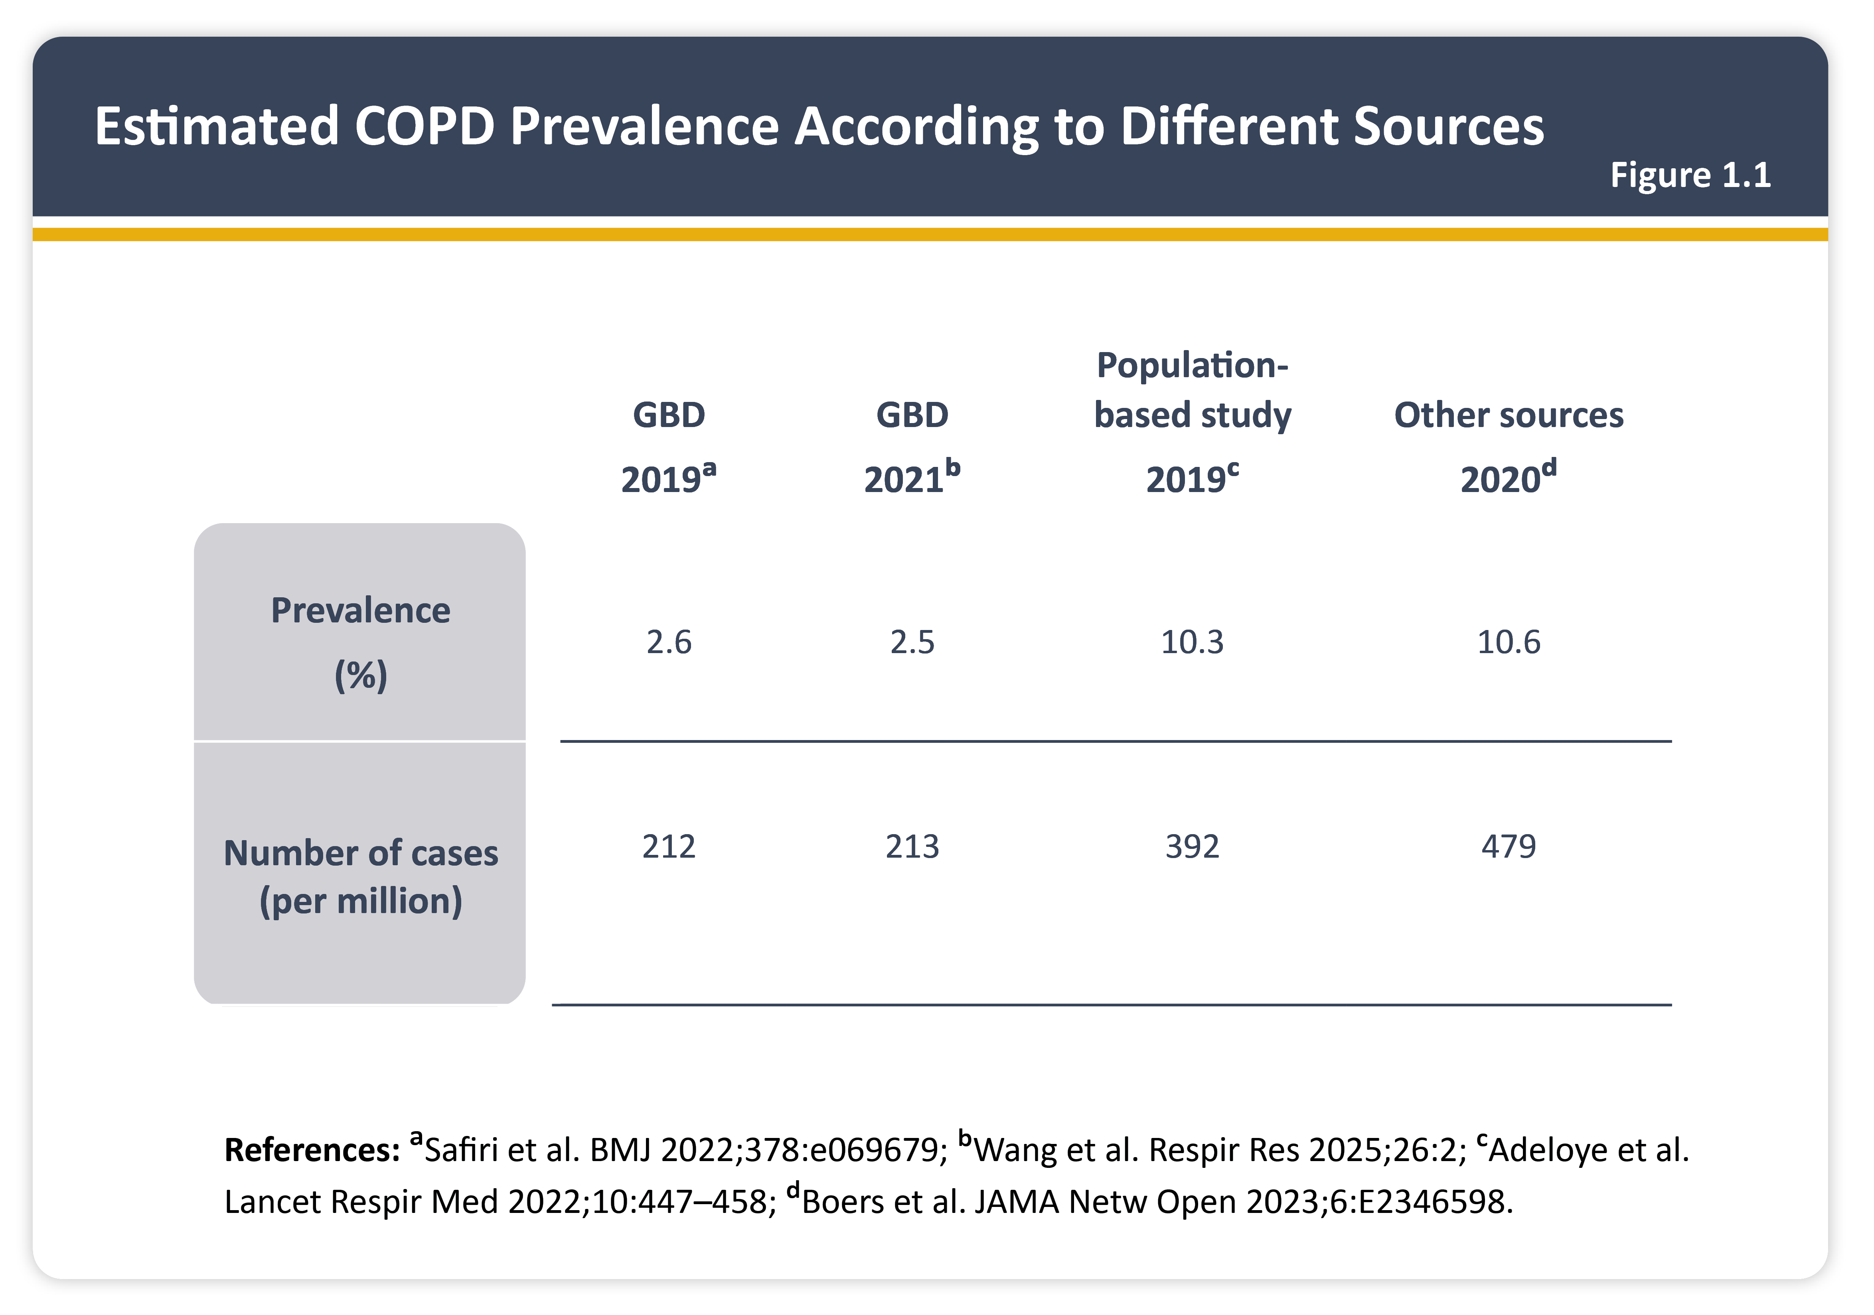
Estimated COPD prevalence
Teaching
Slide Set
Teaching
Slide Set

Slide 4
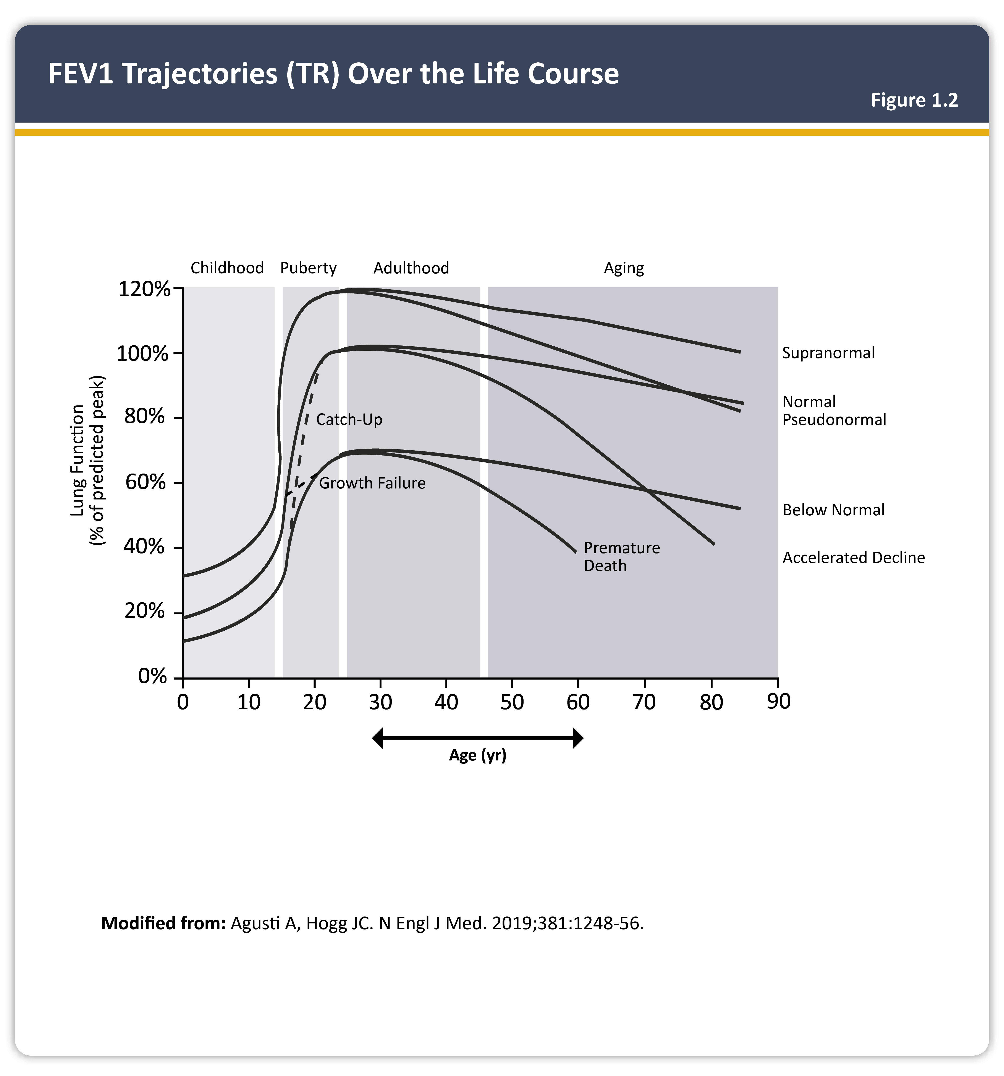
FEV1 trajectories over the life course
Teaching
Slide Set

Slide 5
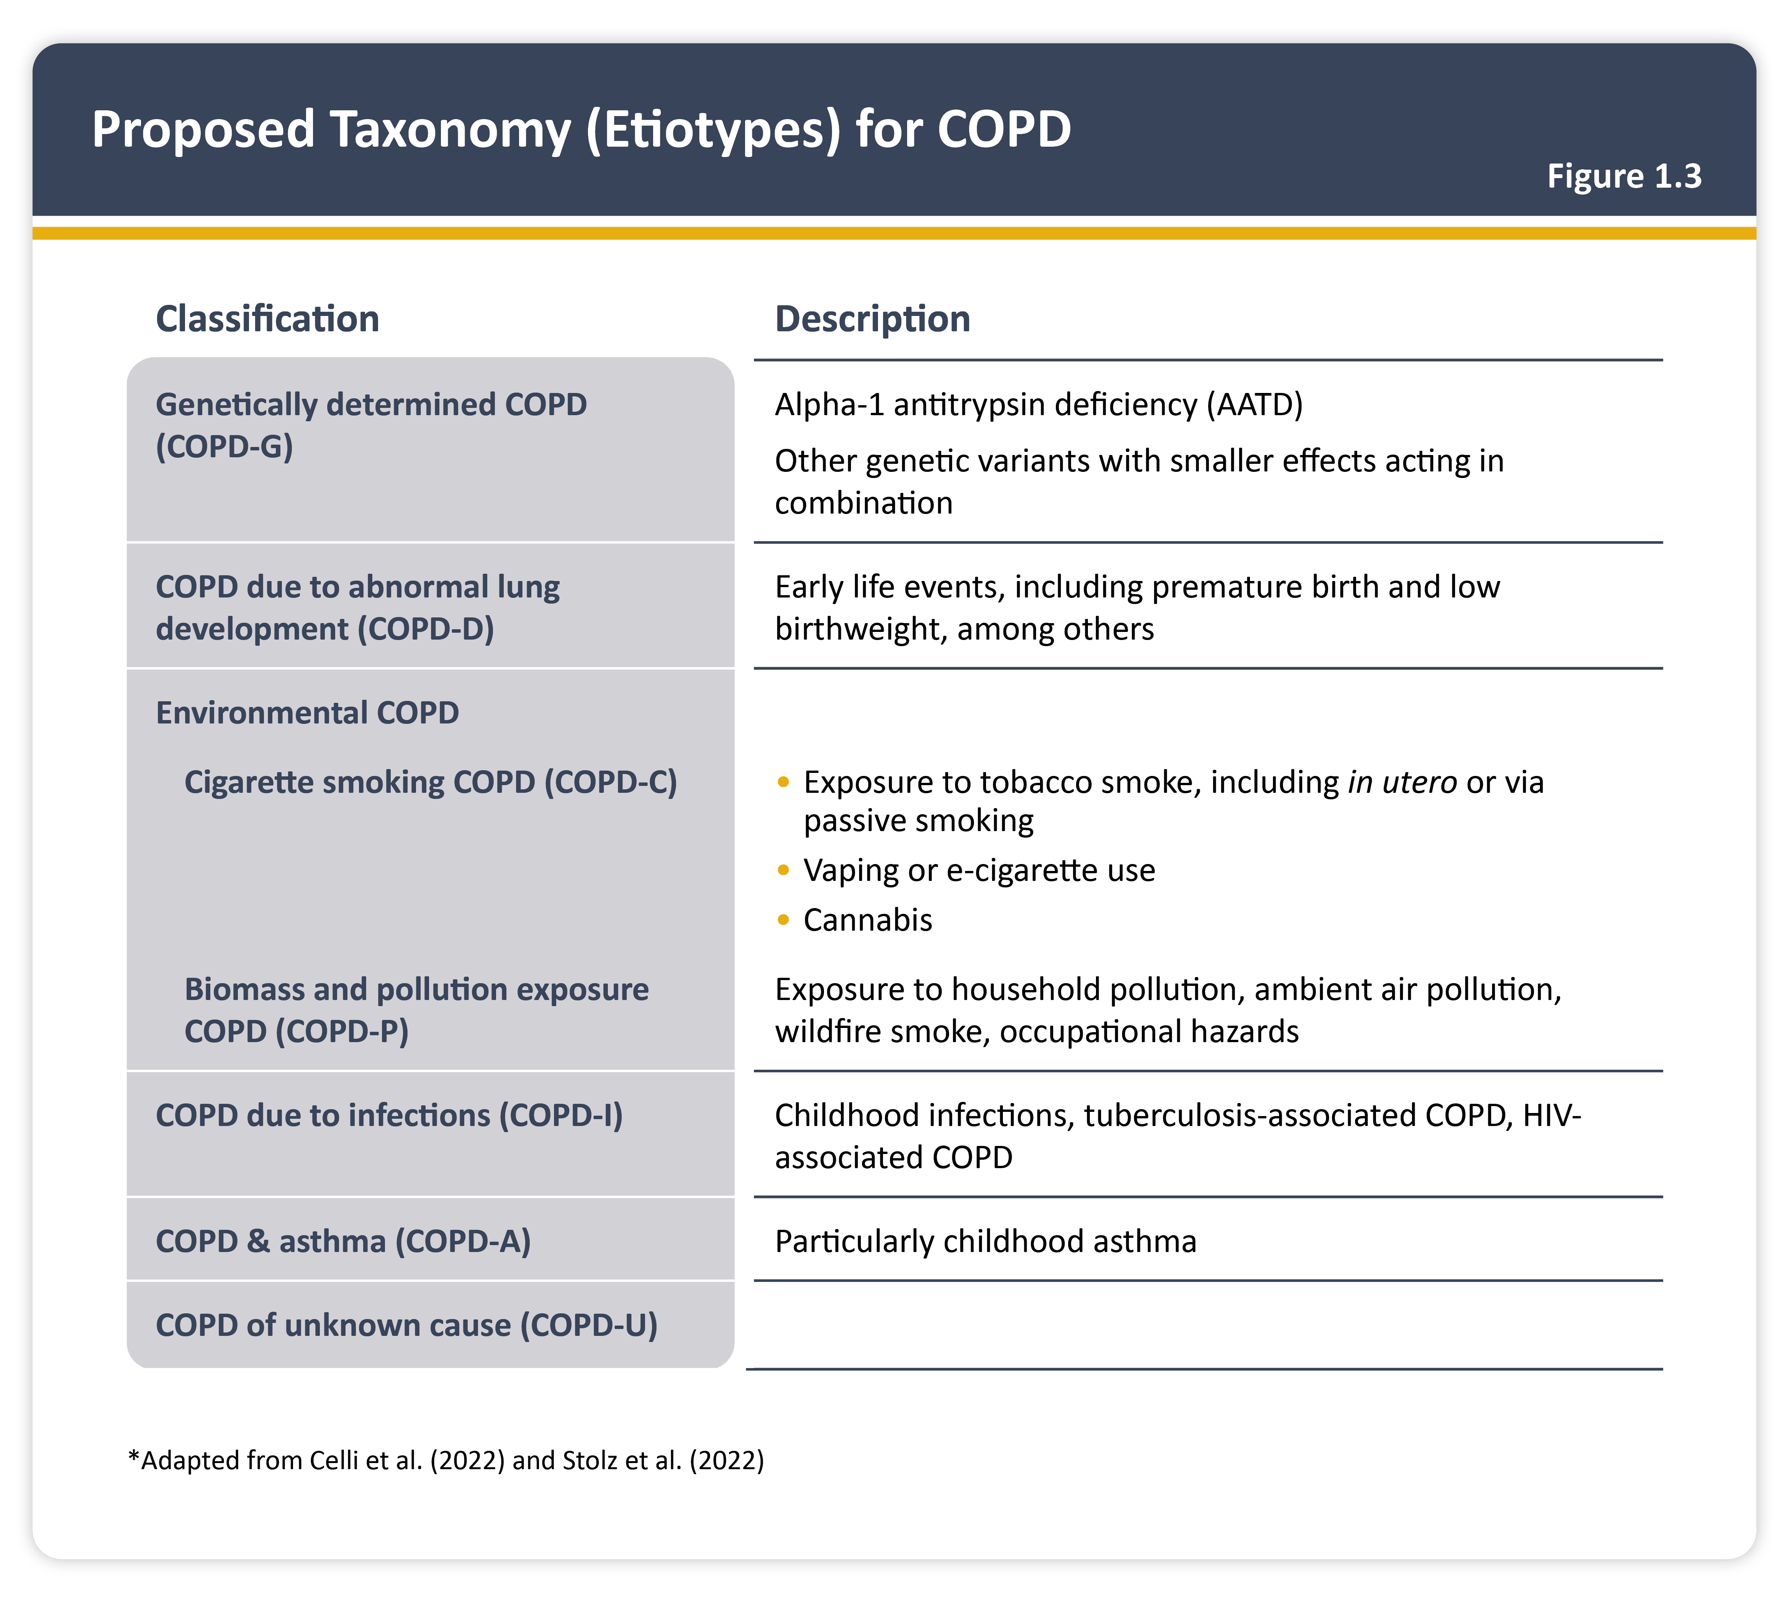
Proposed taxonomy (etiotypes) for COPD
Teaching
Slide Set
Teaching
Slide Set

Slide 6
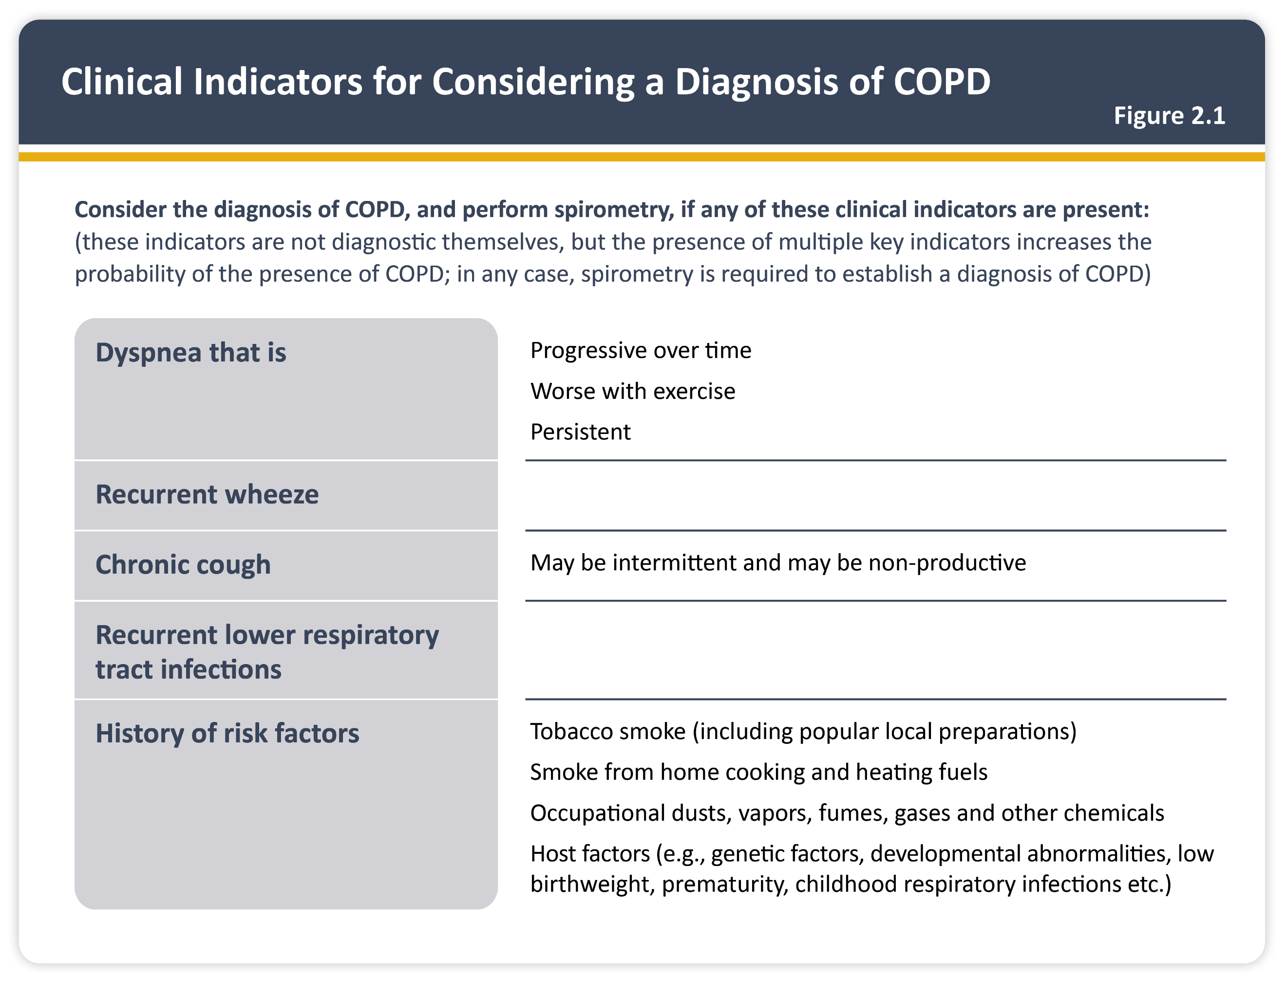
Clinical indicators for considering a diagnosis of COPD
Teaching
Slide Set
Teaching
Slide Set

Slide 7
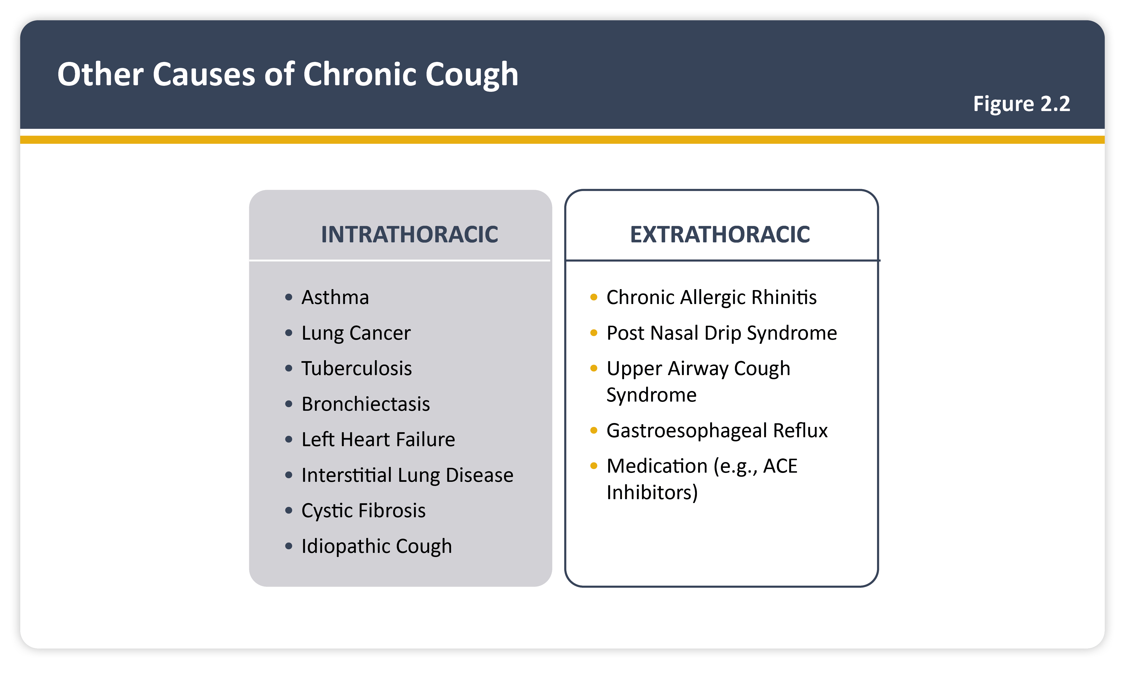
Other causes of chronic cough
Teaching
Slide Set
Teaching
Slide Set

Slide 8
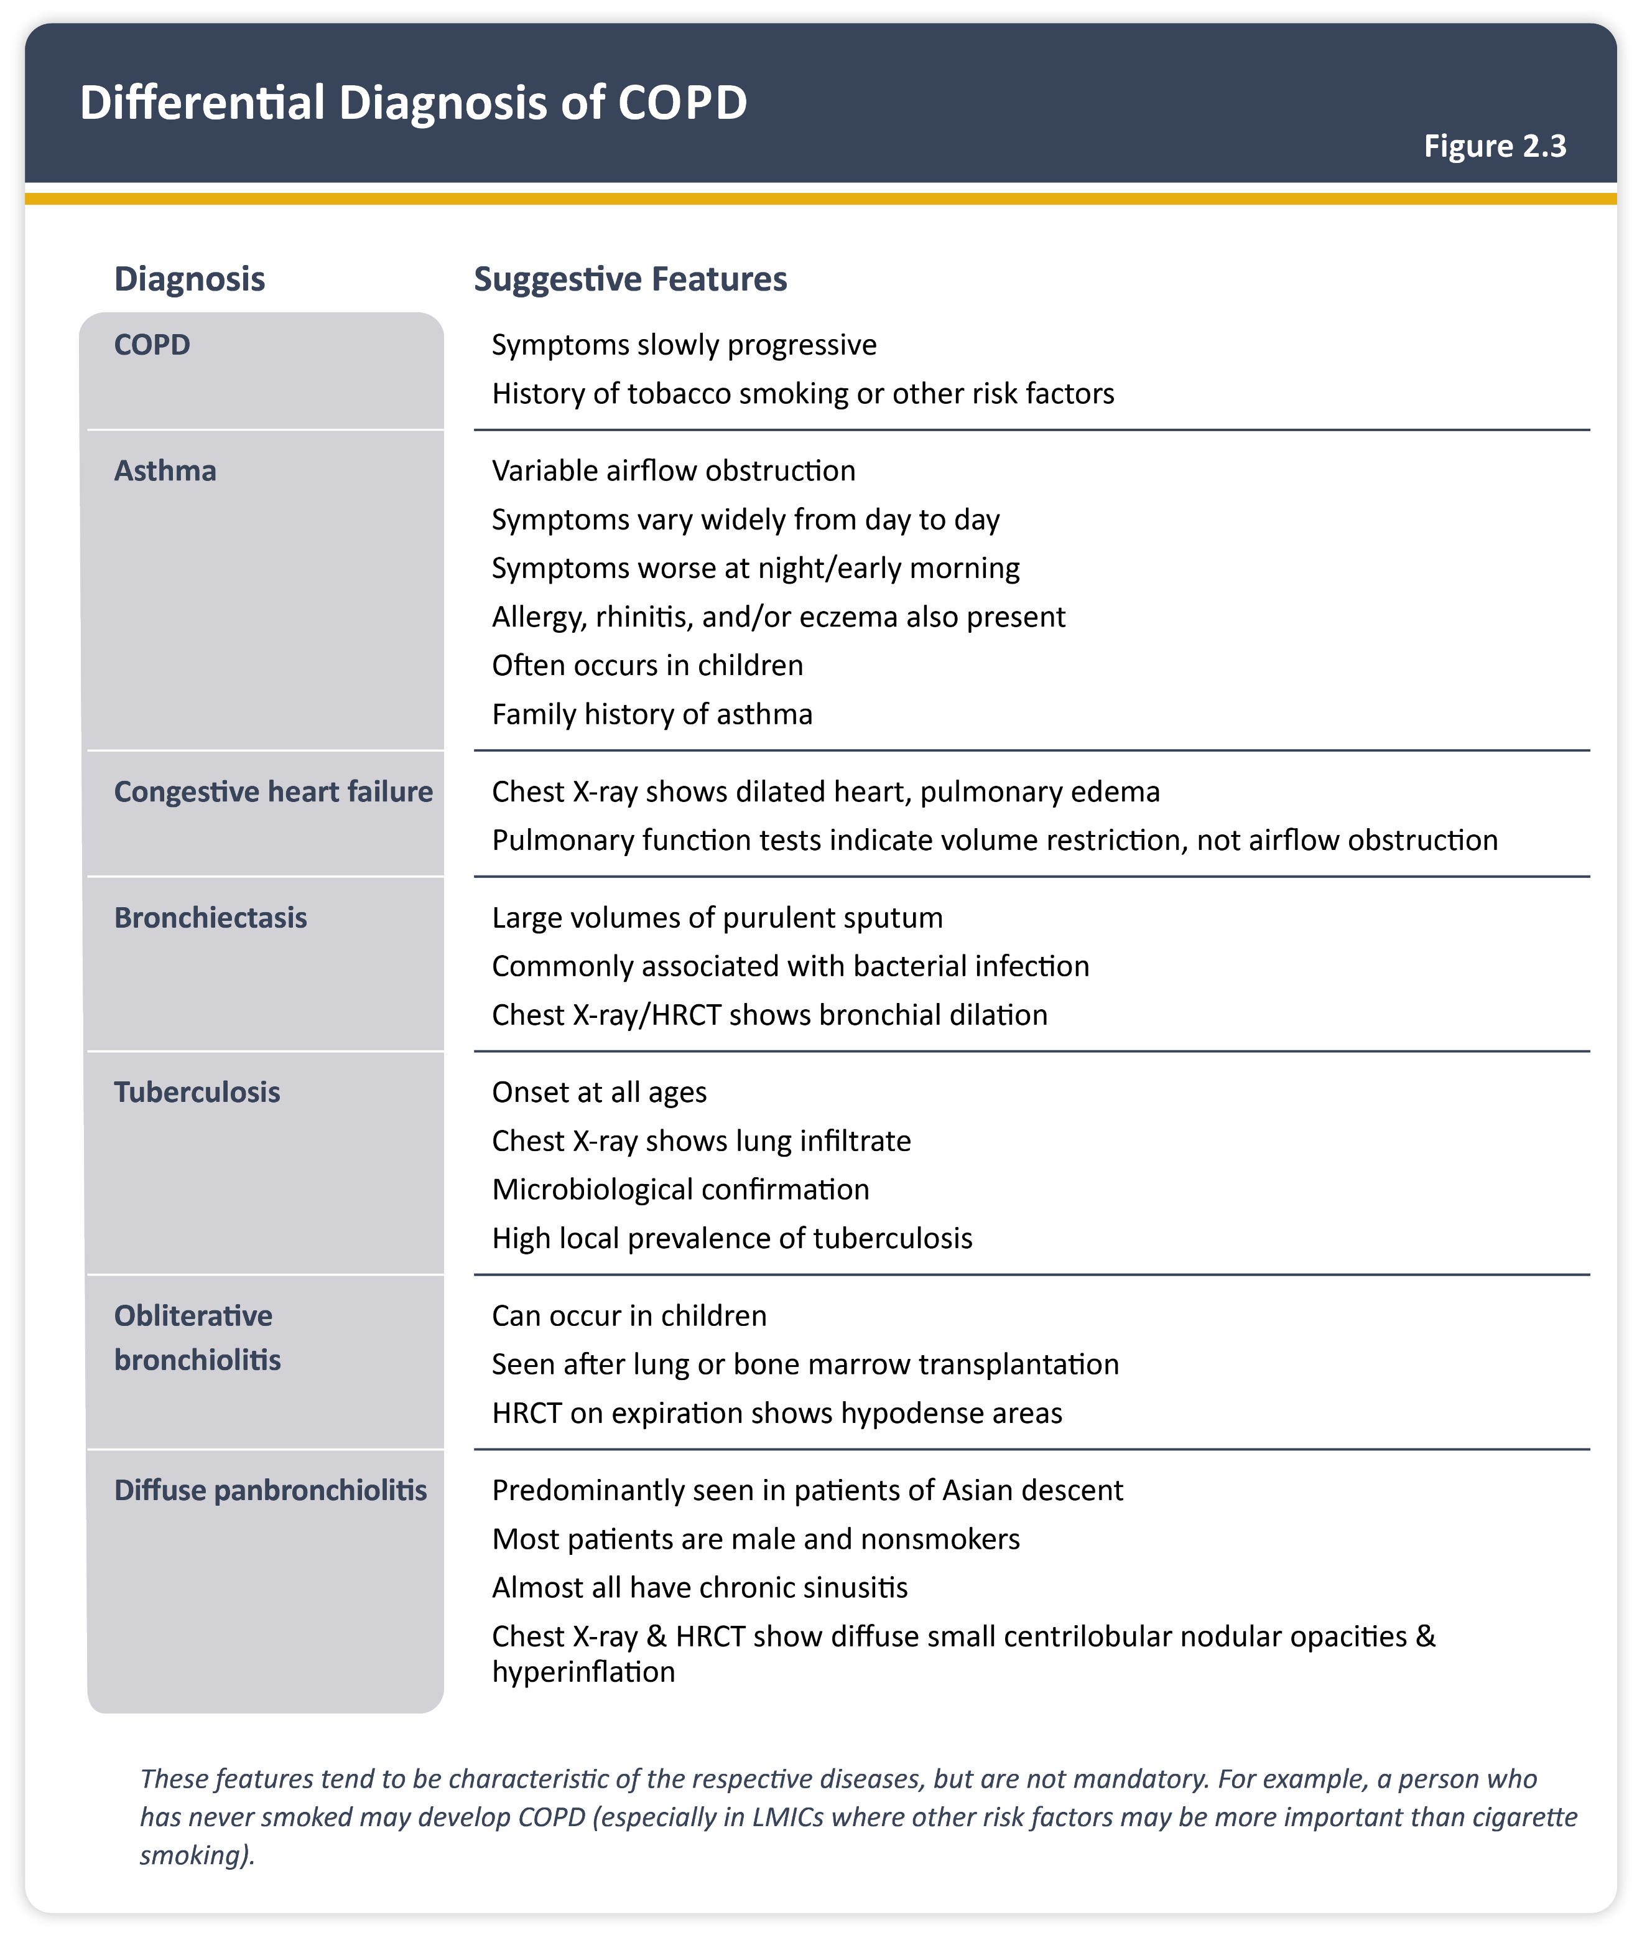
Differential diagnosis of COPD
Teaching
Slide Set
Teaching
Slide Set

Slide 9
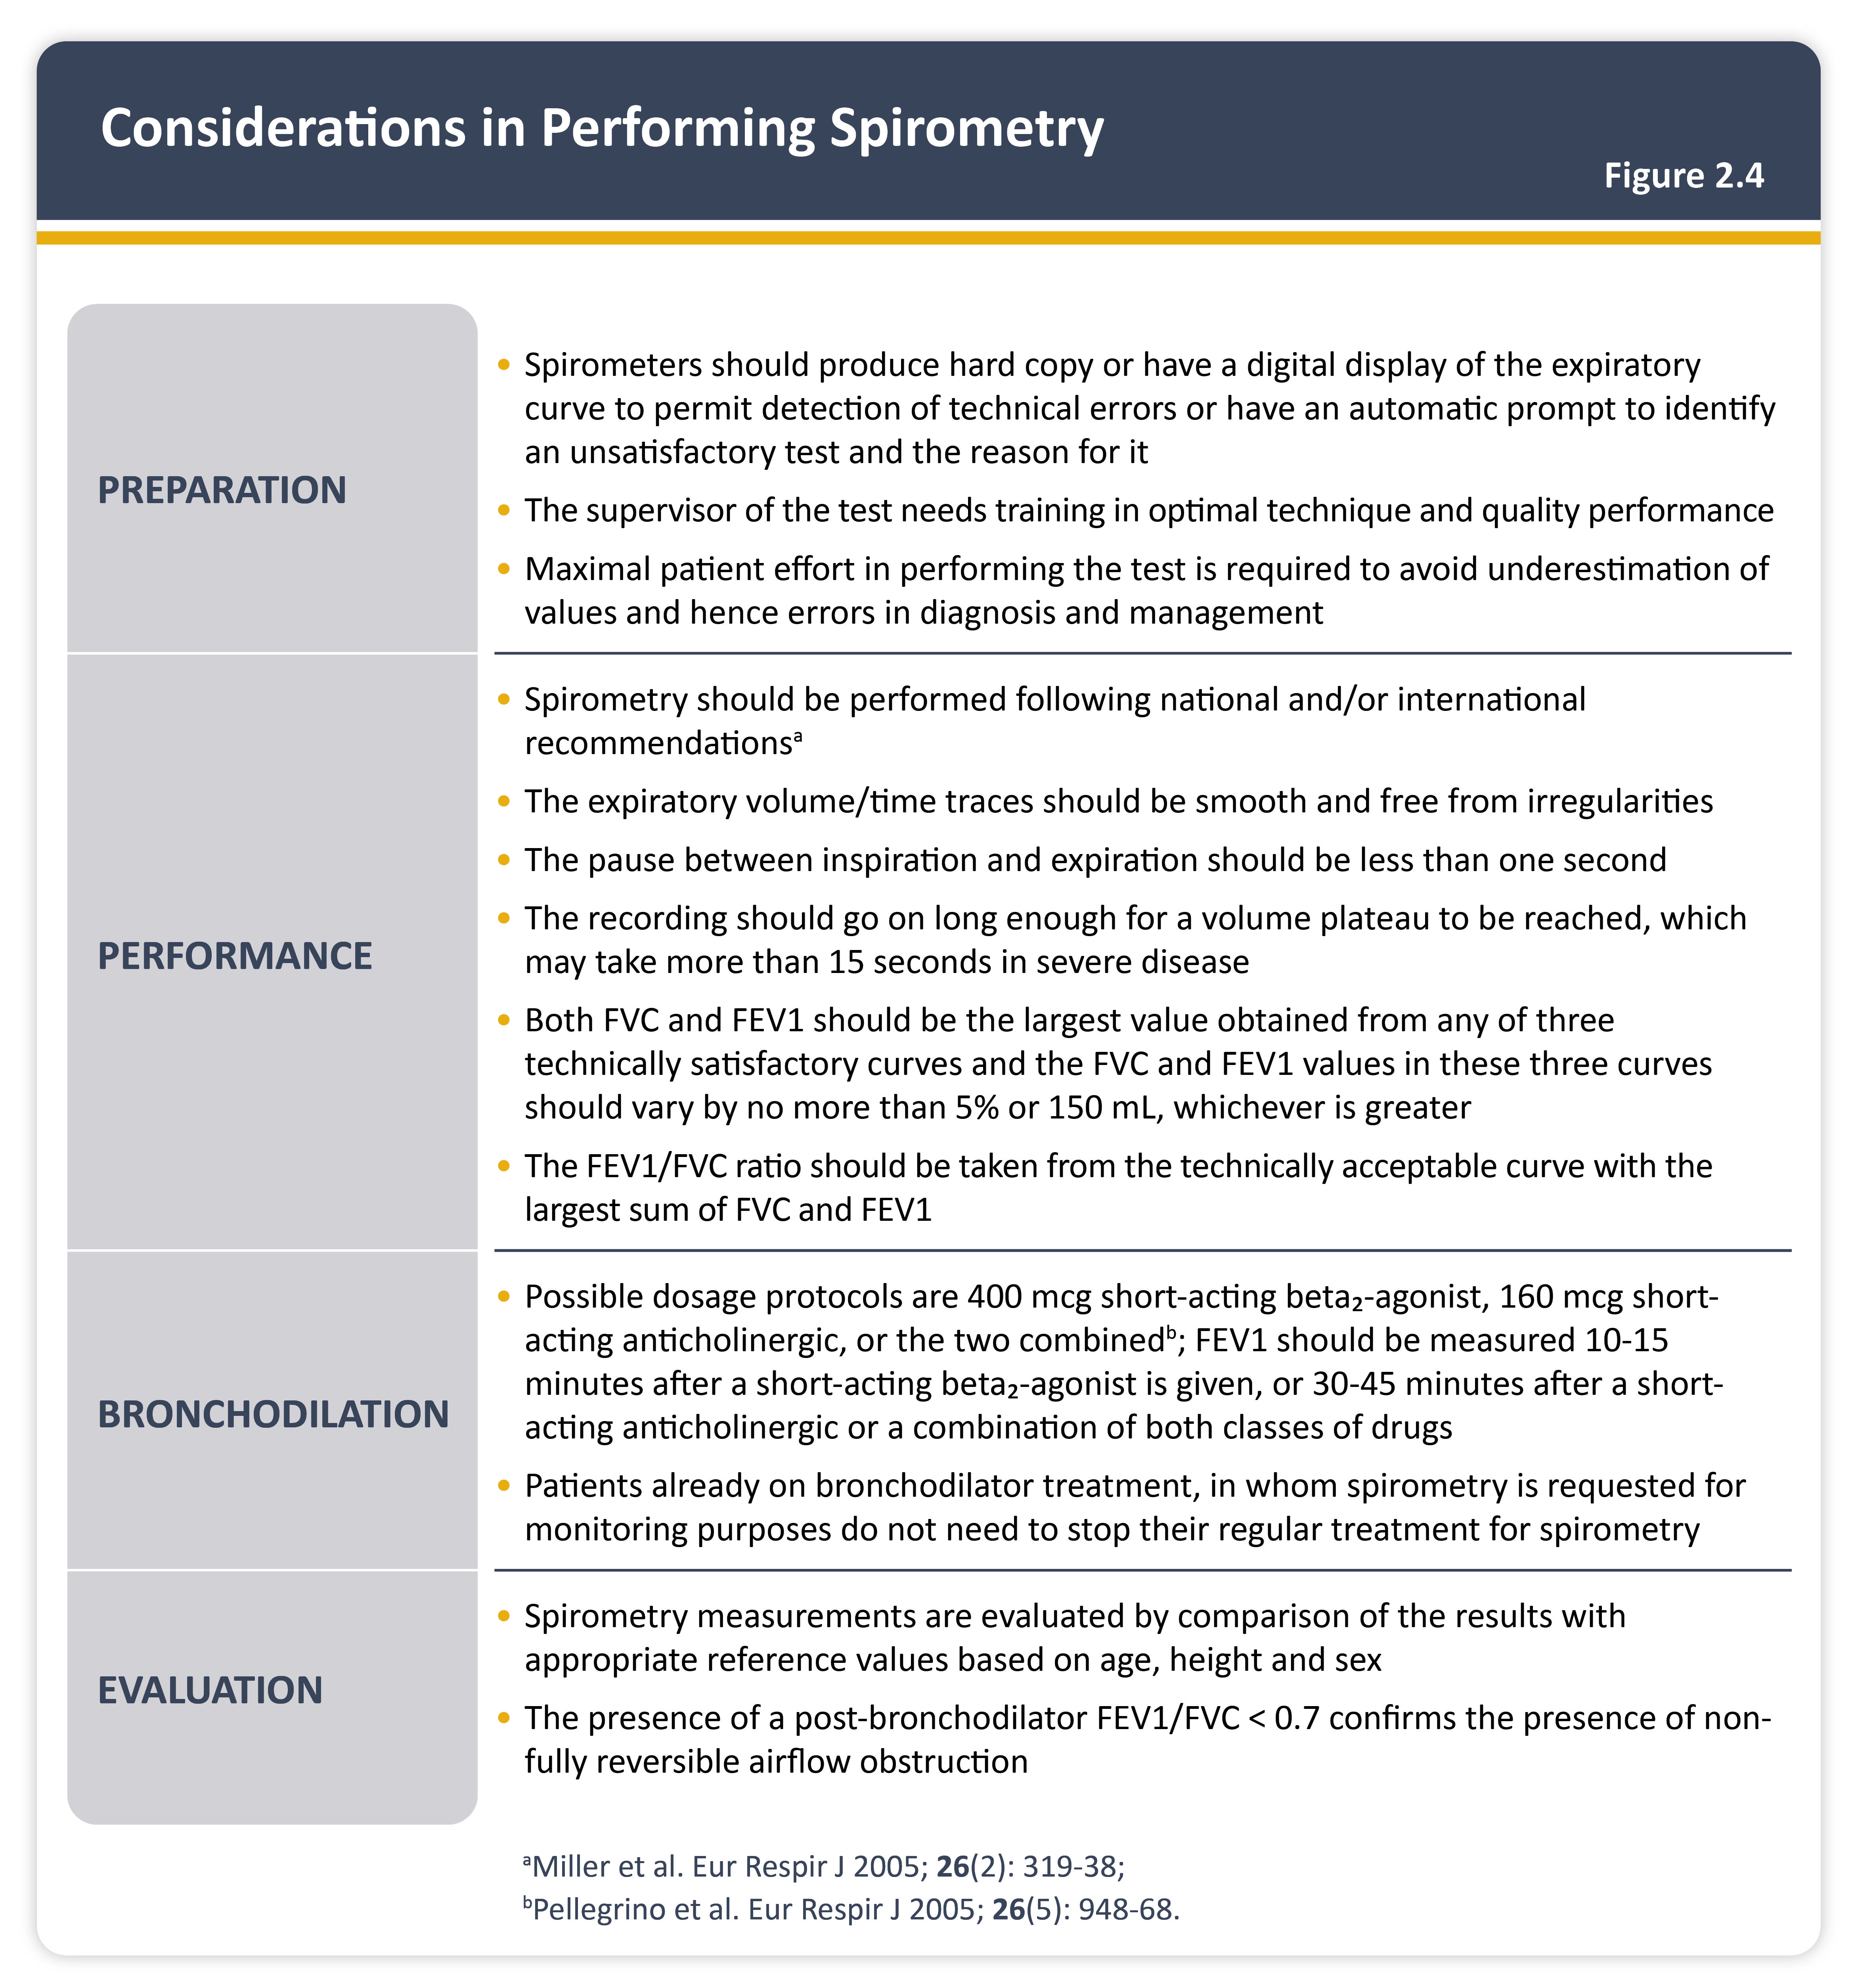
Considerations in performing spirometry
Teaching
Slide Set
Teaching
Slide Set

Slide 10
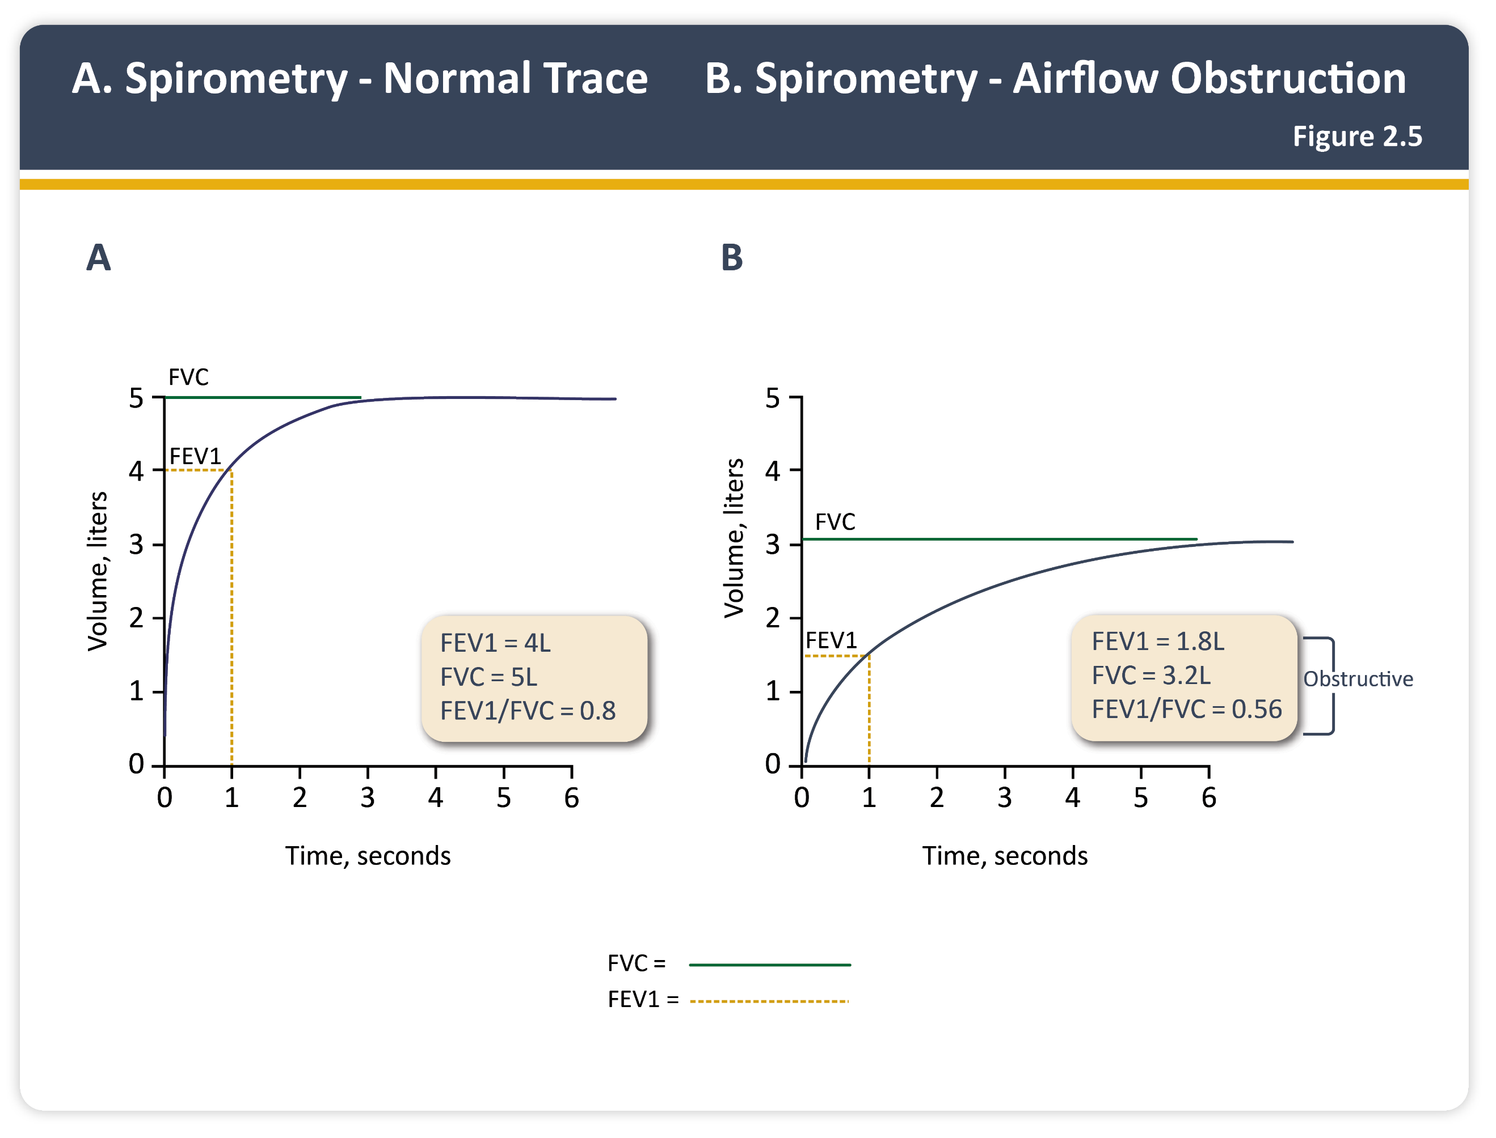
Spirometry normal trace and airflow obstruction
Teaching
Slide Set
Teaching
Slide Set

Slide 11
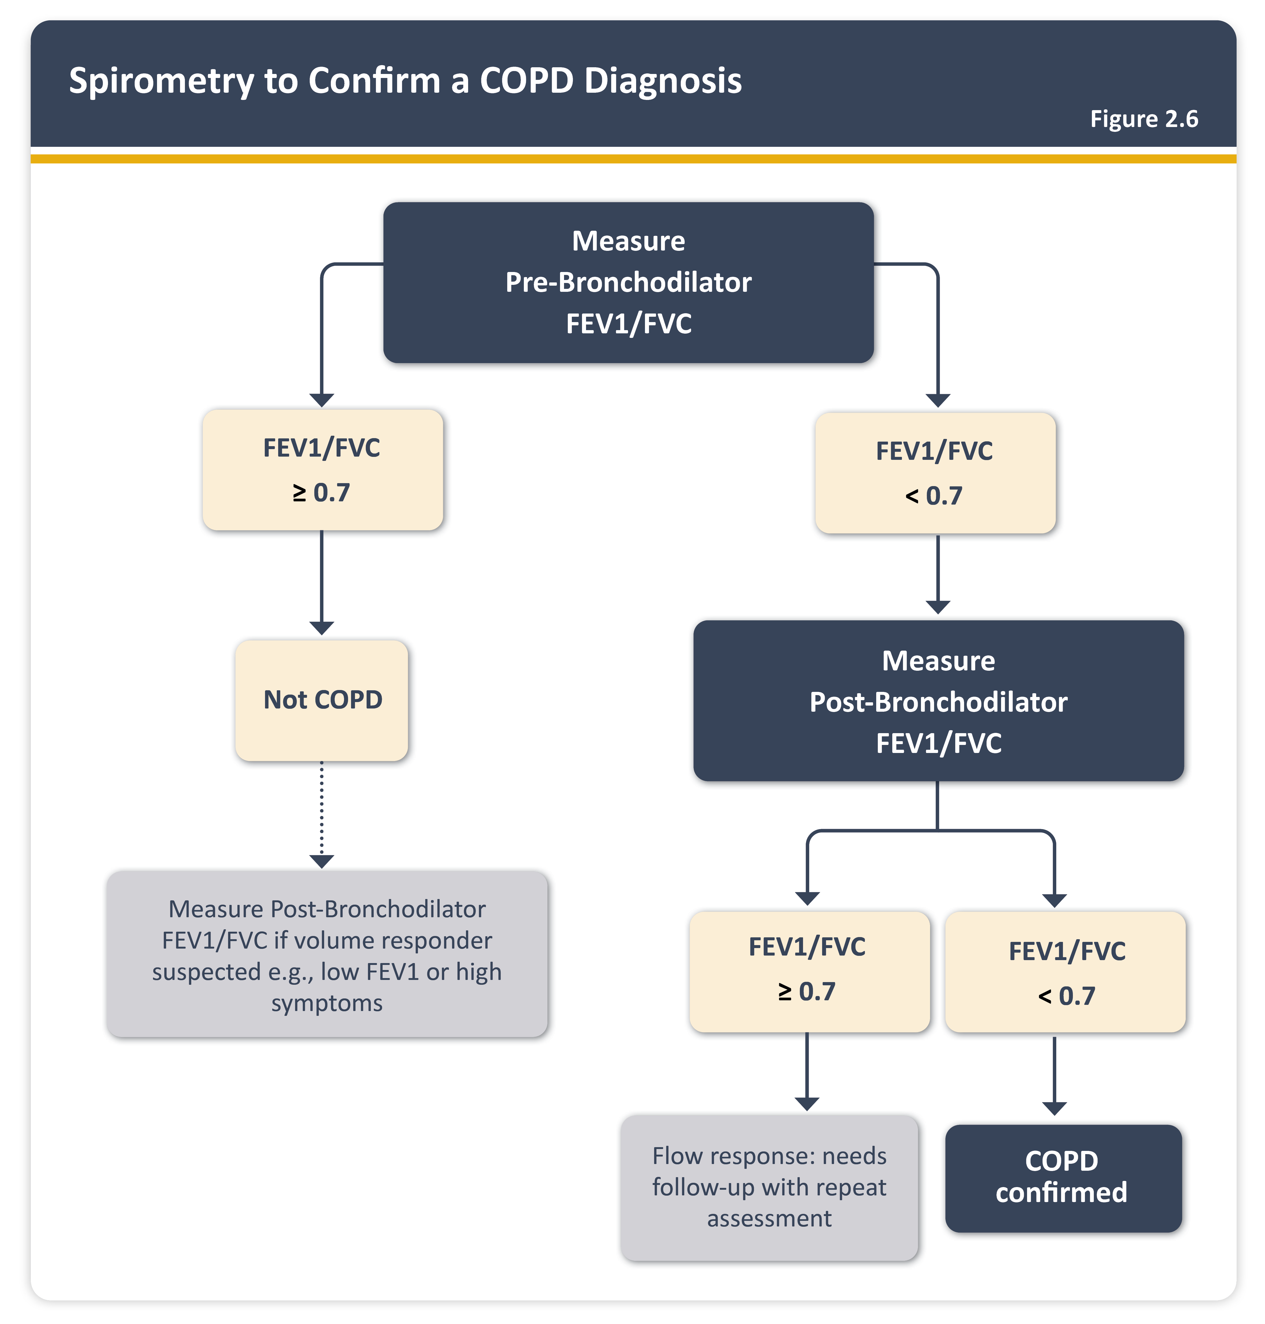
Pre- and Post- Bronchodilator Spirometry
Teaching
Slide Set
Teaching
Slide Set

Slide 12
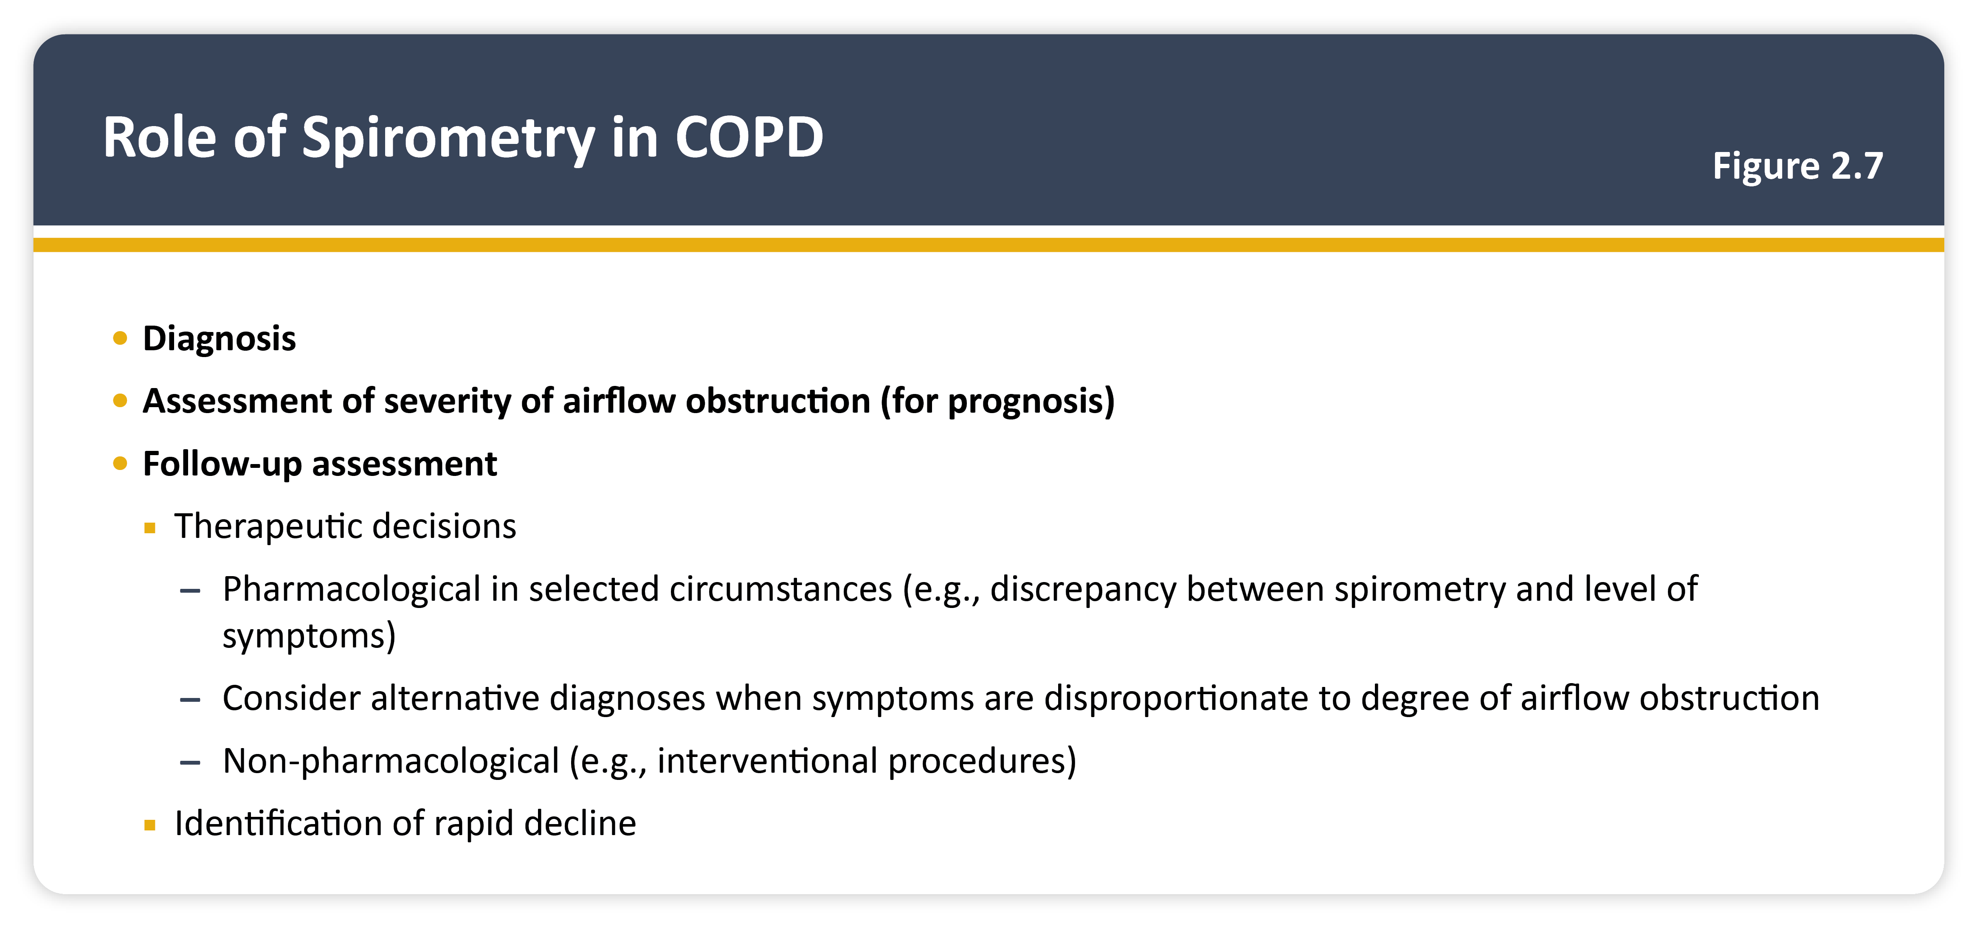
Role of spirometry in COPD
Teaching
Slide Set
Teaching
Slide Set

Slide 13
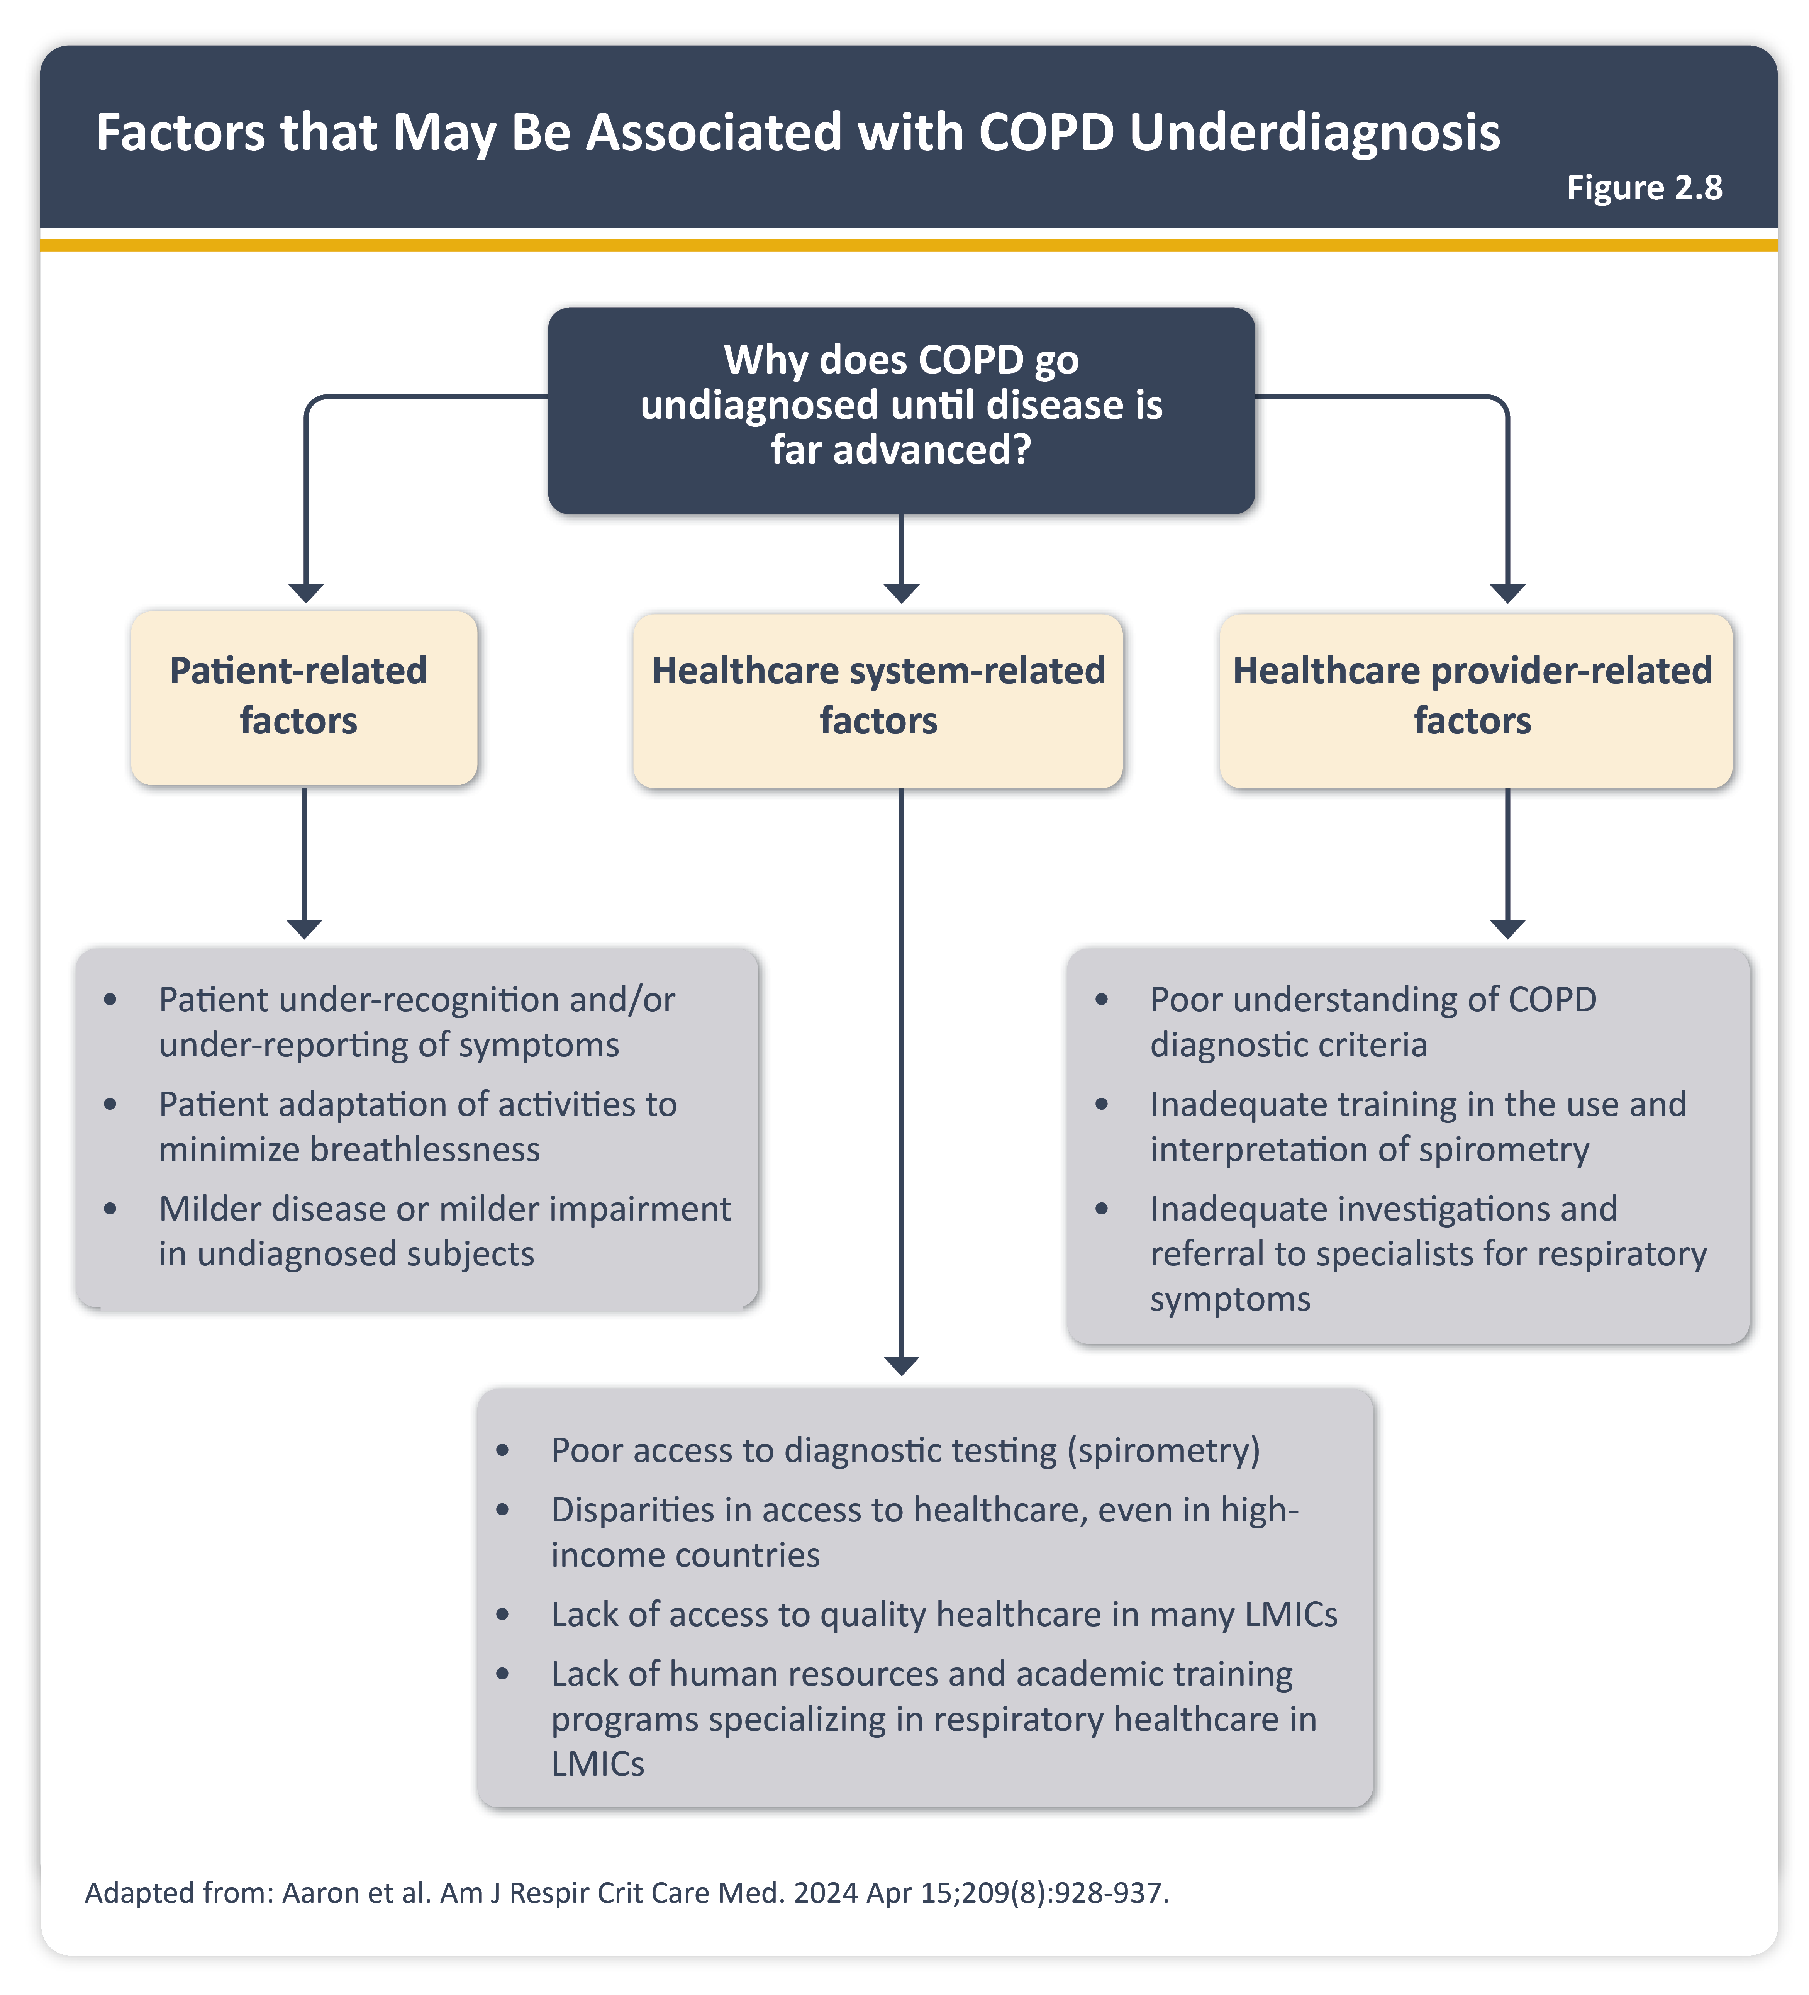
Factors that may be associated with COPD under-diagnosis
Teaching
Slide Set
Teaching
Slide Set

Slide 14
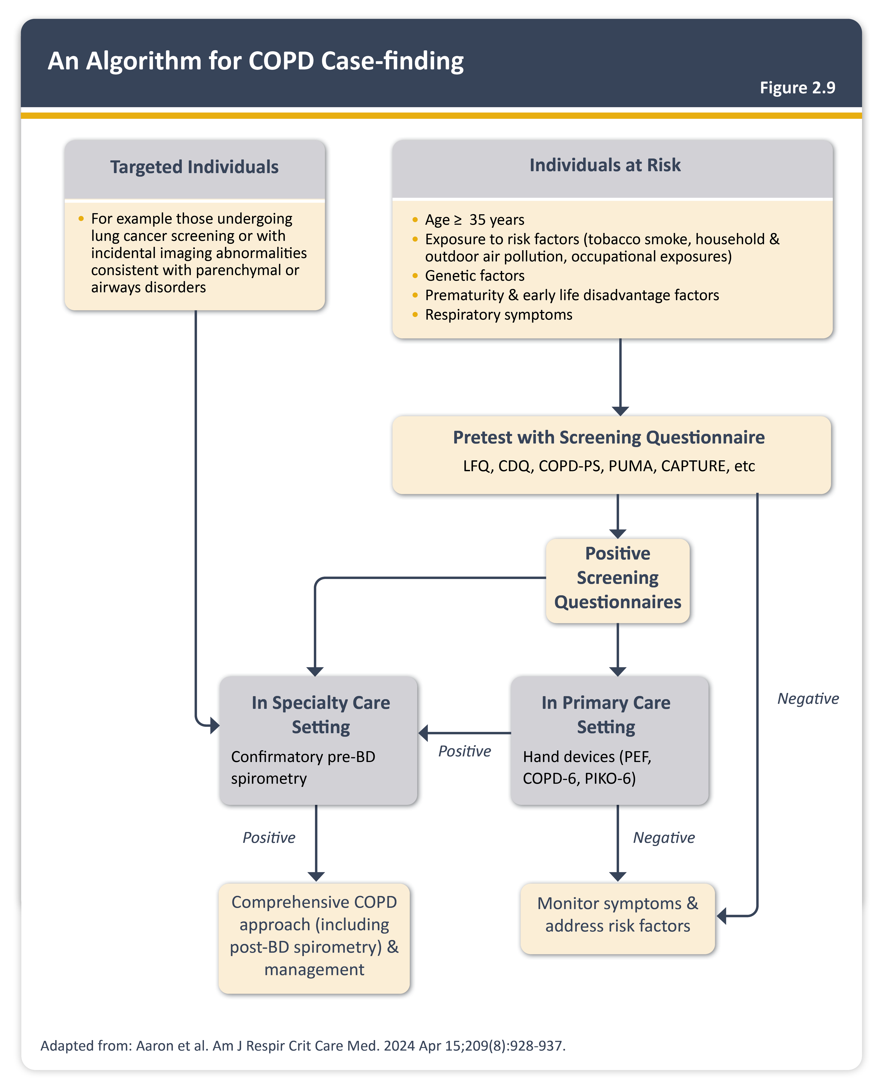
An Algorithm for COPD case-finding
Teaching
Slide Set
Teaching
Slide Set

Slide 15
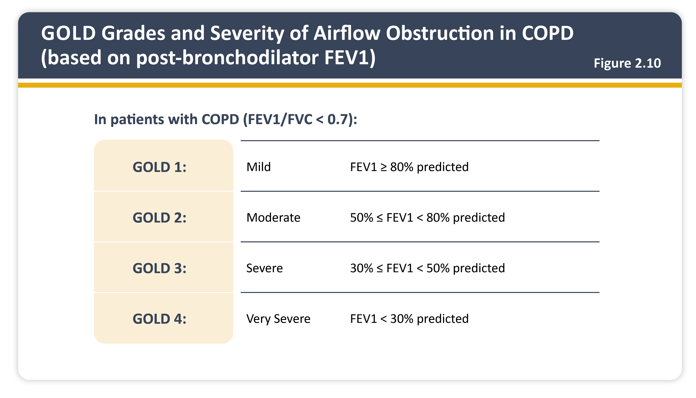
GOLD grades and severity of airflow obstruction
Teaching
Slide Set
Teaching
Slide Set

Slide 16
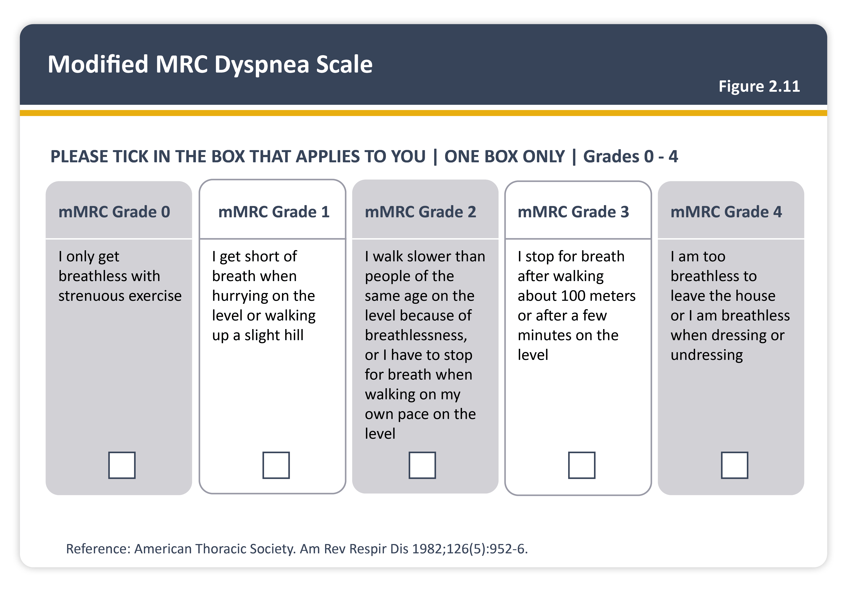
Modified MRC dyspnea scale
Teaching
Slide Set
Teaching
Slide Set

Slide 17
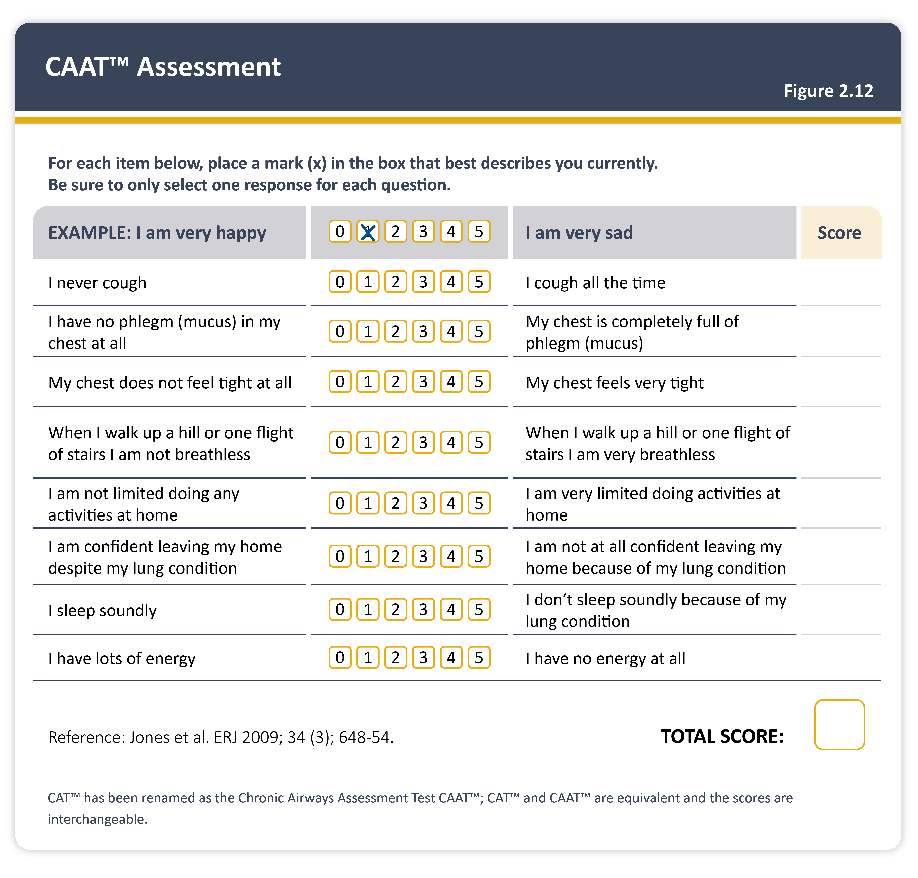
CAAT assessment
Teaching
Slide Set
Teaching
Slide Set

Slide 18
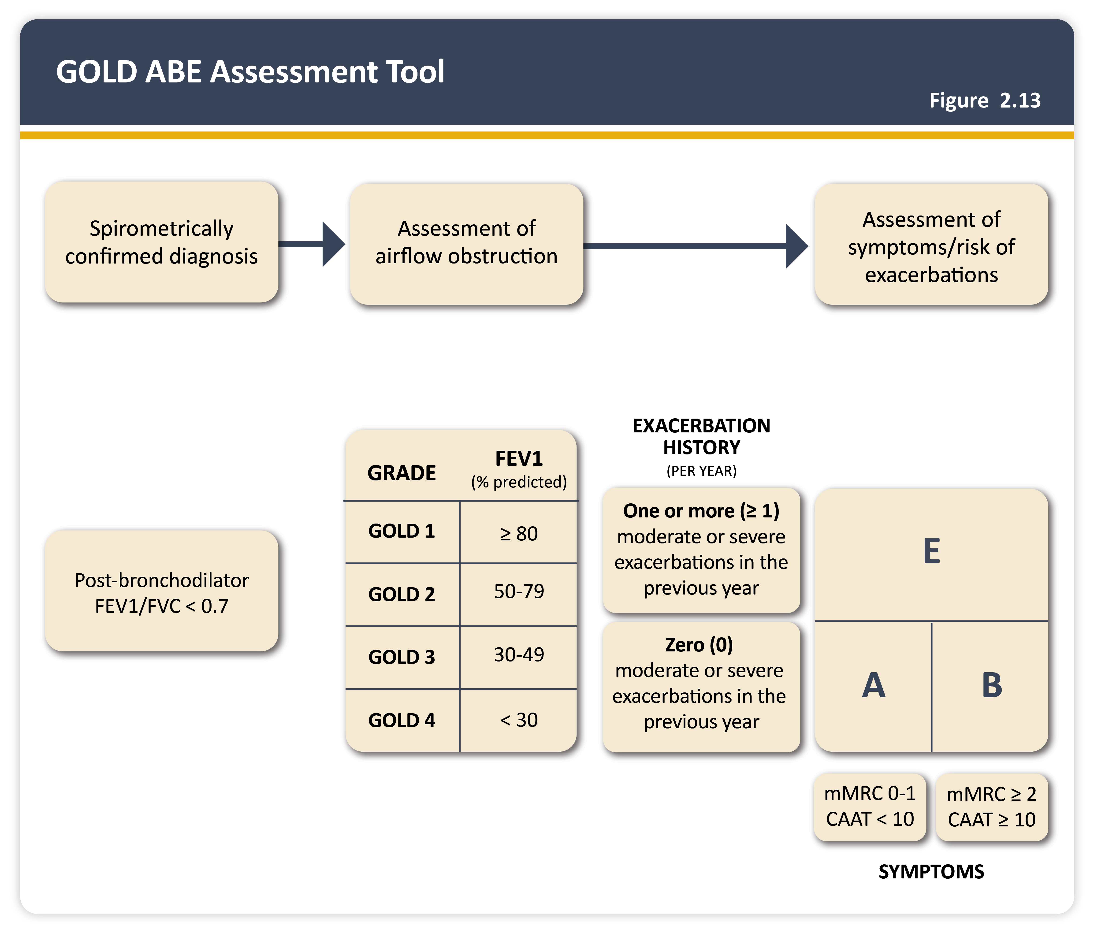
GOLD ABE assessment tool
Teaching
Slide Set
Teaching
Slide Set

Slide 19
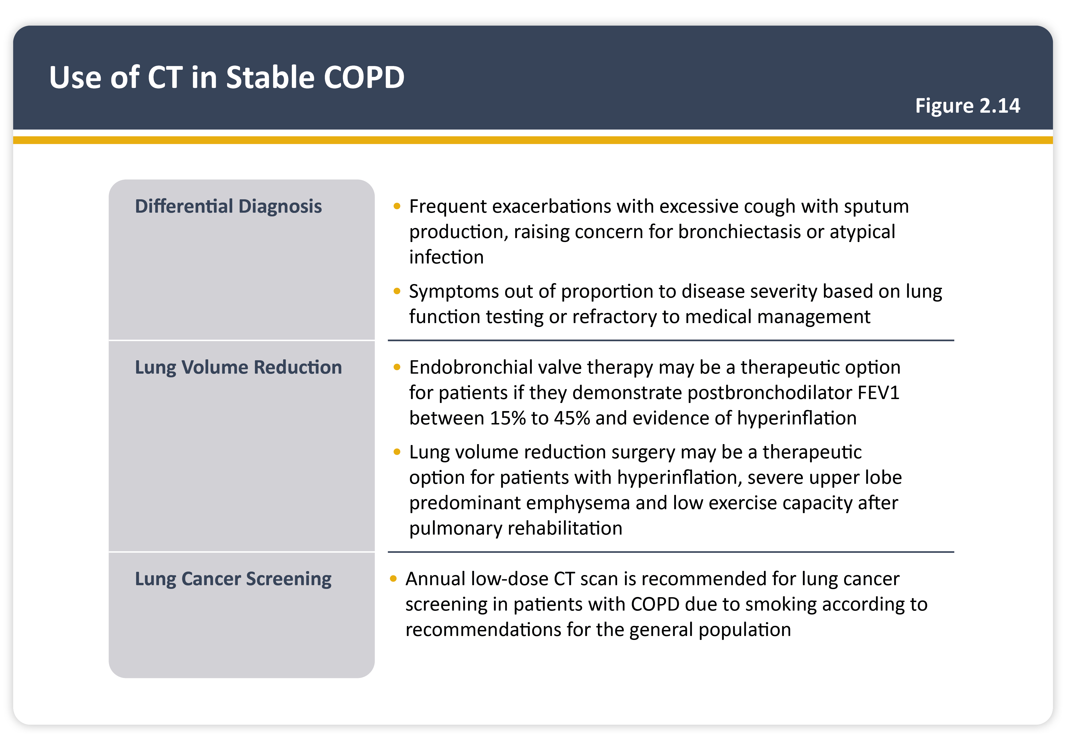
Use of CT in stable COPD
Teaching
Slide Set
Teaching
Slide Set

Slide 20
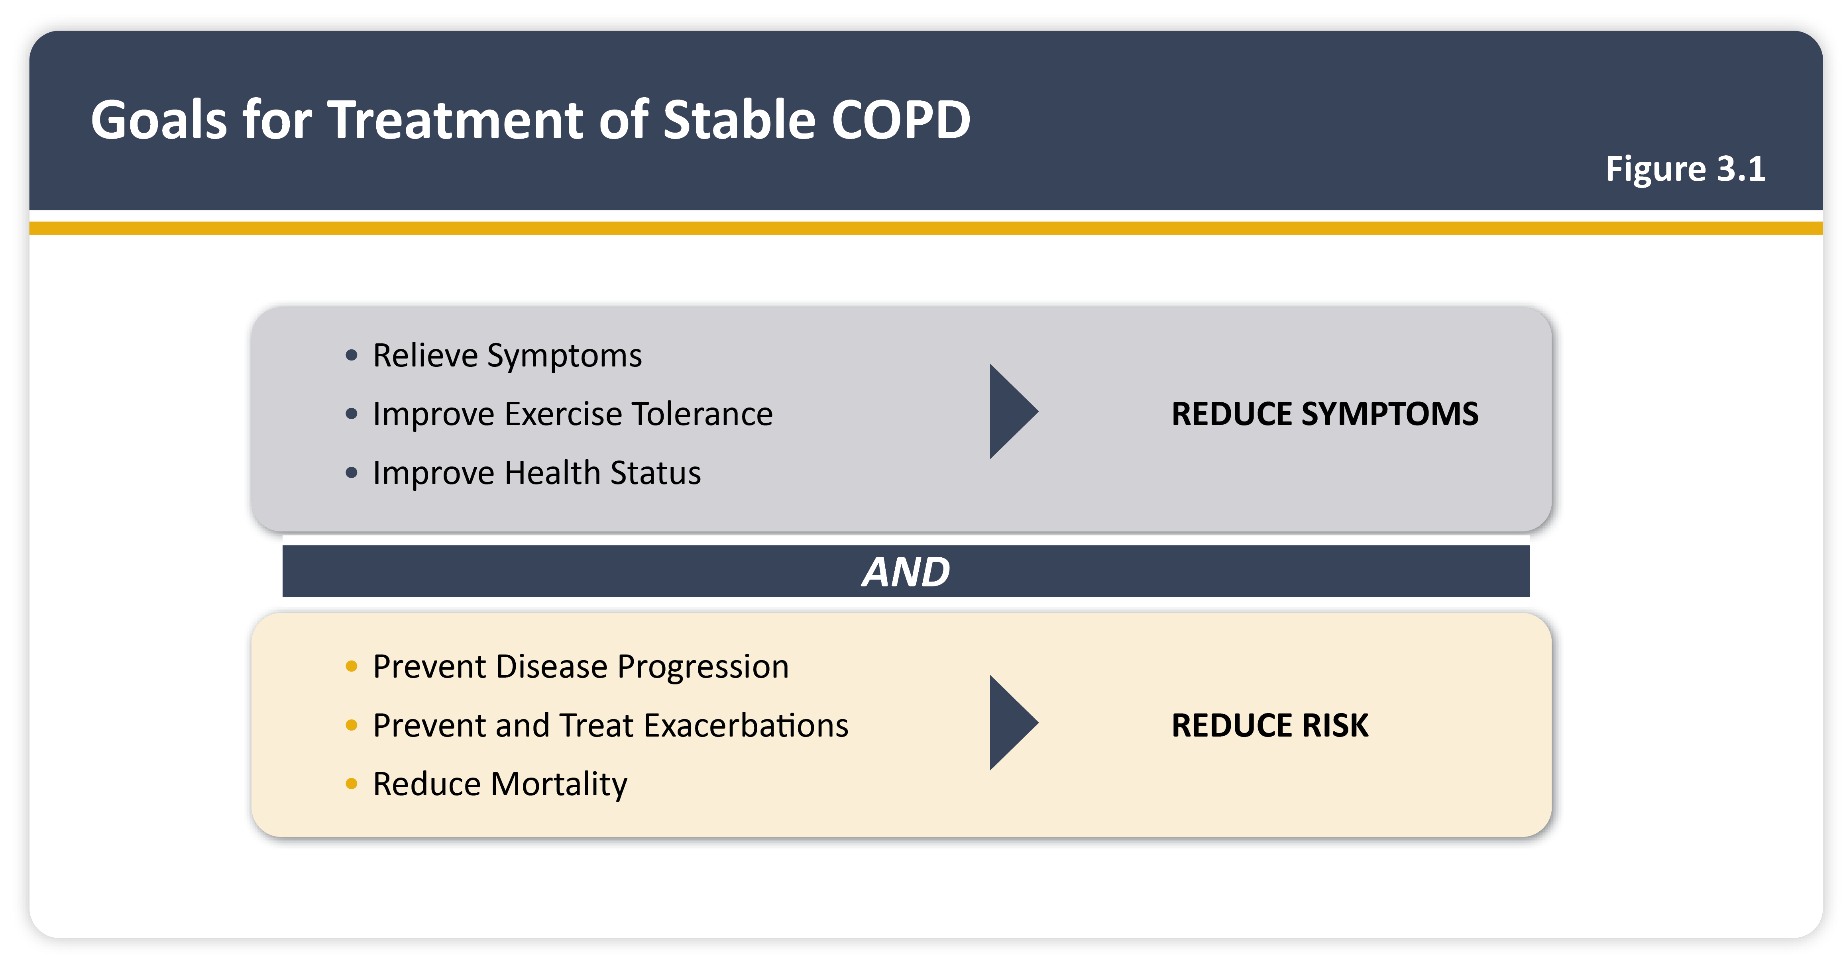
Goals for treatment of stable COPD
Teaching
Slide Set
Teaching
Slide Set

Slide 21
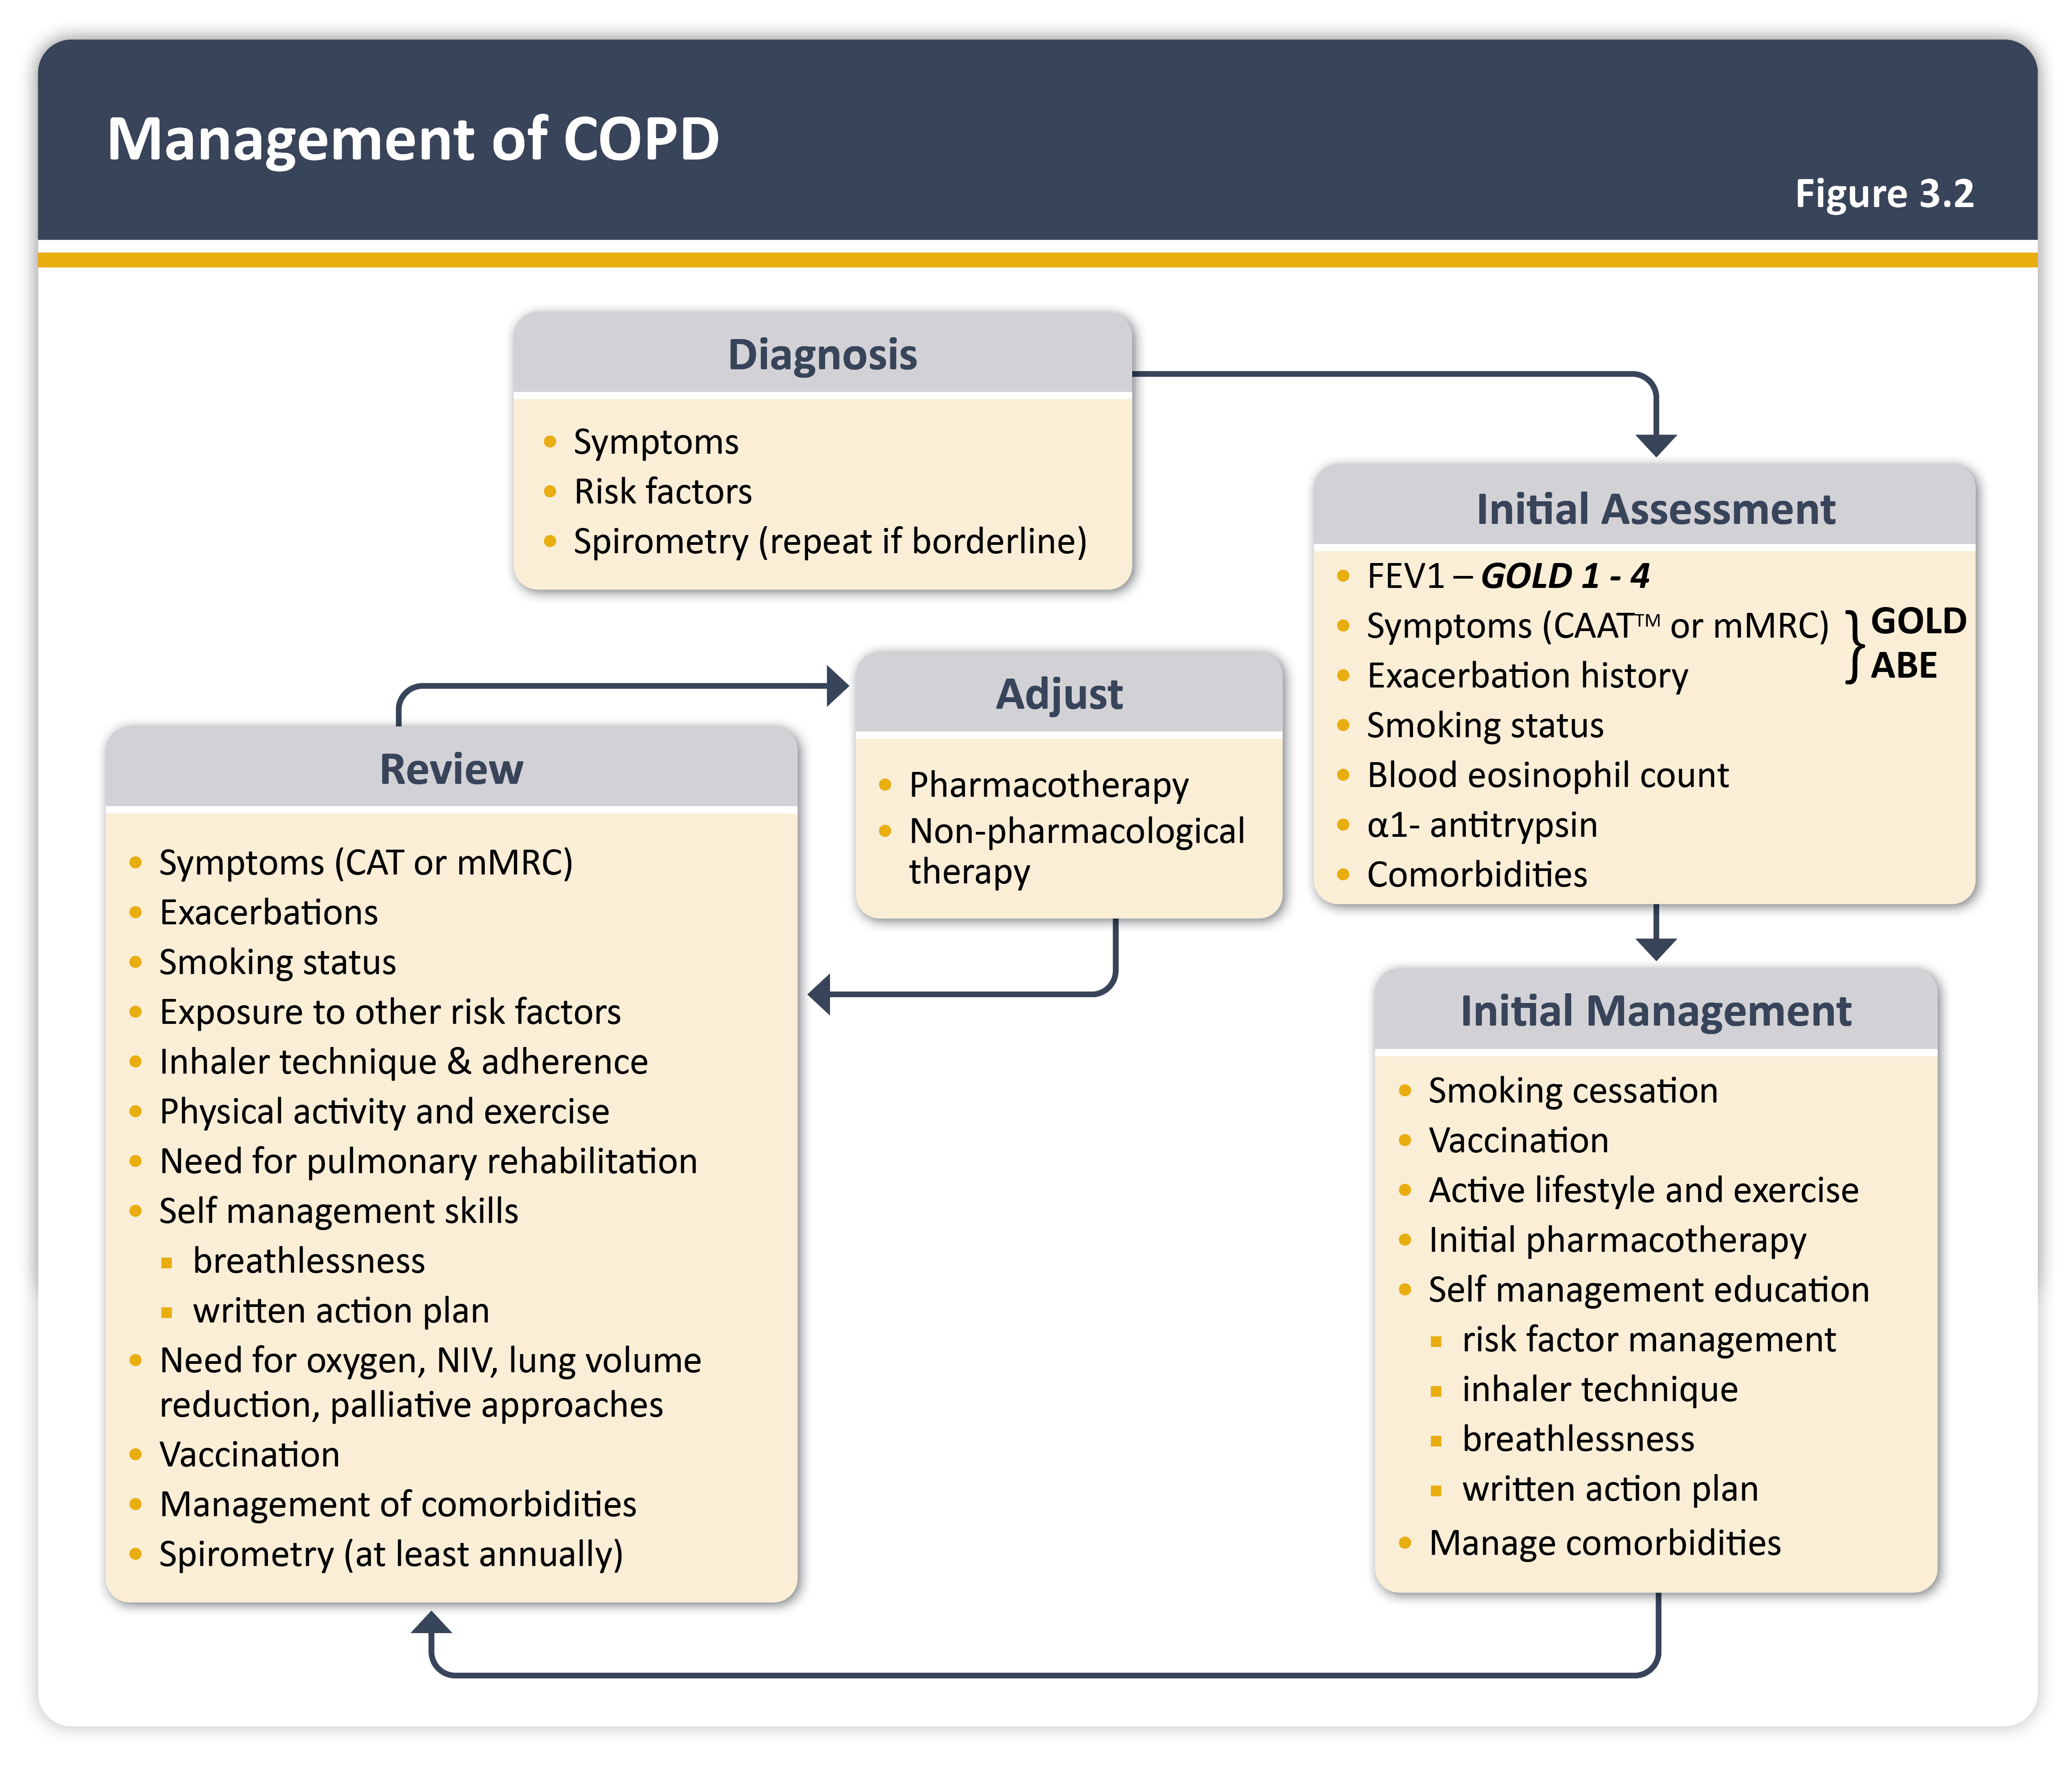
Management of COPD
Teaching
Slide Set
Teaching
Slide Set

Slide 22
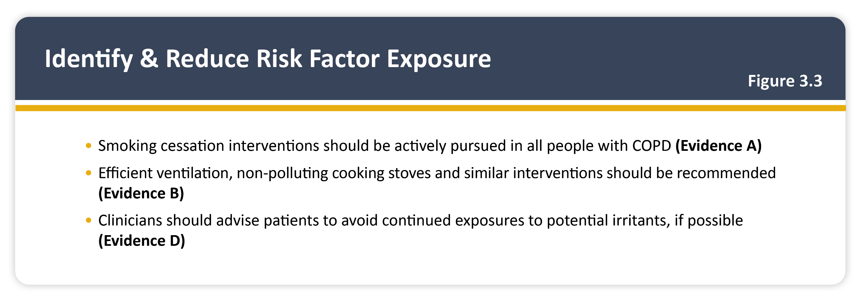
Identify and reduce risk factor exposure
Teaching
Slide Set
Teaching
Slide Set

Slide 23
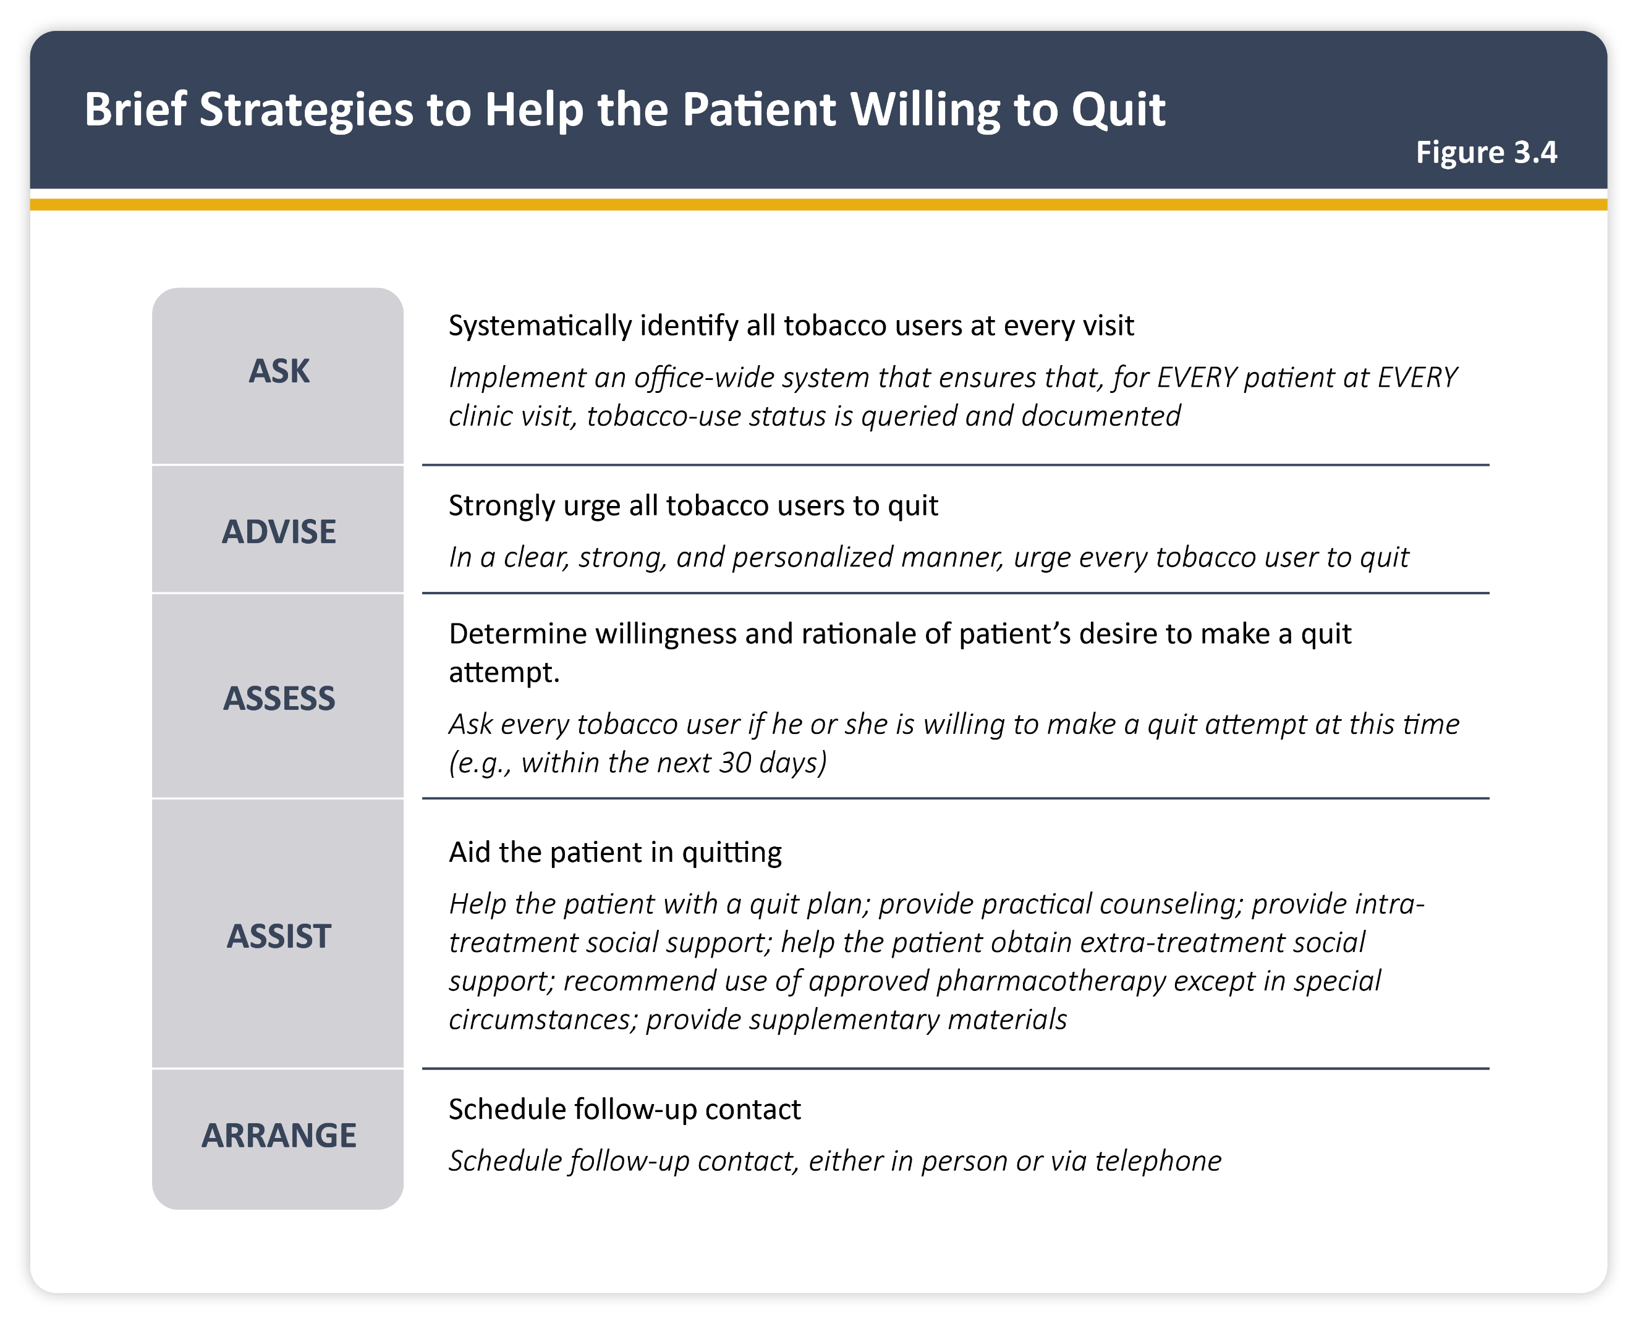
Brief strategies to help the patient willing to quit
Teaching
Slide Set
Teaching
Slide Set

Slide 24
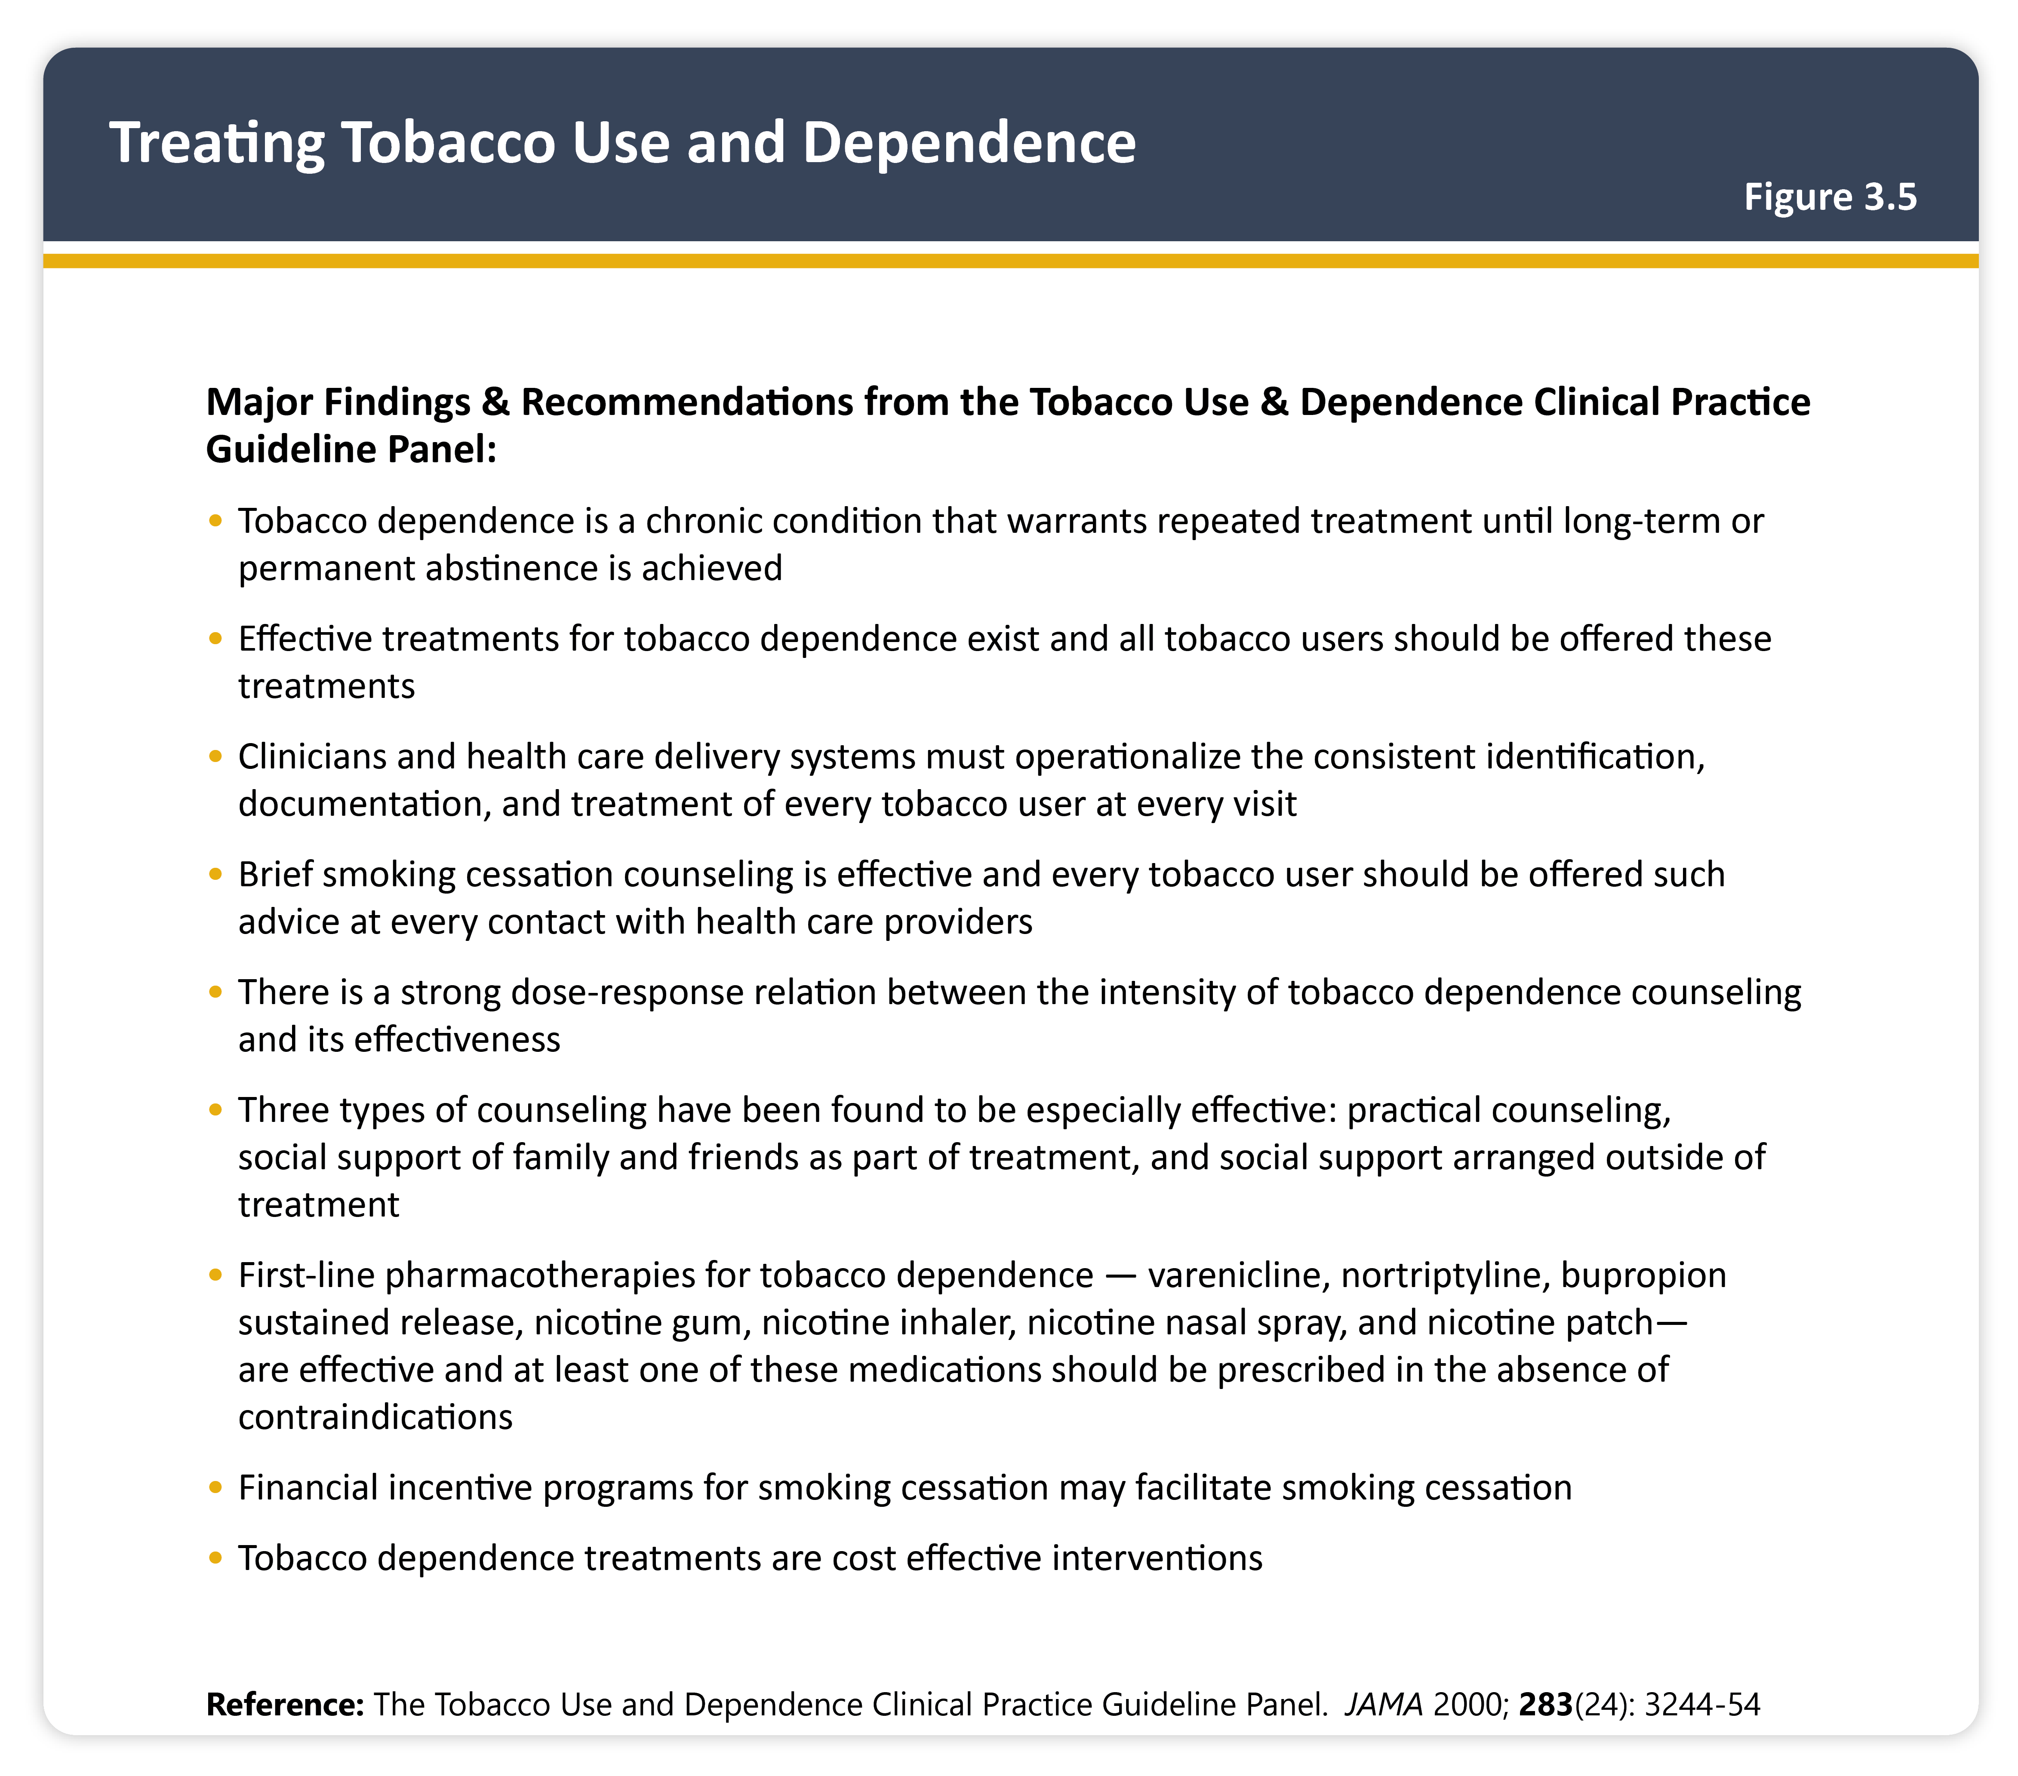
Treating tobacco use and dependence
Teaching
Slide Set
Teaching
Slide Set

Slide 25
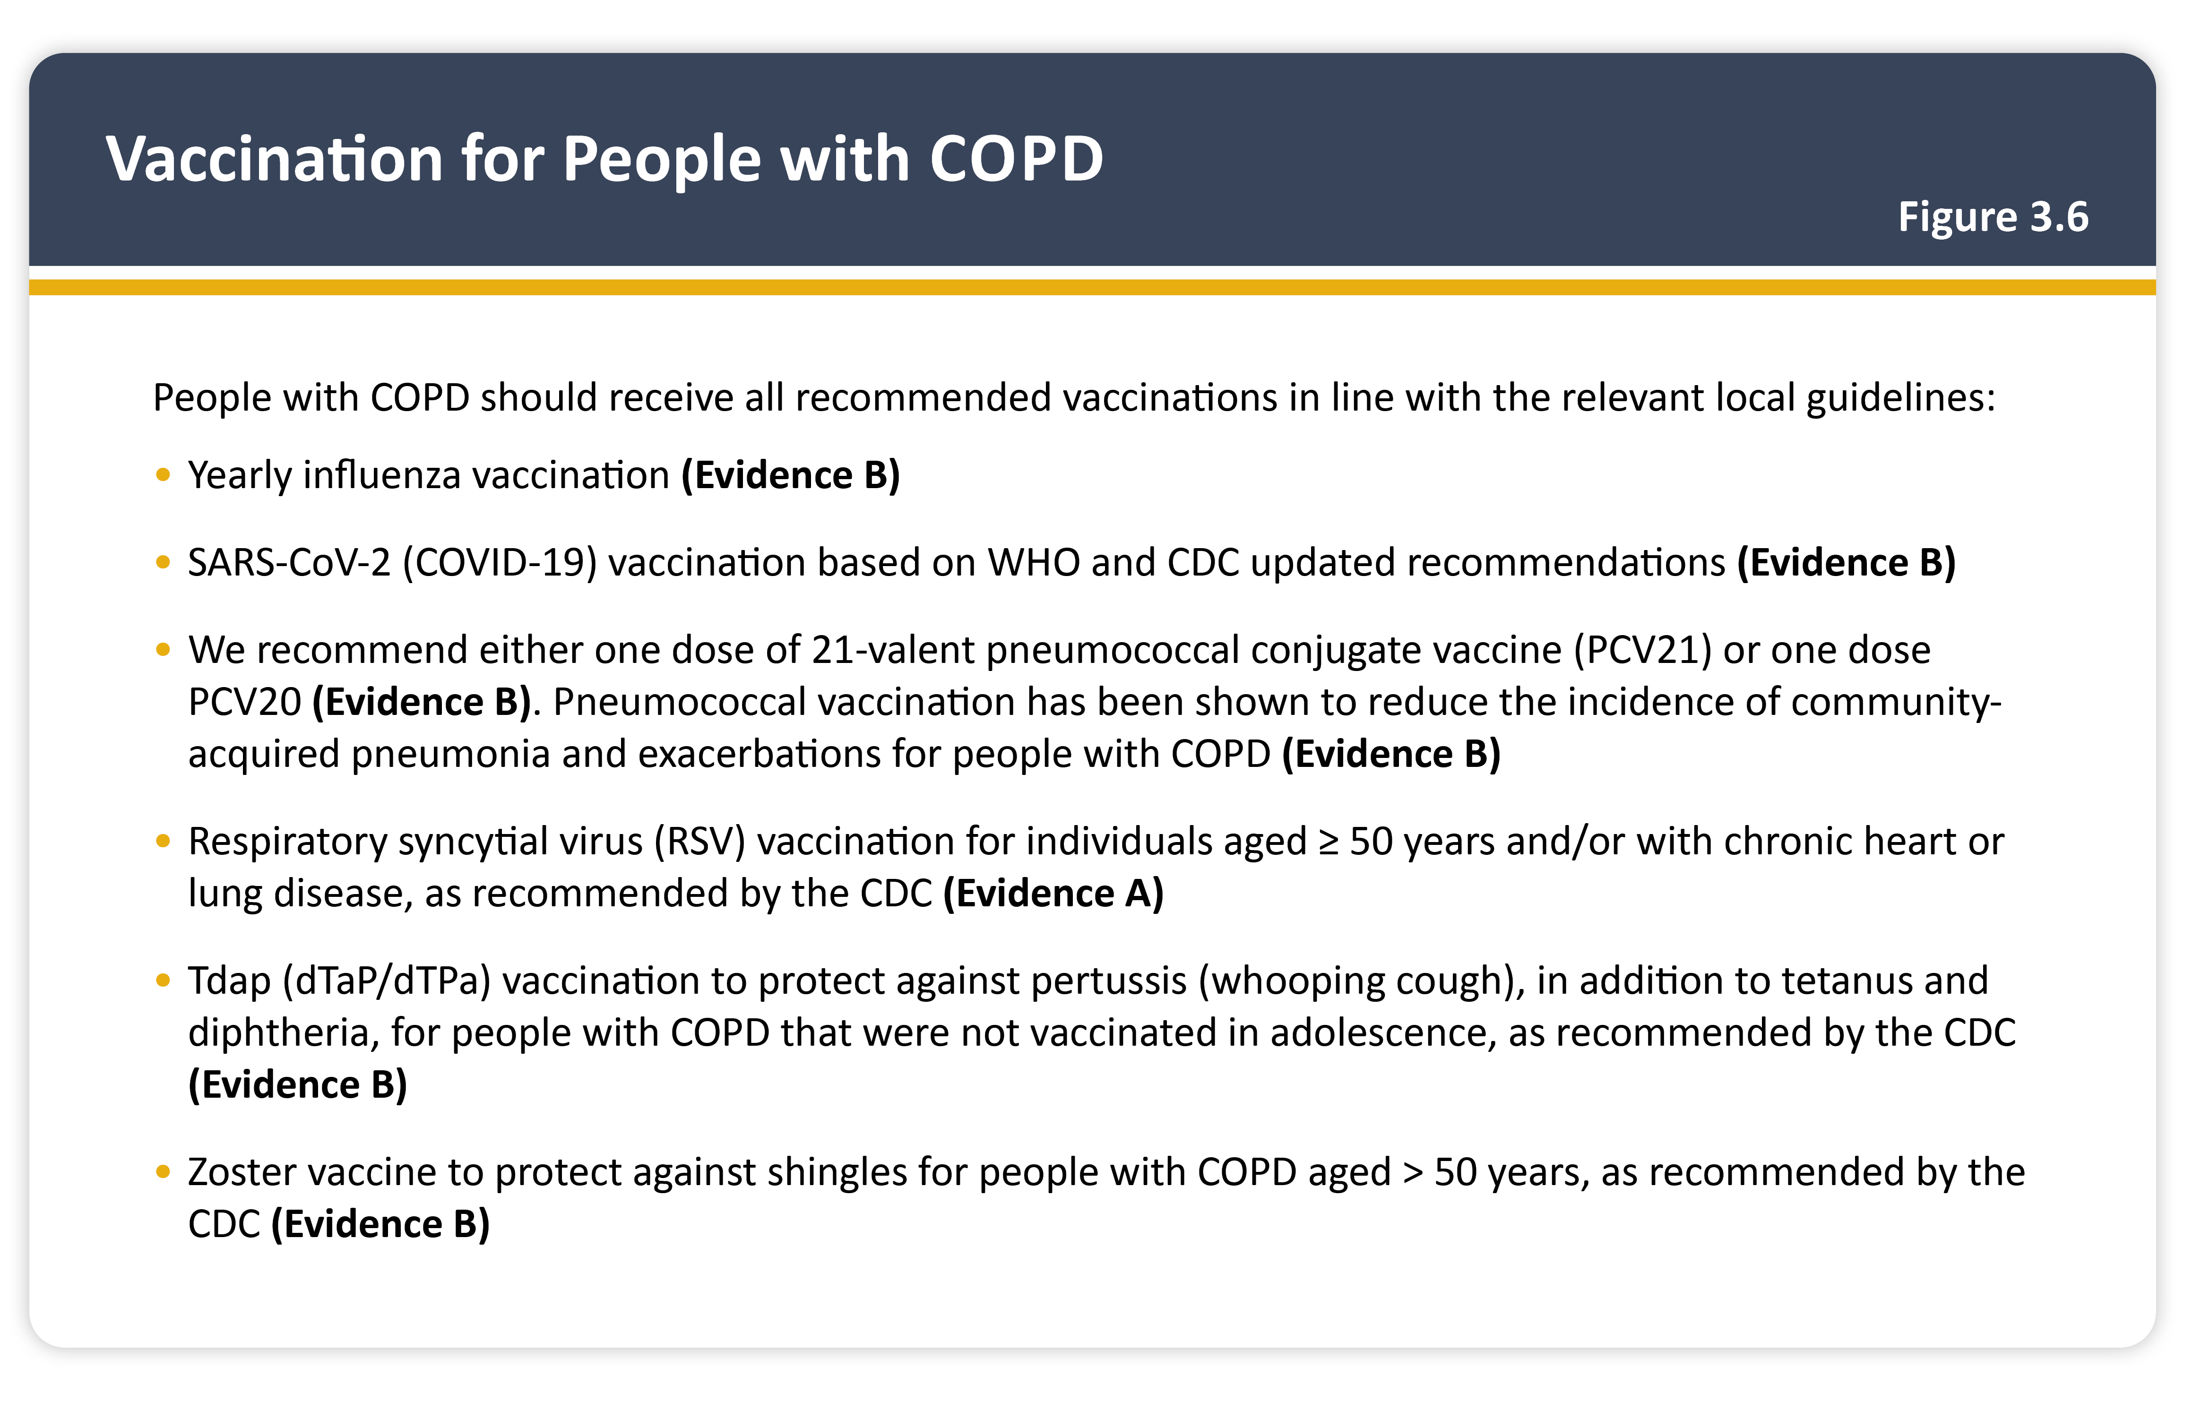
Vaccination for stable COPD
Teaching
Slide Set
Teaching
Slide Set

Slide 26
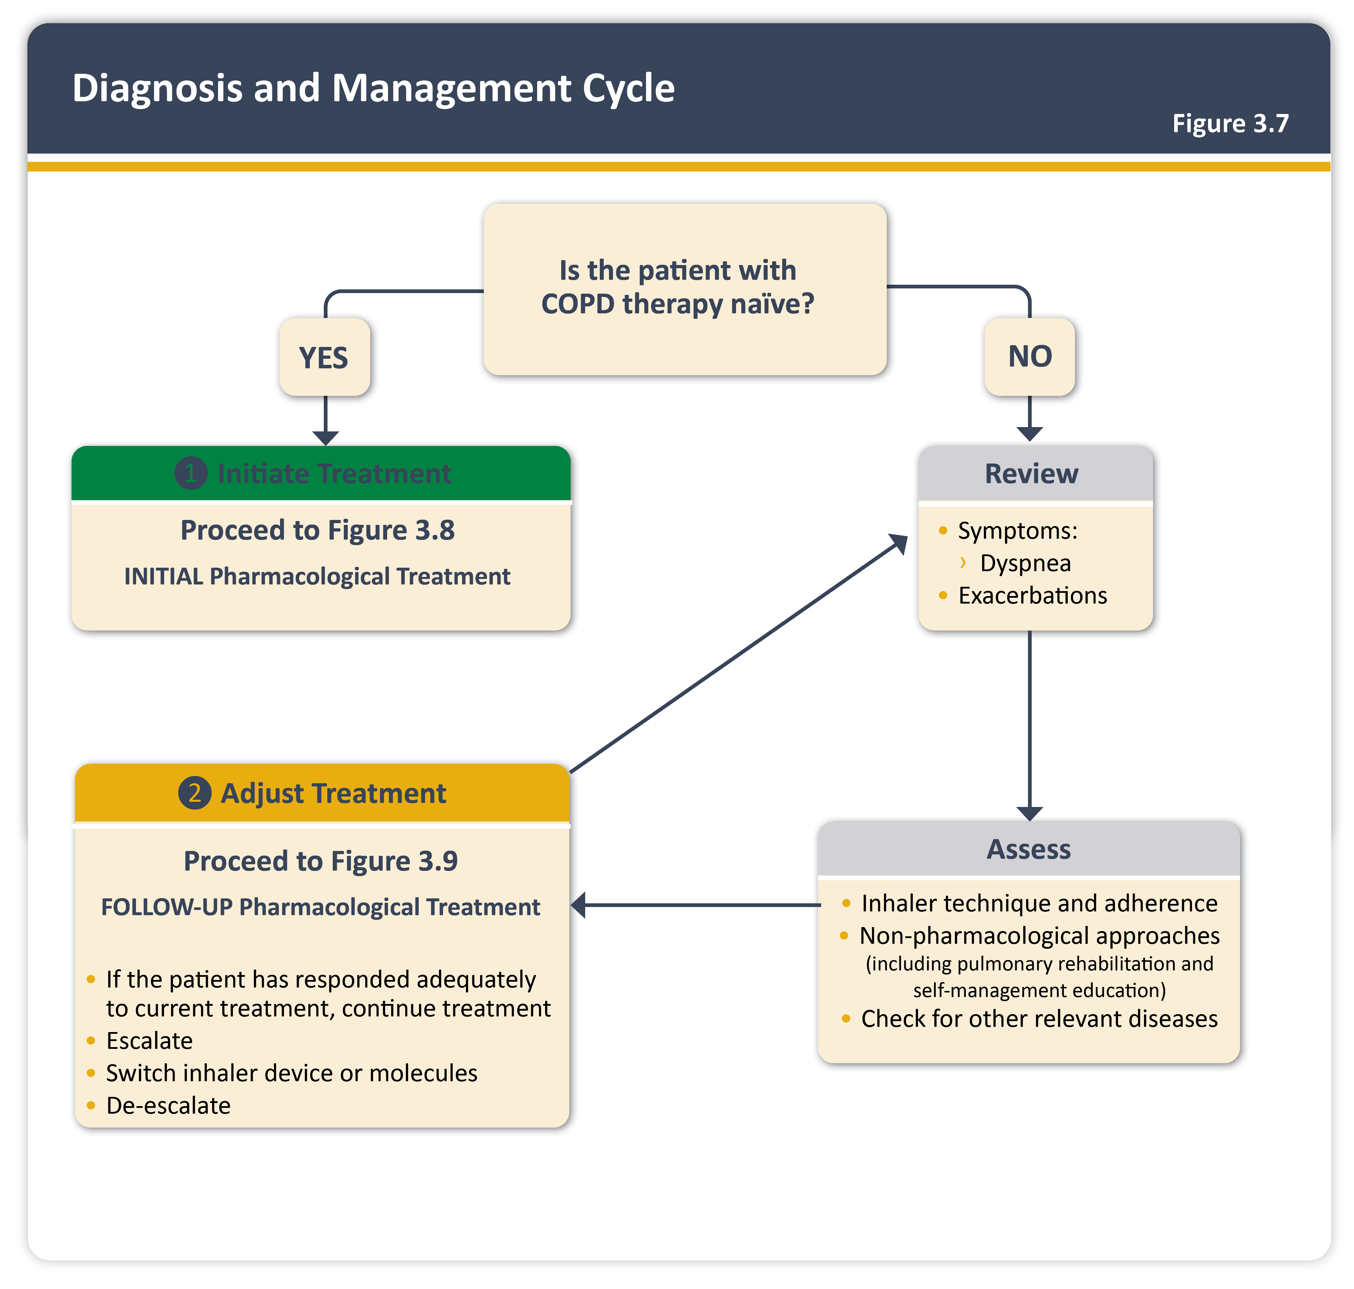
Diagnosis andManagement cycle
Teaching
Slide Set
Teaching
Slide Set

Slide 27
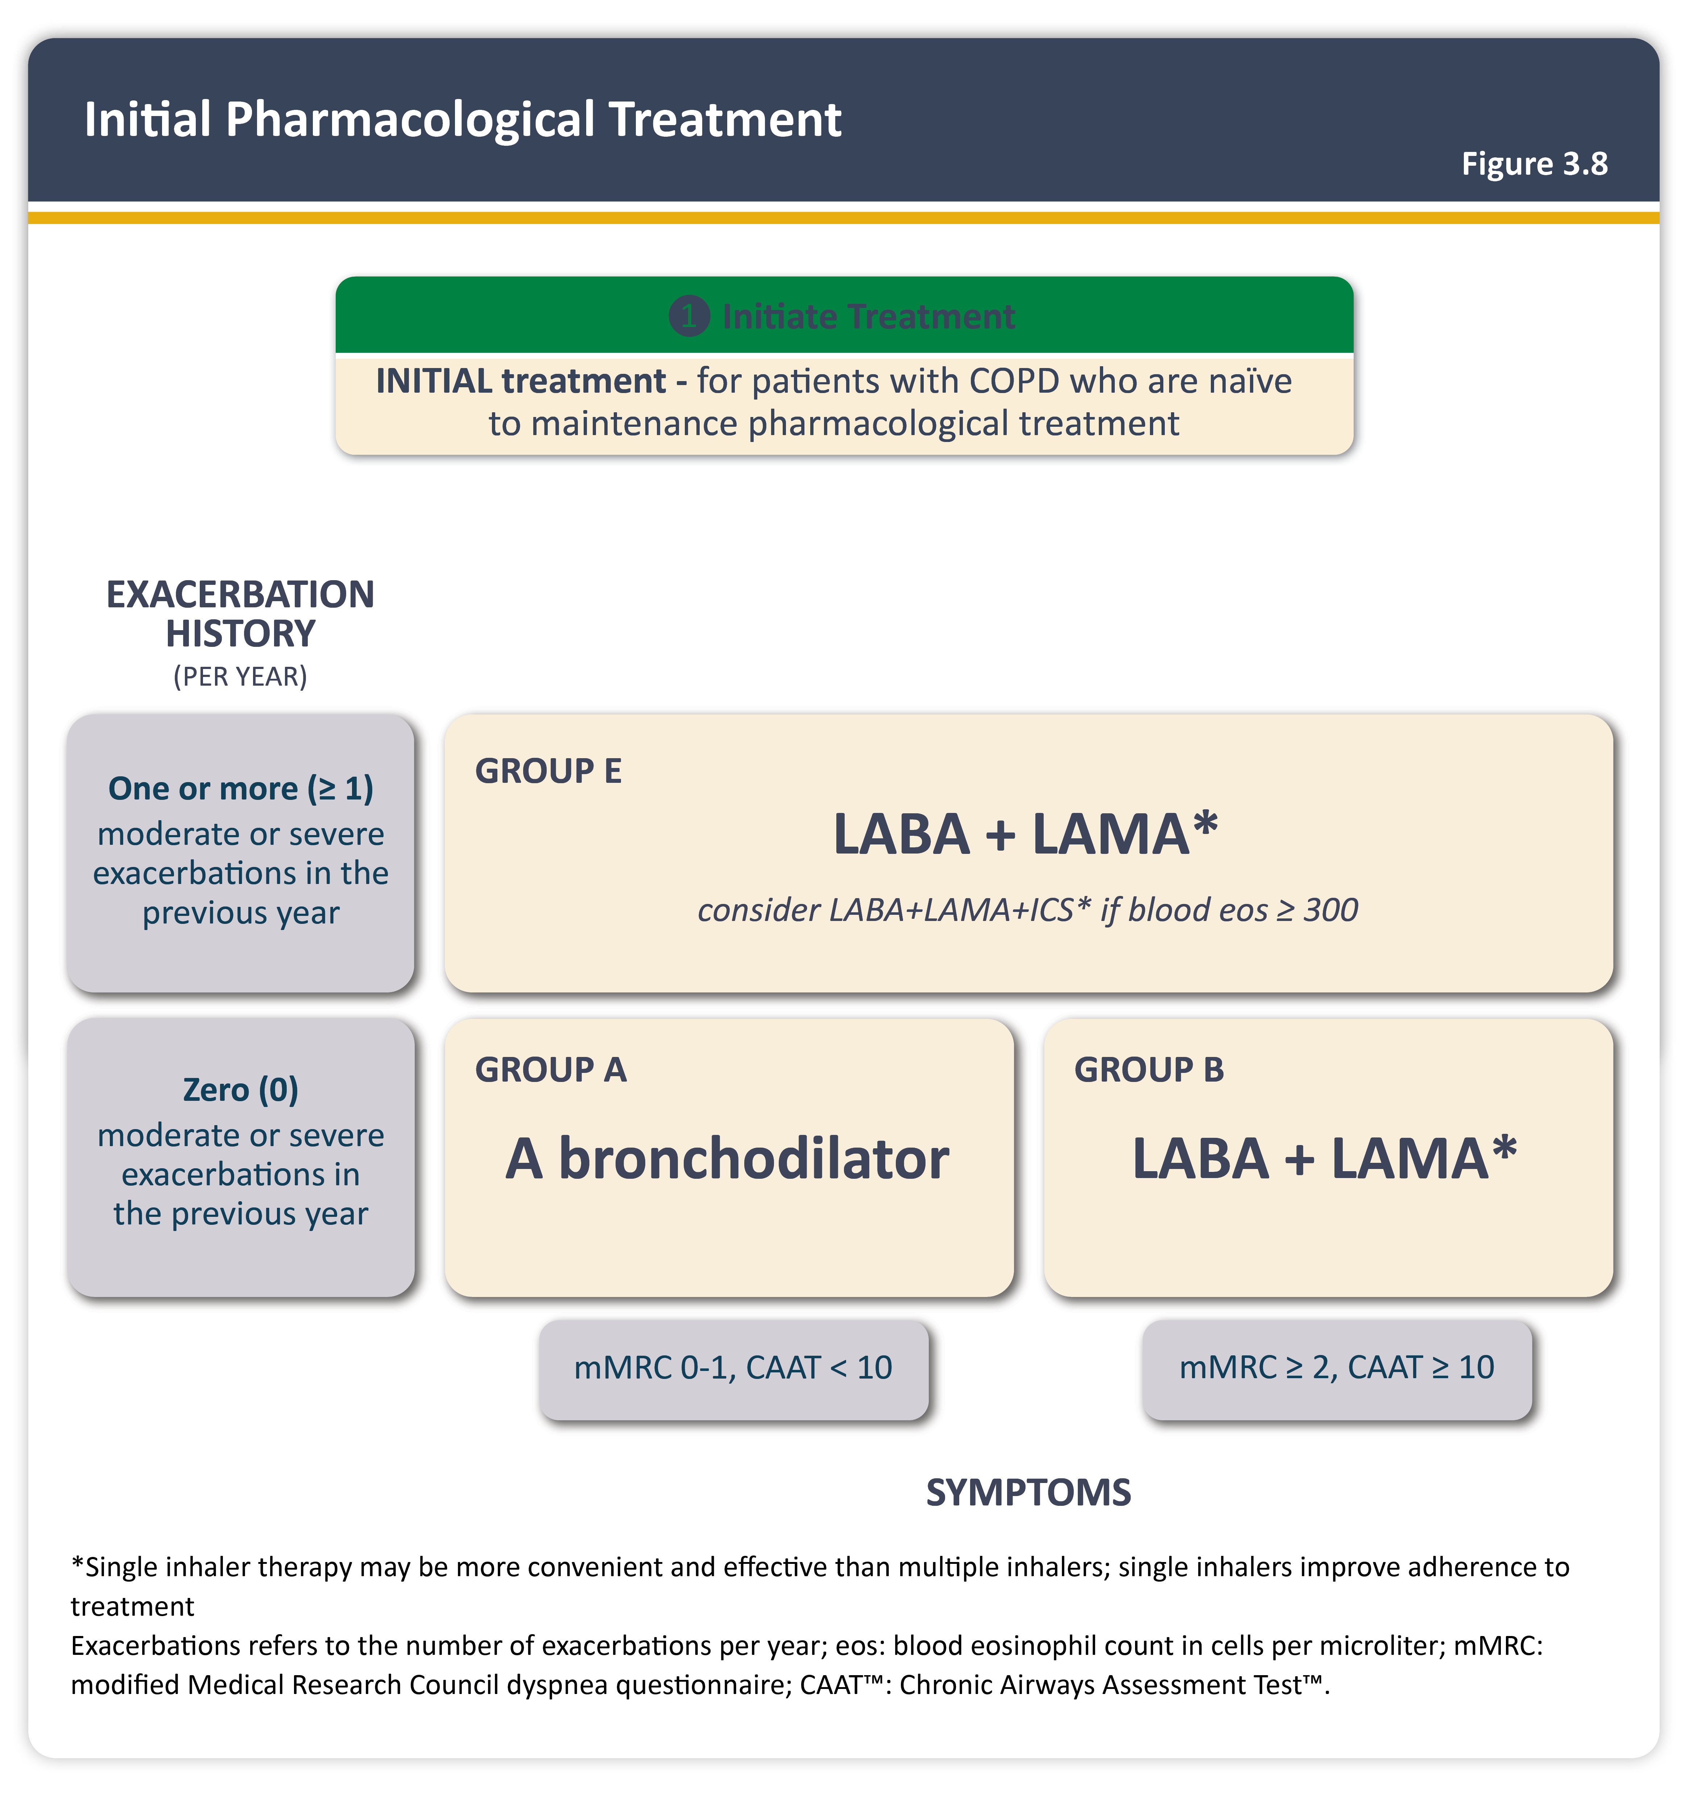
Initial pharmacological treatment
Teaching
Slide Set
Teaching
Slide Set

Slide 28
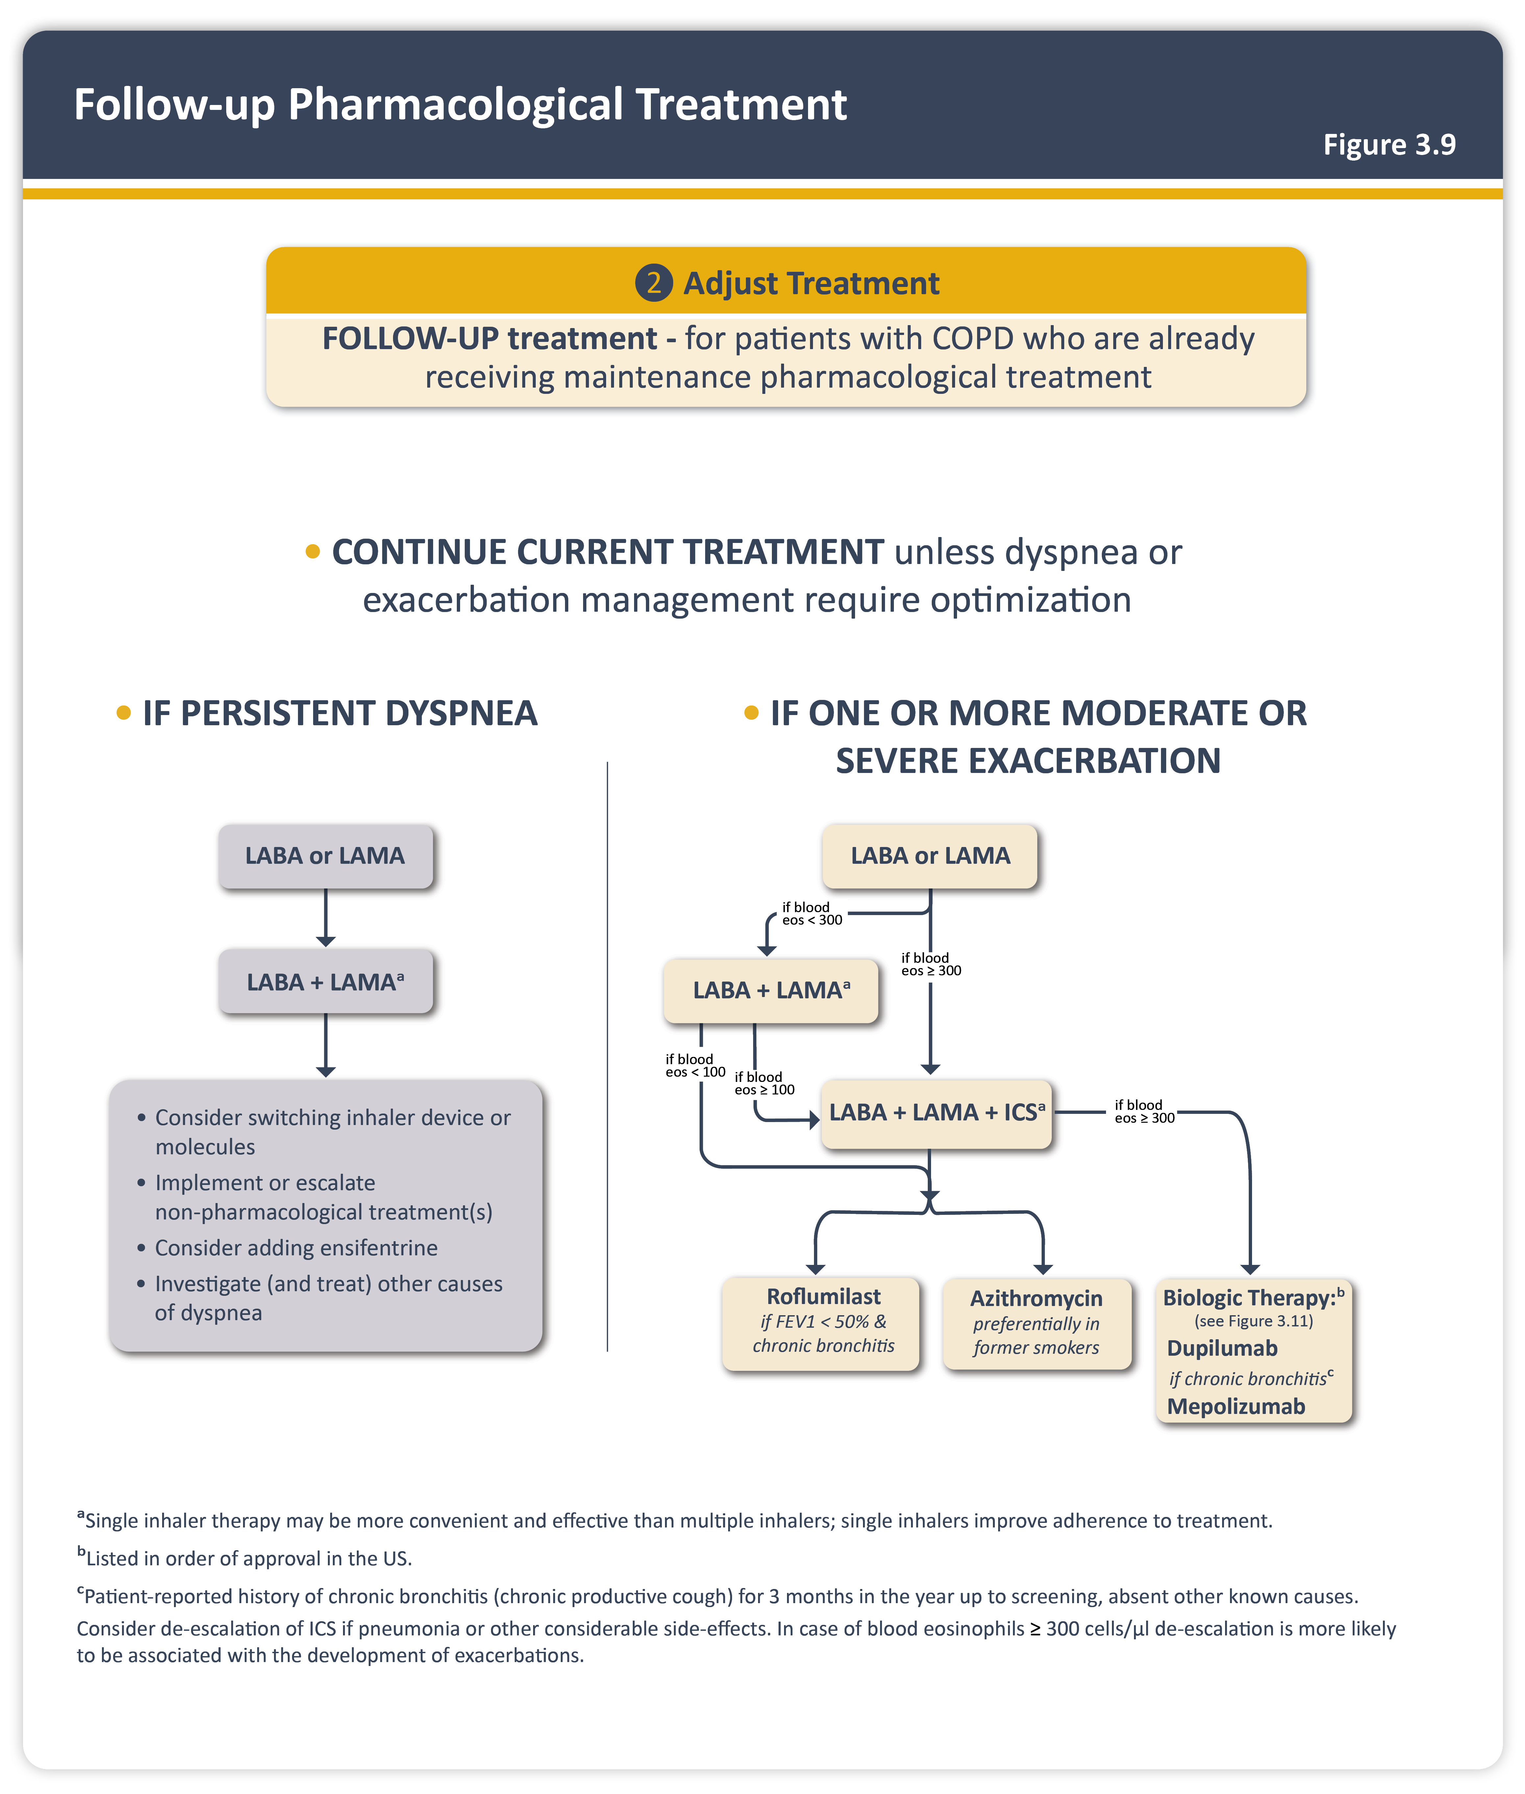
Follow-up pharmacological treatment
Teaching
Slide Set
Teaching
Slide Set

Slide 29
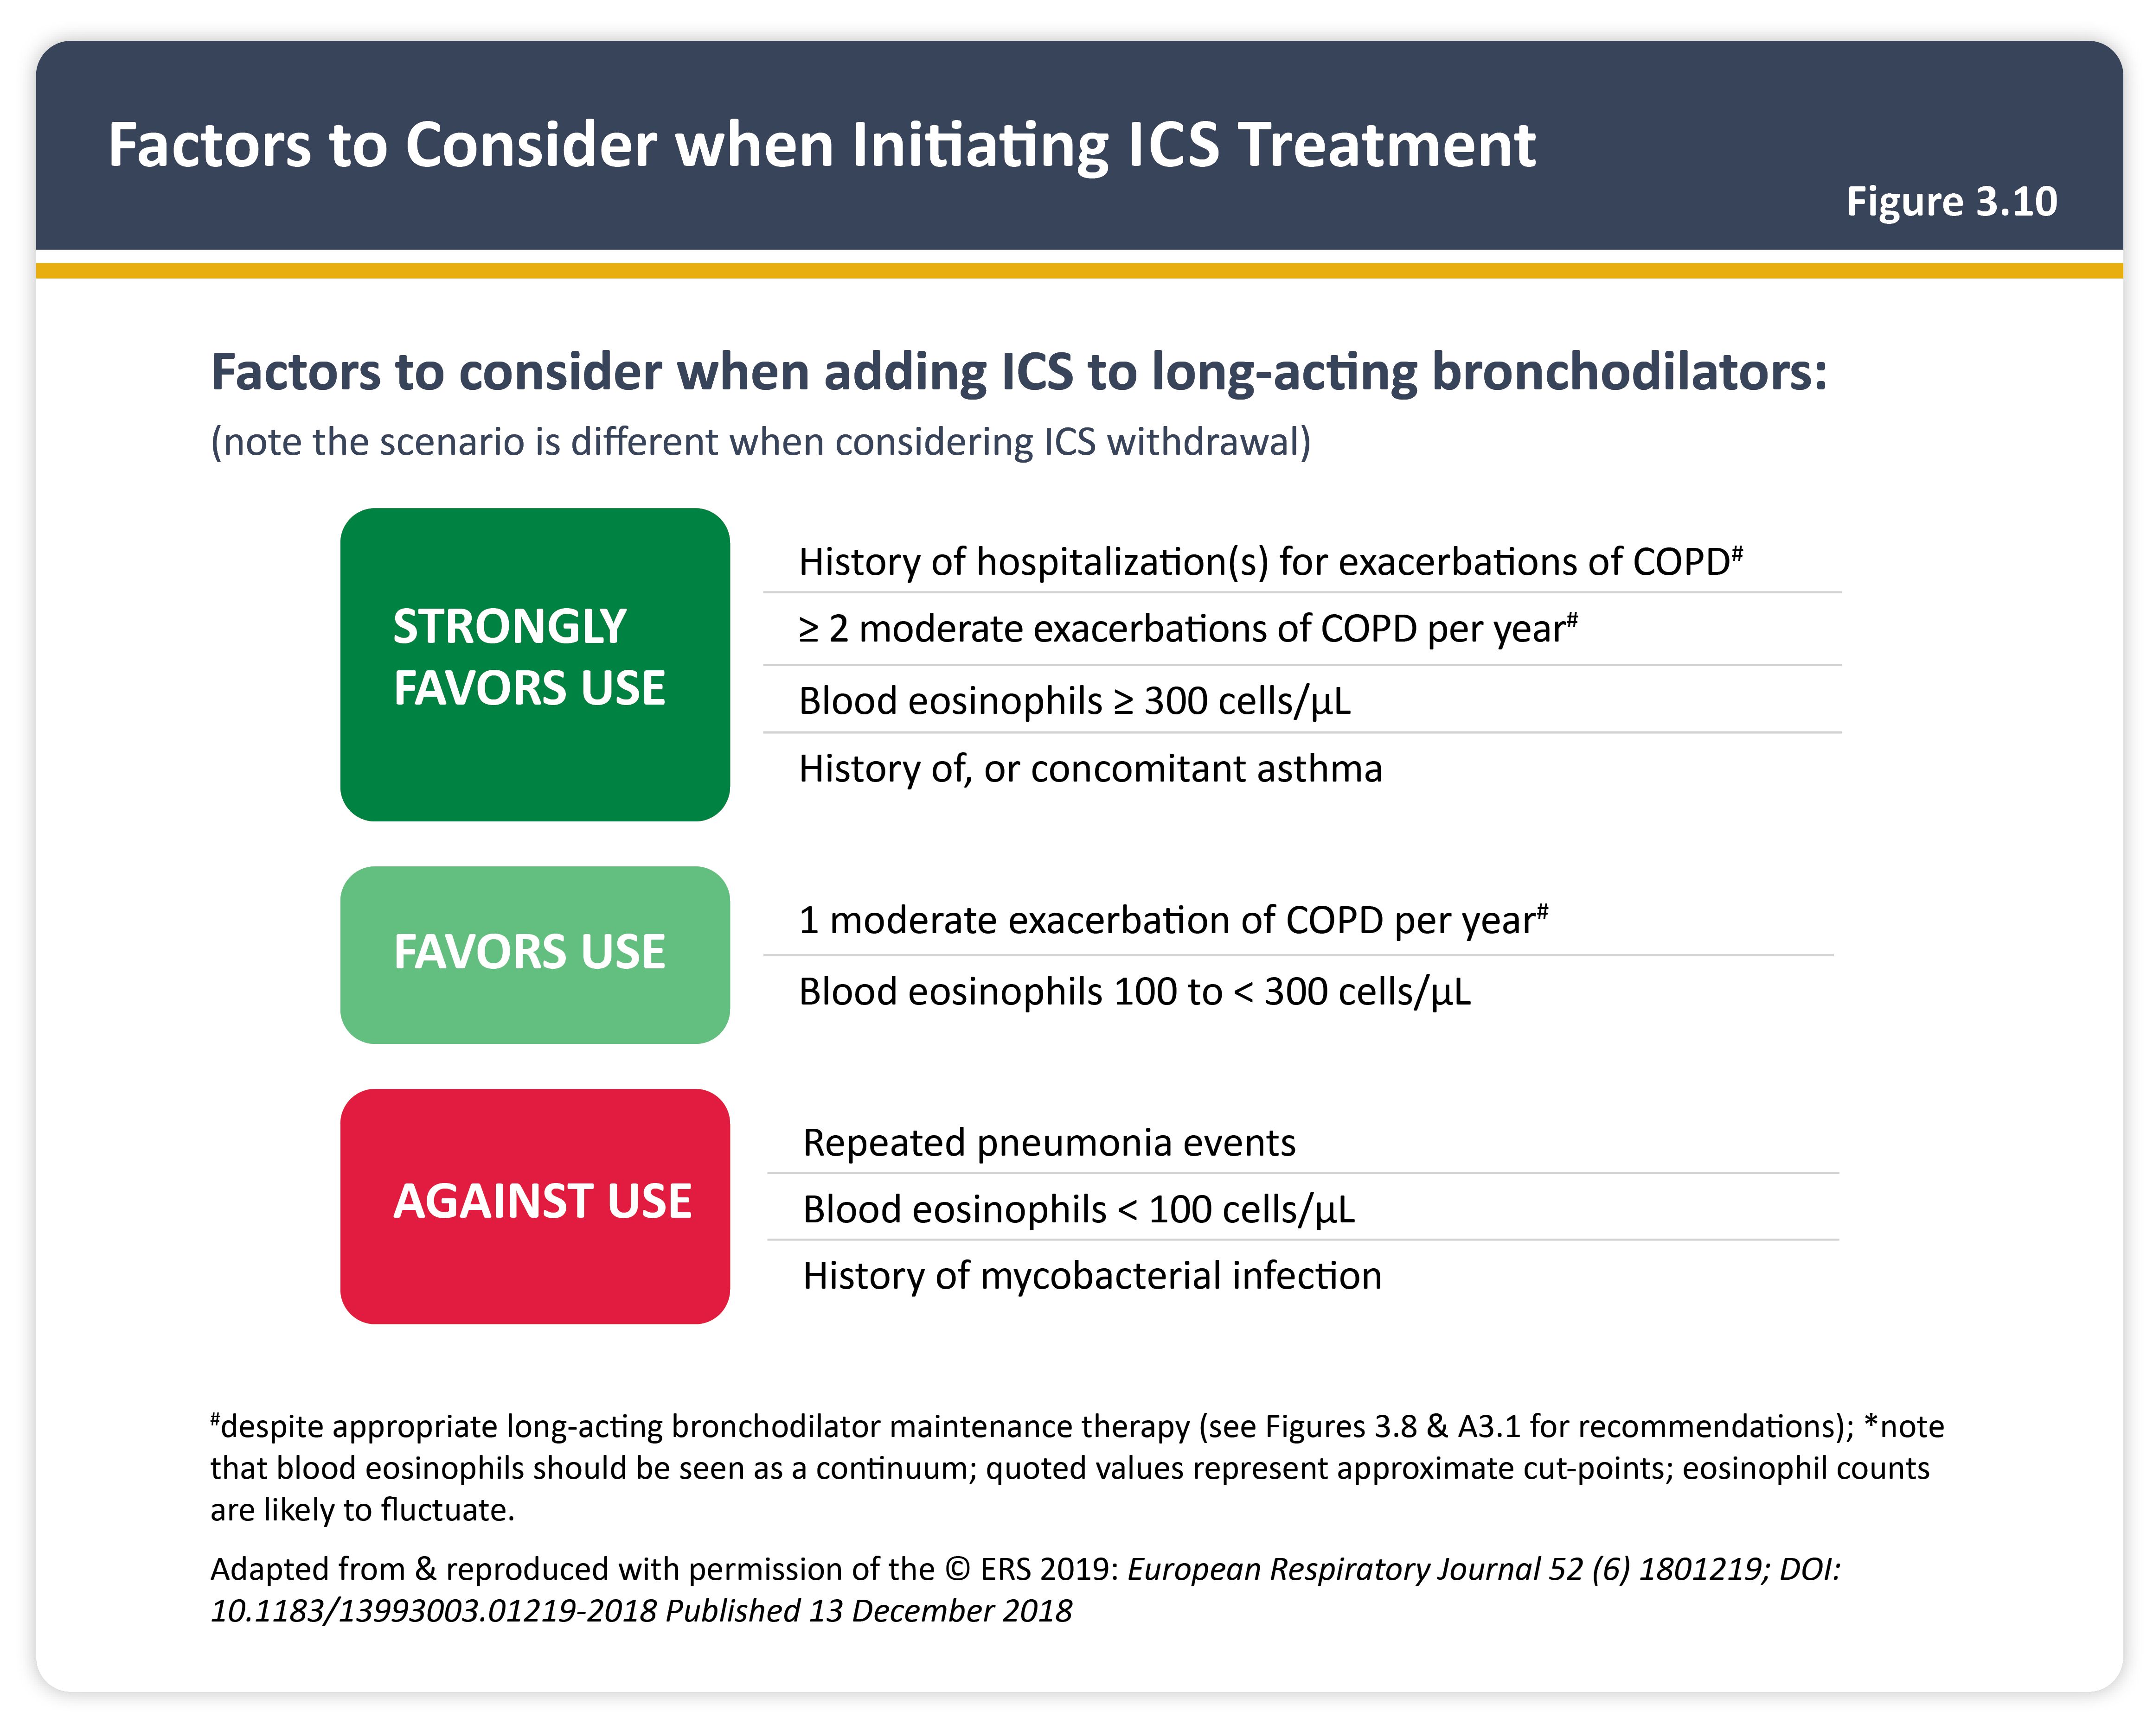
Factors to consider when initiating ICS treatment
Teaching
Slide Set
Teaching
Slide Set

Slide 30
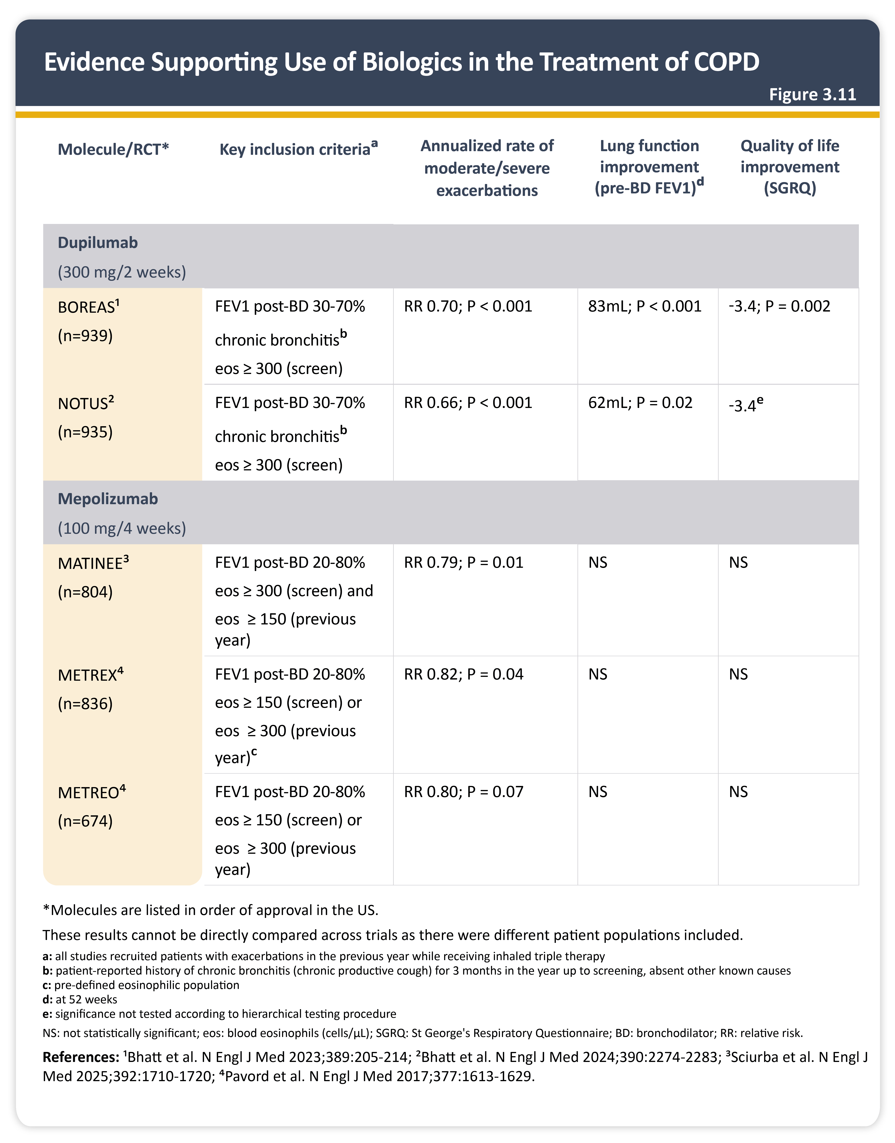
Evidence supporting the use of biologics in the treatment of COPD
Teaching
Slide Set
Teaching
Slide Set

Slide 31
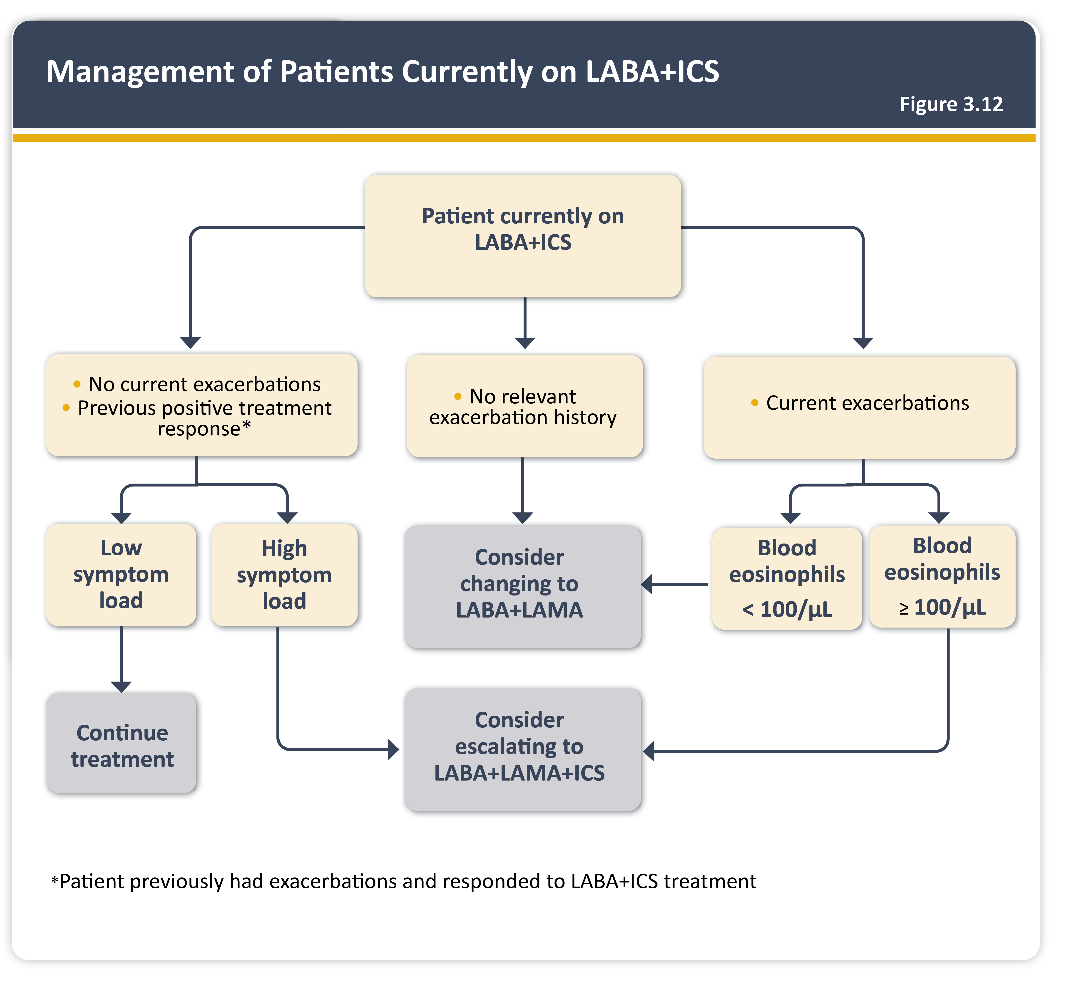
Management of patients currently on LABA+ICS
Teaching
Slide Set
Teaching
Slide Set

Slide 32
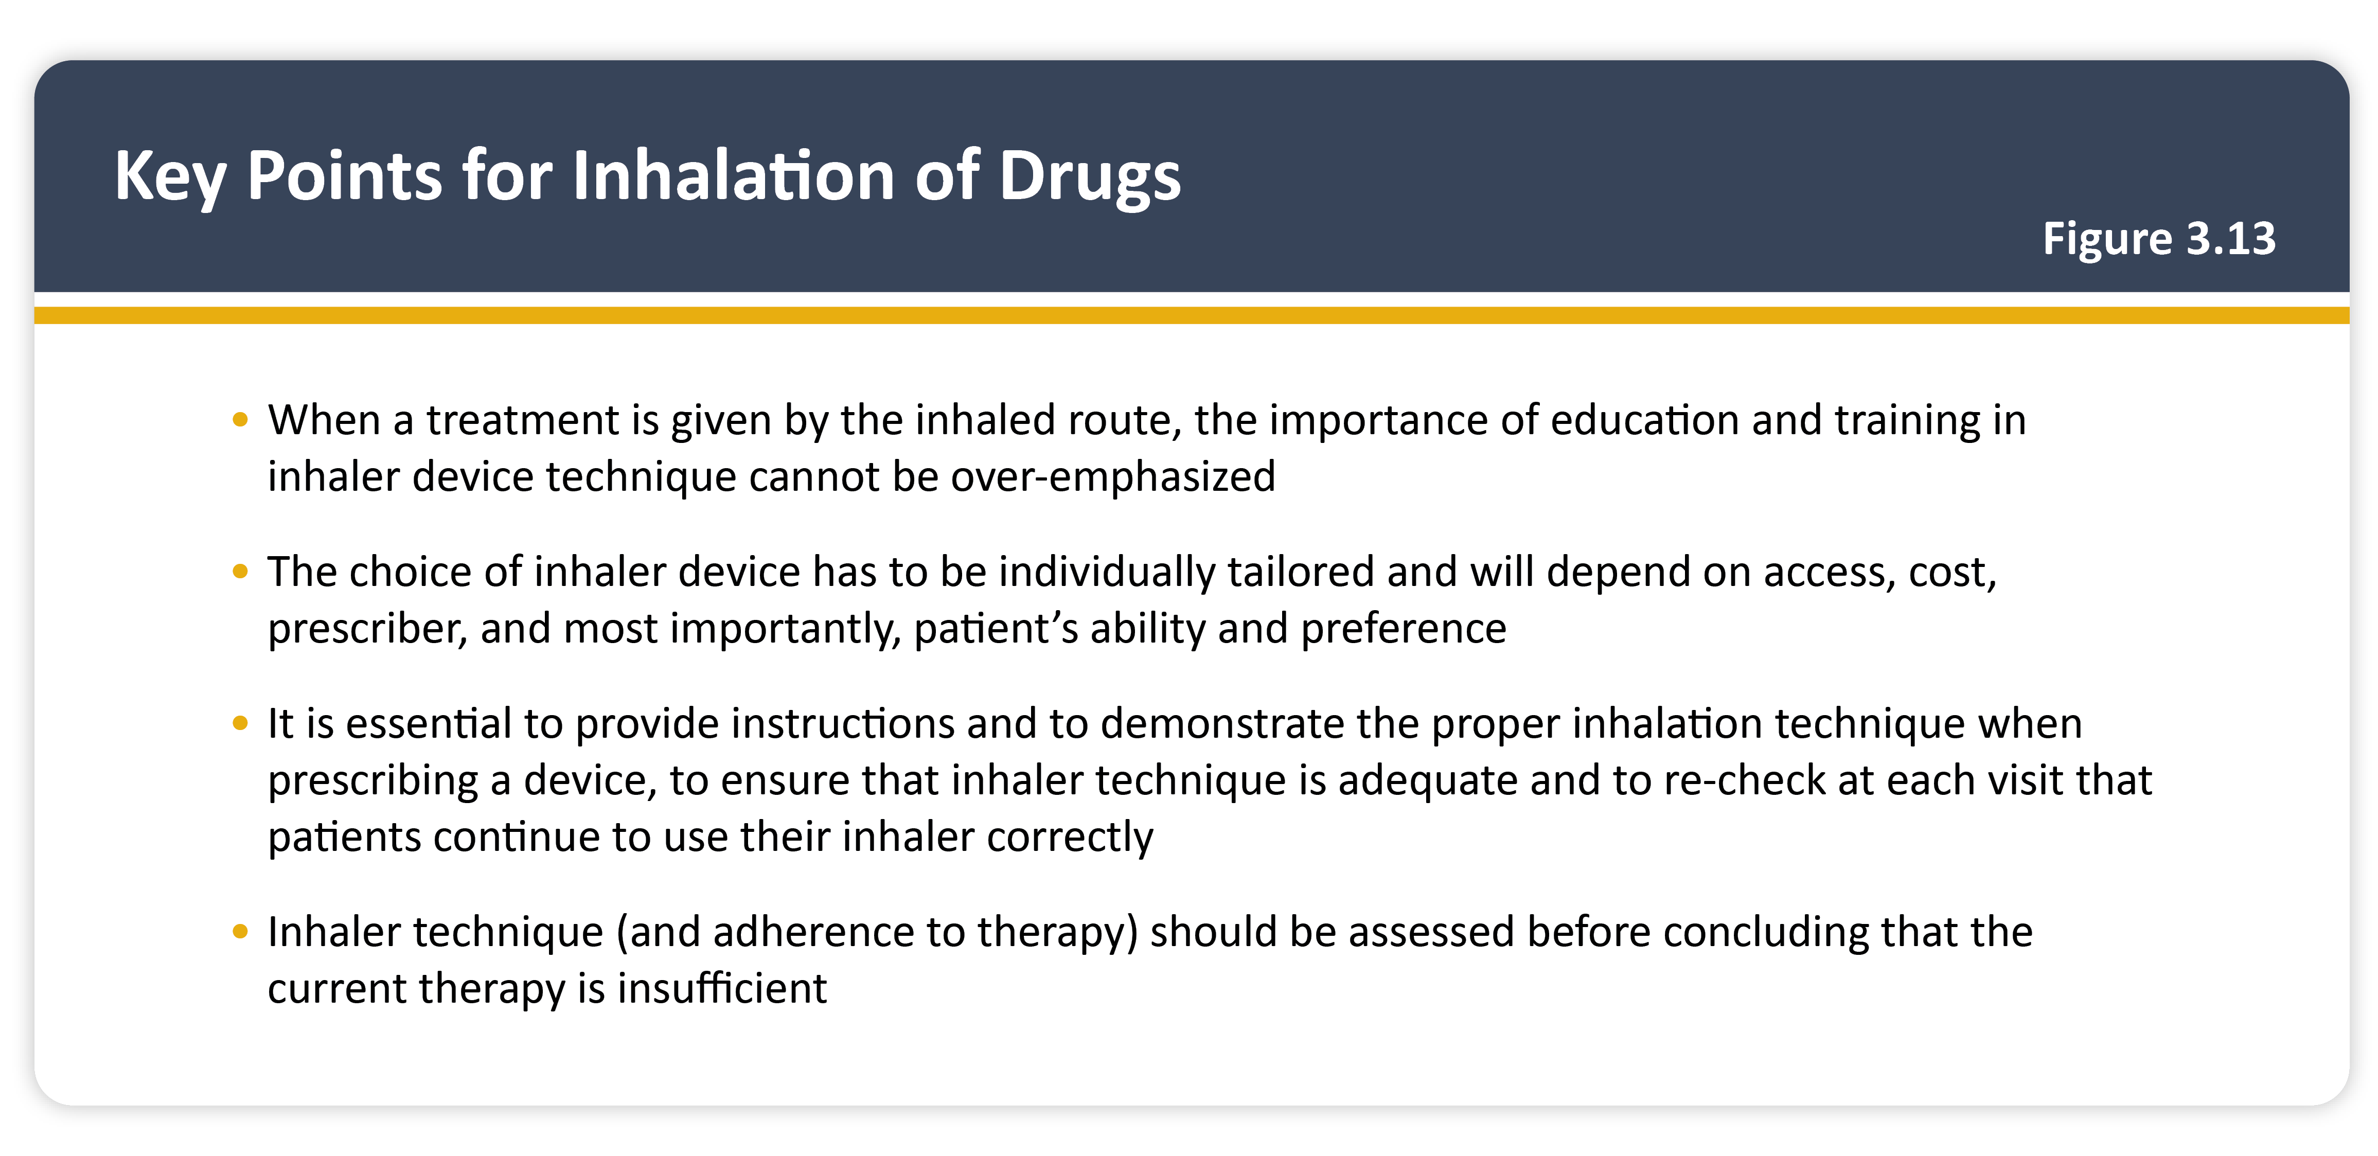
Key points for inhalation of drugs
Teaching
Slide Set
Teaching
Slide Set

Slide 33
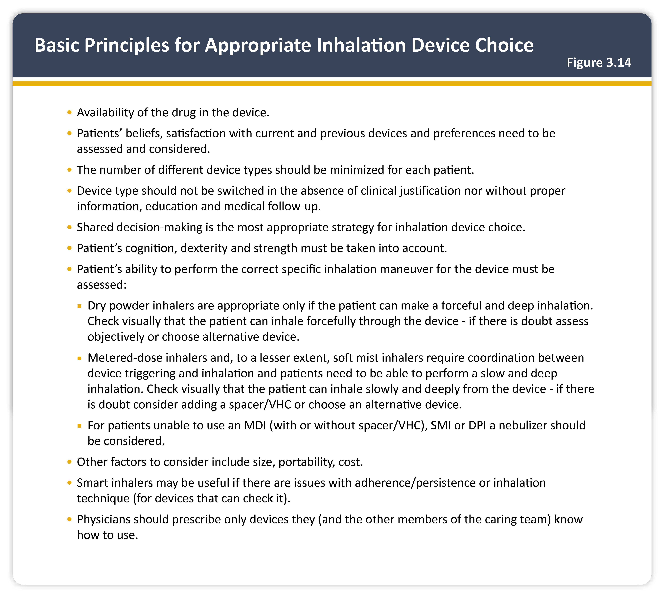
Basic principles for appropriate inhalation device choice
Teaching
Slide Set
Teaching
Slide Set

Slide 34
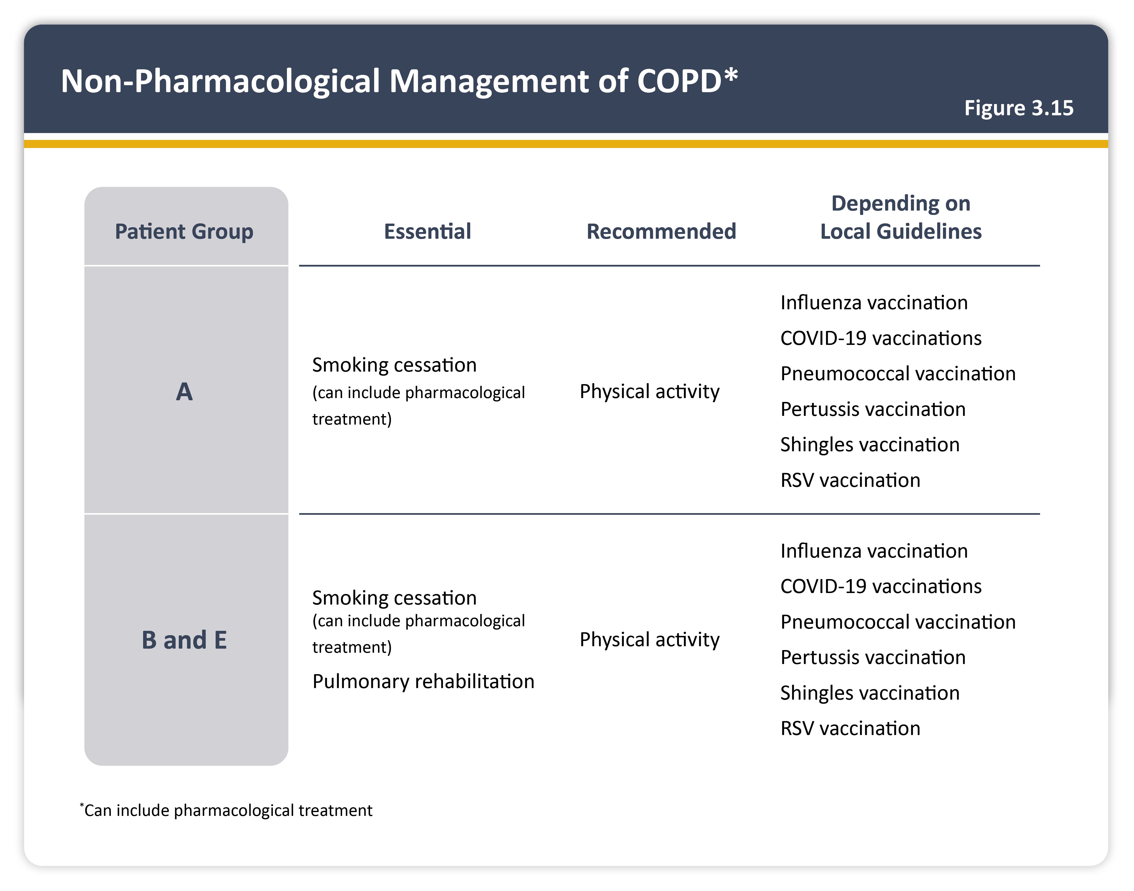
Non-pharmacological management of COPD
Teaching
Slide Set
Teaching
Slide Set

Slide 35
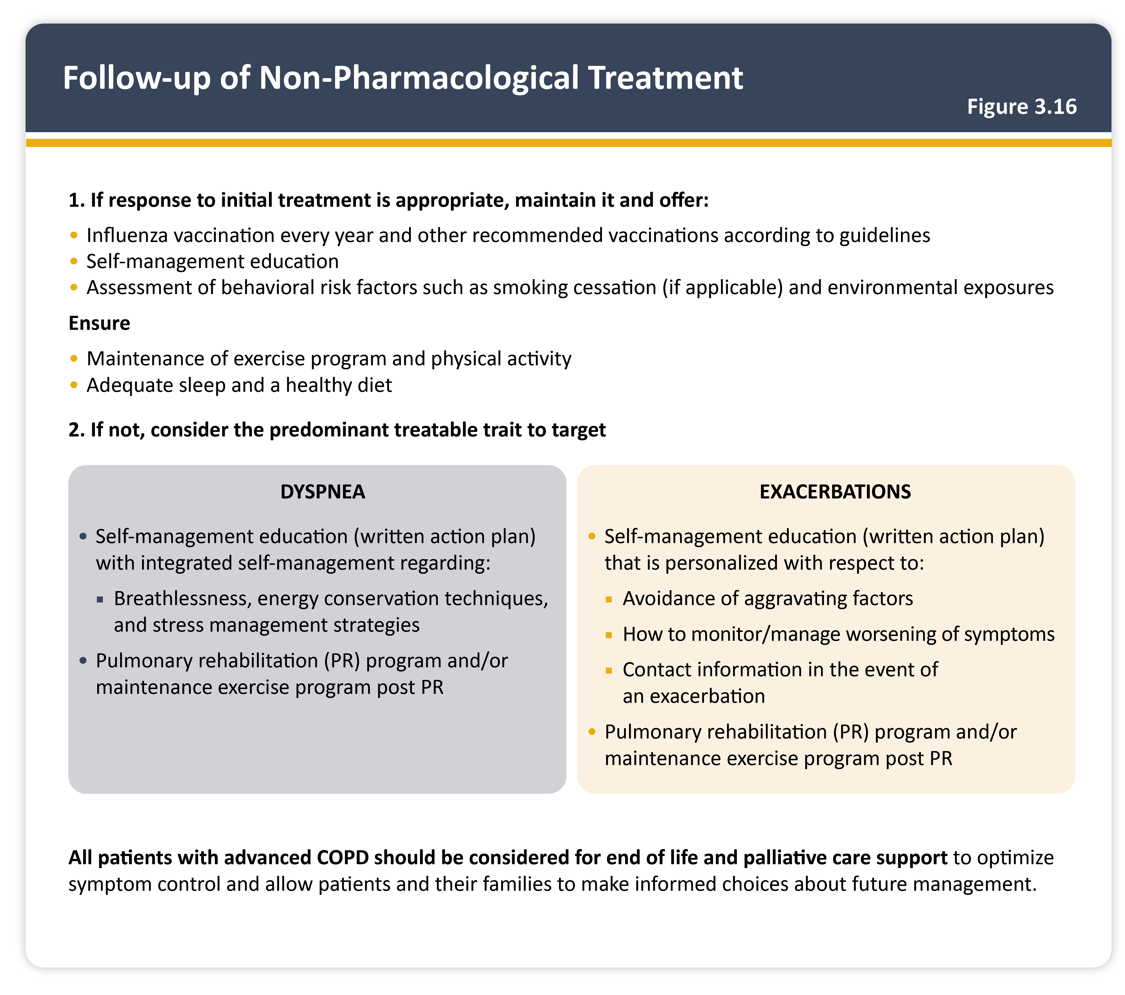
Follow-up of non-pharmacological treatment
Teaching
Slide Set
Teaching
Slide Set

Slide 36
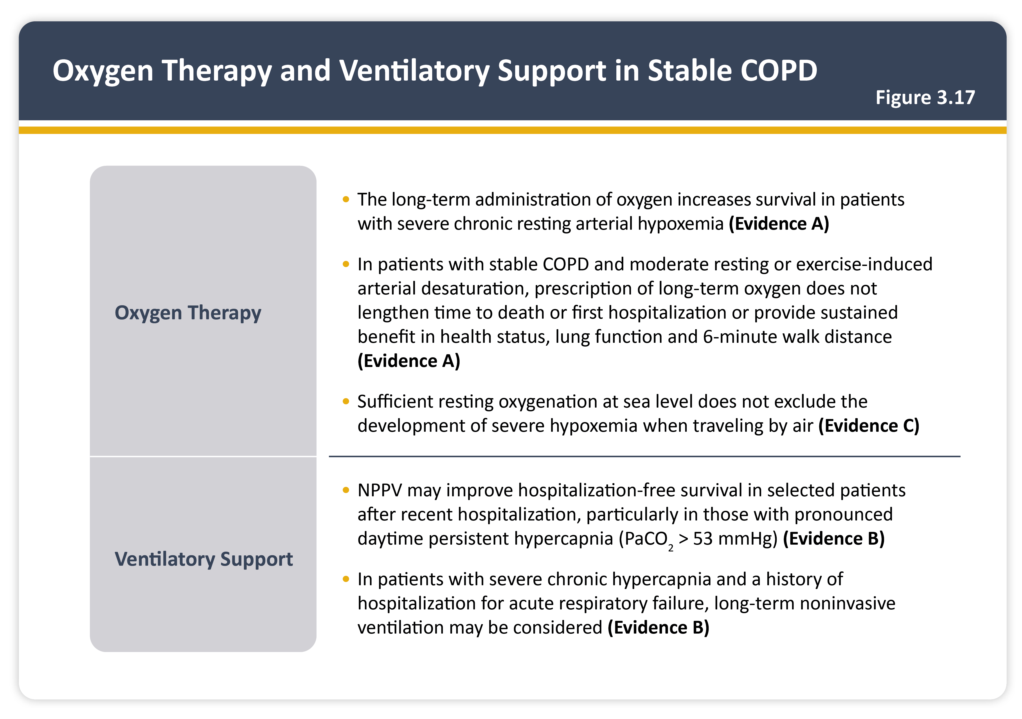
Oxygen therapy and ventilatory support in stable COPD
Teaching
Slide Set
Teaching
Slide Set

Slide 37
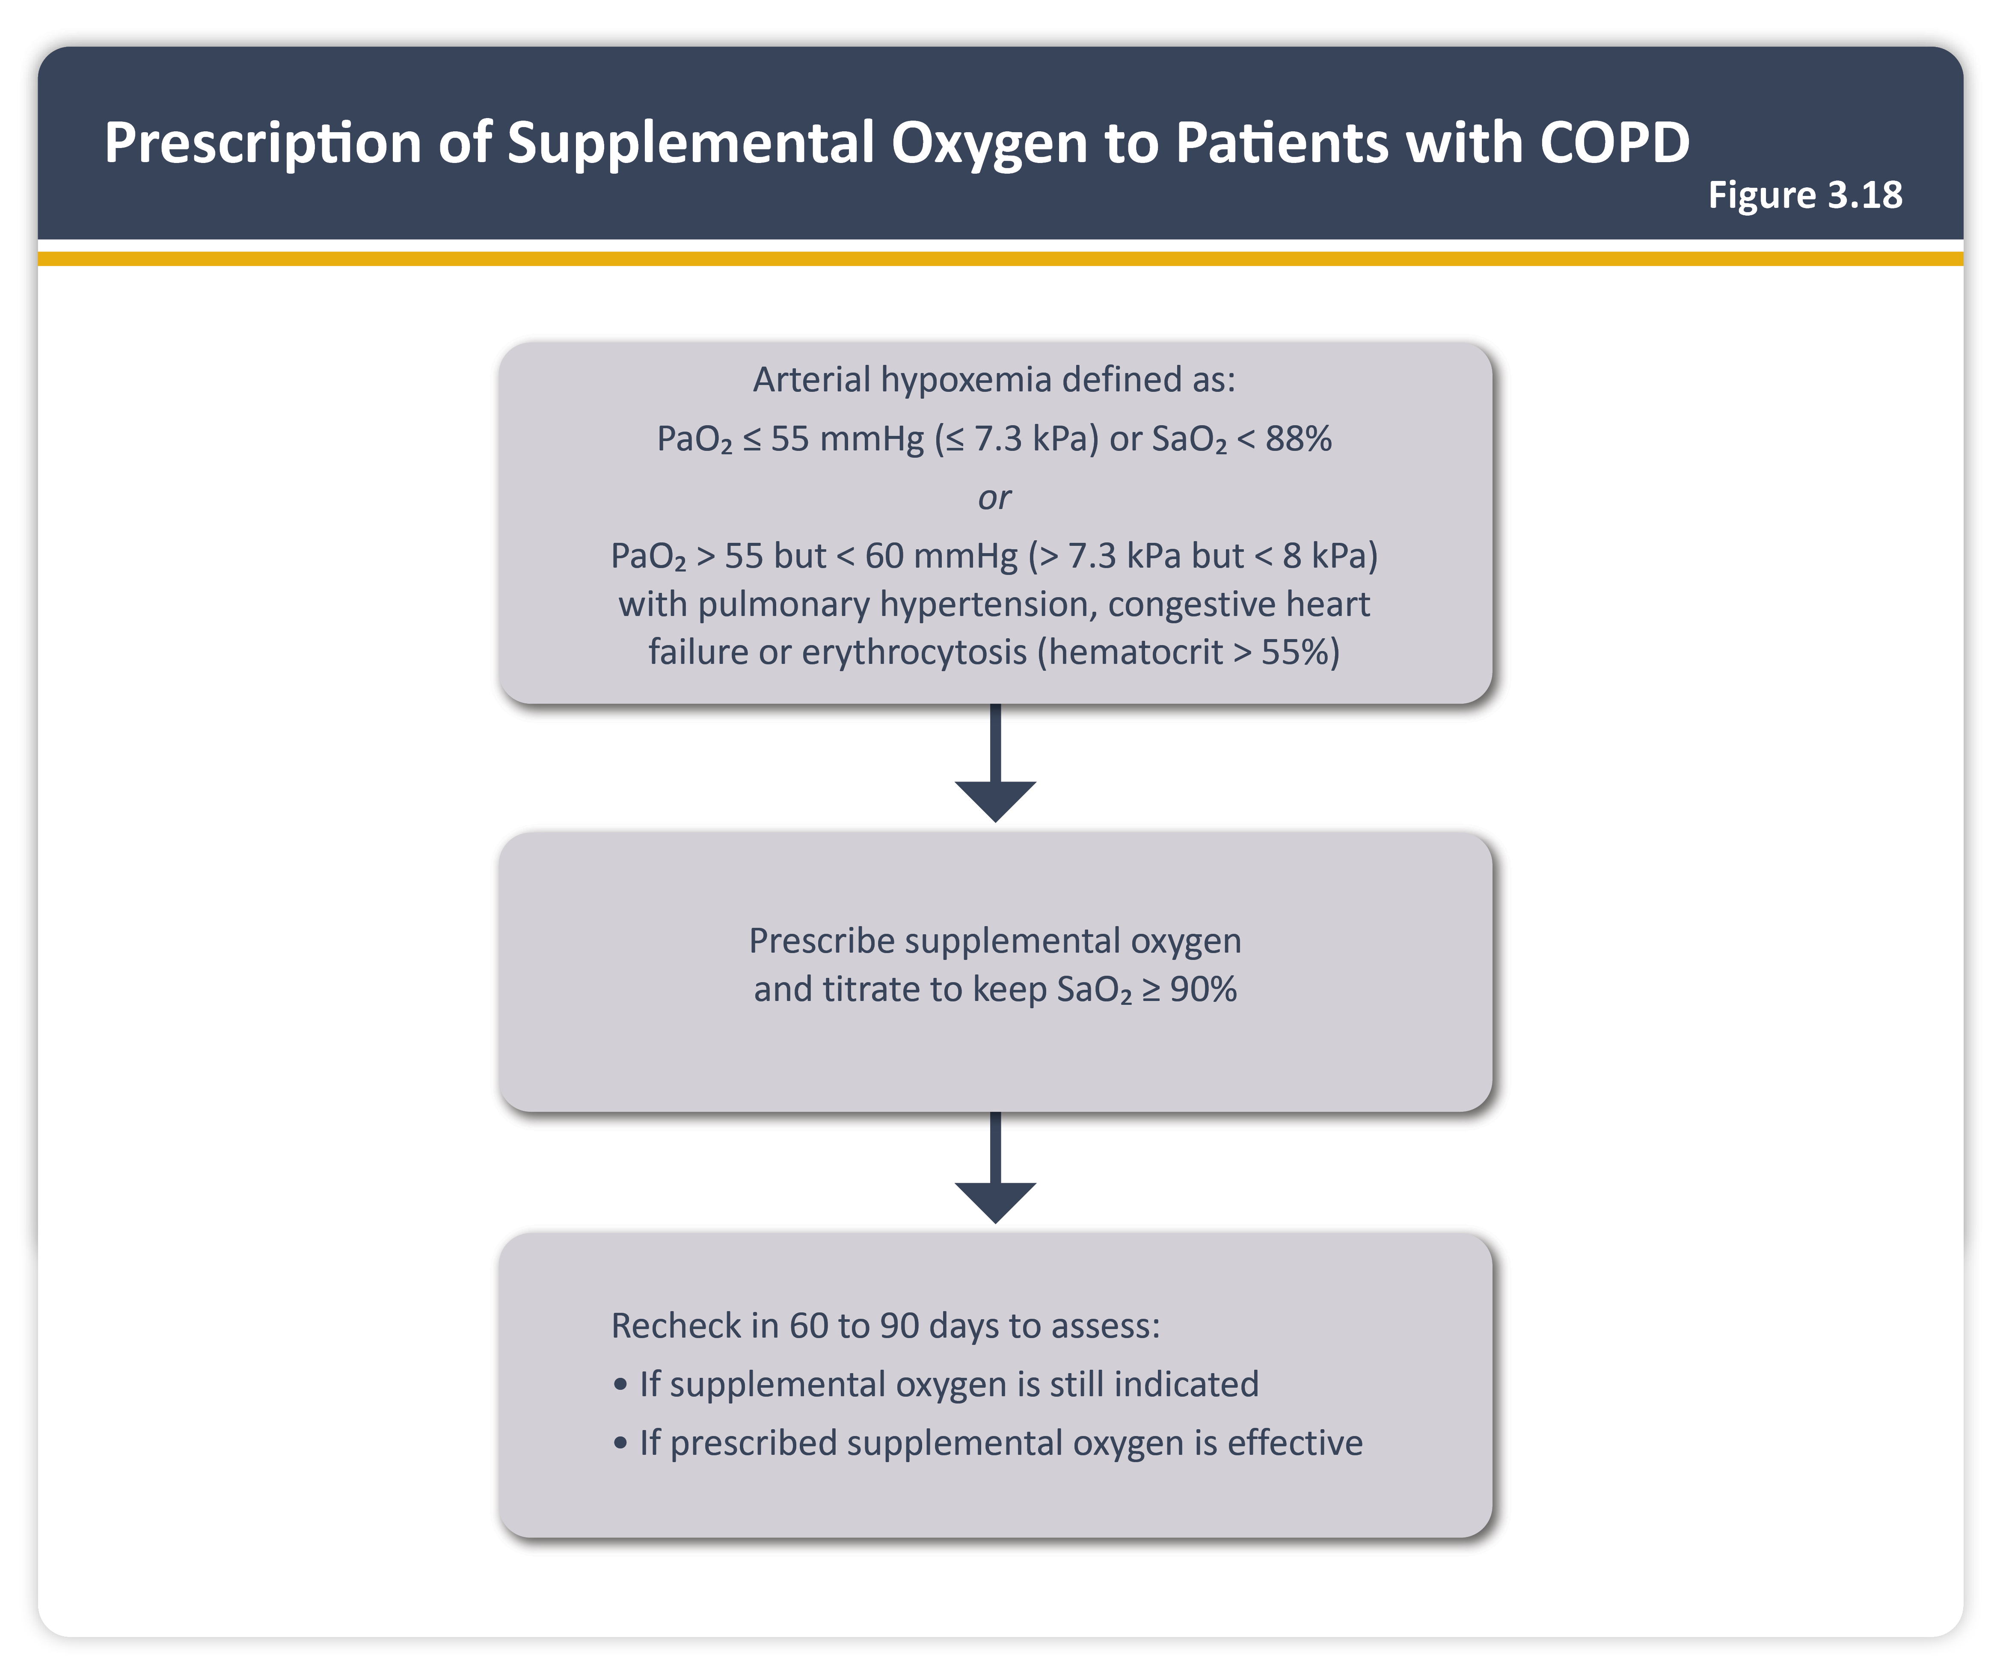
Prescription of supplemental oxygen to COPD patients
Teaching
Slide Set
Teaching
Slide Set

Slide 38
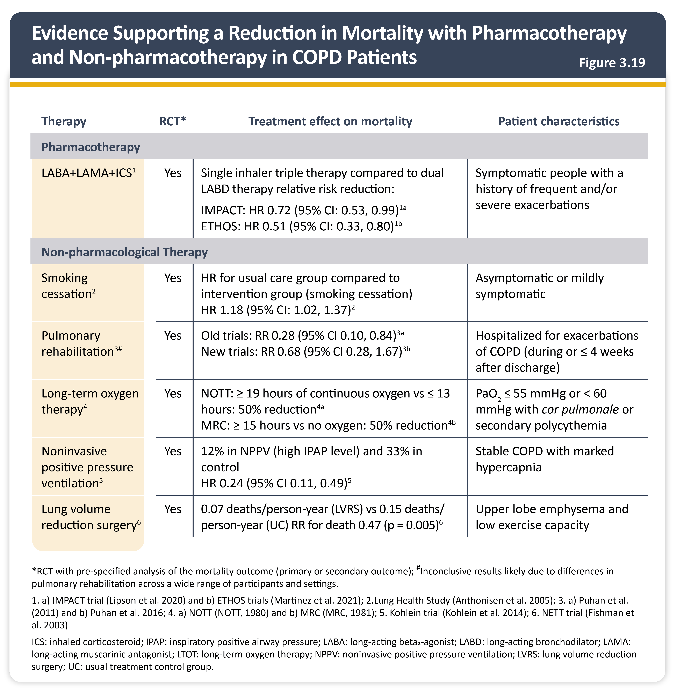
Evidence supporting a reduction in mortality with pharmacotherapy and non-pharmacotherapy in COPD patients
Teaching
Slide Set
Teaching
Slide Set

Slide 39
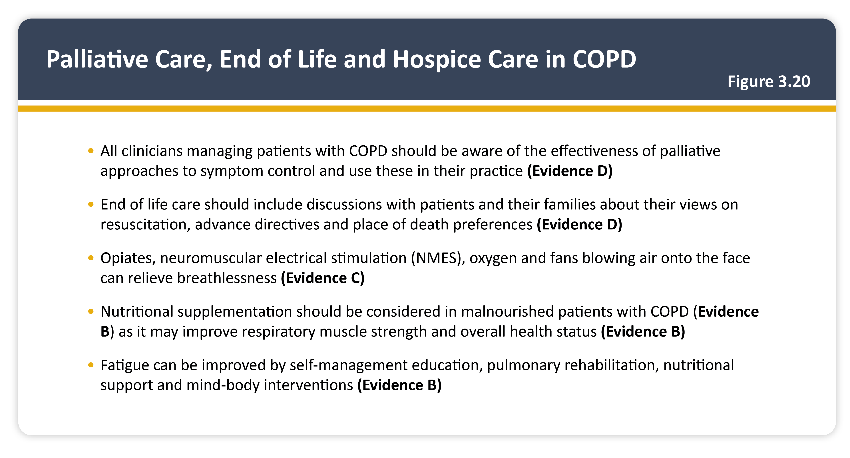
Palliative care, end of life, and hospice care in COPD
Teaching
Slide Set
Teaching
Slide Set

Slide 40
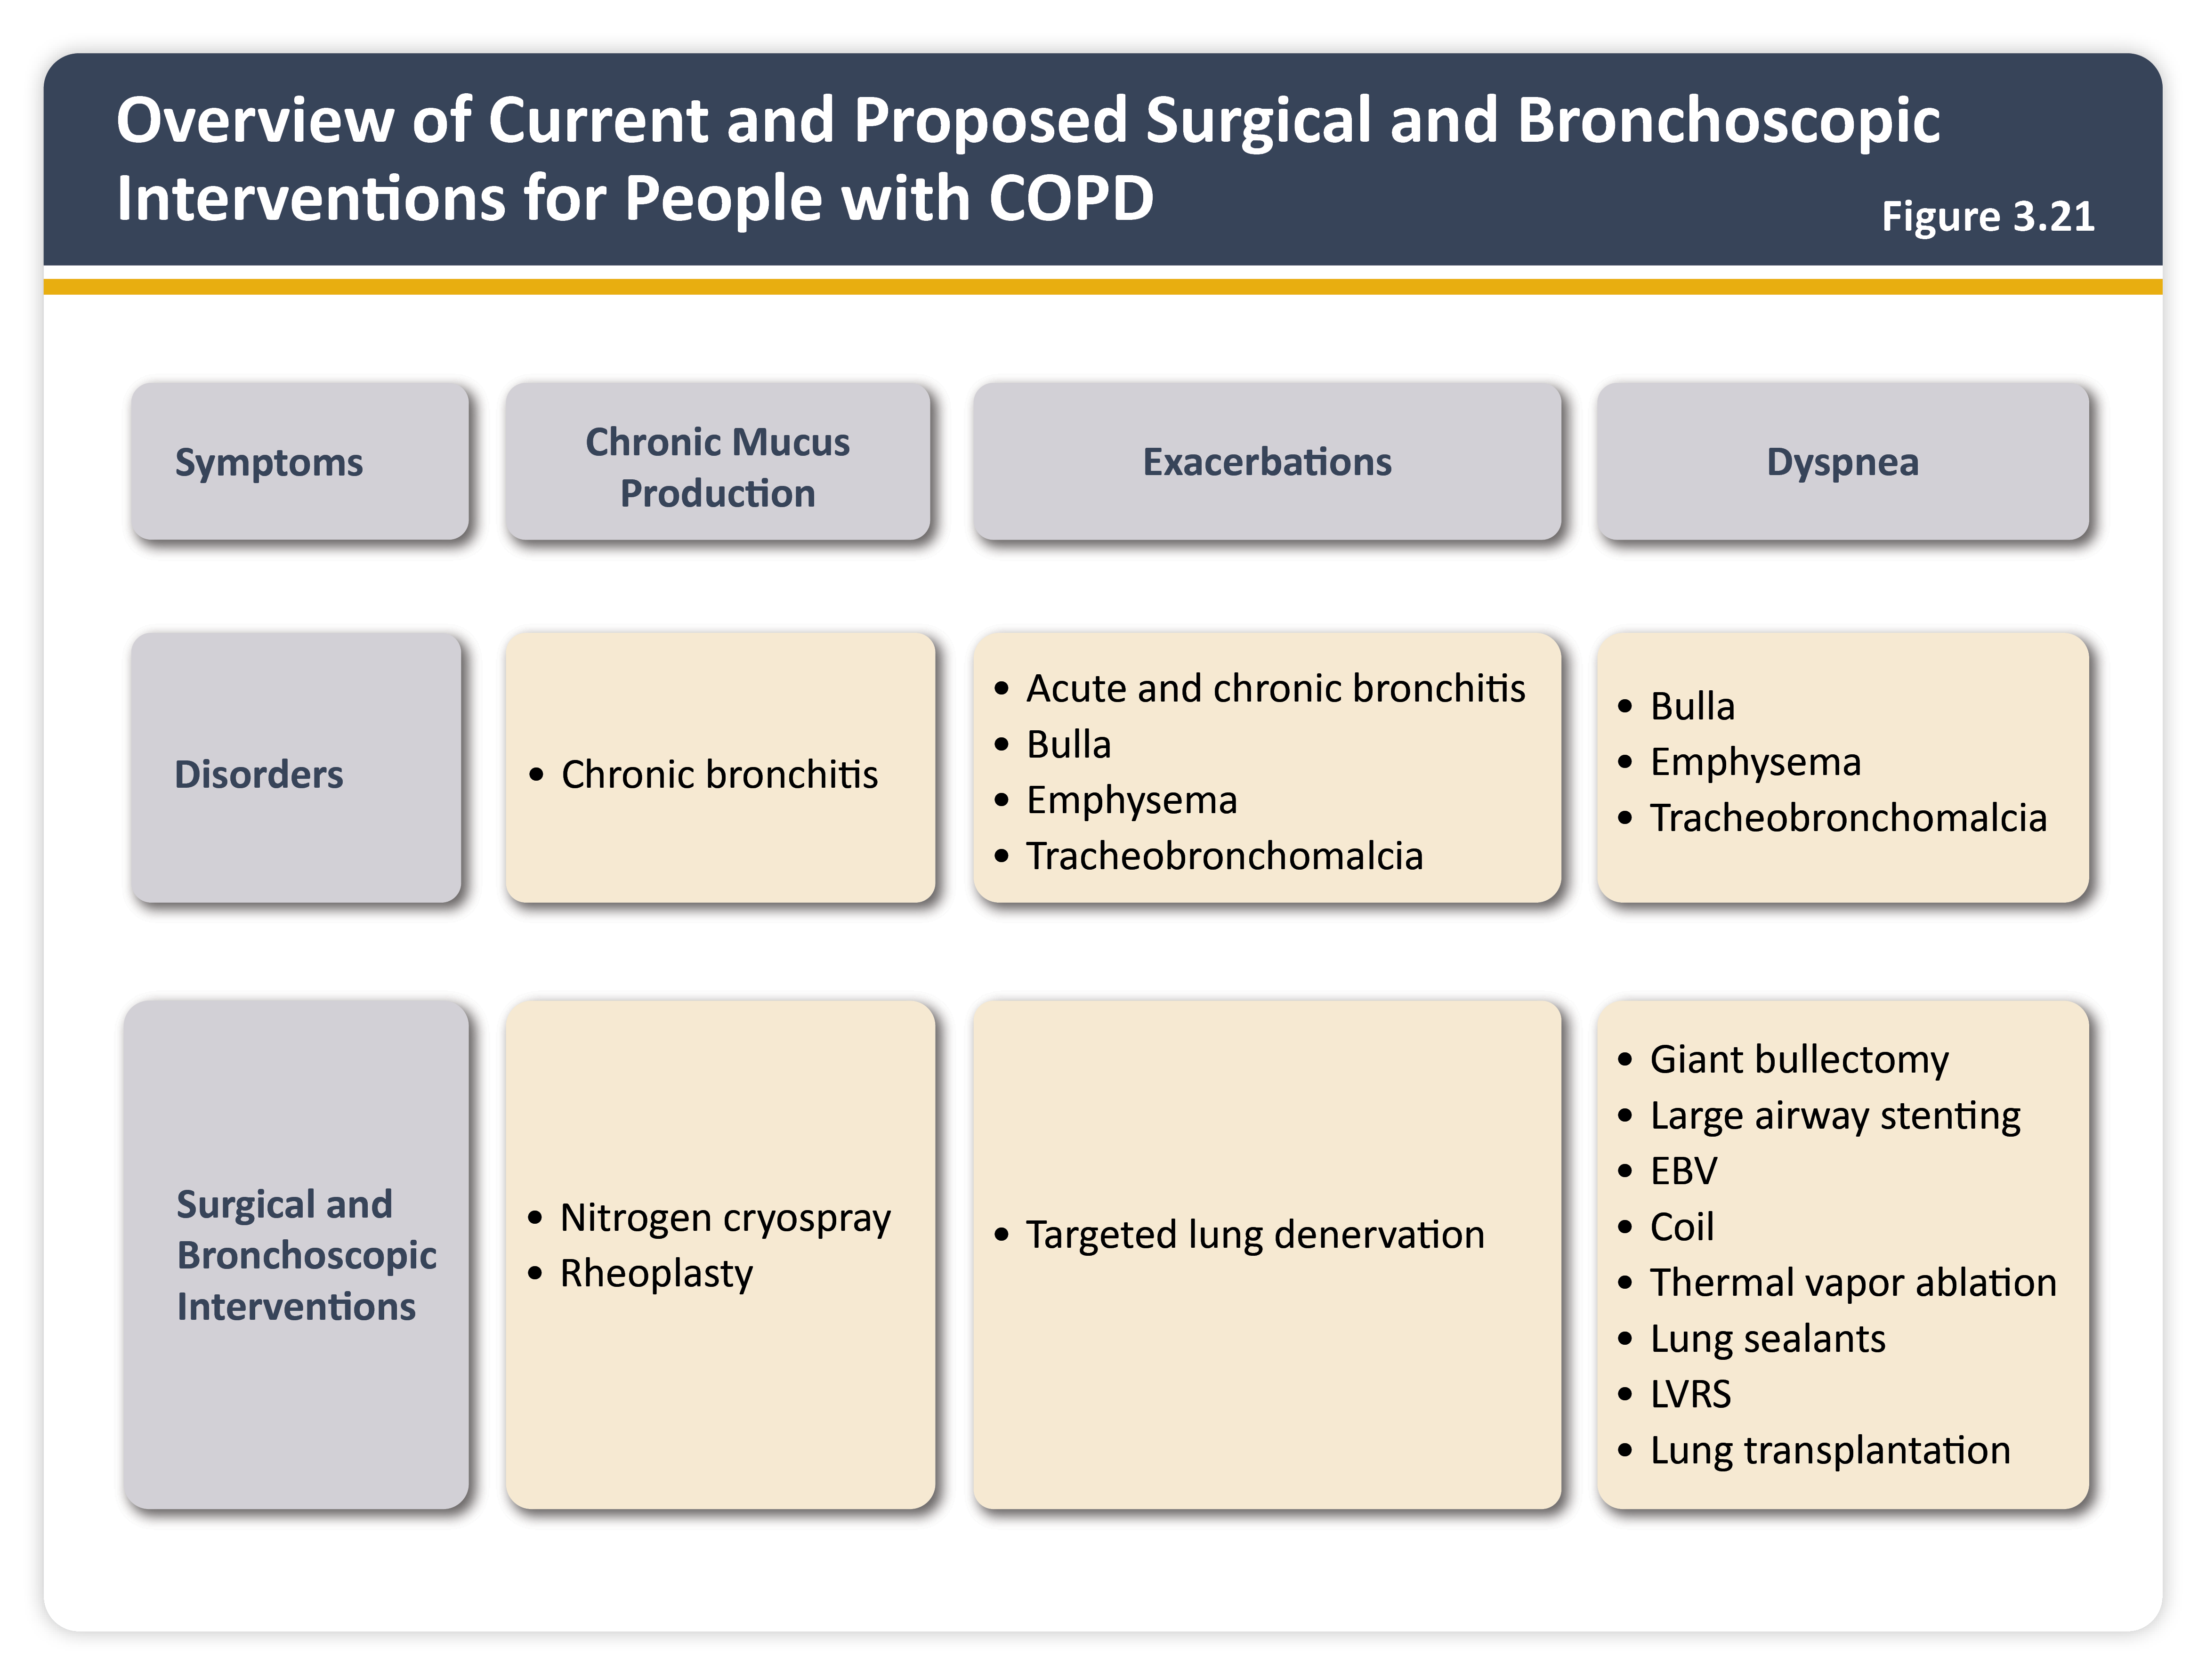
Overview of current and proposed surgical and bronchoscopic interventions for people with COPD
Teaching
Slide Set
Teaching
Slide Set

Slide 41
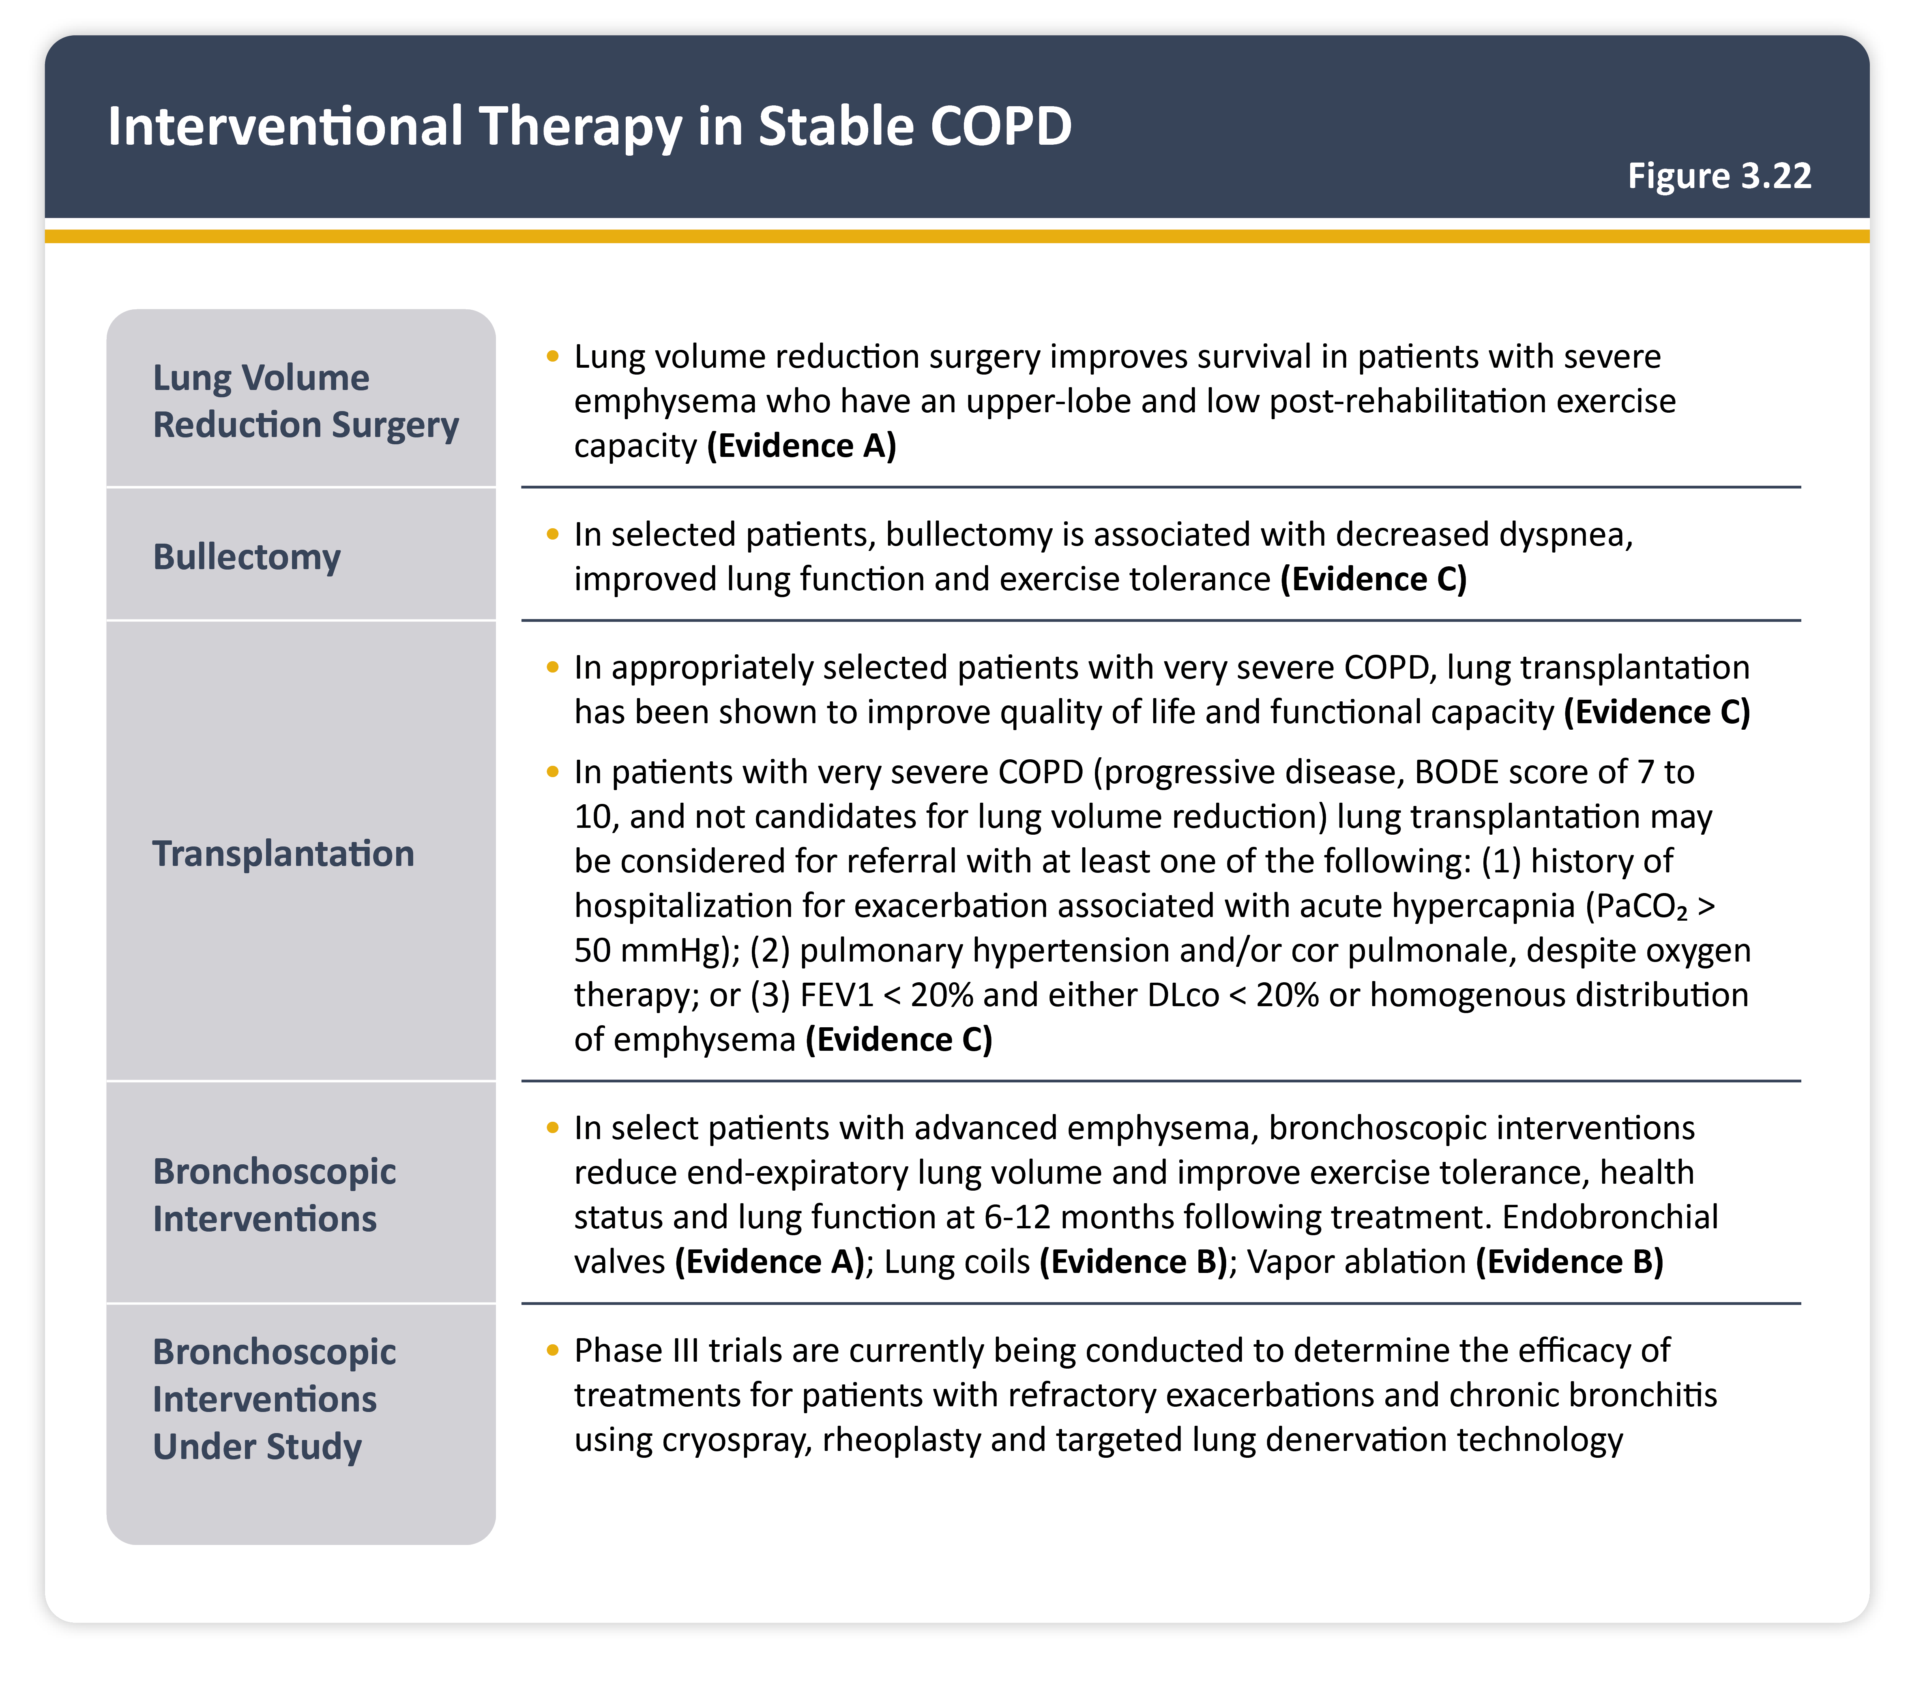
Interventional therapy in stable COPD
Teaching
Slide Set
Teaching
Slide Set

Slide 42
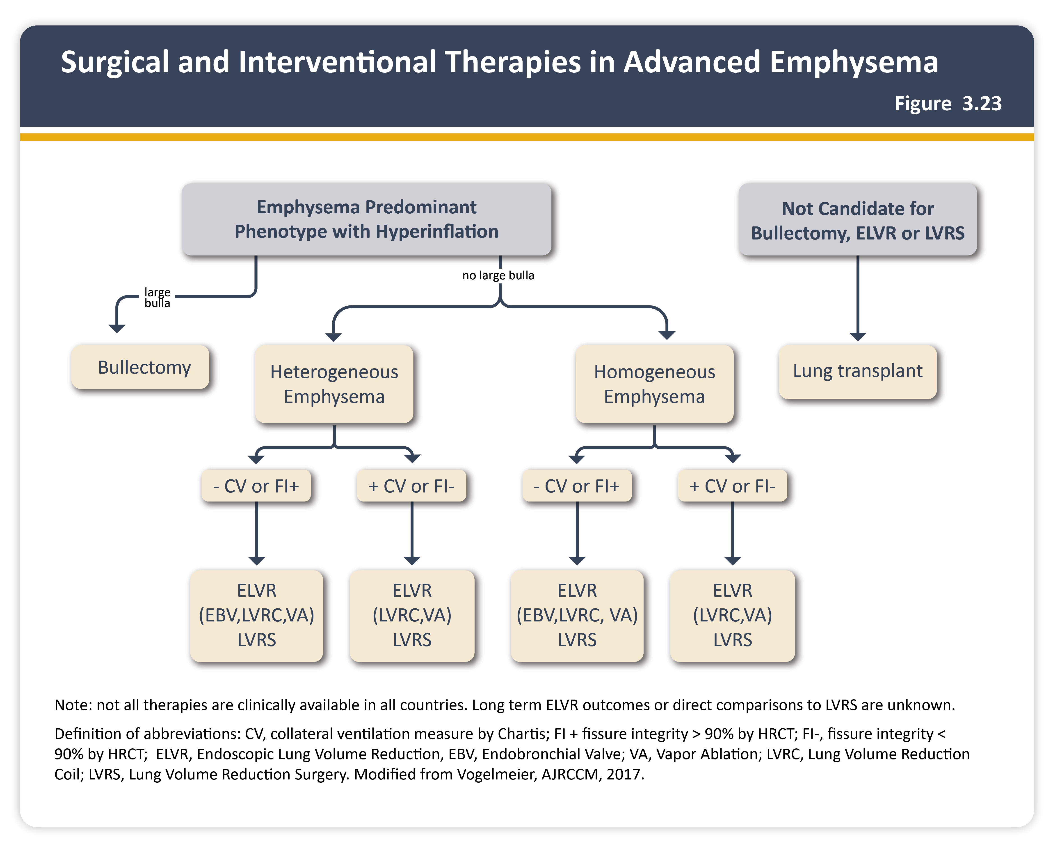
Management of patients currently on LABA plus ICS
Teaching
Slide Set
Teaching
Slide Set

Slide 43
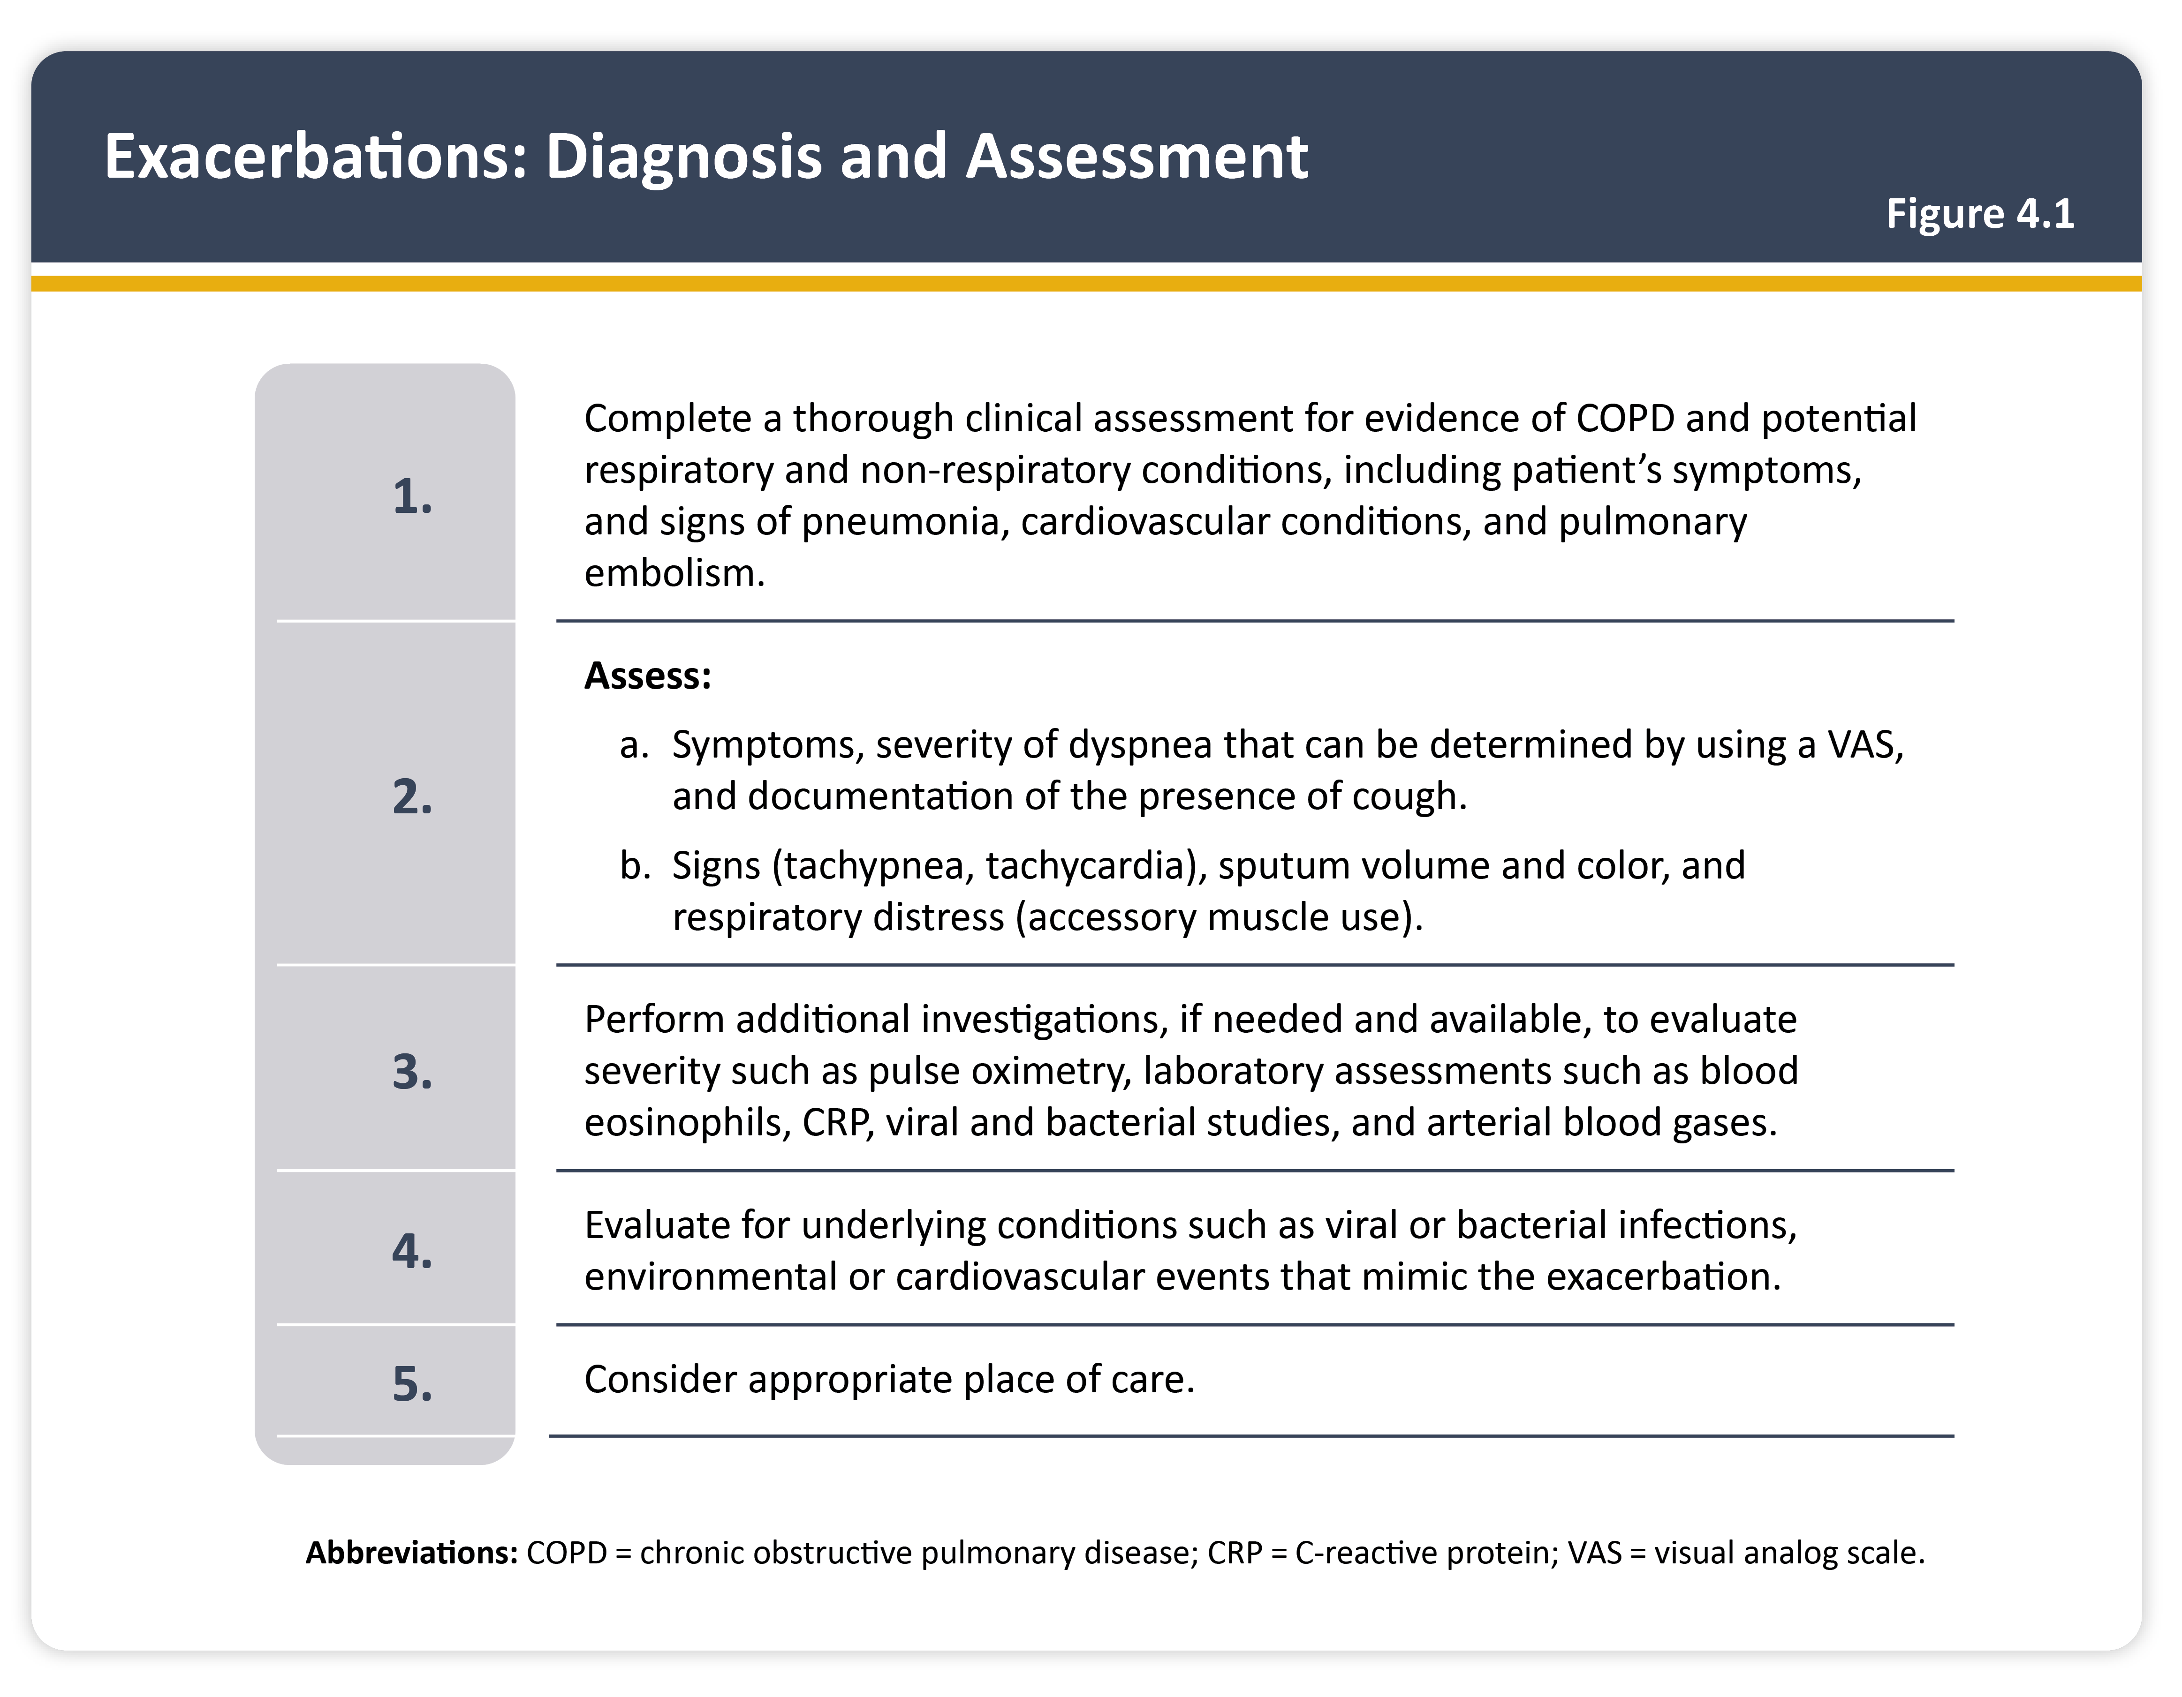
Diagnosis and assessment
Teaching
Slide Set
Teaching
Slide Set

Slide 44
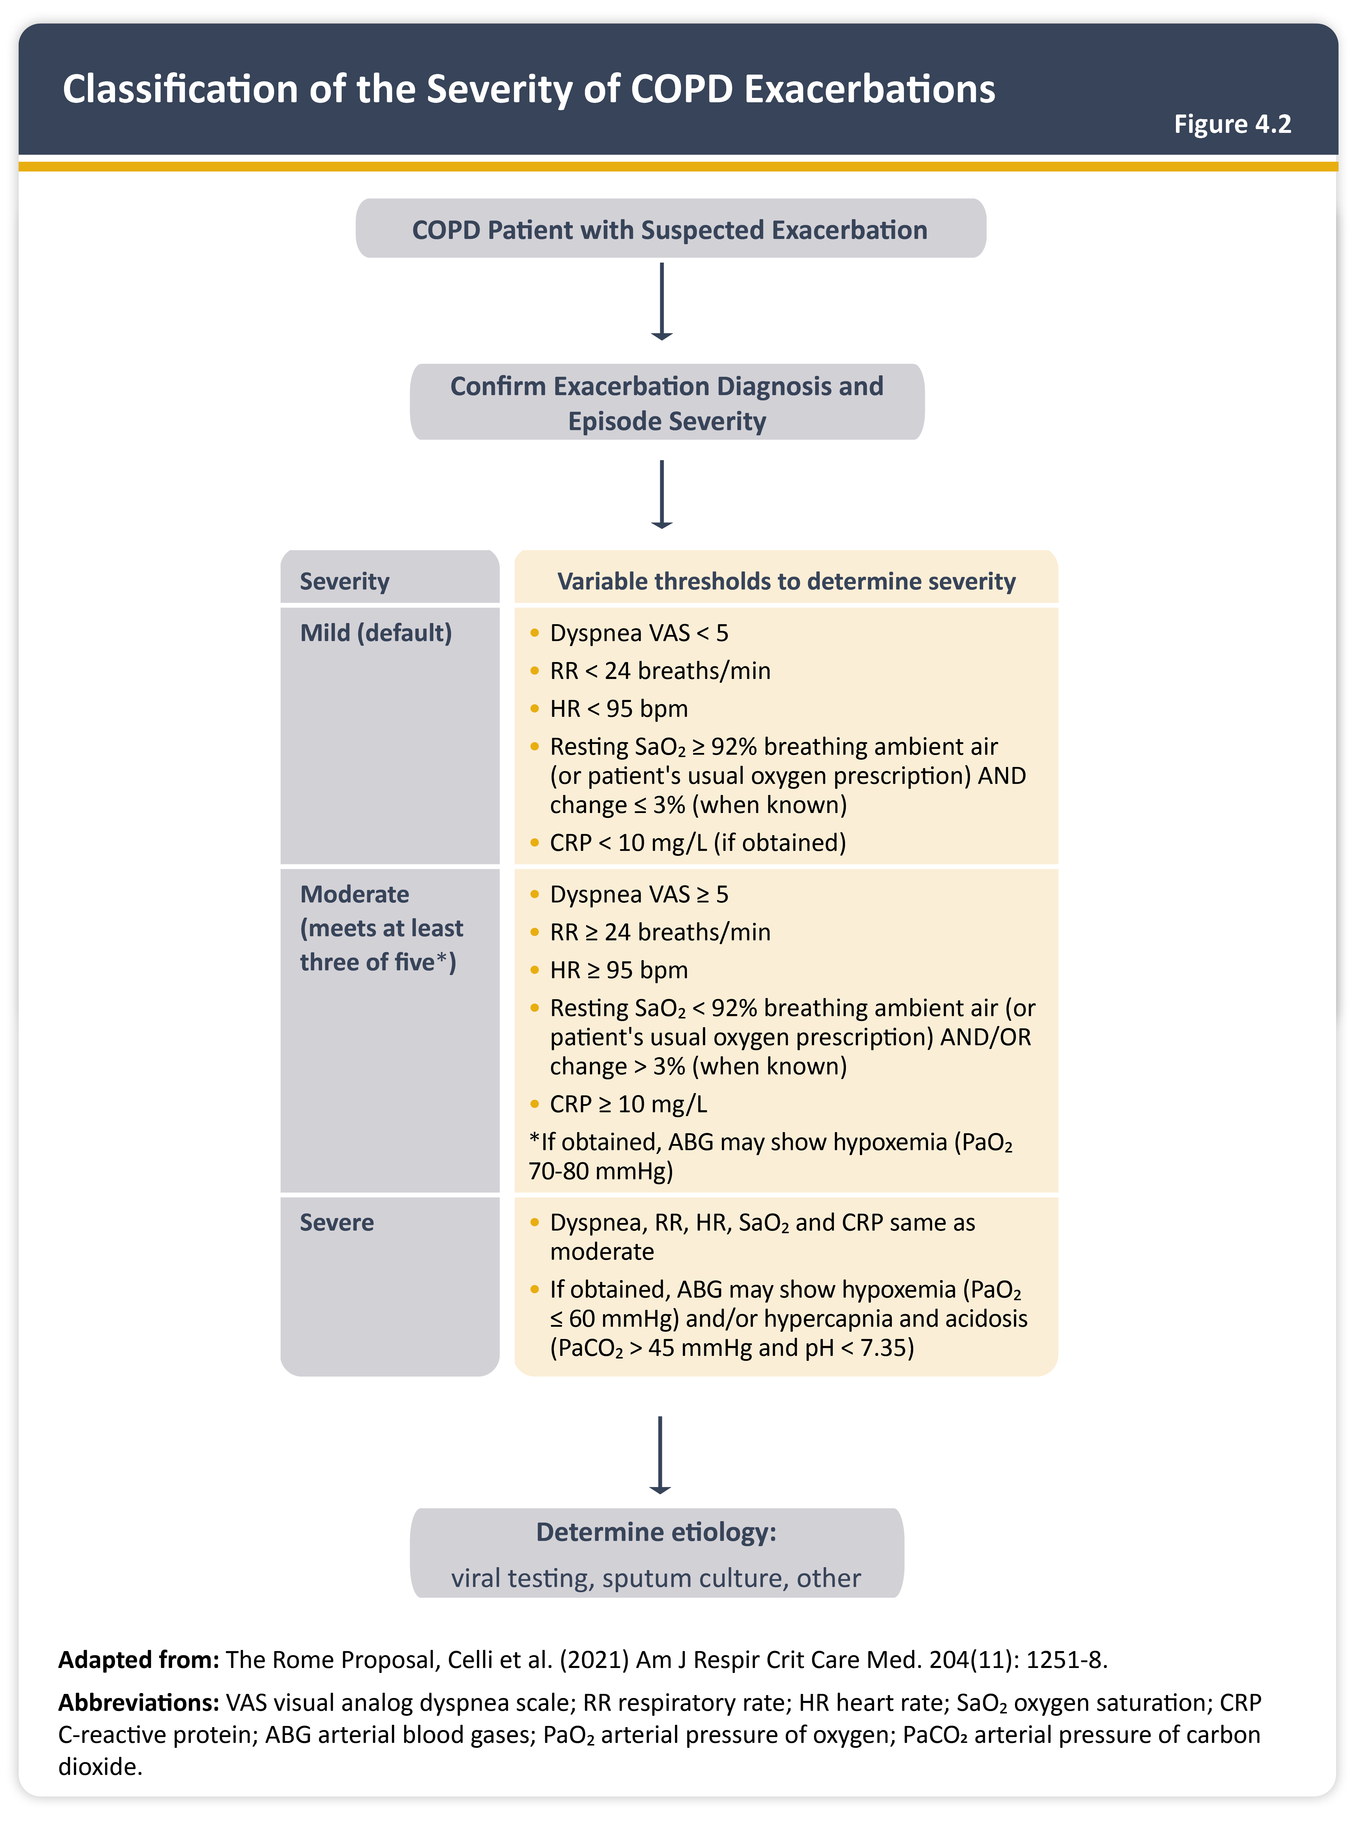
Classification of the severity of COPD exacerbations
Teaching
Slide Set
Teaching
Slide Set

Slide 45
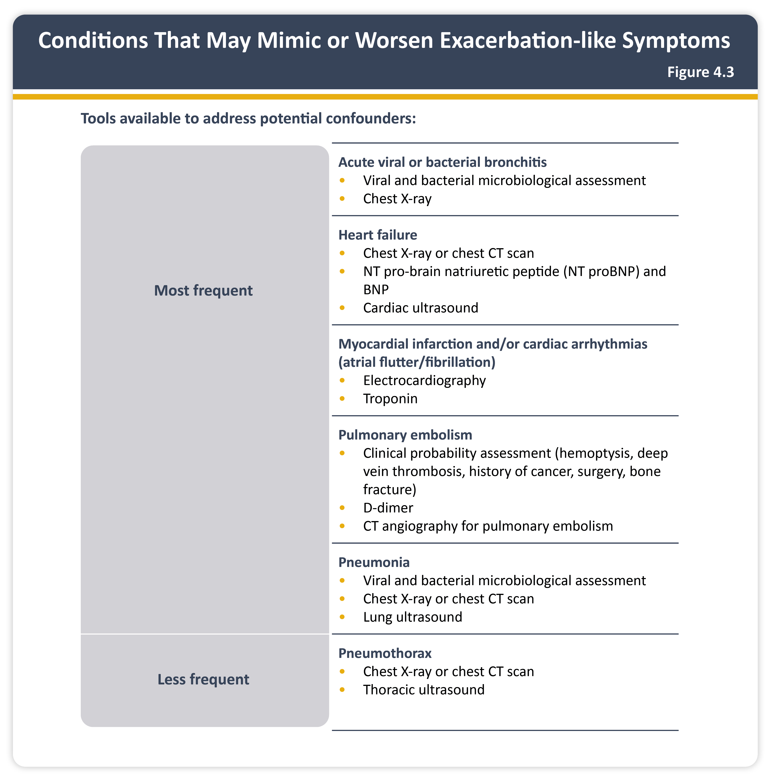
Conditions that may mimic or worsen exacerbation-like symptoms
Teaching
Slide Set
Teaching
Slide Set

Slide 46
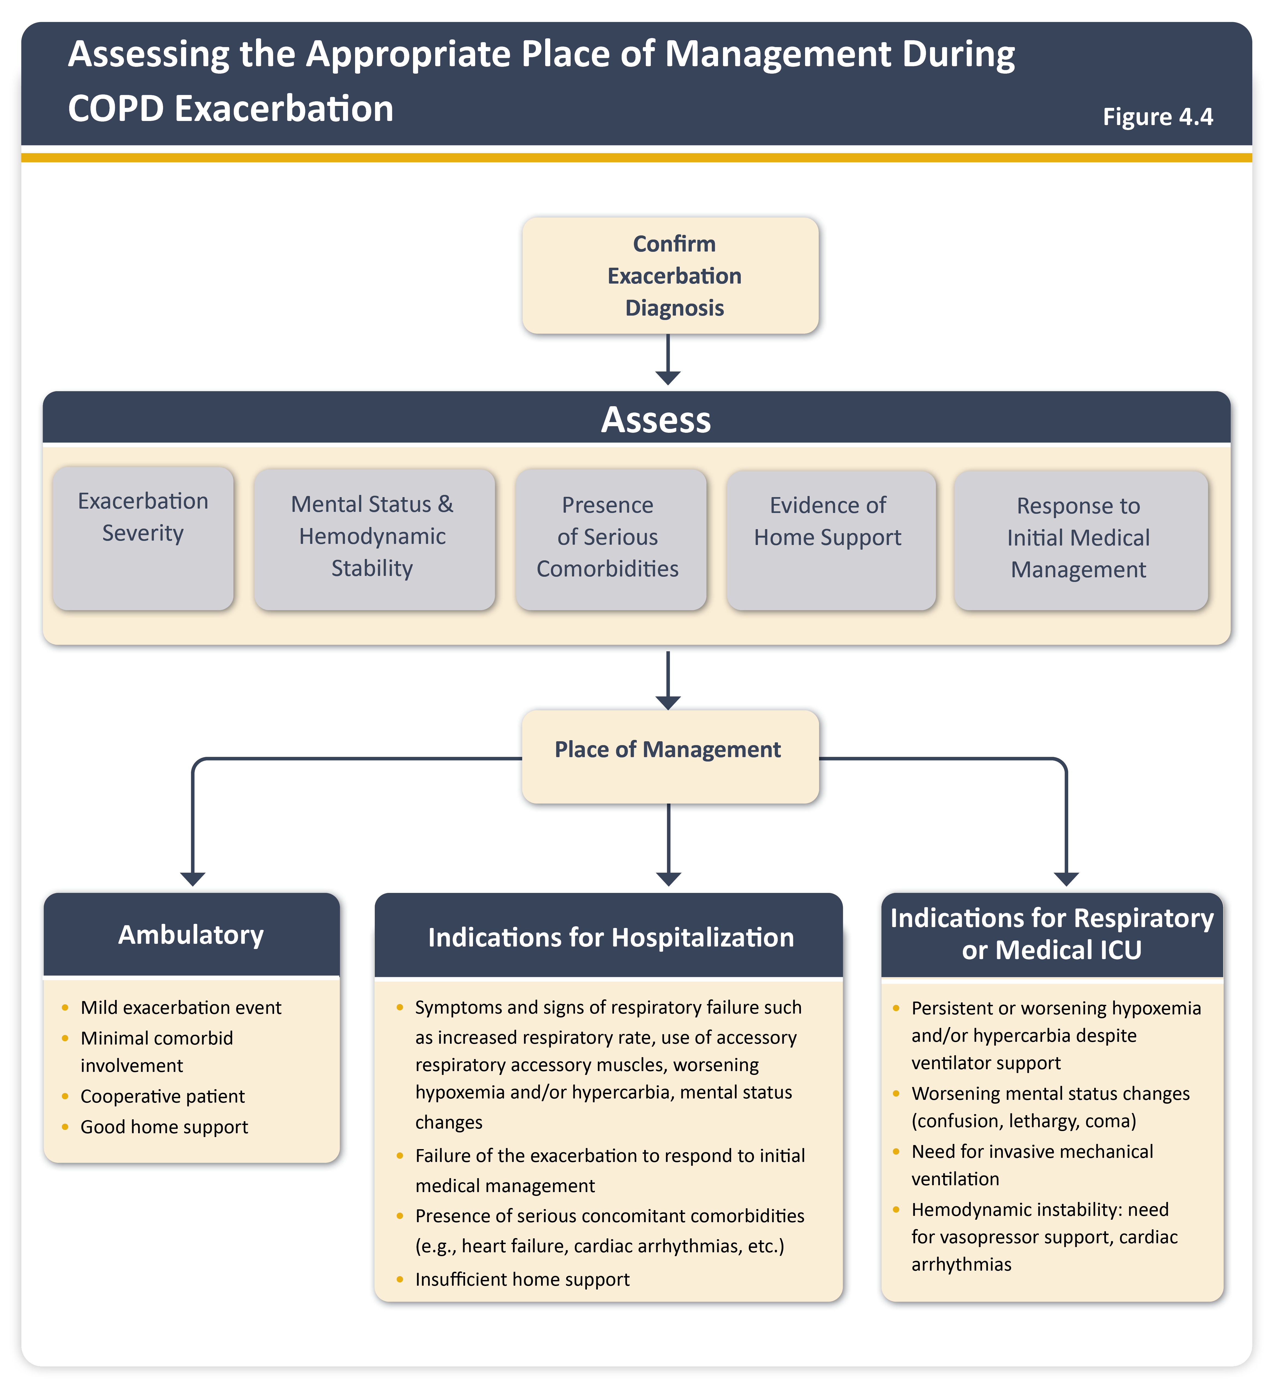
Assessing the appropriate place of management during COPD exacerbation
Teaching
Slide Set
Teaching
Slide Set

Slide 47
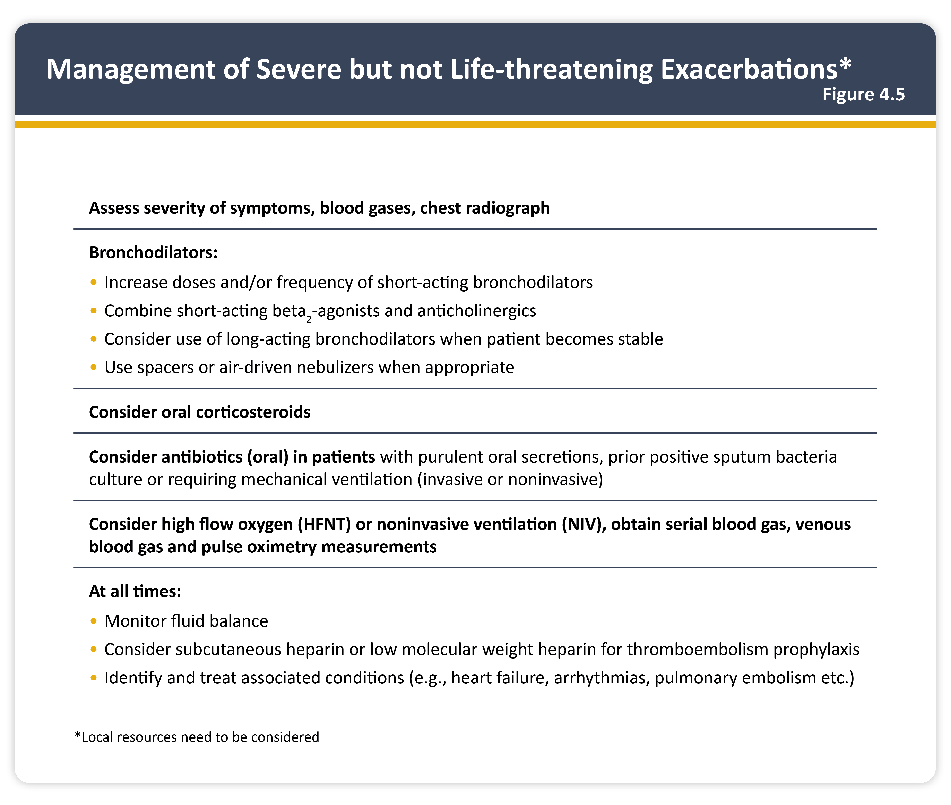
Management of sever but not life-threatening exacerbations
Teaching
Slide Set
Teaching
Slide Set

Slide 48
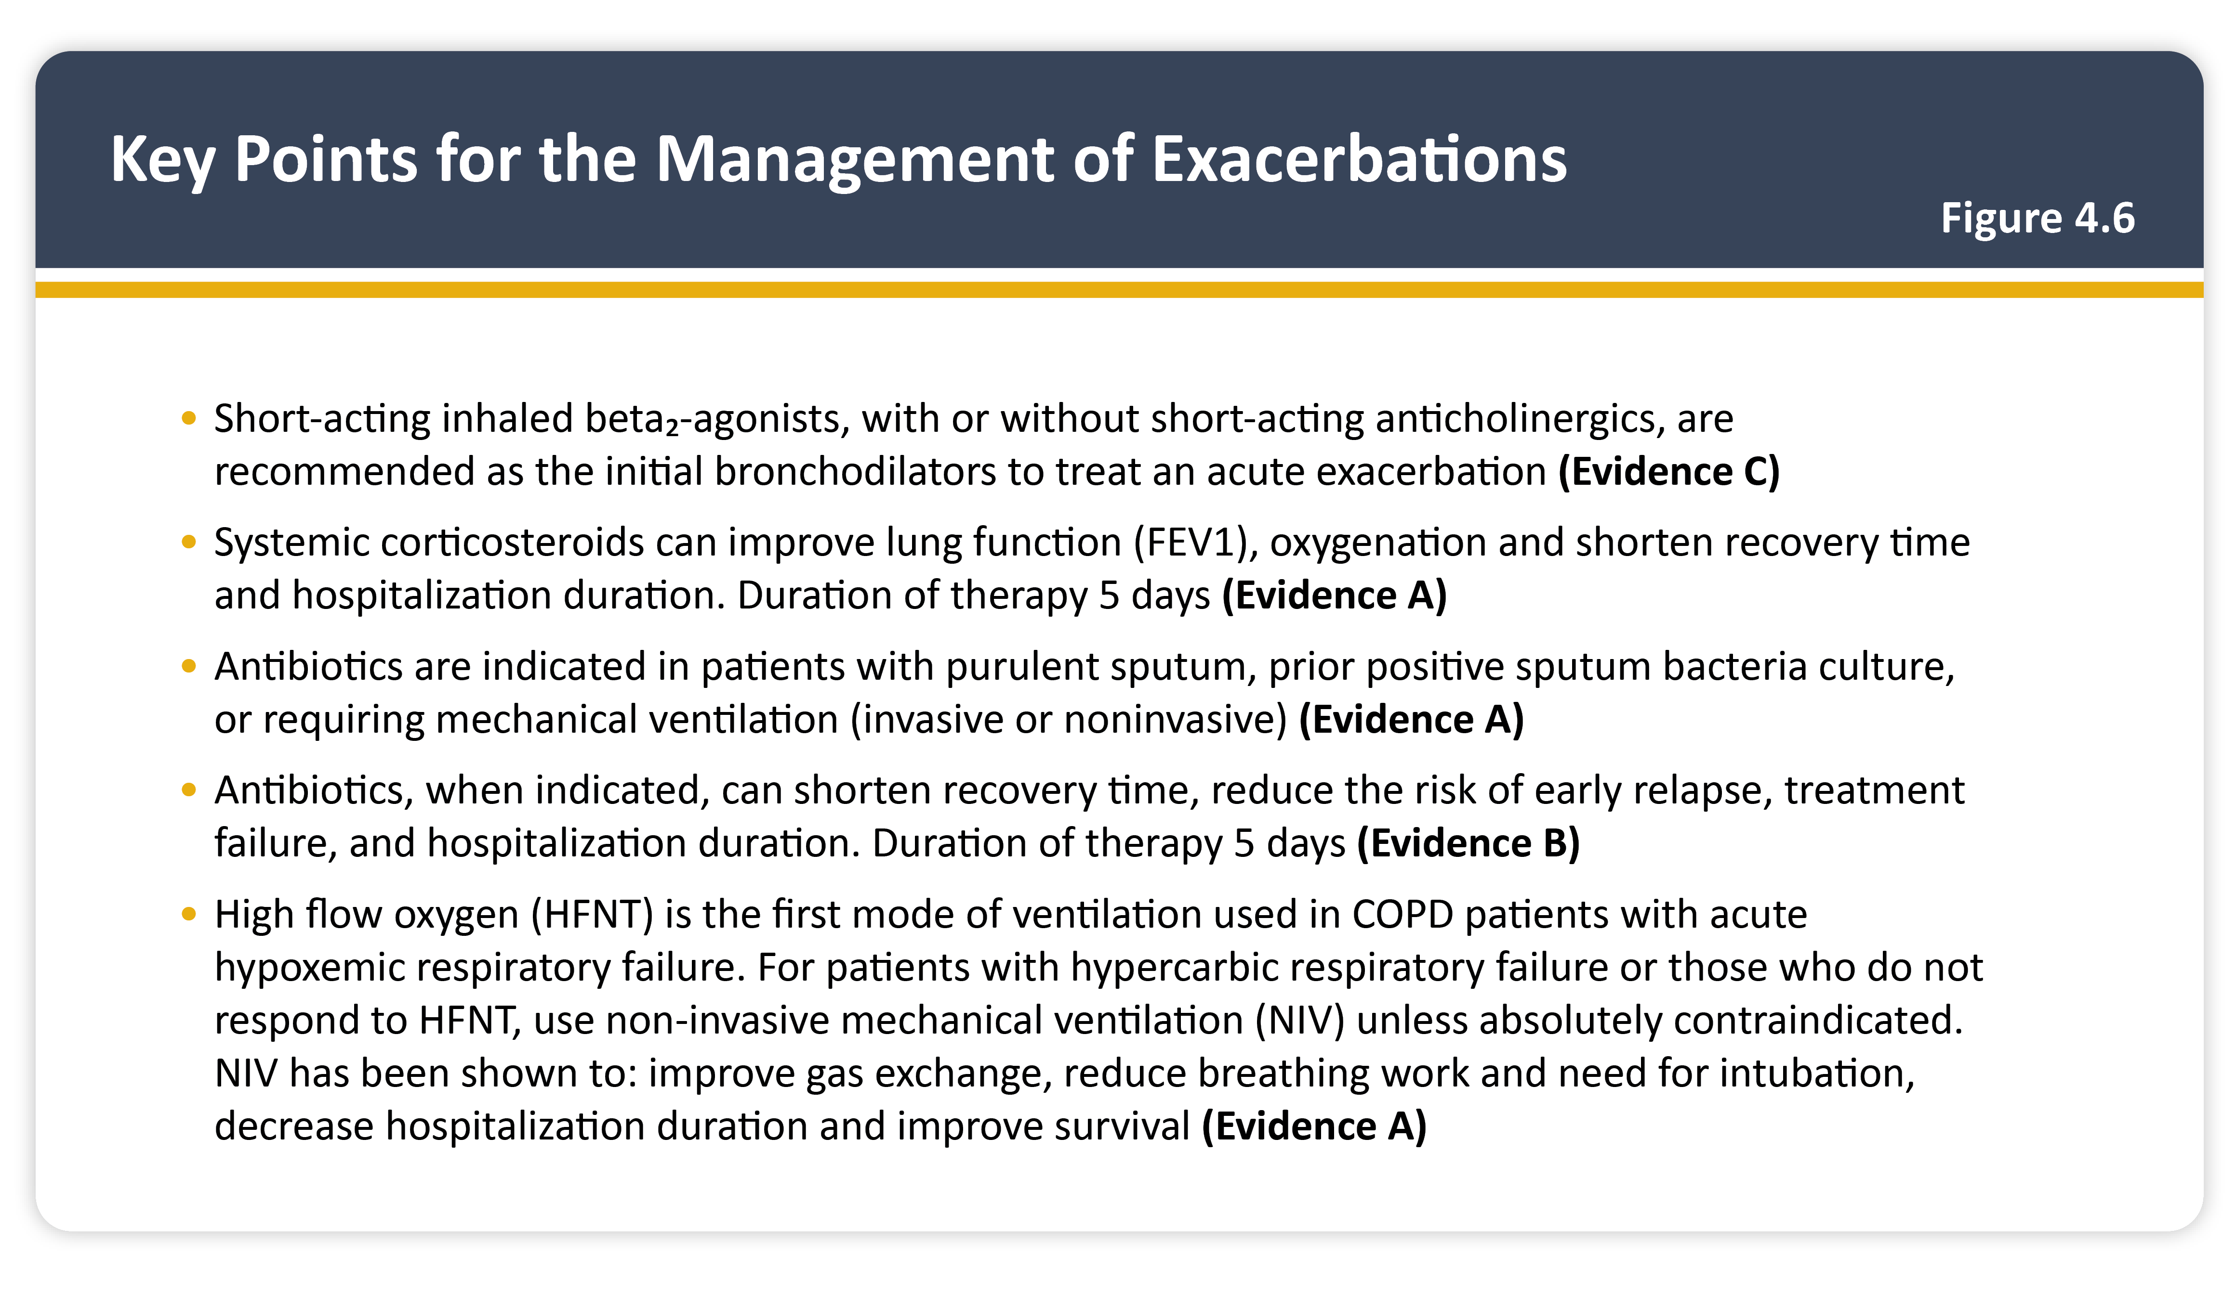
Key points for the management of exacerbations
Teaching
Slide Set
Teaching
Slide Set

Slide 49
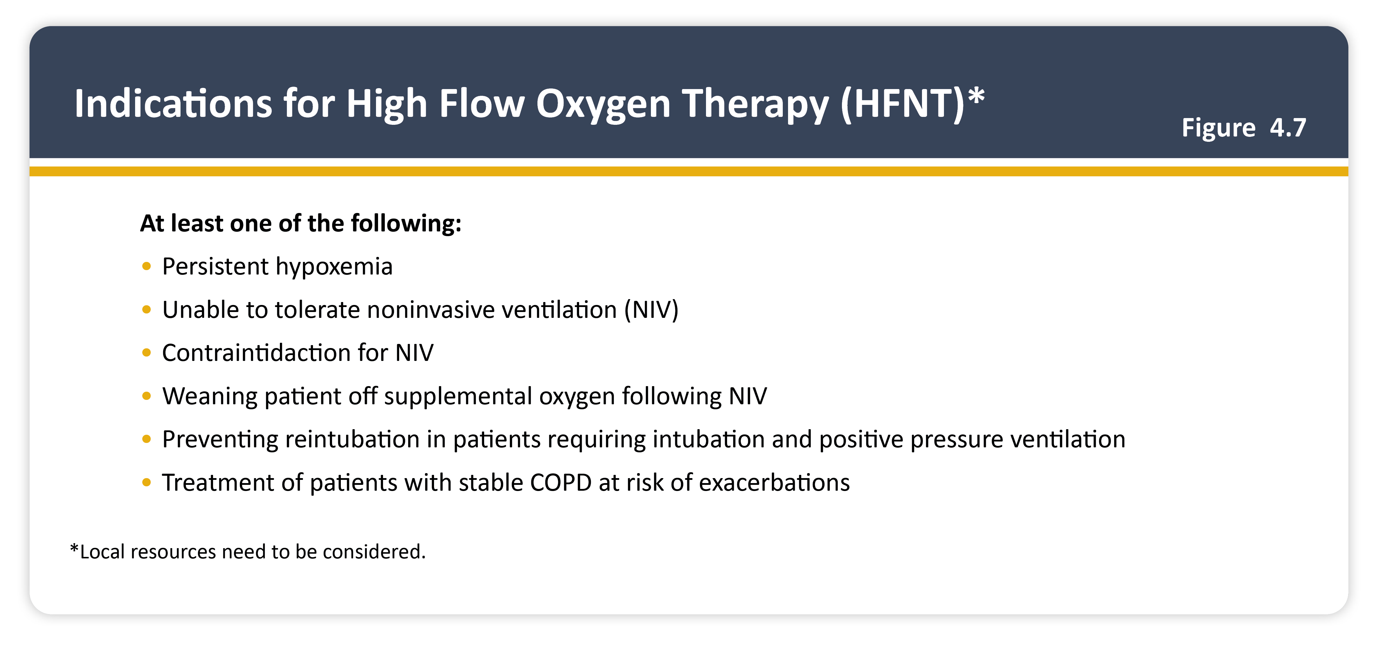
Indications for high flow oxygen therapy (HFNT)
Teaching
Slide Set
Teaching
Slide Set

Slide 50
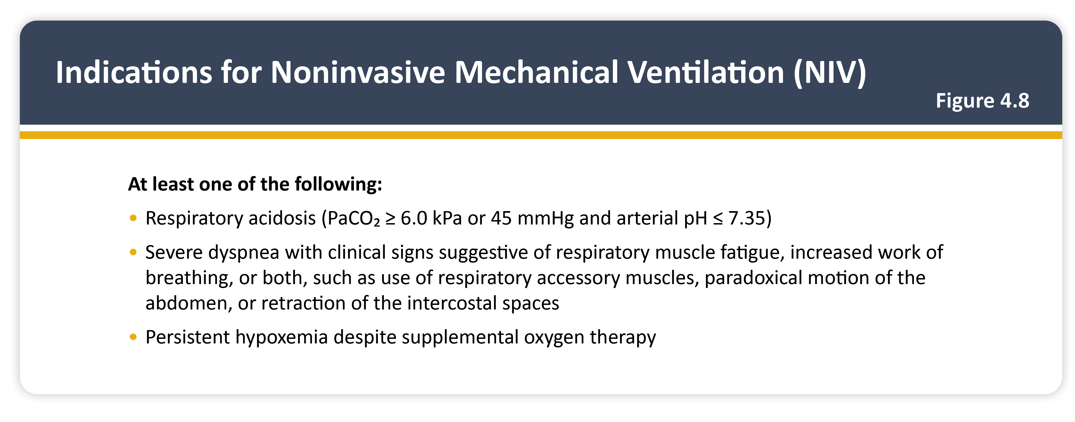
Indications for noninvasive mechanical ventilation (NIV)
Teaching
Slide Set
Teaching
Slide Set

Slide 51

Indications for invasive mechanical ventilation
Teaching
Slide Set
Teaching
Slide Set

Slide 52

Discharge criteria and recommendations for follow-up
Teaching
Slide Set
Teaching
Slide Set

Slide 53

Interventions that reduce the frequency of COPD exacerbations
Teaching
Slide Set
Teaching
Slide Set

Slide 54

Summary of the modified 4Ms person-centered approach to multimorbid patients with COPD
Teaching
Slide Set
Teaching
Slide Set

Slide 55

Morbidity clusters frequently present in patients with COPD that independently impact outcomes
Teaching
Slide Set
Teaching
Slide Set

Slide 56

Treatable traits in pulmonary hypertension-COPD (PH-COPD) and suggested management
Teaching
Slide Set
Teaching
Slide Set

Slide 57

Common risk factors for the development of lung cancer
Teaching
Slide Set
Teaching
Slide Set

Slide 58

Potential complementary approach for the detection of frequent morbidities in all patients with COPD – initial evaluation
Teaching
Slide Set
Teaching
Slide Set

Slide 59

Potential complementary approach for the detection of frequent morbidities in all patients with COPD – regular follow-up
Teaching
Slide Set
Teaching
Slide Set

Slide 60

Principal AI Models
Teaching
Slide Set
Teaching
Slide Set

Slide 61

Potential risks and mitigation strategies of AI in medicine
Teaching
Slide Set
Teaching
Slide Set

Slide 62

Maintenance medications in COPD
Teaching
Slide Set
Teaching
Slide Set

Slide 63

Bronchodilators in stable COPD
Teaching
Slide Set
Teaching
Slide Set

Slide 64

Anti-inflammatory therapy in stable COPD
Teaching
Slide Set
Teaching
Slide Set

Slide 65

Other pharmacological treatments
Teaching
Slide Set
Teaching
Slide Set

Slide 66

Pulmonary rehabilitation, self-management and integrative care in COPD
Teaching
Slide Set
Teaching
Slide Set

