Slide 1
Teaching
Slide Set
Global Strategy for the Diagnosis, Management, and Prevention of
Chronic Obstructive Pulmonary Disease
This slide set is restricted for academic and educational purposes only. Use of the slide set, or of individual slides, for commercial or promotional purposes requires approval from GOLD.

Slide 2
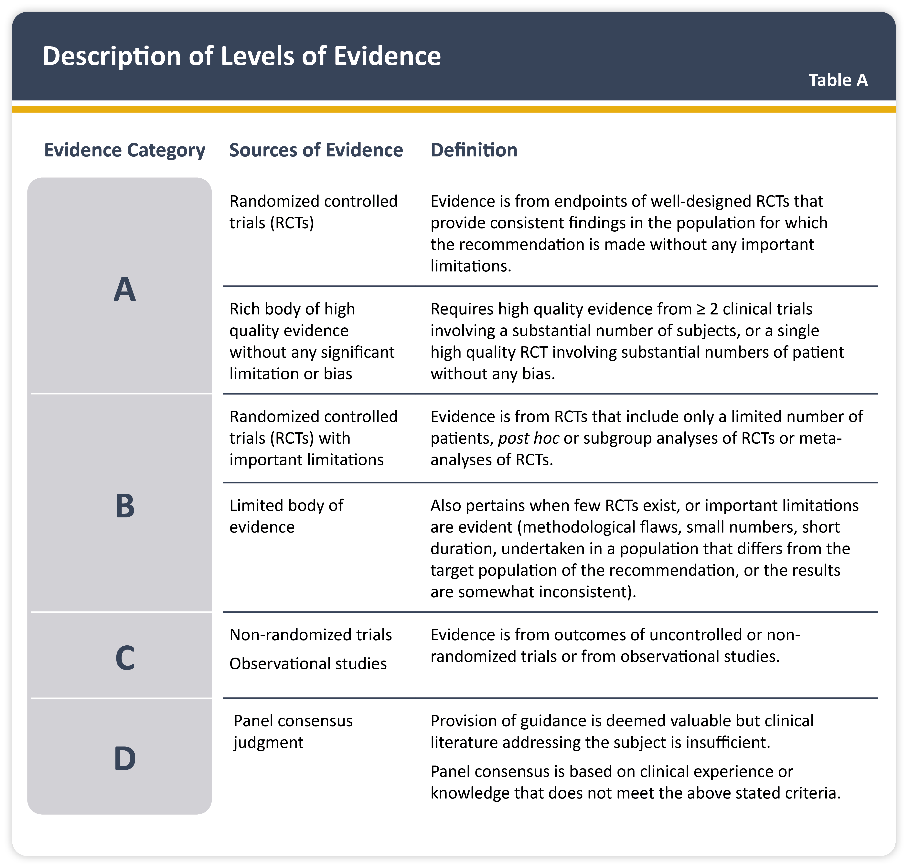
Teaching
Slide Set

Slide 3
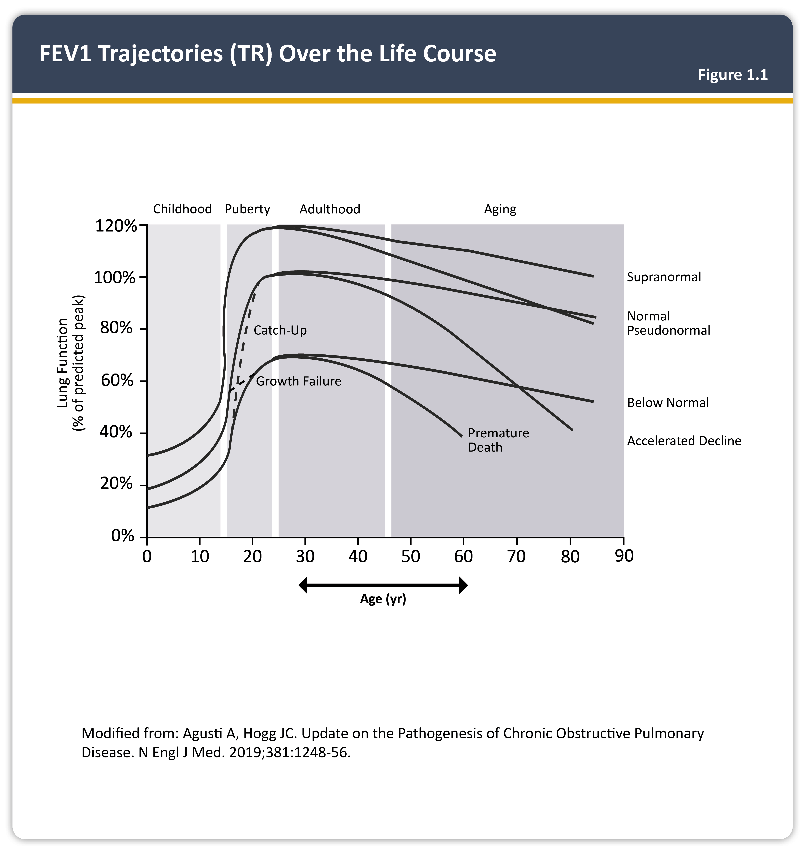

Slide 4
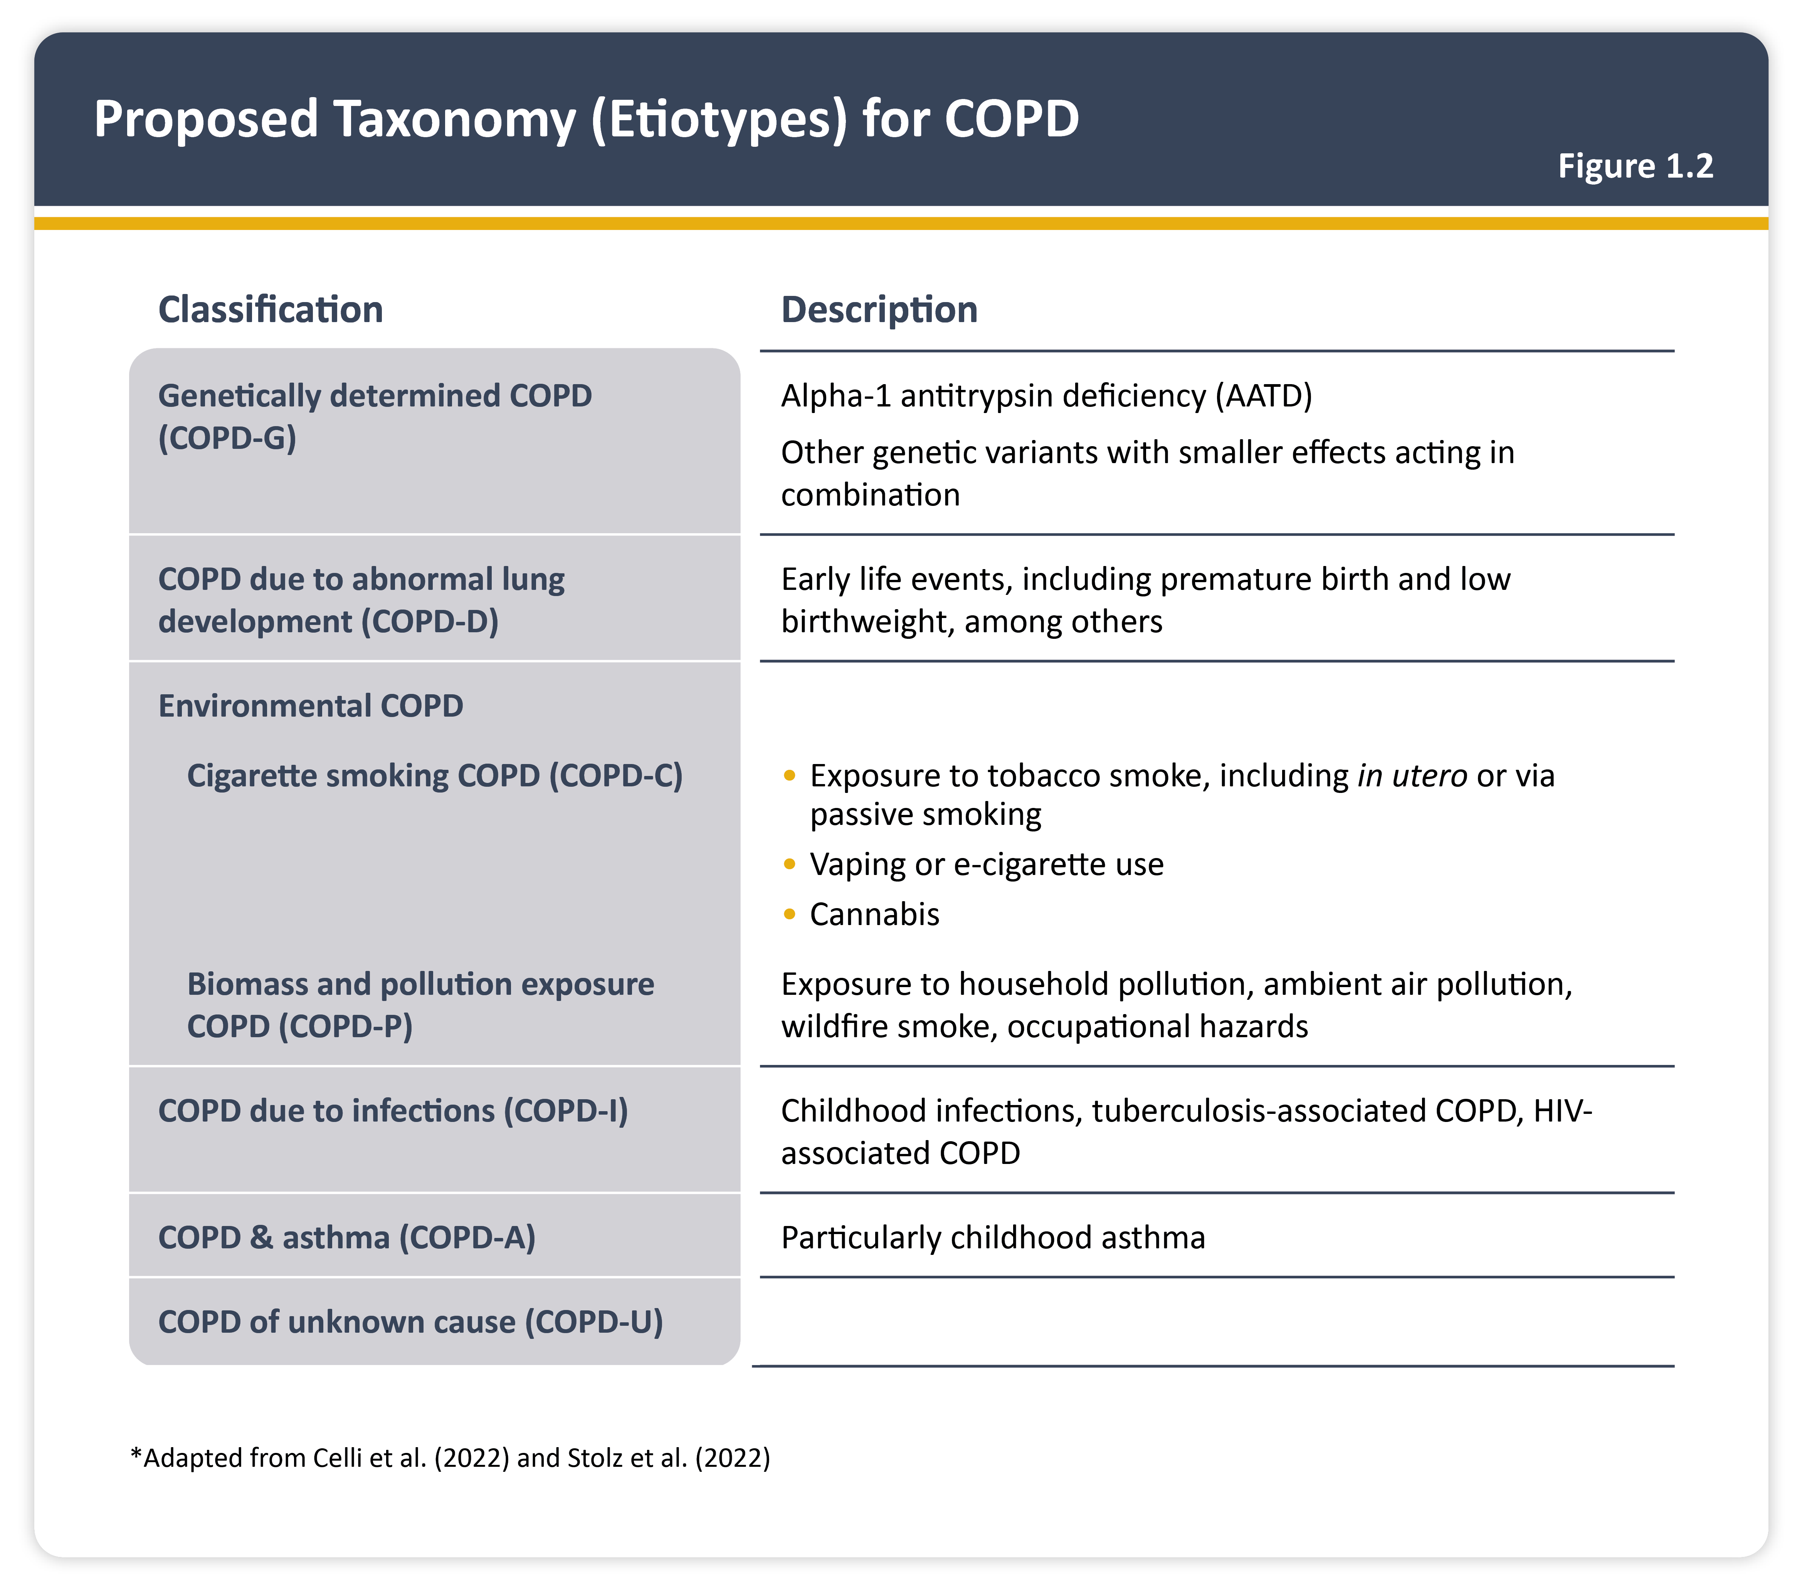
Teaching
Slide Set

Slide 5
Teaching
Slide Set

Slide 6
Teaching
Slide Set

Slide 7
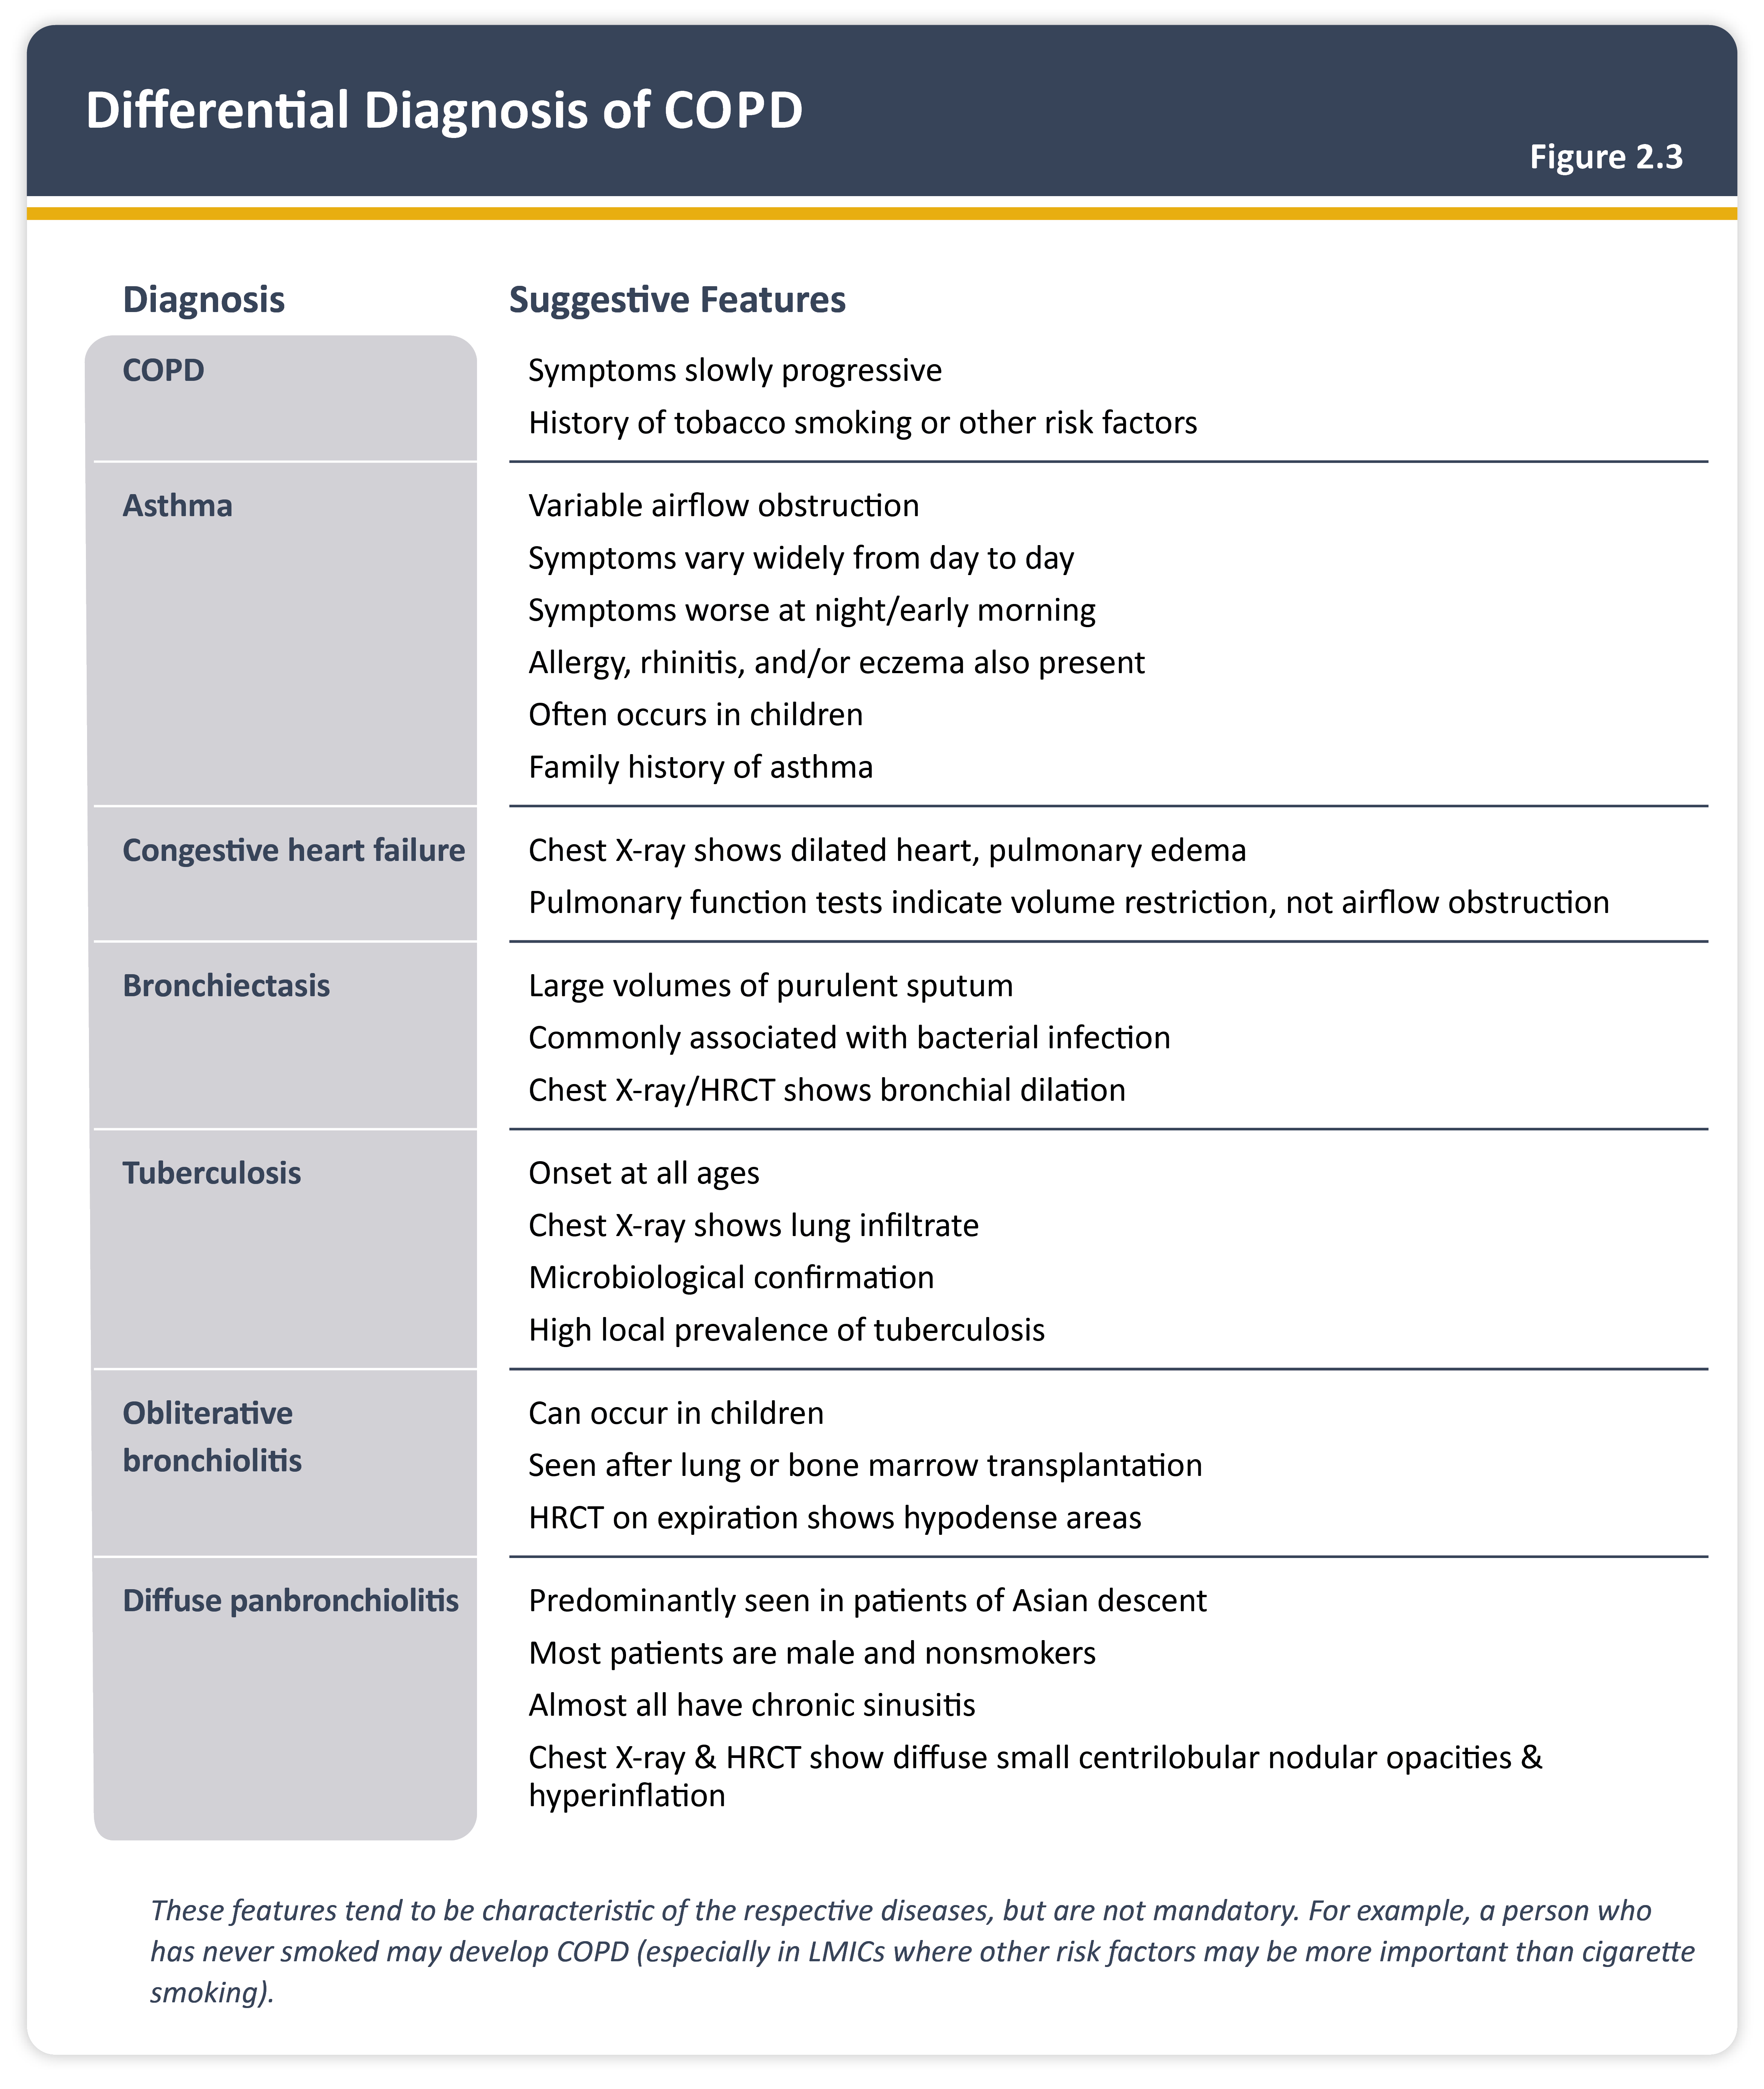
Teaching
Slide Set

Slide 8
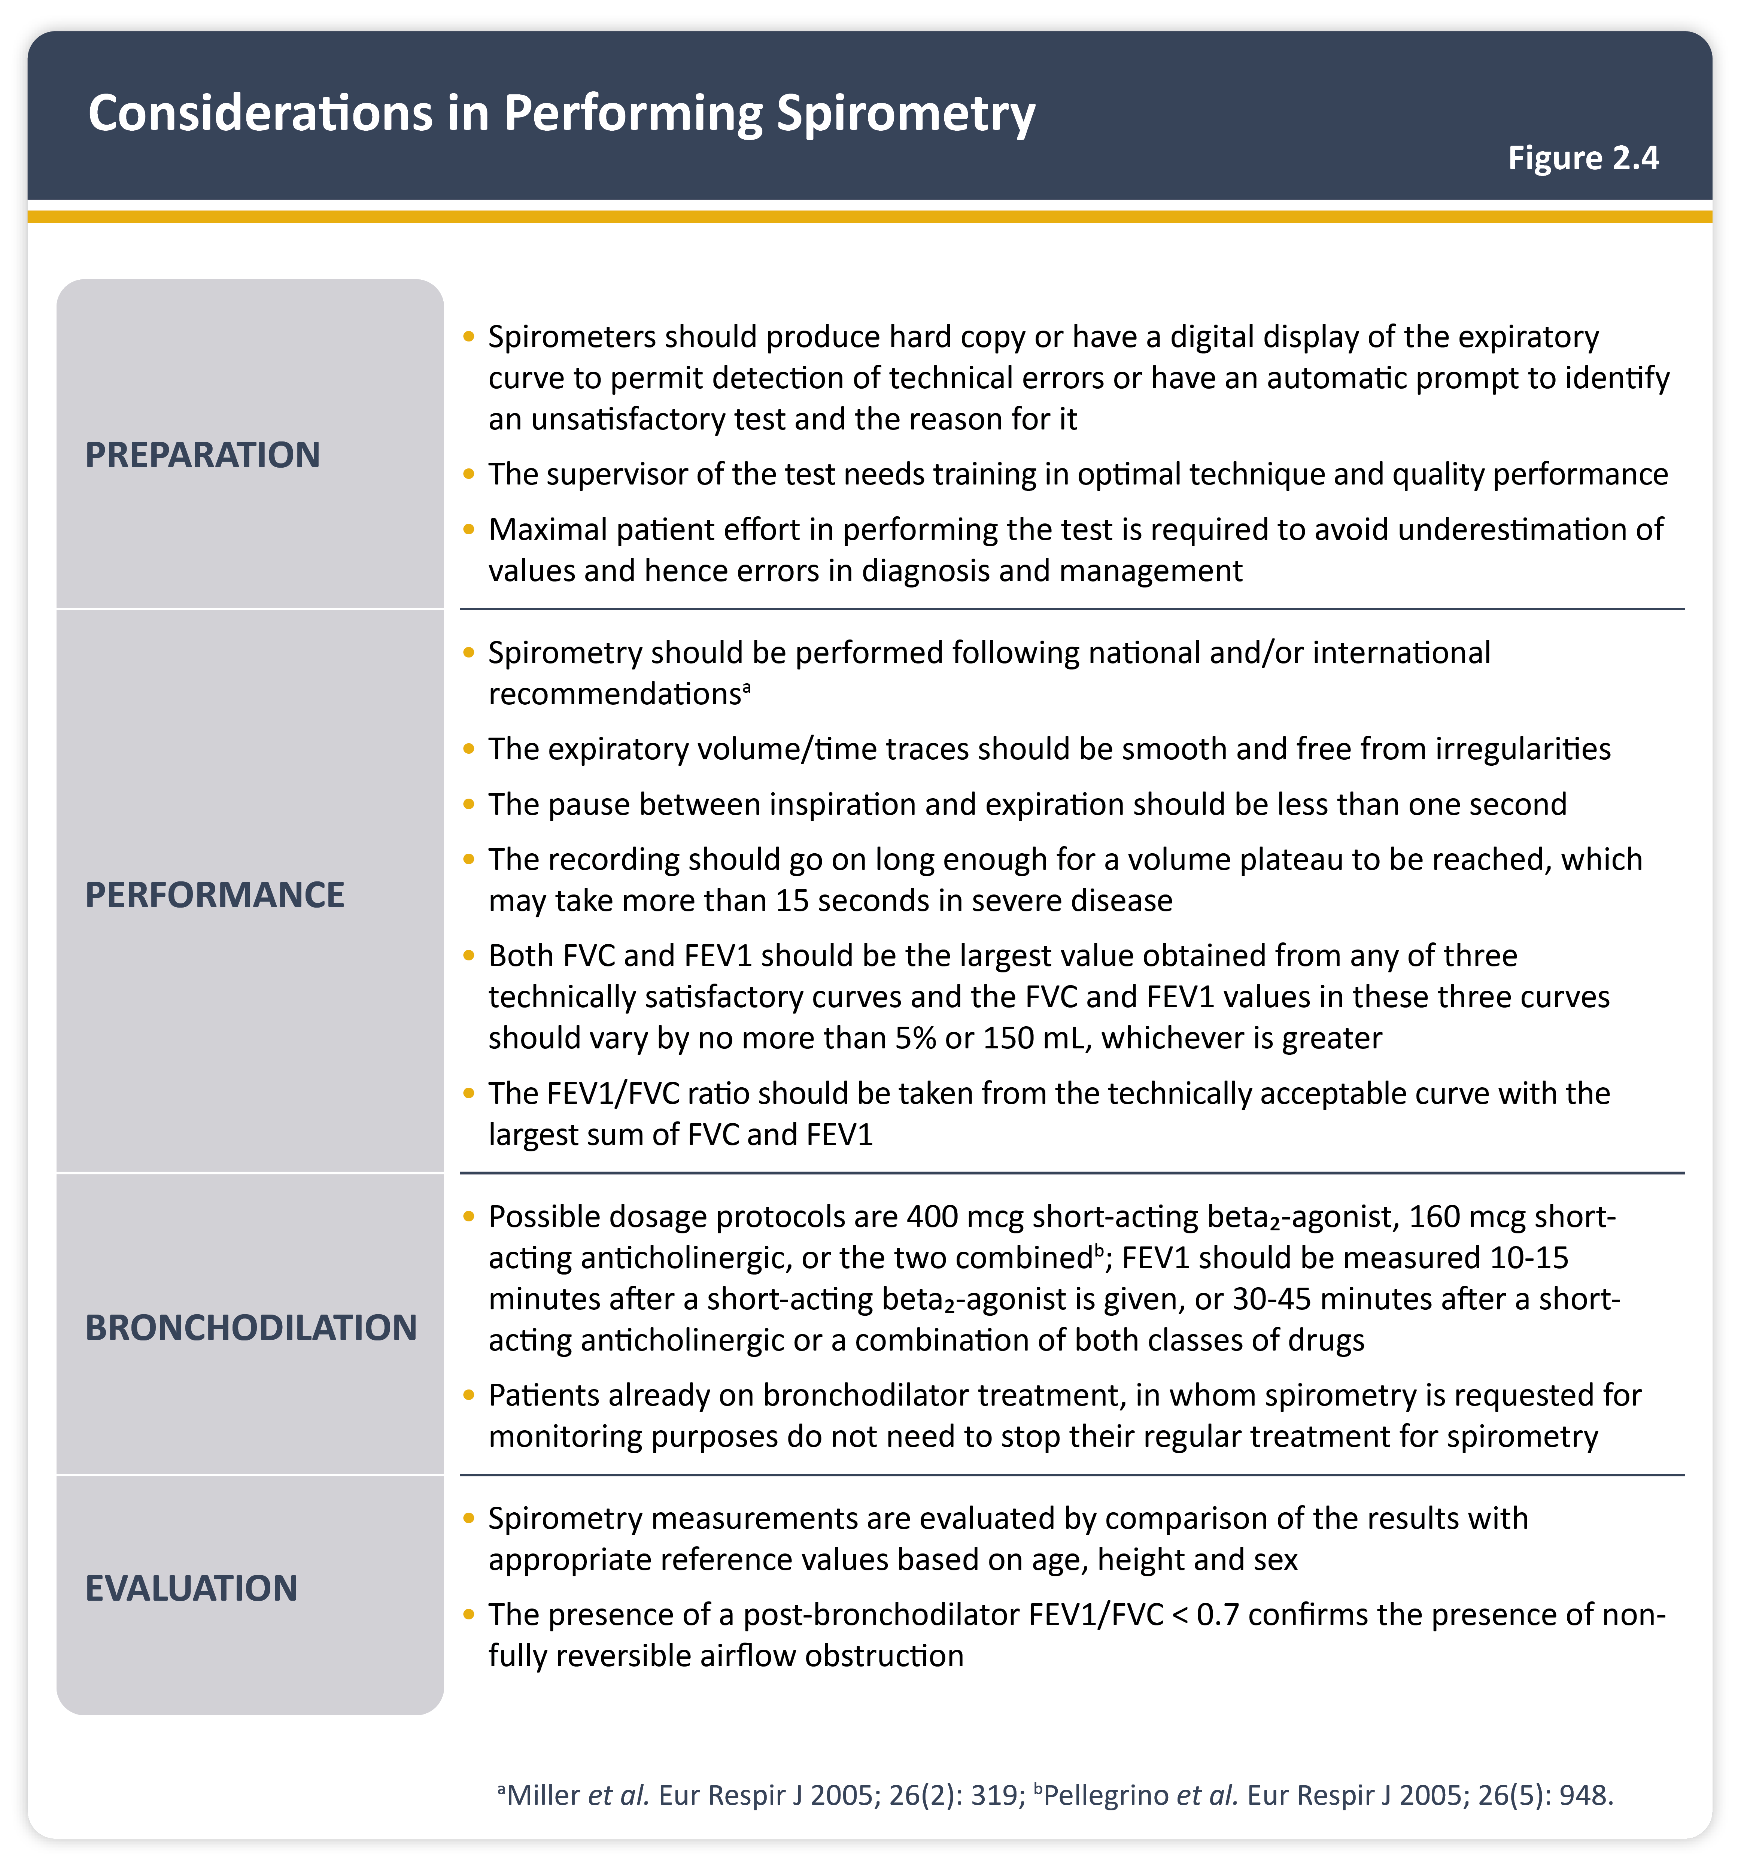
Teaching
Slide Set

Slide 9
Teaching
Slide Set

Slide 10
Teaching
Slide Set

Slide 11
Teaching
Slide Set

Slide 12
Teaching
Slide Set

Slide 13
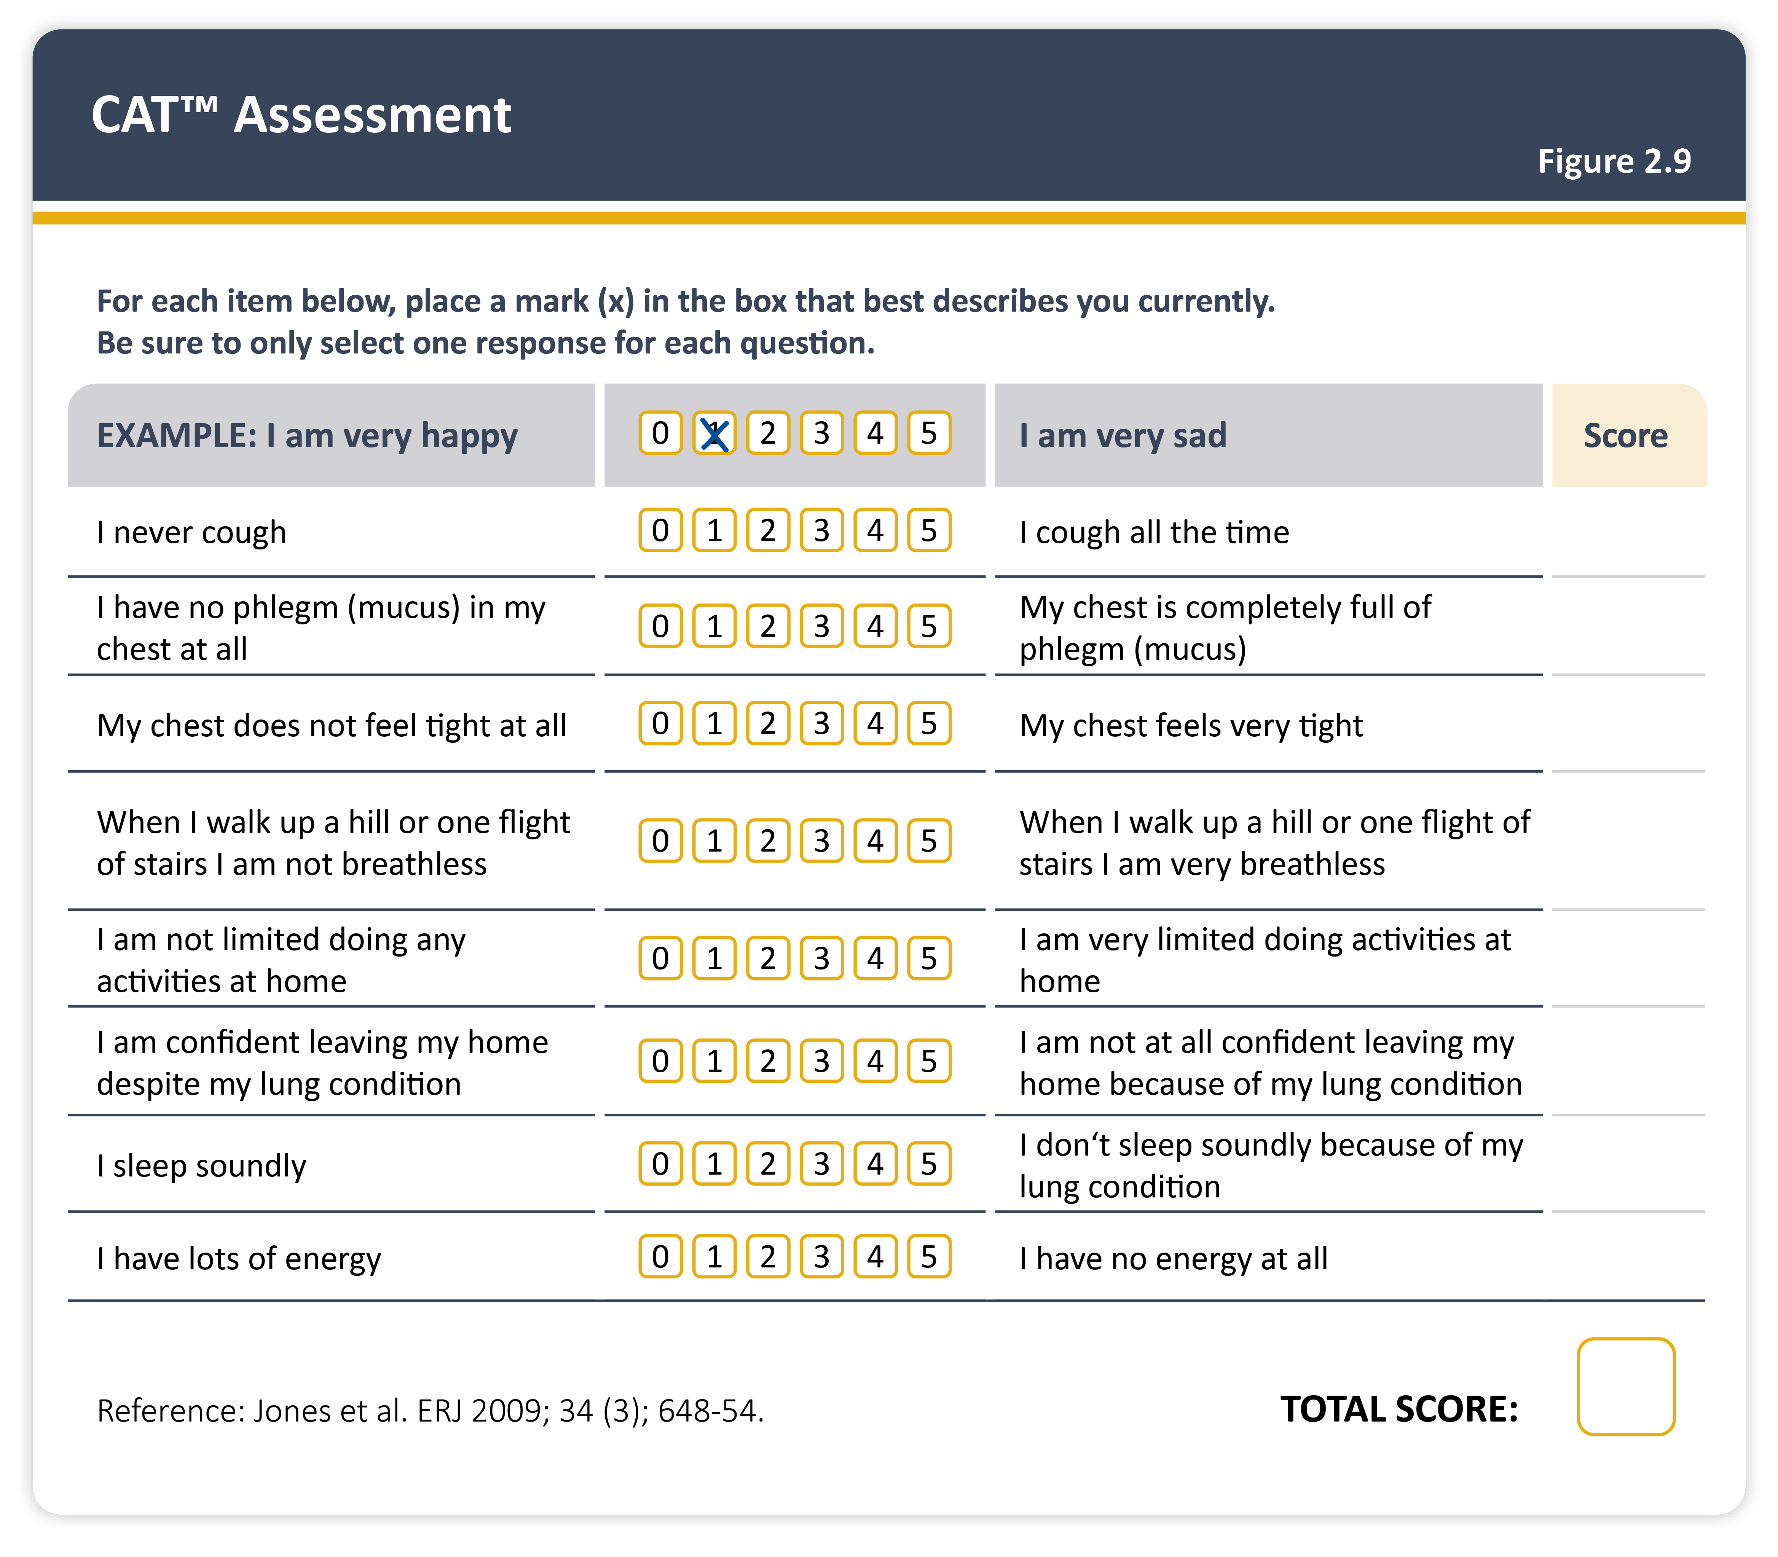
Teaching
Slide Set

Slide 14
Teaching
Slide Set

Slide 15
Teaching
Slide Set

Slide 16
Teaching
Slide Set

Slide 17
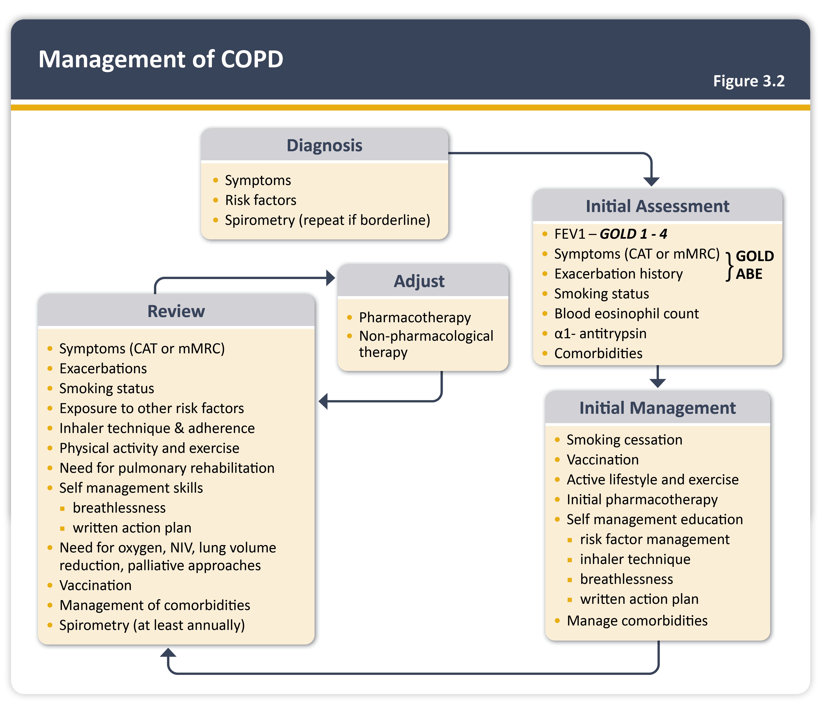
Teaching
Slide Set

Slide 18
Teaching
Slide Set

Slide 19
Teaching
Slide Set

Slide 20
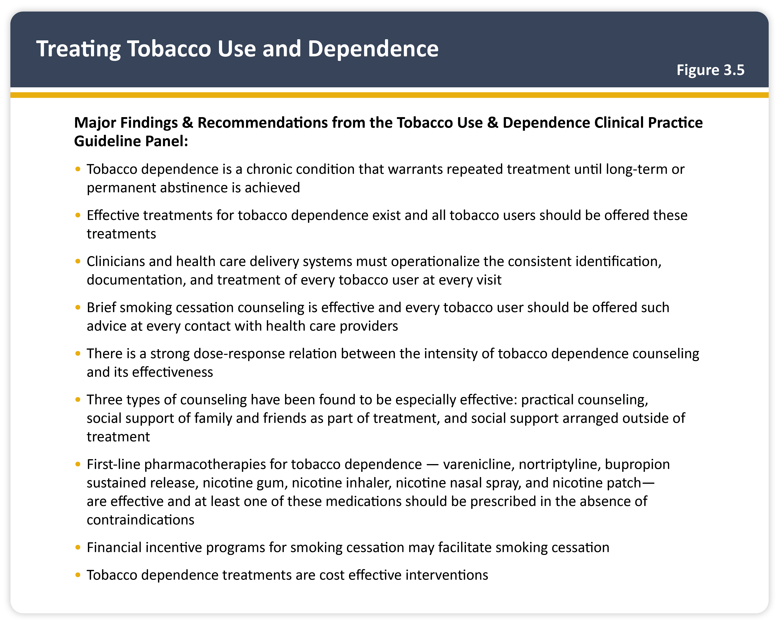
Teaching
Slide Set

Slide 21
Teaching
Slide Set

Slide 22
Teaching
Slide Set

Slide 23
Teaching
Slide Set

Slide 24
Teaching
Slide Set

Slide 25
Teaching
Slide Set

Slide 26
Teaching
Slide Set

Slide 27
Teaching
Slide Set

Slide 28
Teaching
Slide Set

Slide 29
Teaching
Slide Set

Slide 30
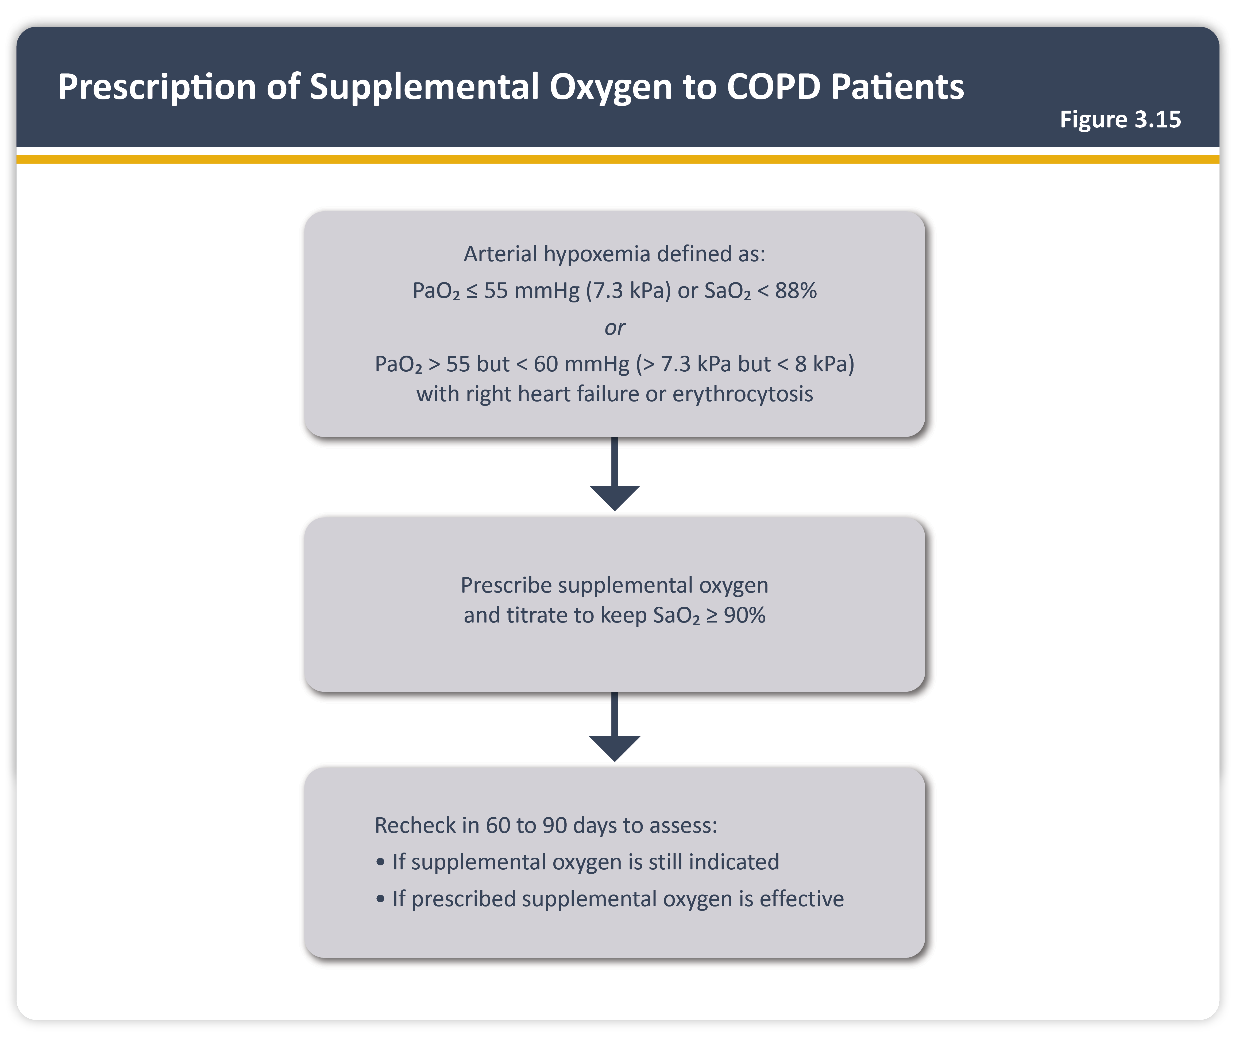
Teaching
Slide Set

Slide 31
Teaching
Slide Set

Slide 32
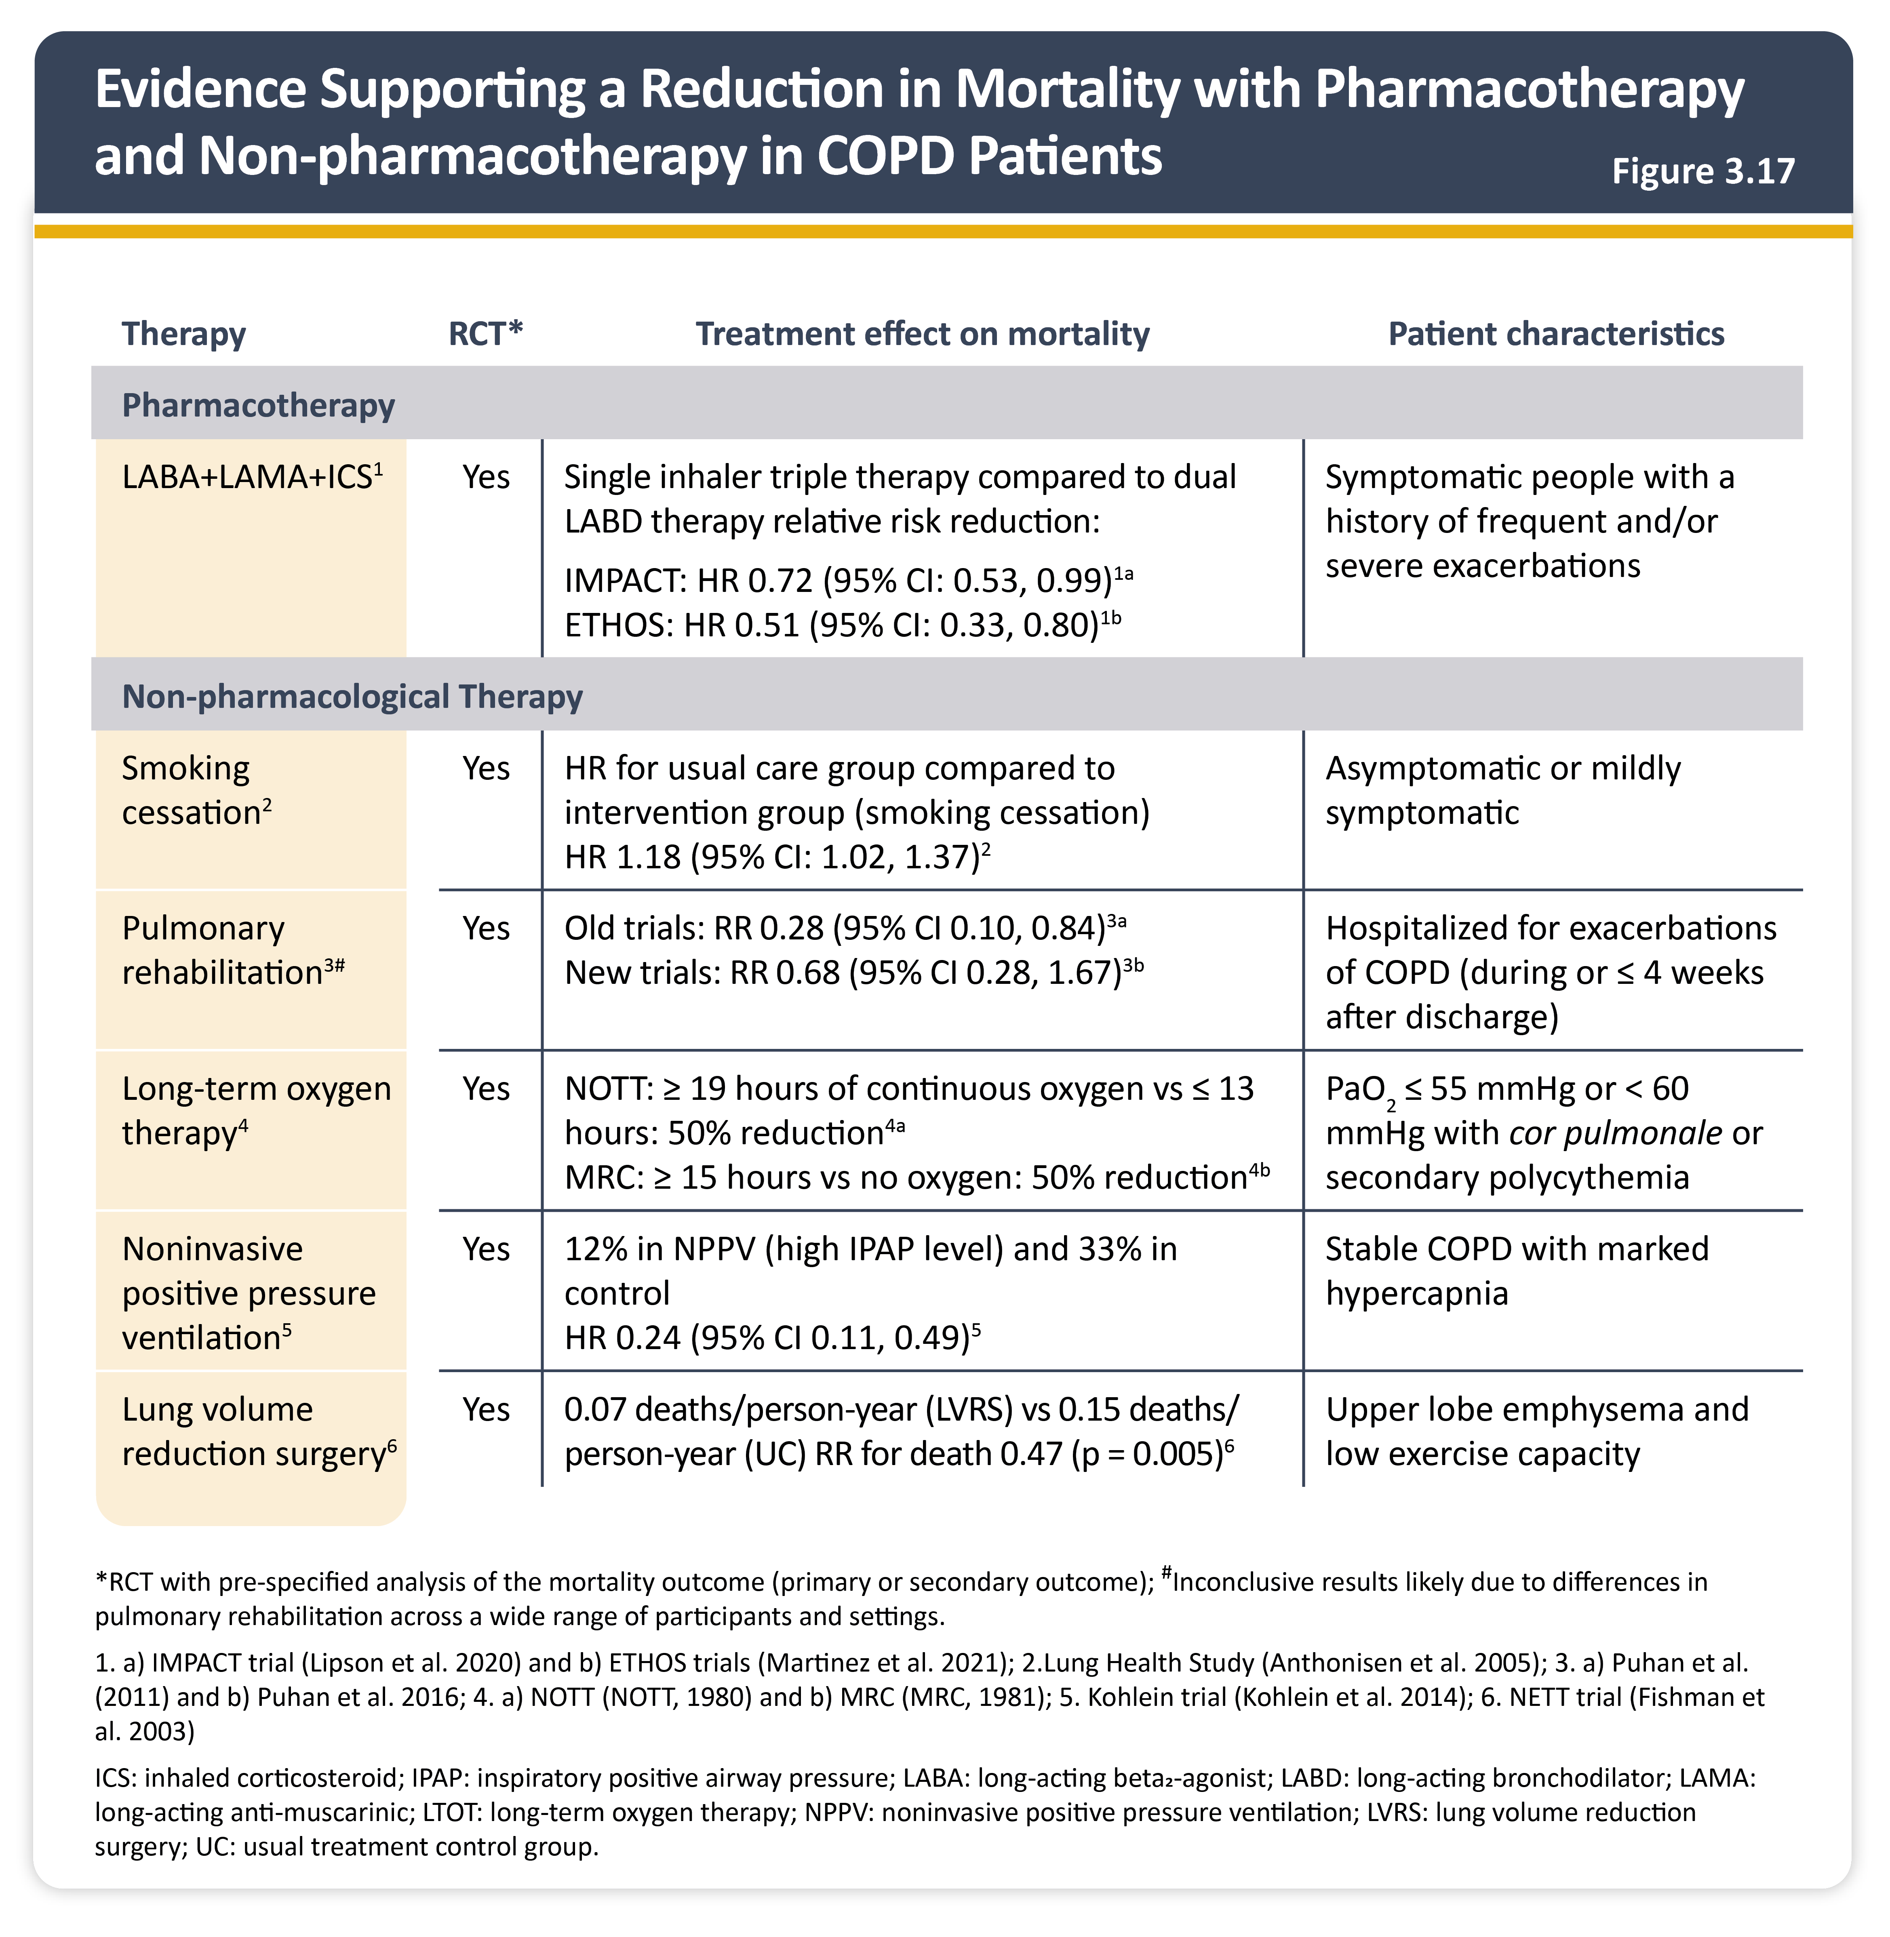
Teaching
Slide Set

Slide 33
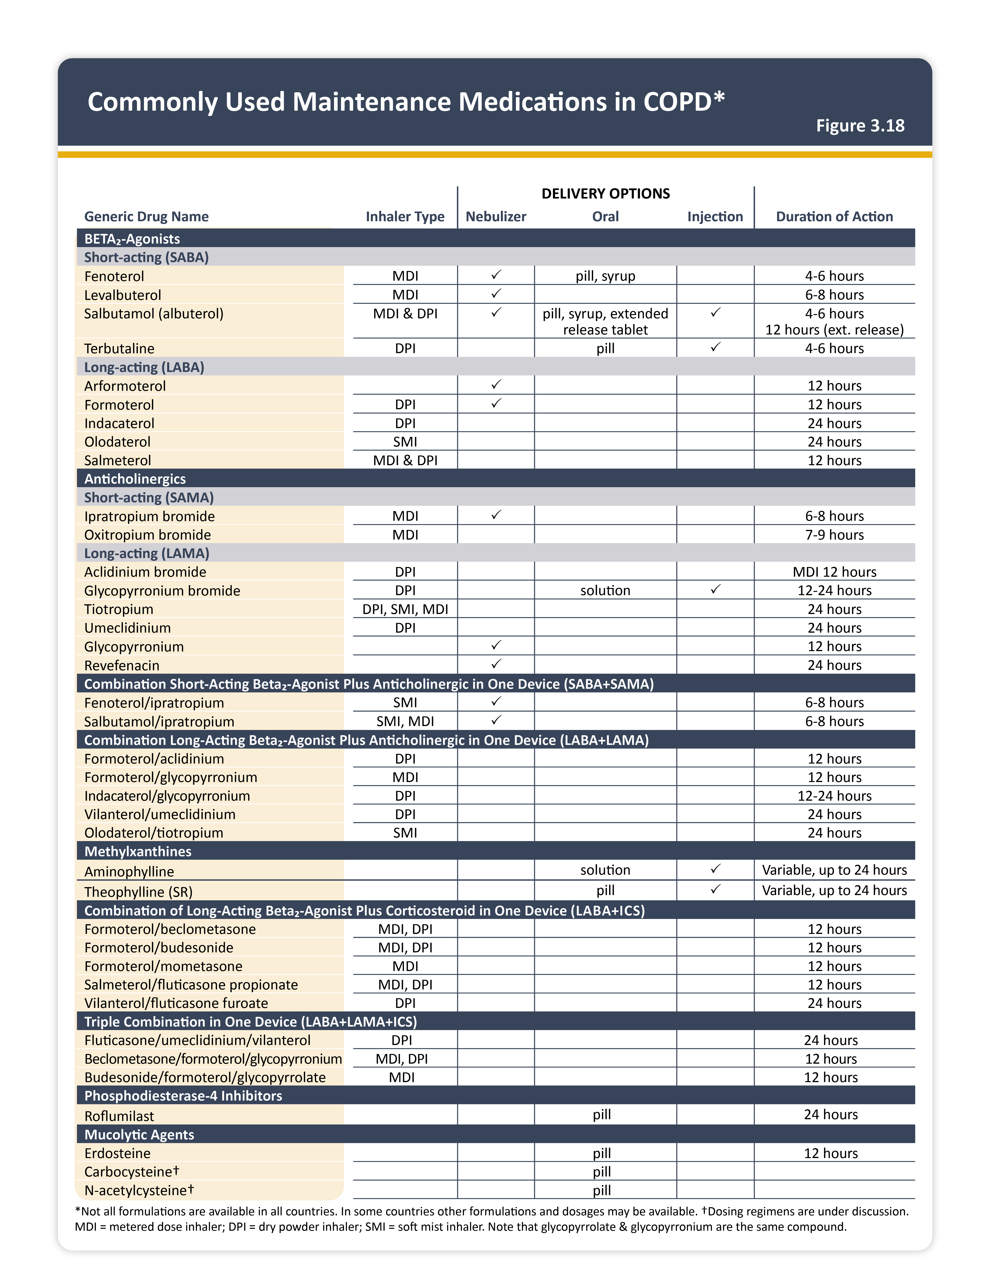
Teaching
Slide Set

Slide 34
Teaching
Slide Set

Slide 35
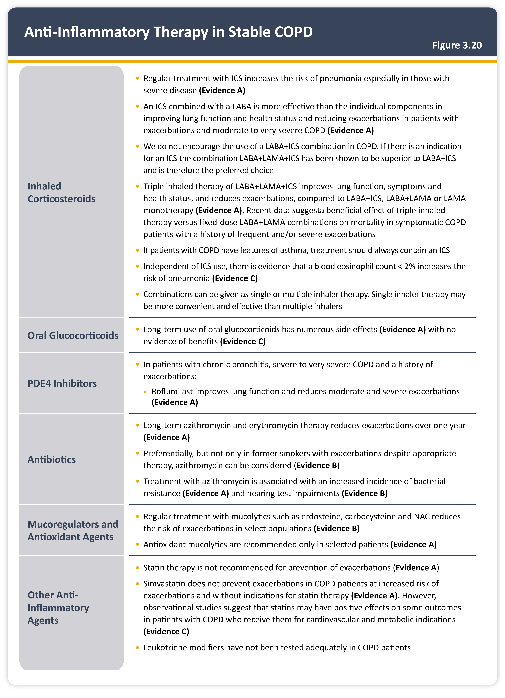
Teaching
Slide Set

Slide 36
Teaching
Slide Set

Slide 37
Teaching
Slide Set

Slide 38
Teaching
Slide Set

Slide 39
Teaching
Slide Set

Slide 40
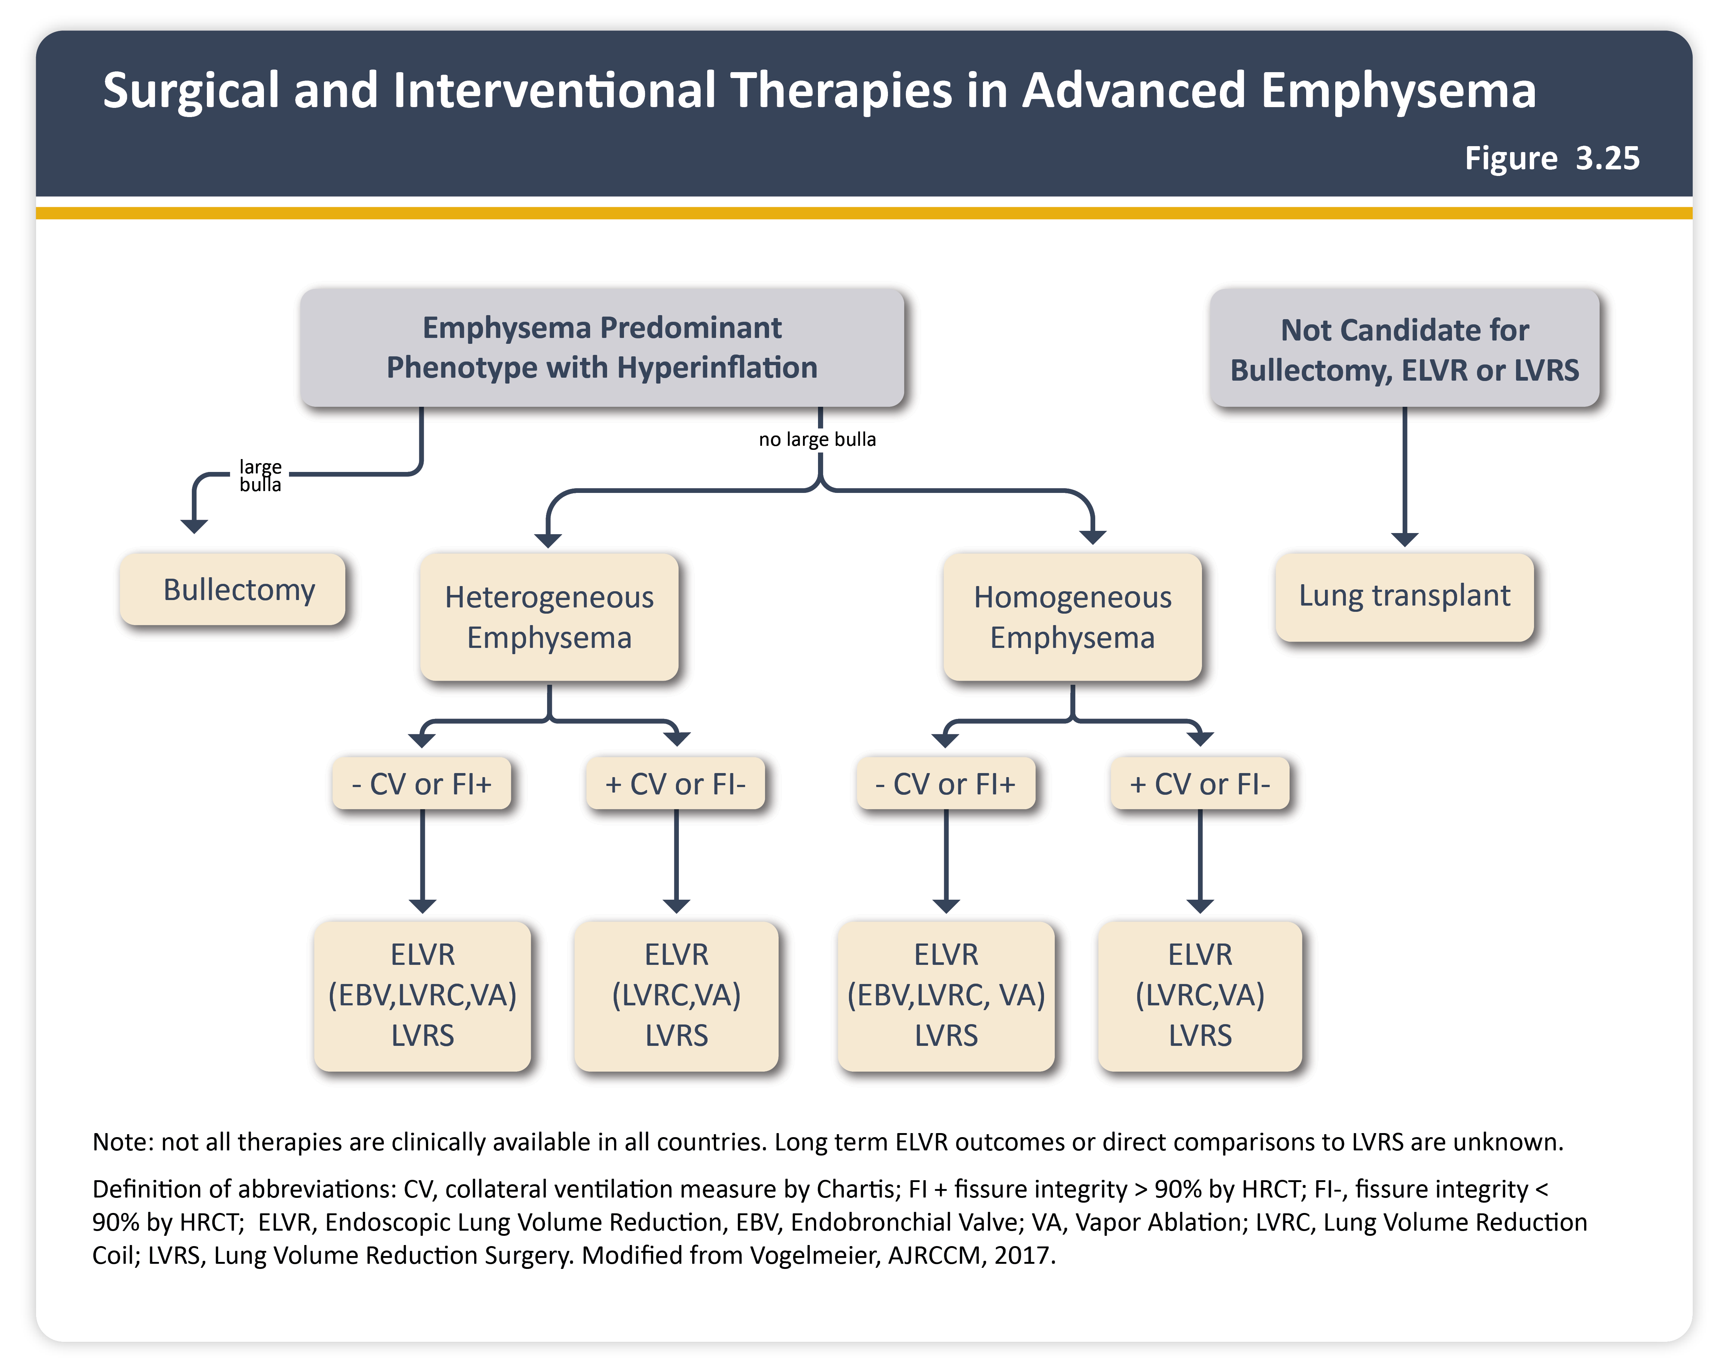
Teaching
Slide Set

Slide 41
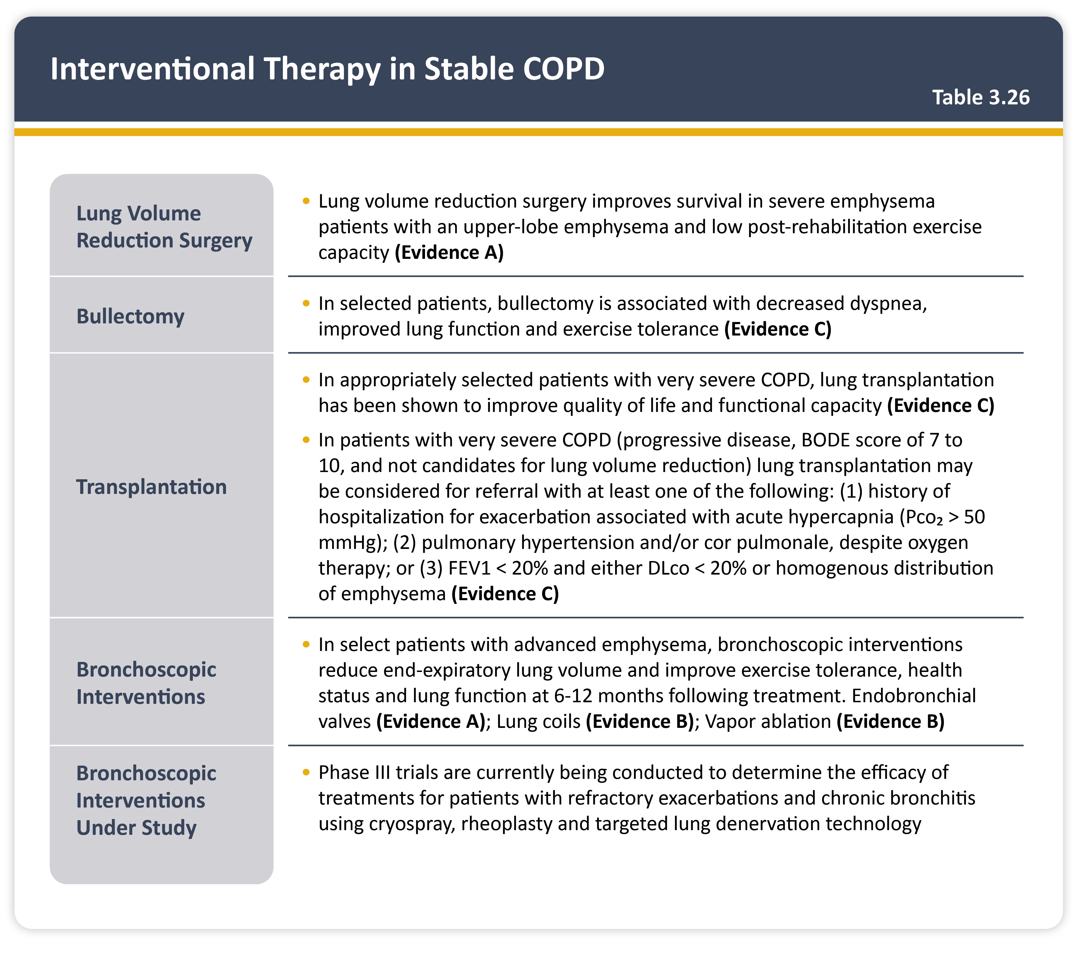
Teaching
Slide Set

Slide 42
Teaching
Slide Set

Slide 43
Teaching
Slide Set

Slide 44
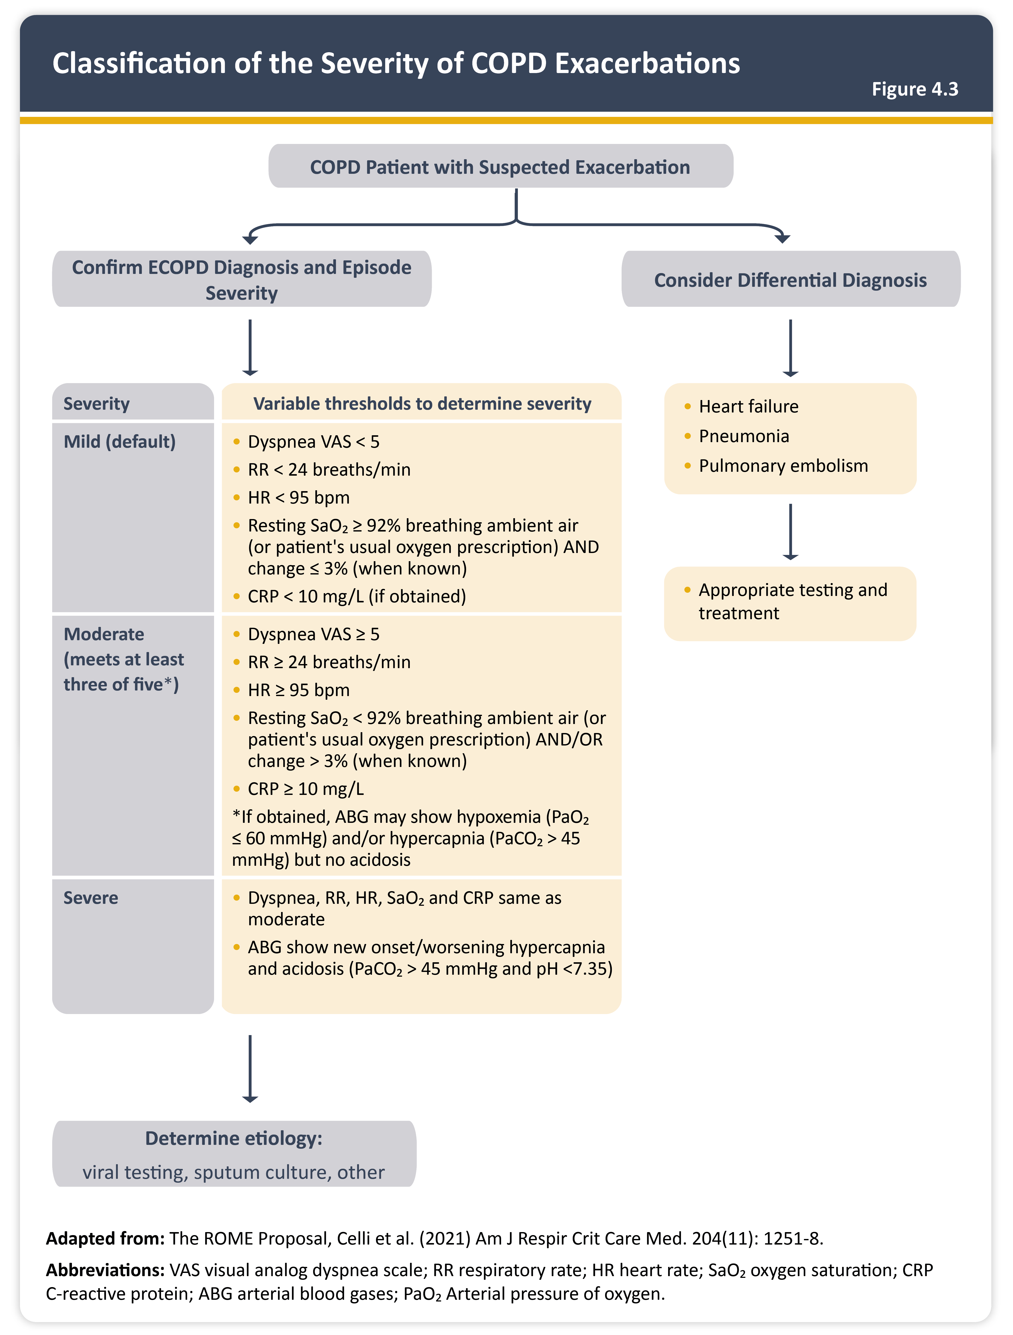
Teaching
Slide Set

Slide 45
Teaching
Slide Set

Slide 46
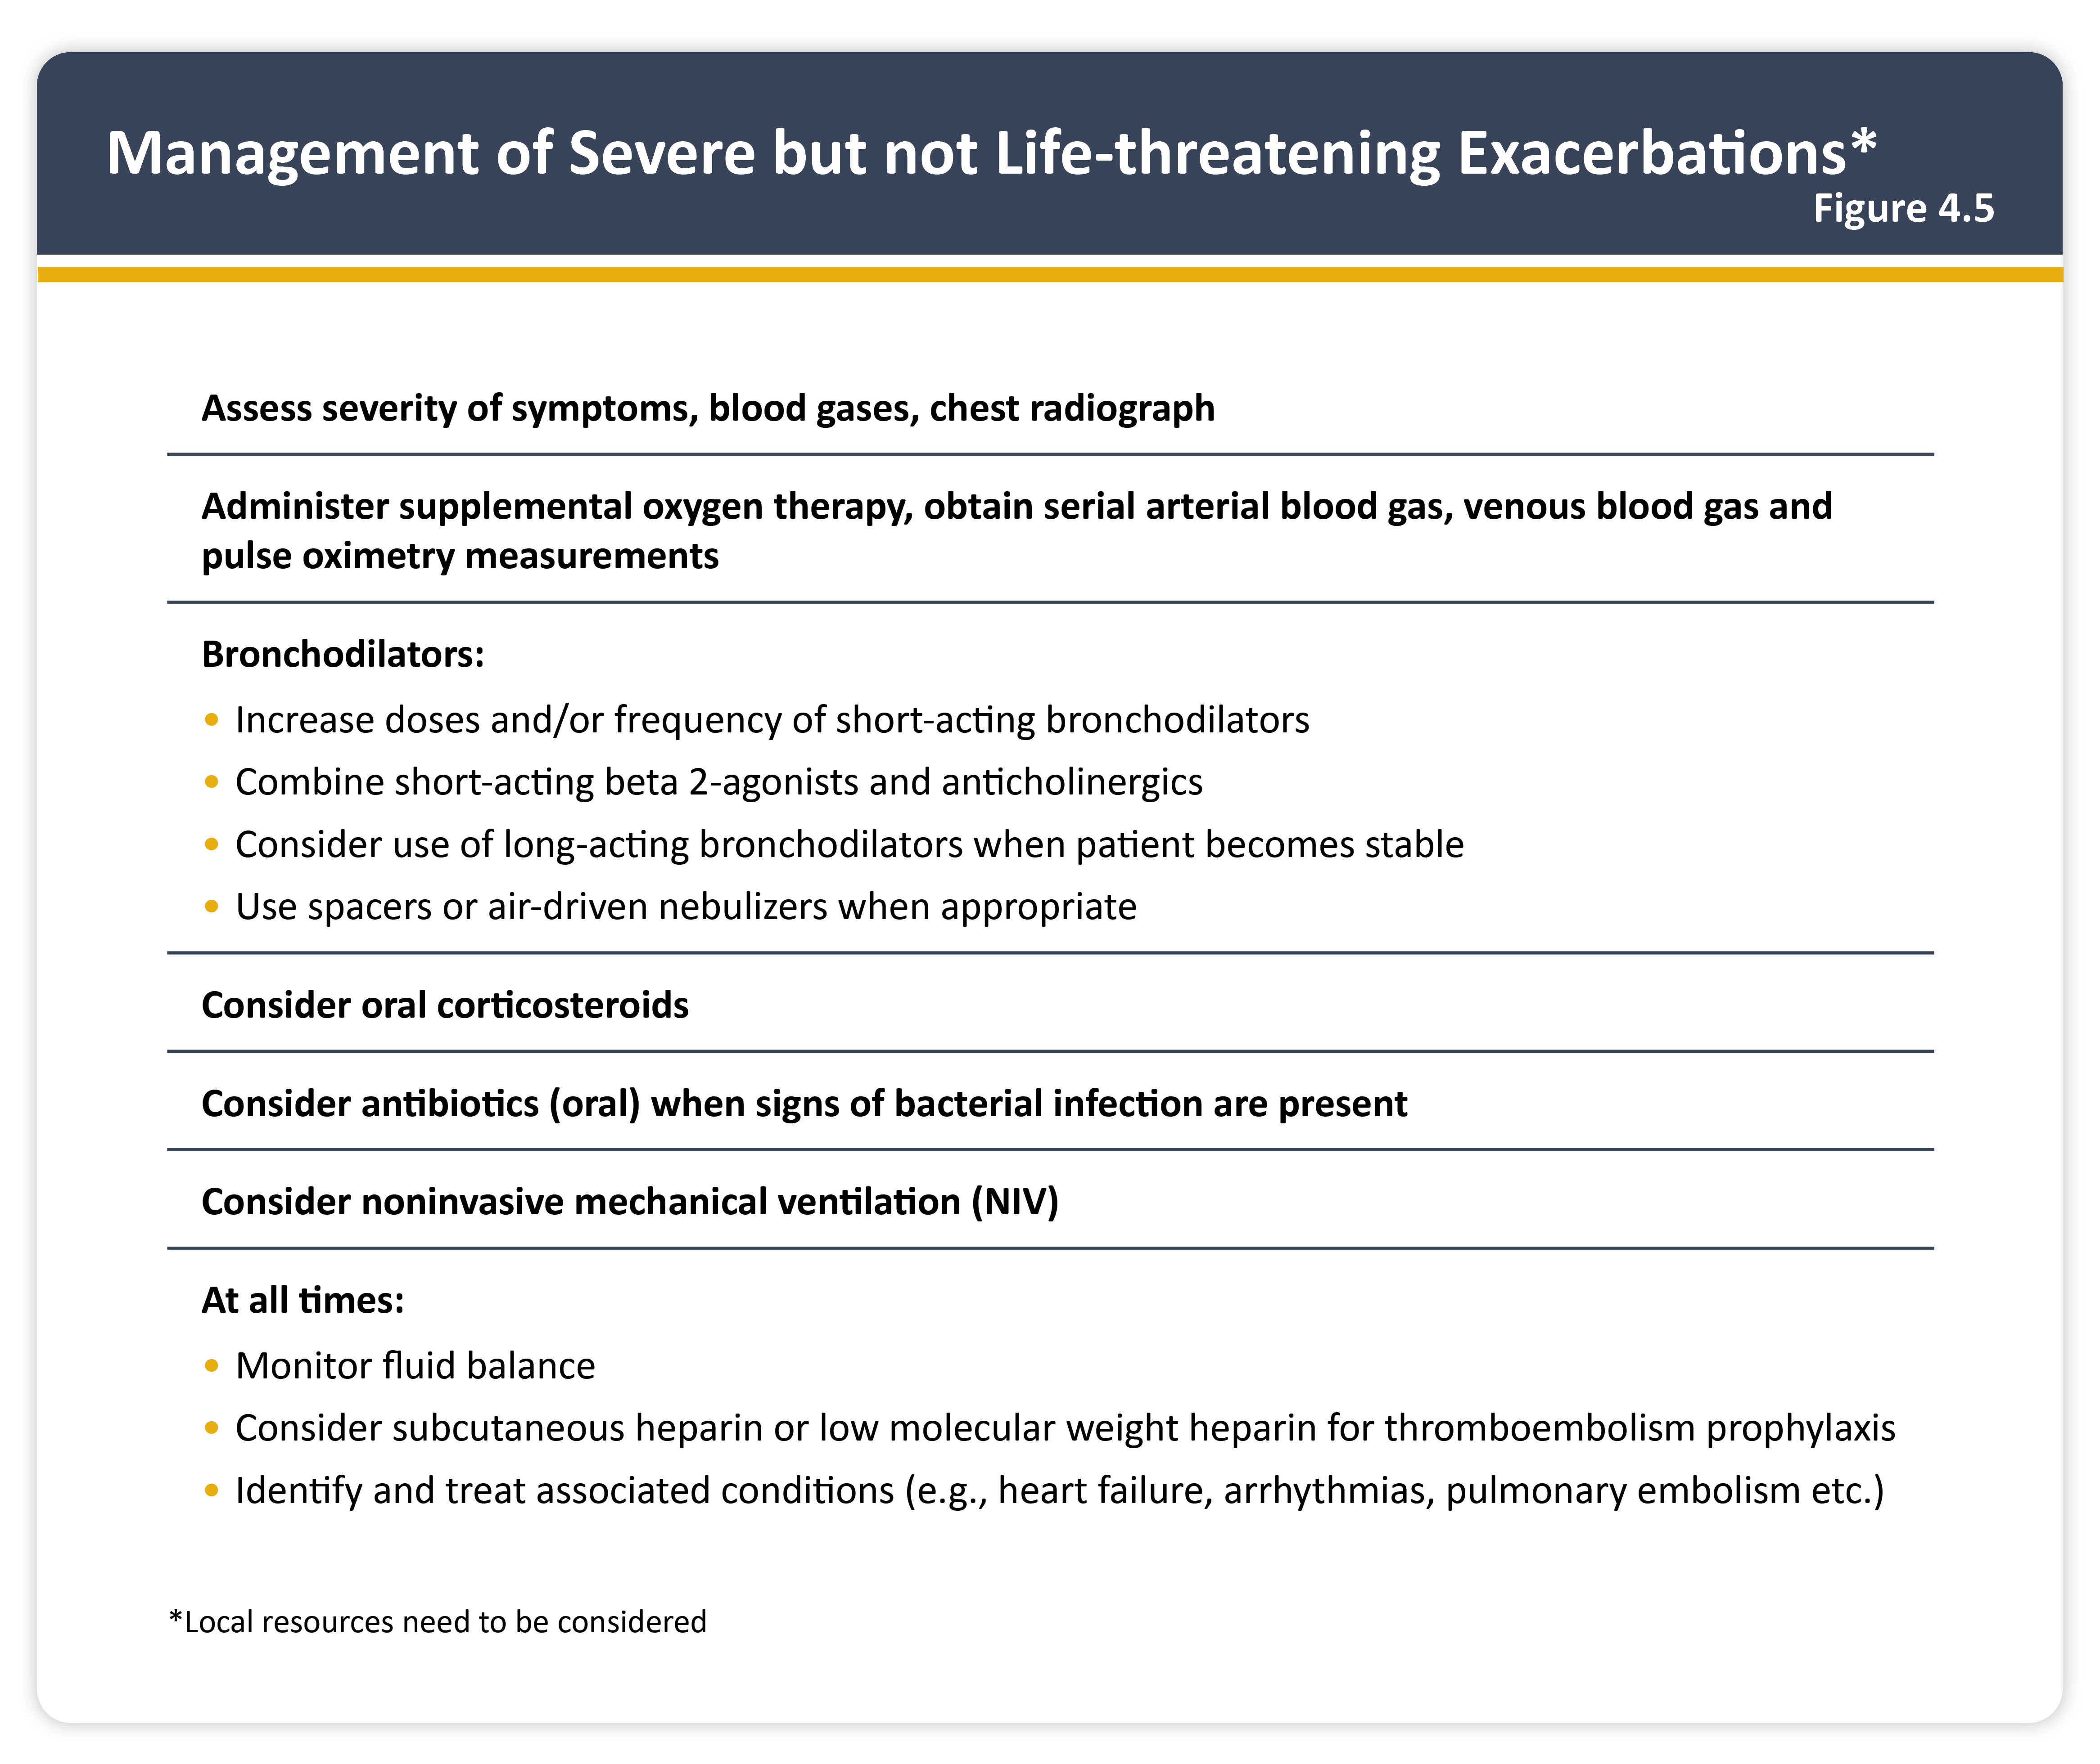
Teaching
Slide Set

Slide 47
Teaching
Slide Set

Slide 48
Teaching
Slide Set

Slide 49
Teaching
Slide Set

Slide 50
Teaching
Slide Set

Slide 51
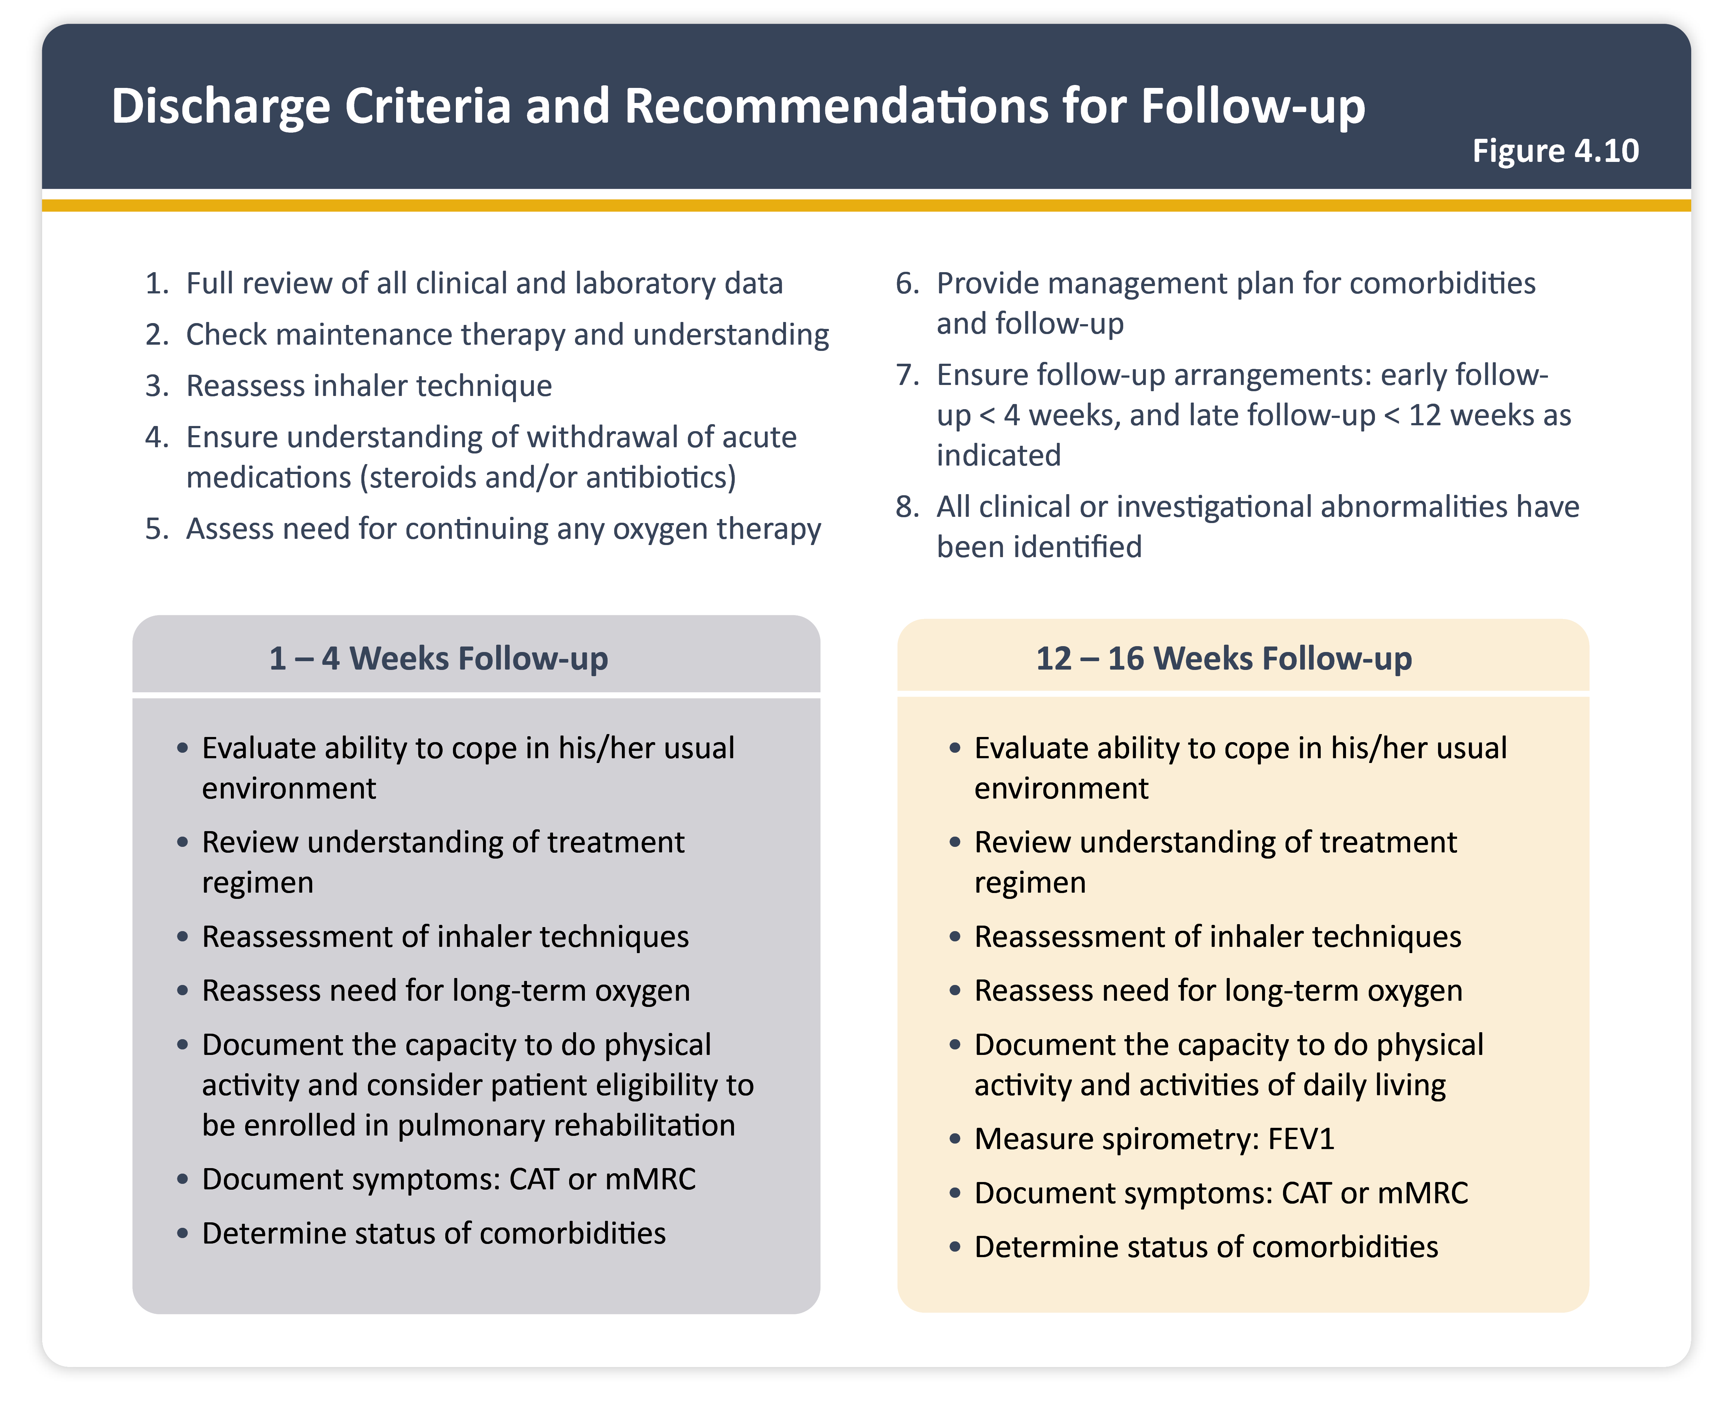
Teaching
Slide Set

Slide 52
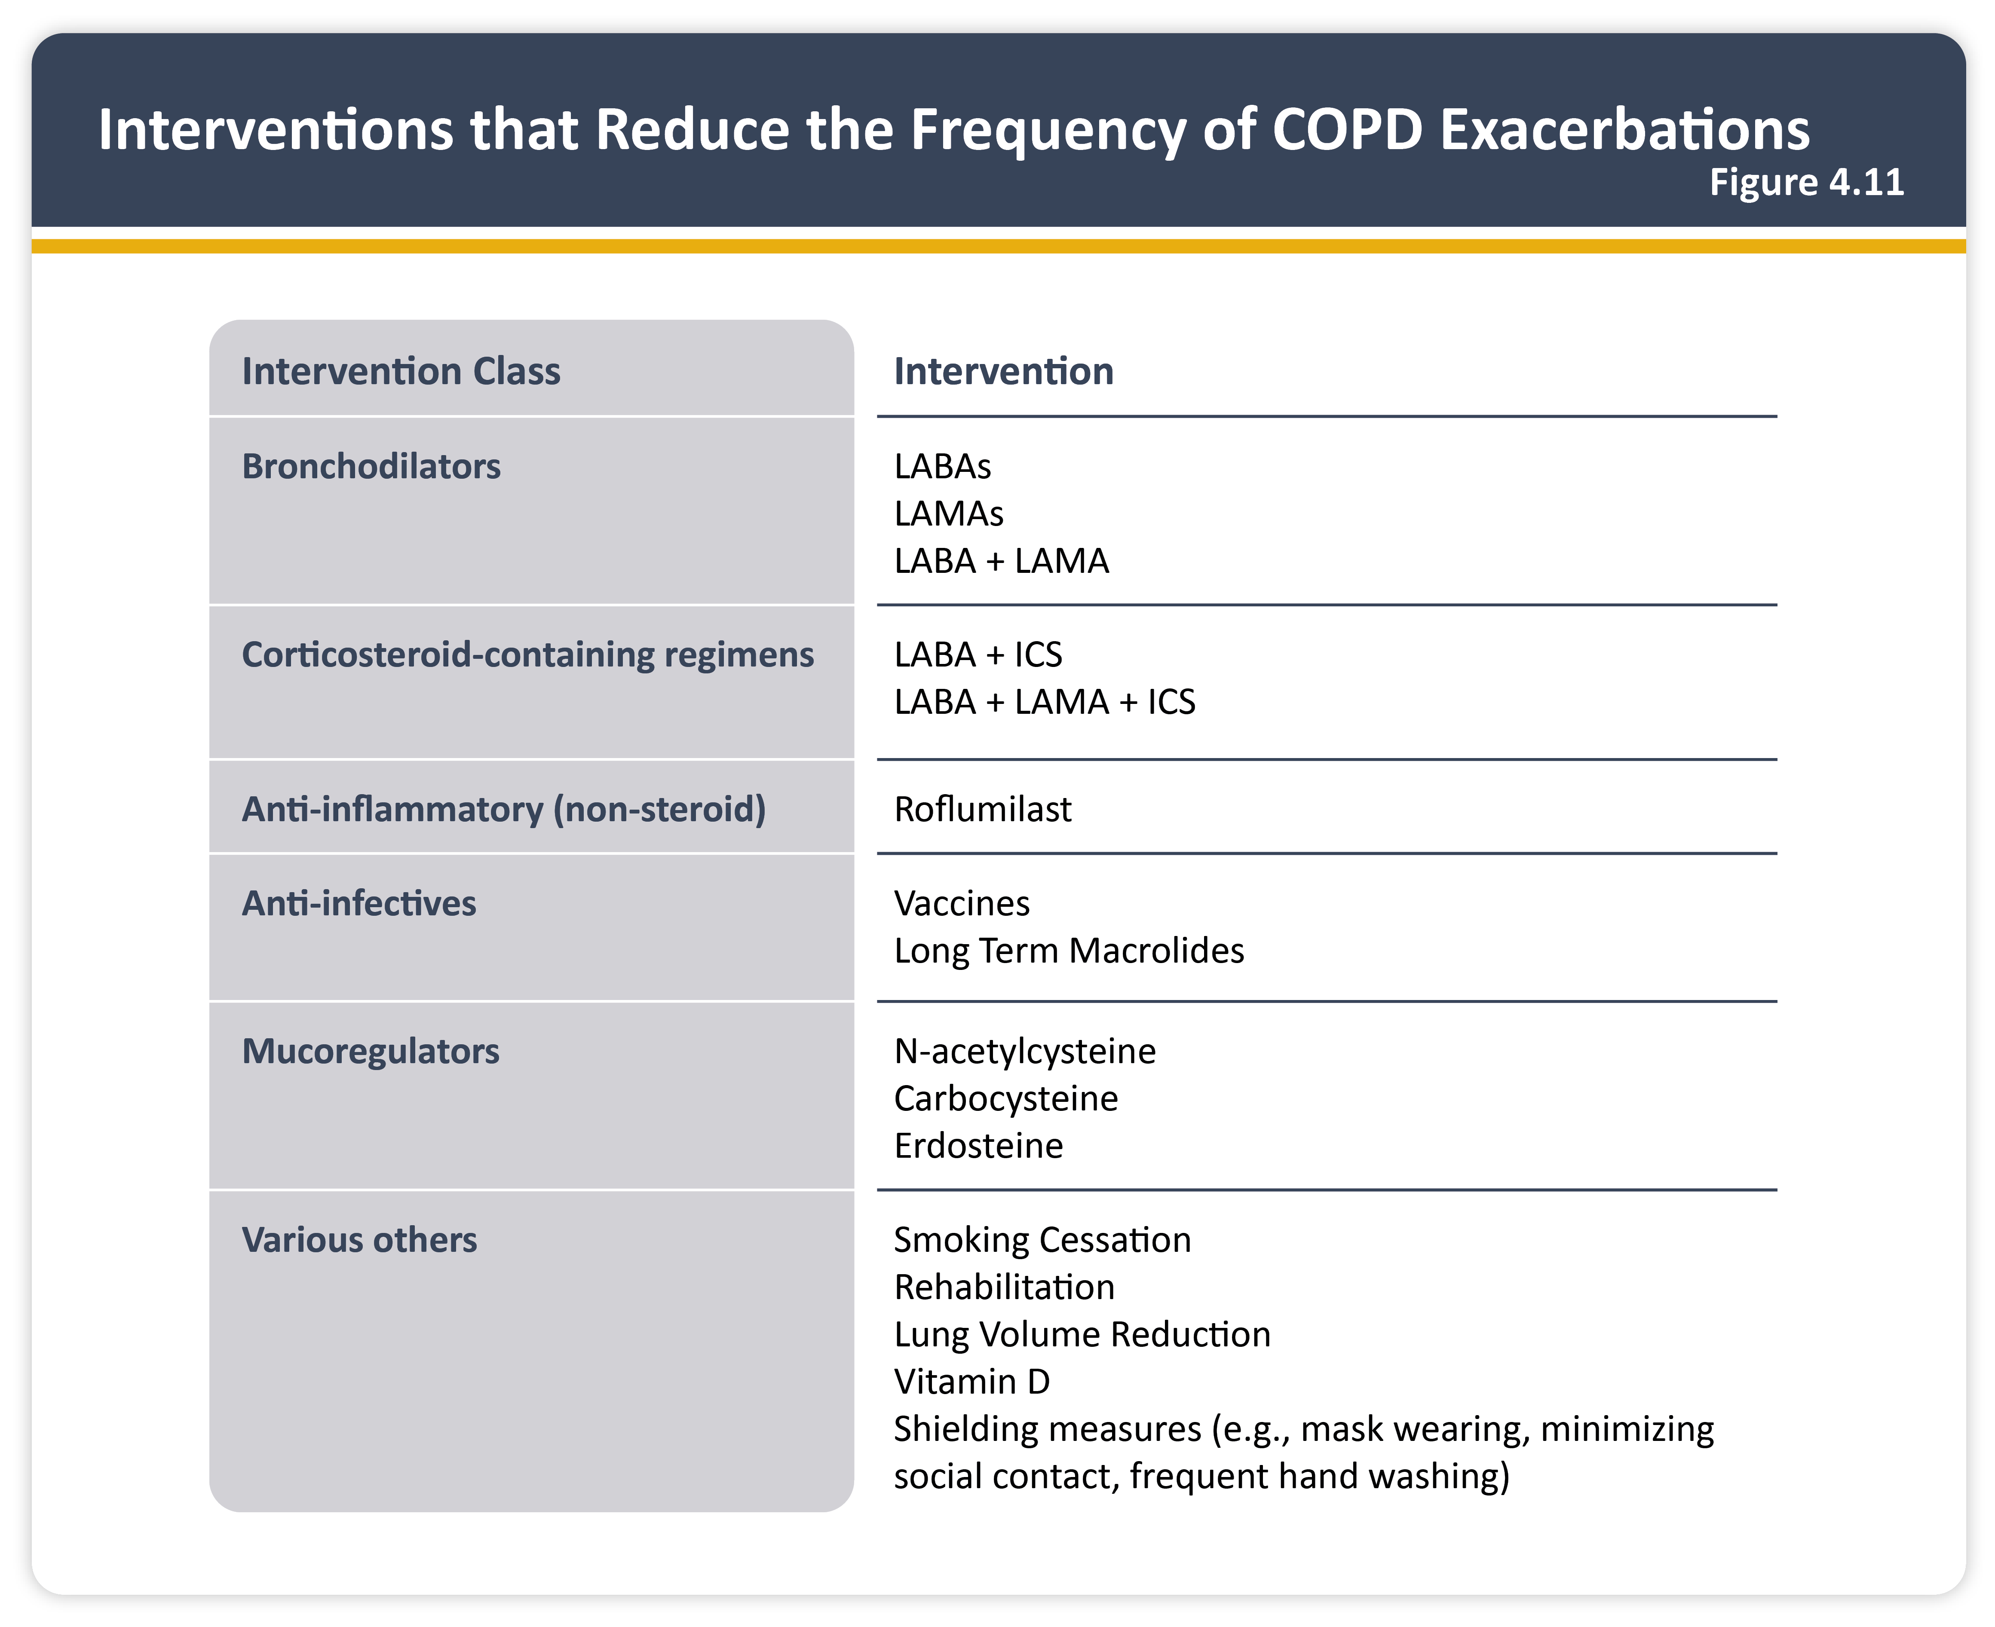
Teaching
Slide Set

Slide 53
Teaching
Slide Set

Slide 54
Teaching
Slide Set

Slide 55
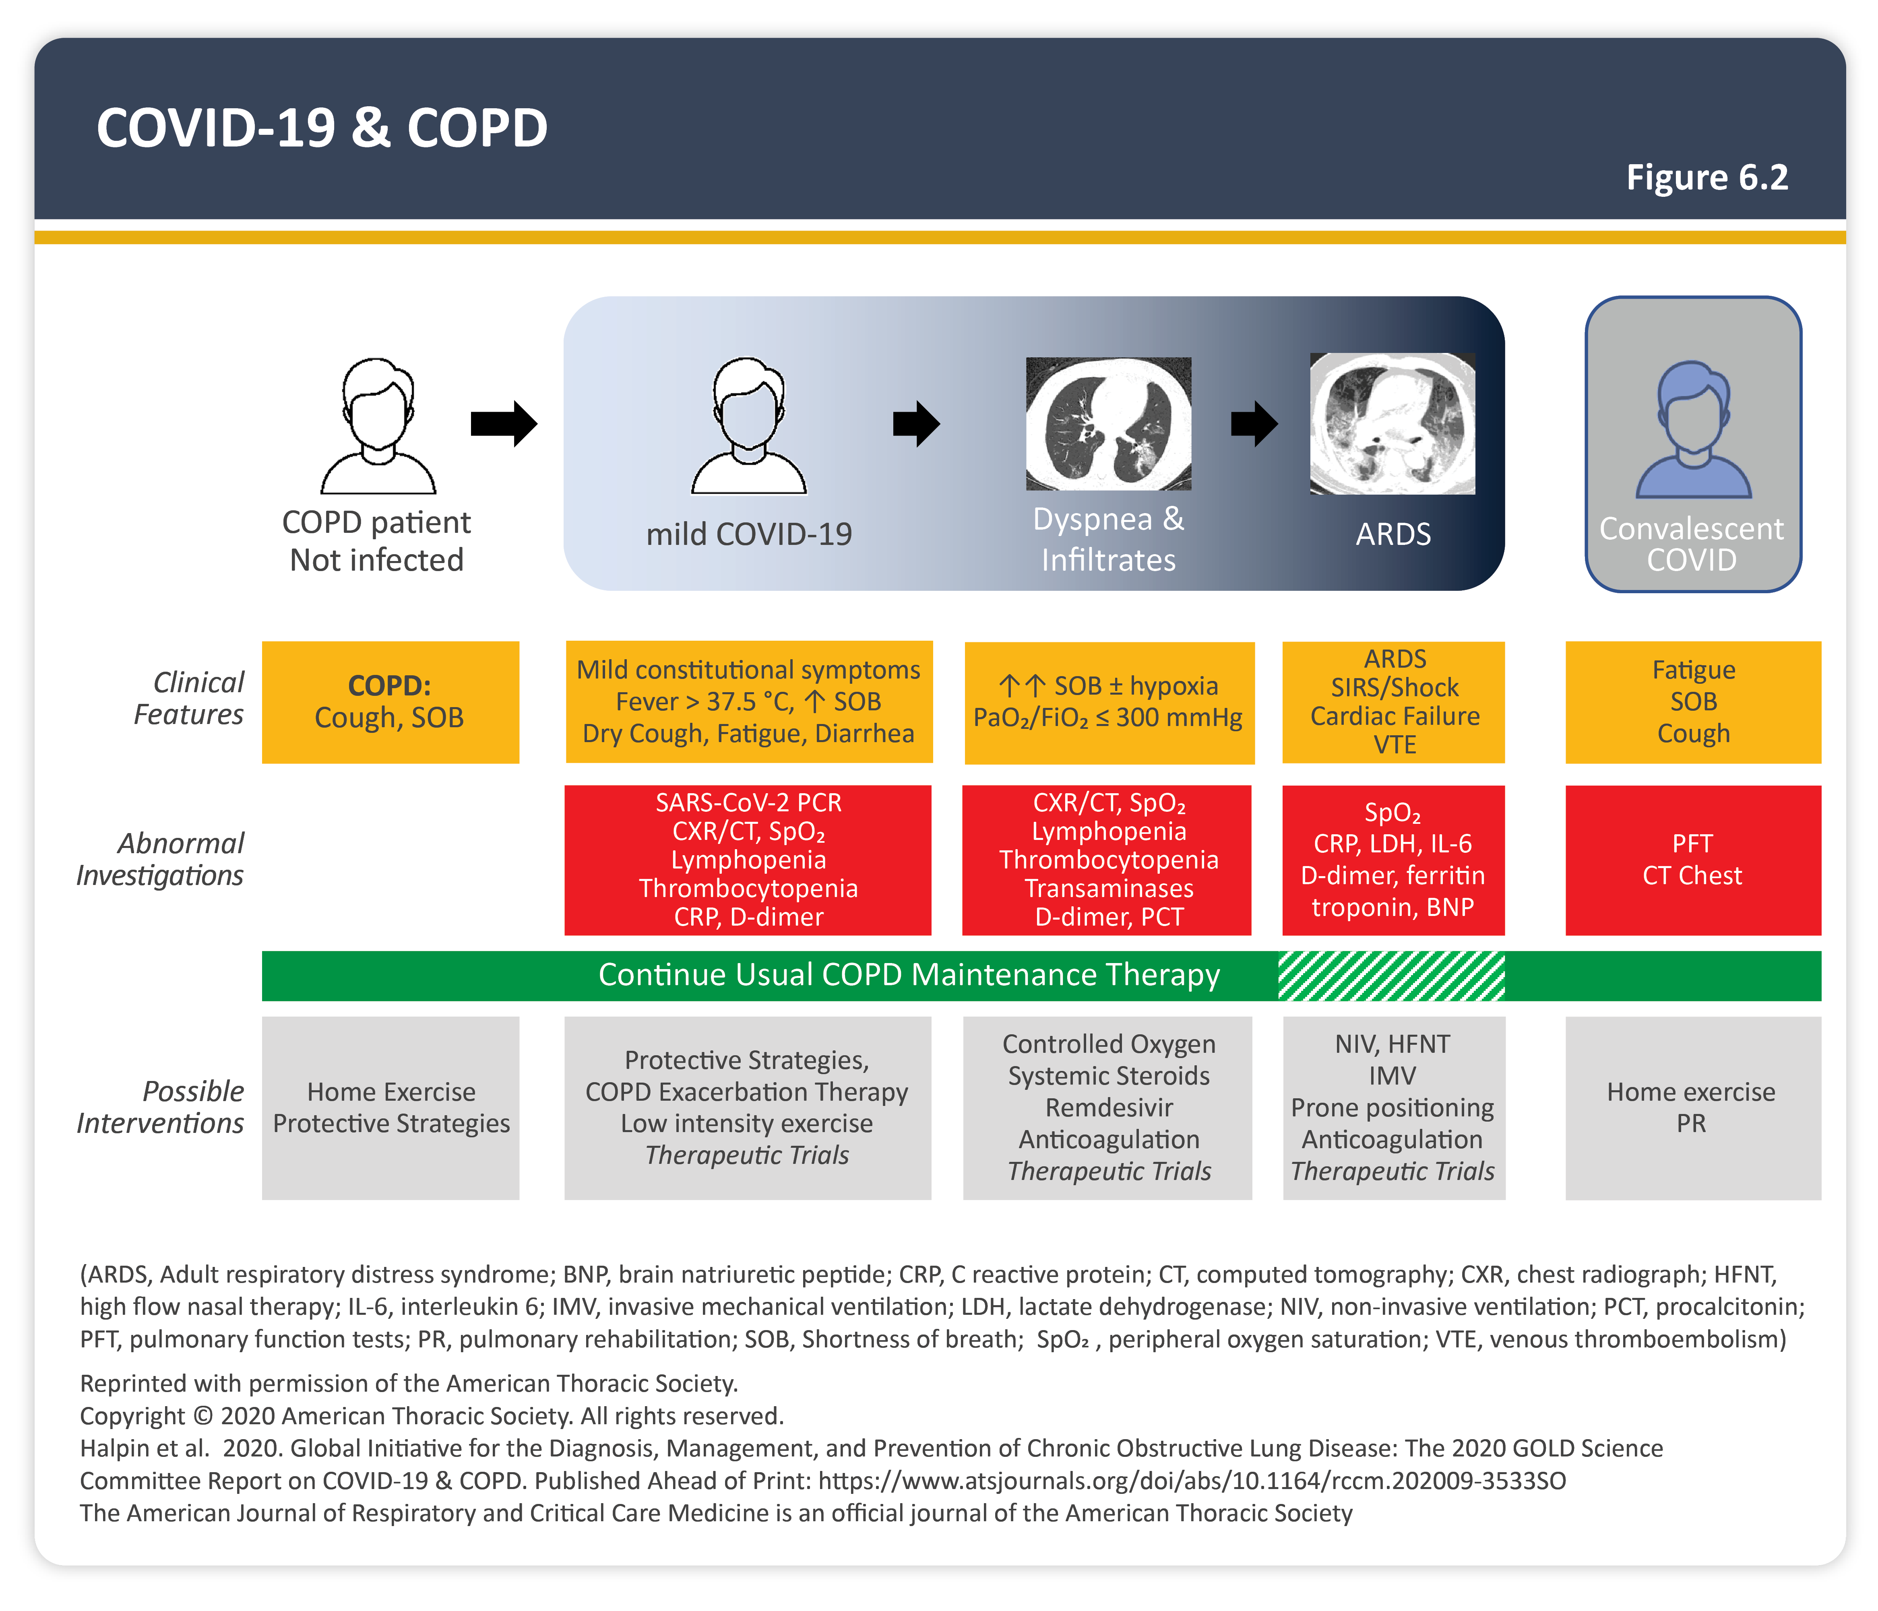
Teaching
Slide Set

Slide 56
Teaching
Slide Set

Slide 57
Teaching
Slide Set

Slide 58
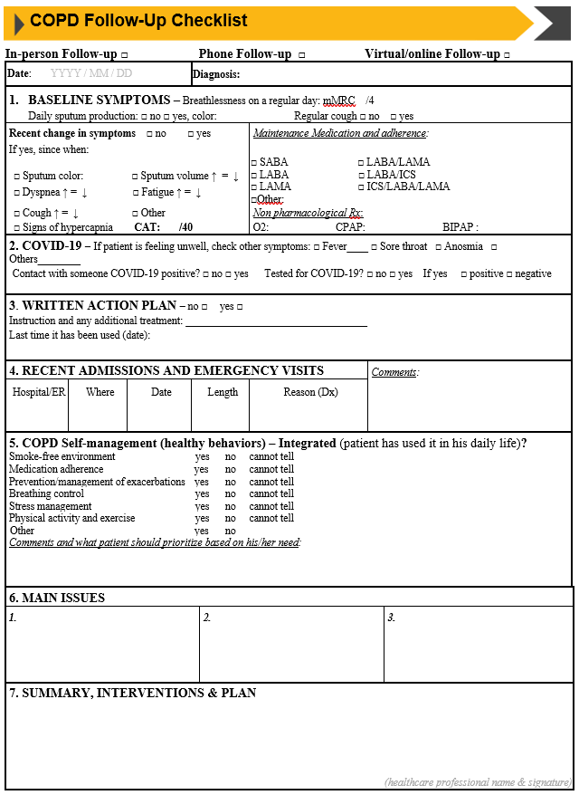
Teaching
Slide Set

