Slide 1


Teaching
Slide Set
Global Strategy for the Diagnosis, Management, and Prevention of
Chronic Obstructive Pulmonary Disease
This slide set is restricted for academic and educational purposes only. Use of the slide set, or of individual slides, for commercial or promotional purposes requires approval from GOLD.

Slide 2
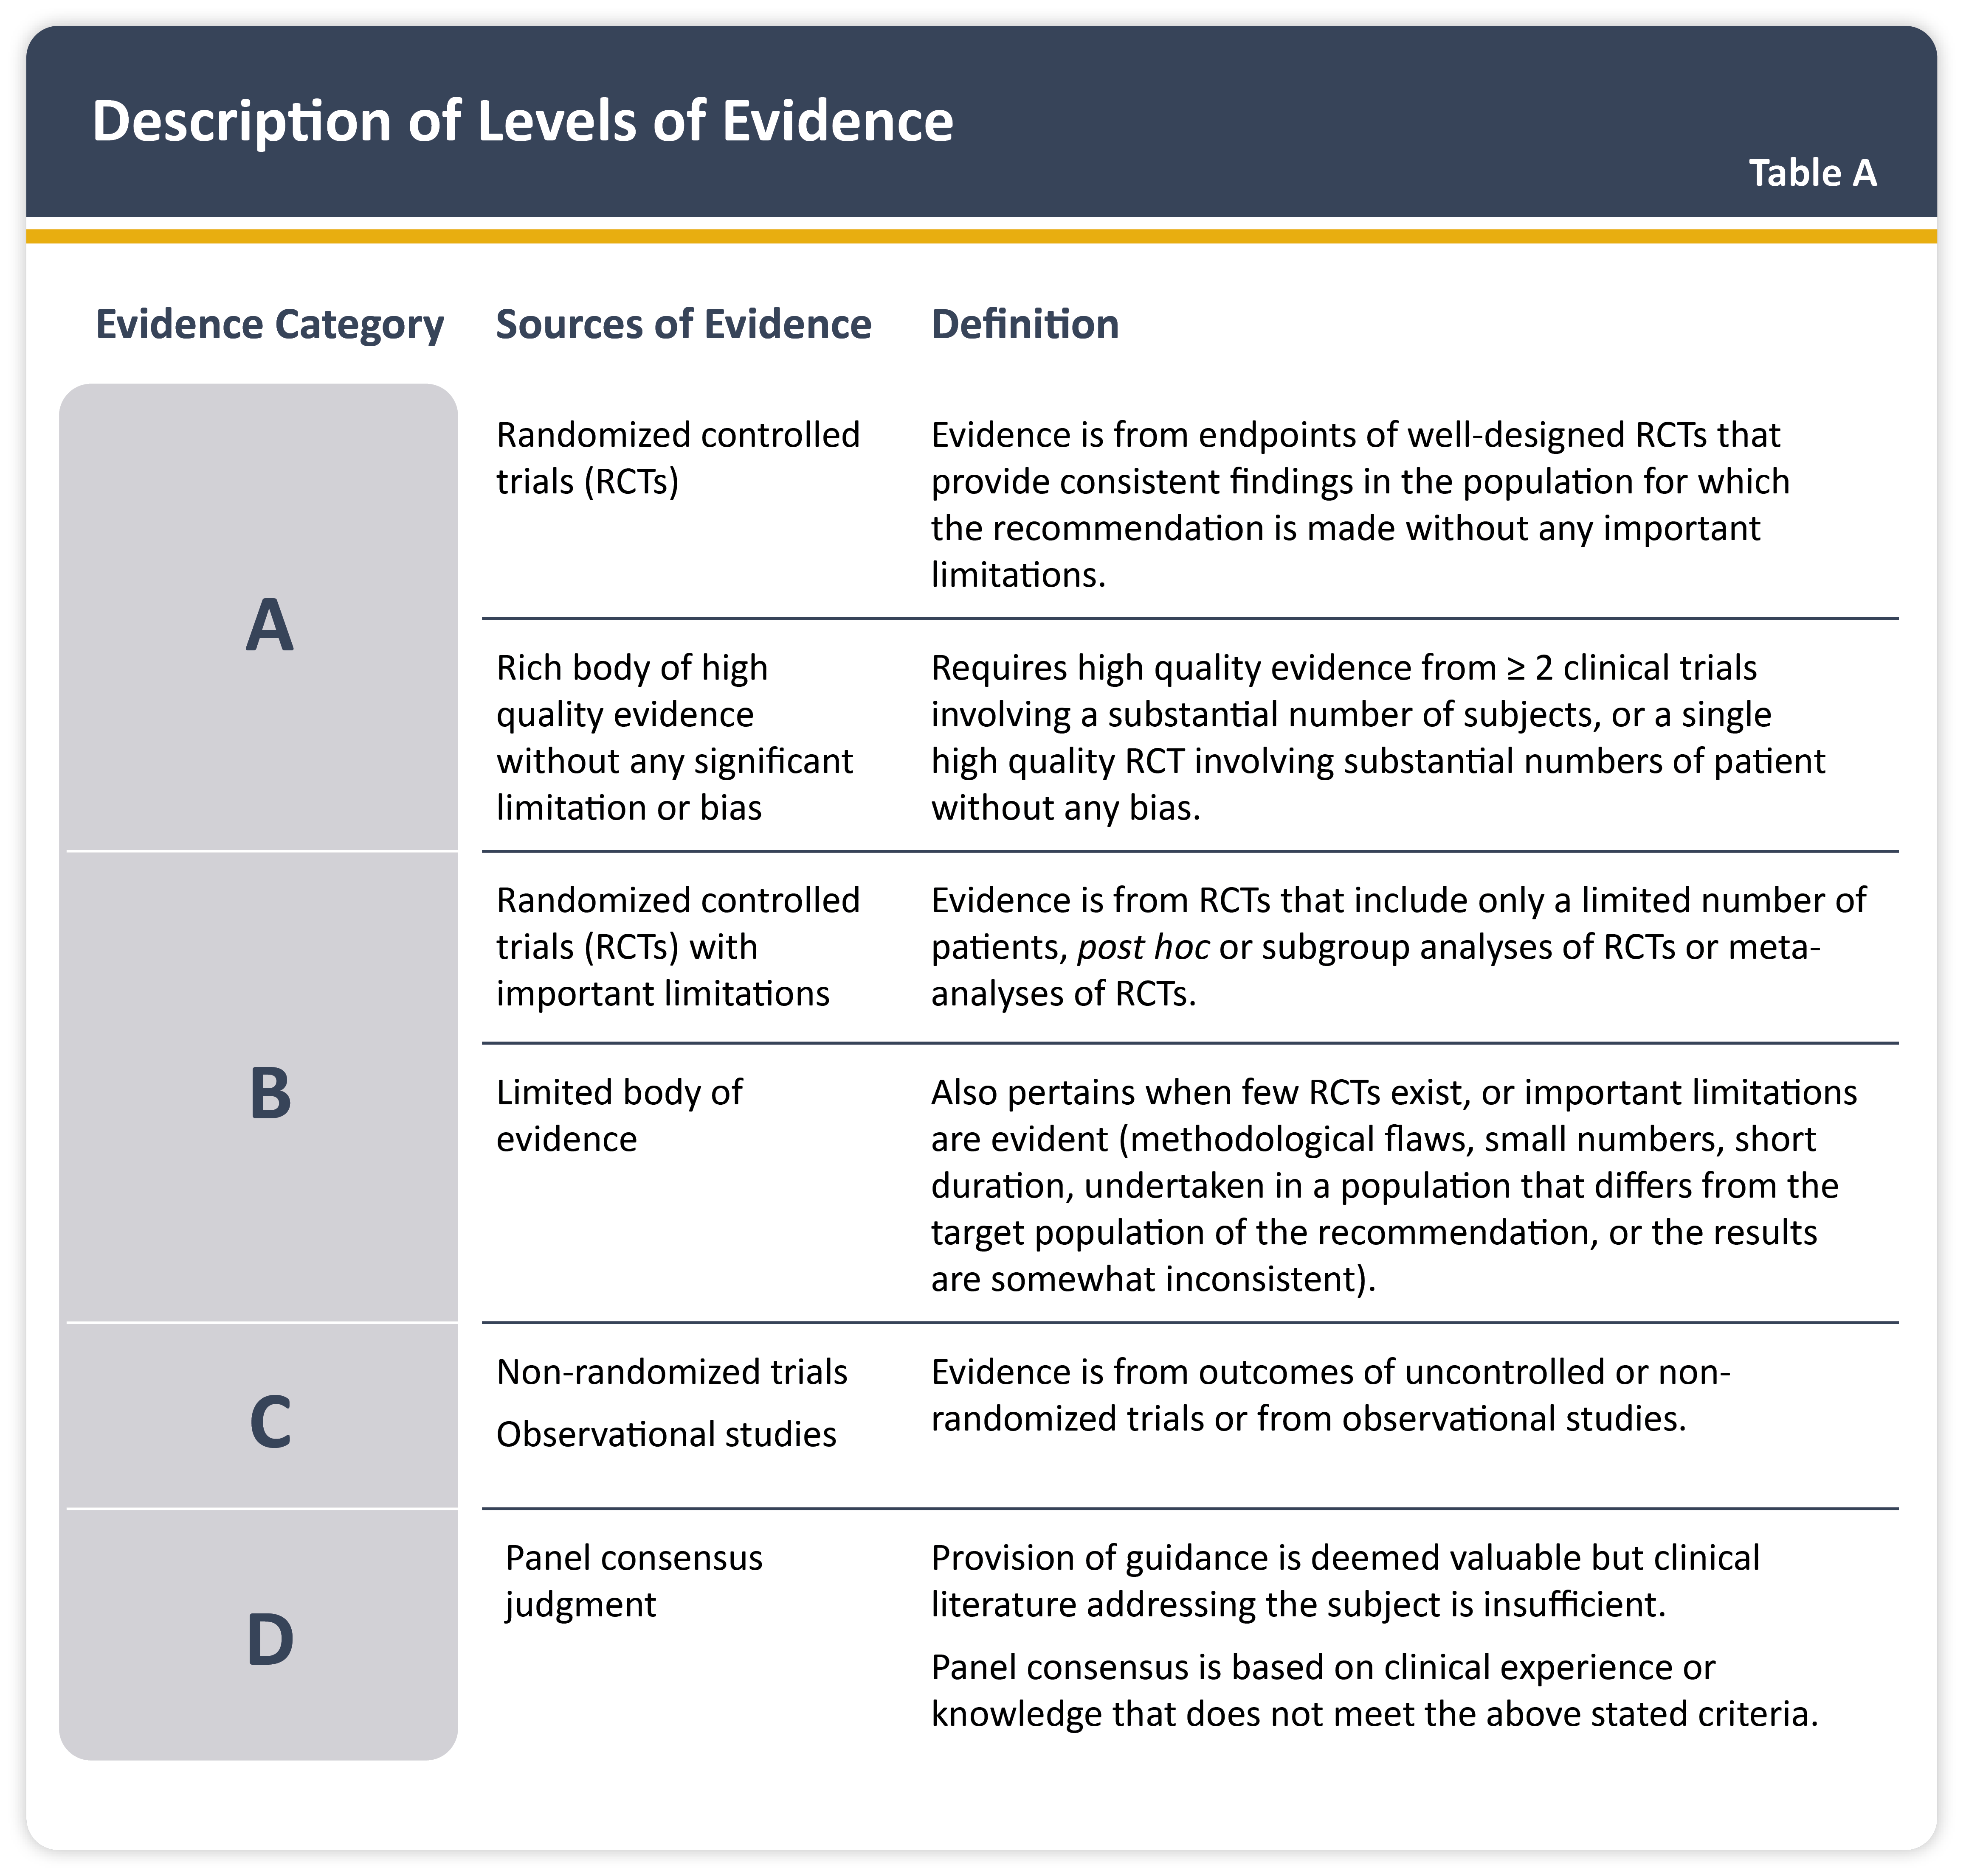

Teaching
Slide Set

Slide 3
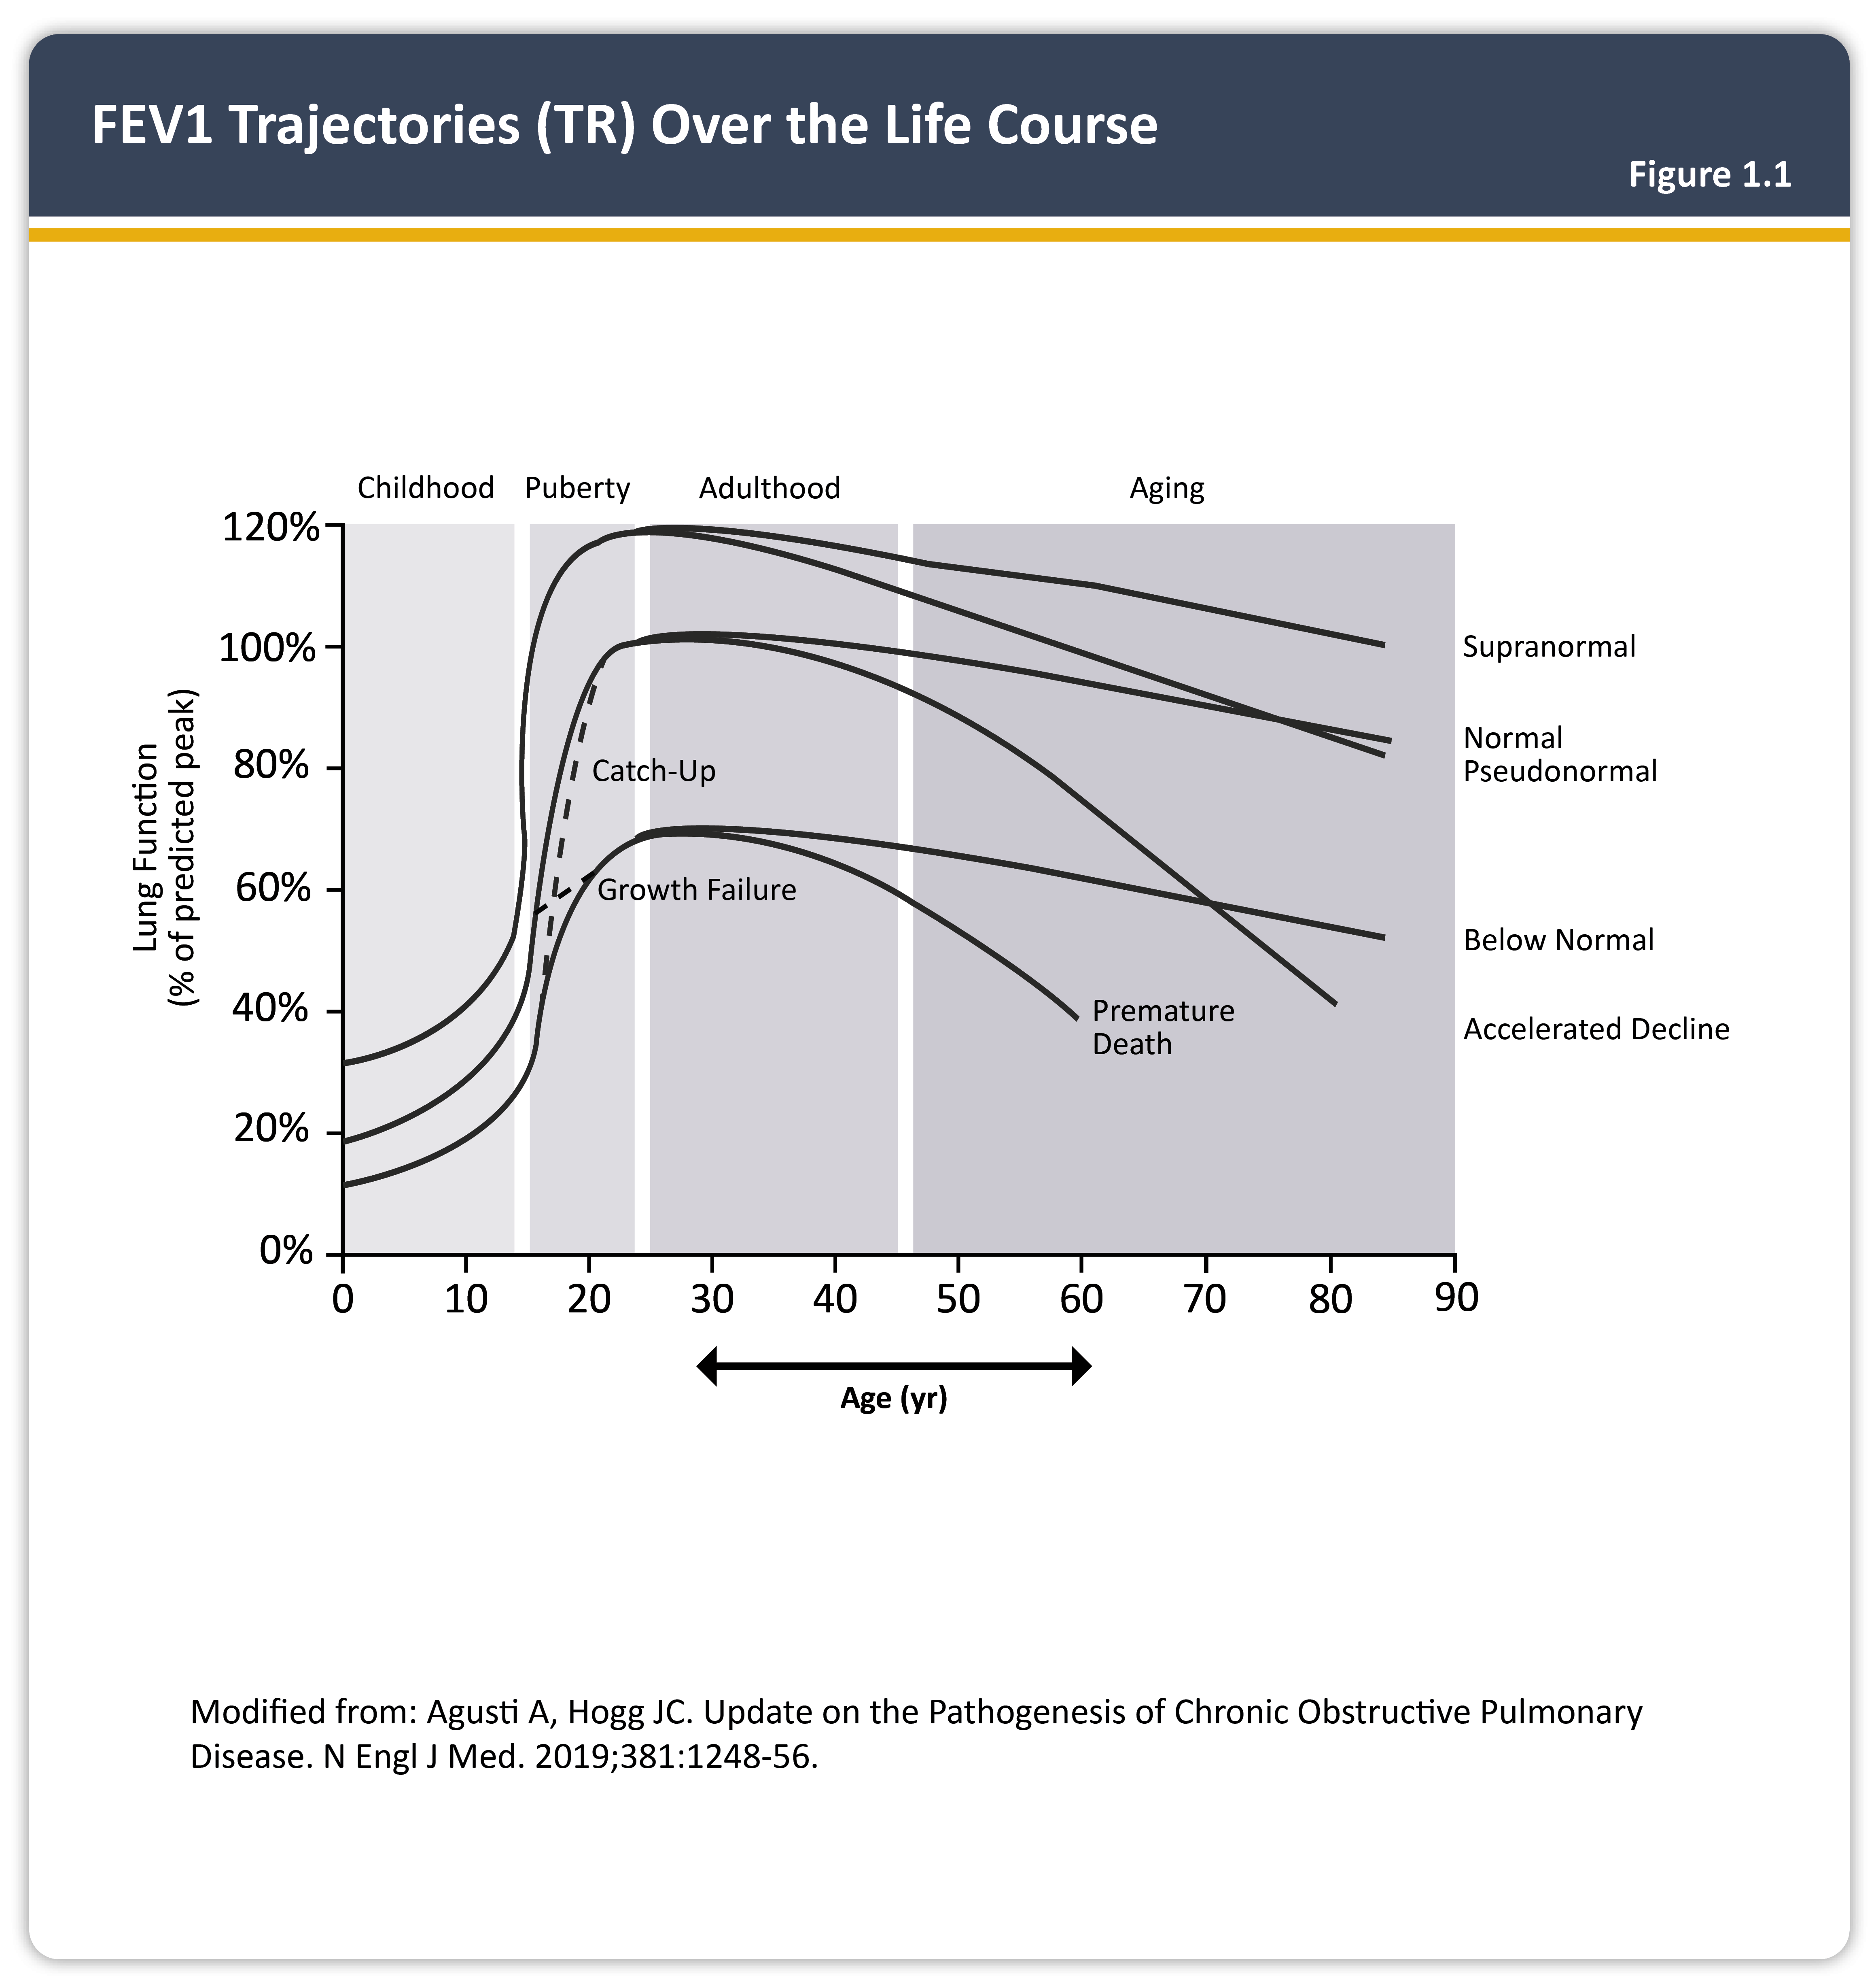

Slide 4
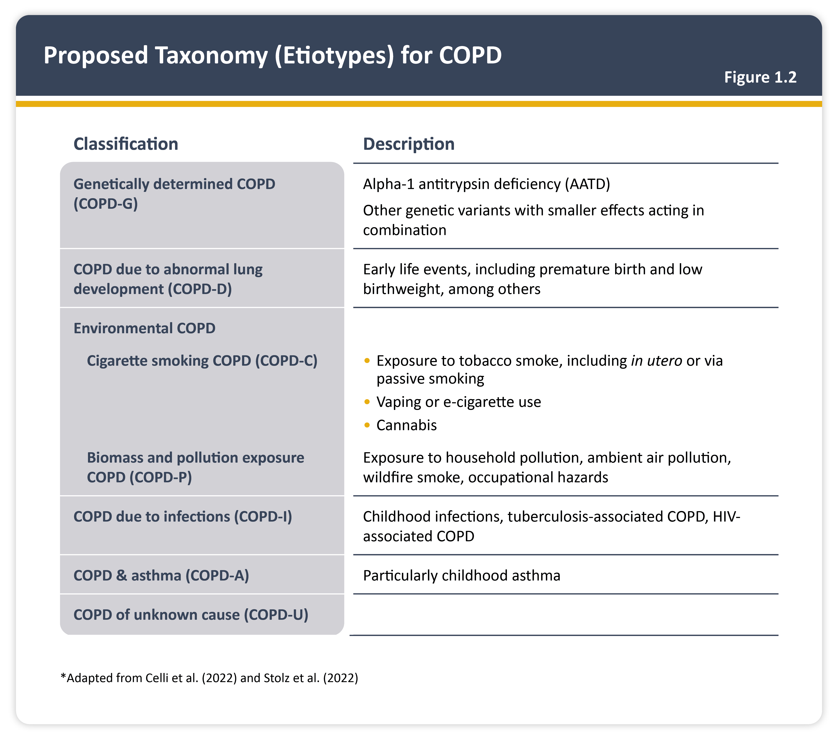
Teaching
Slide Set

Slide 5
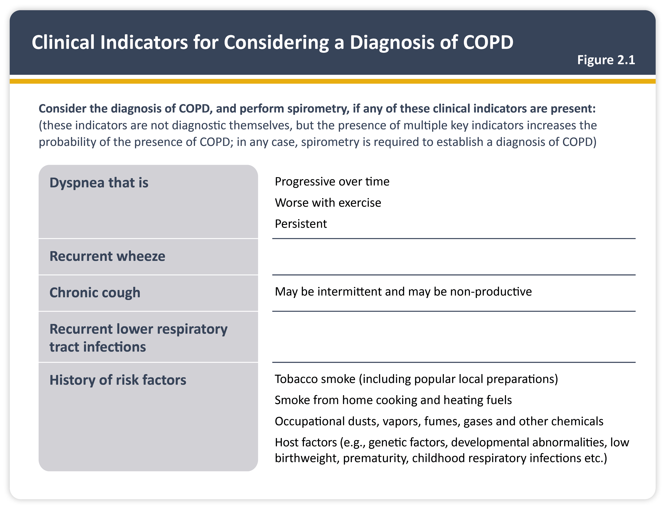
Teaching
Slide Set

Slide 6
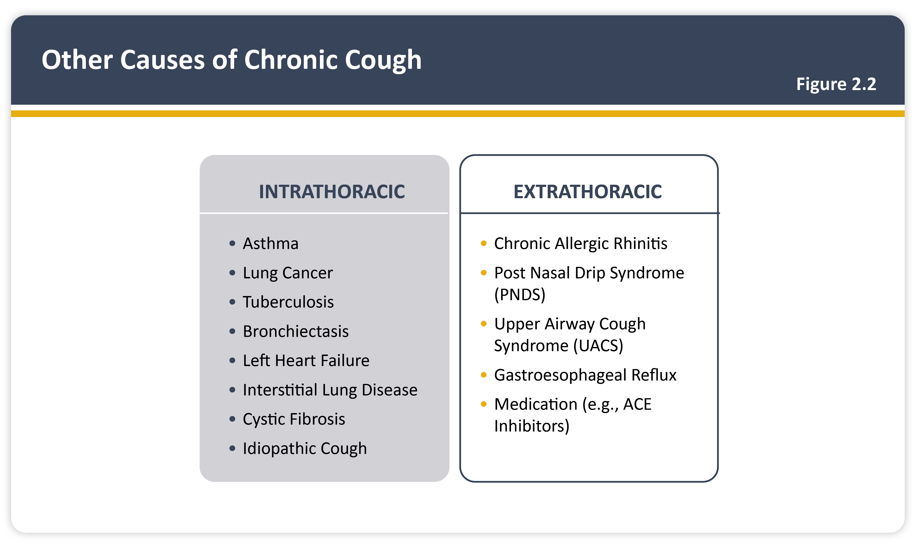
Teaching
Slide Set

Slide 7
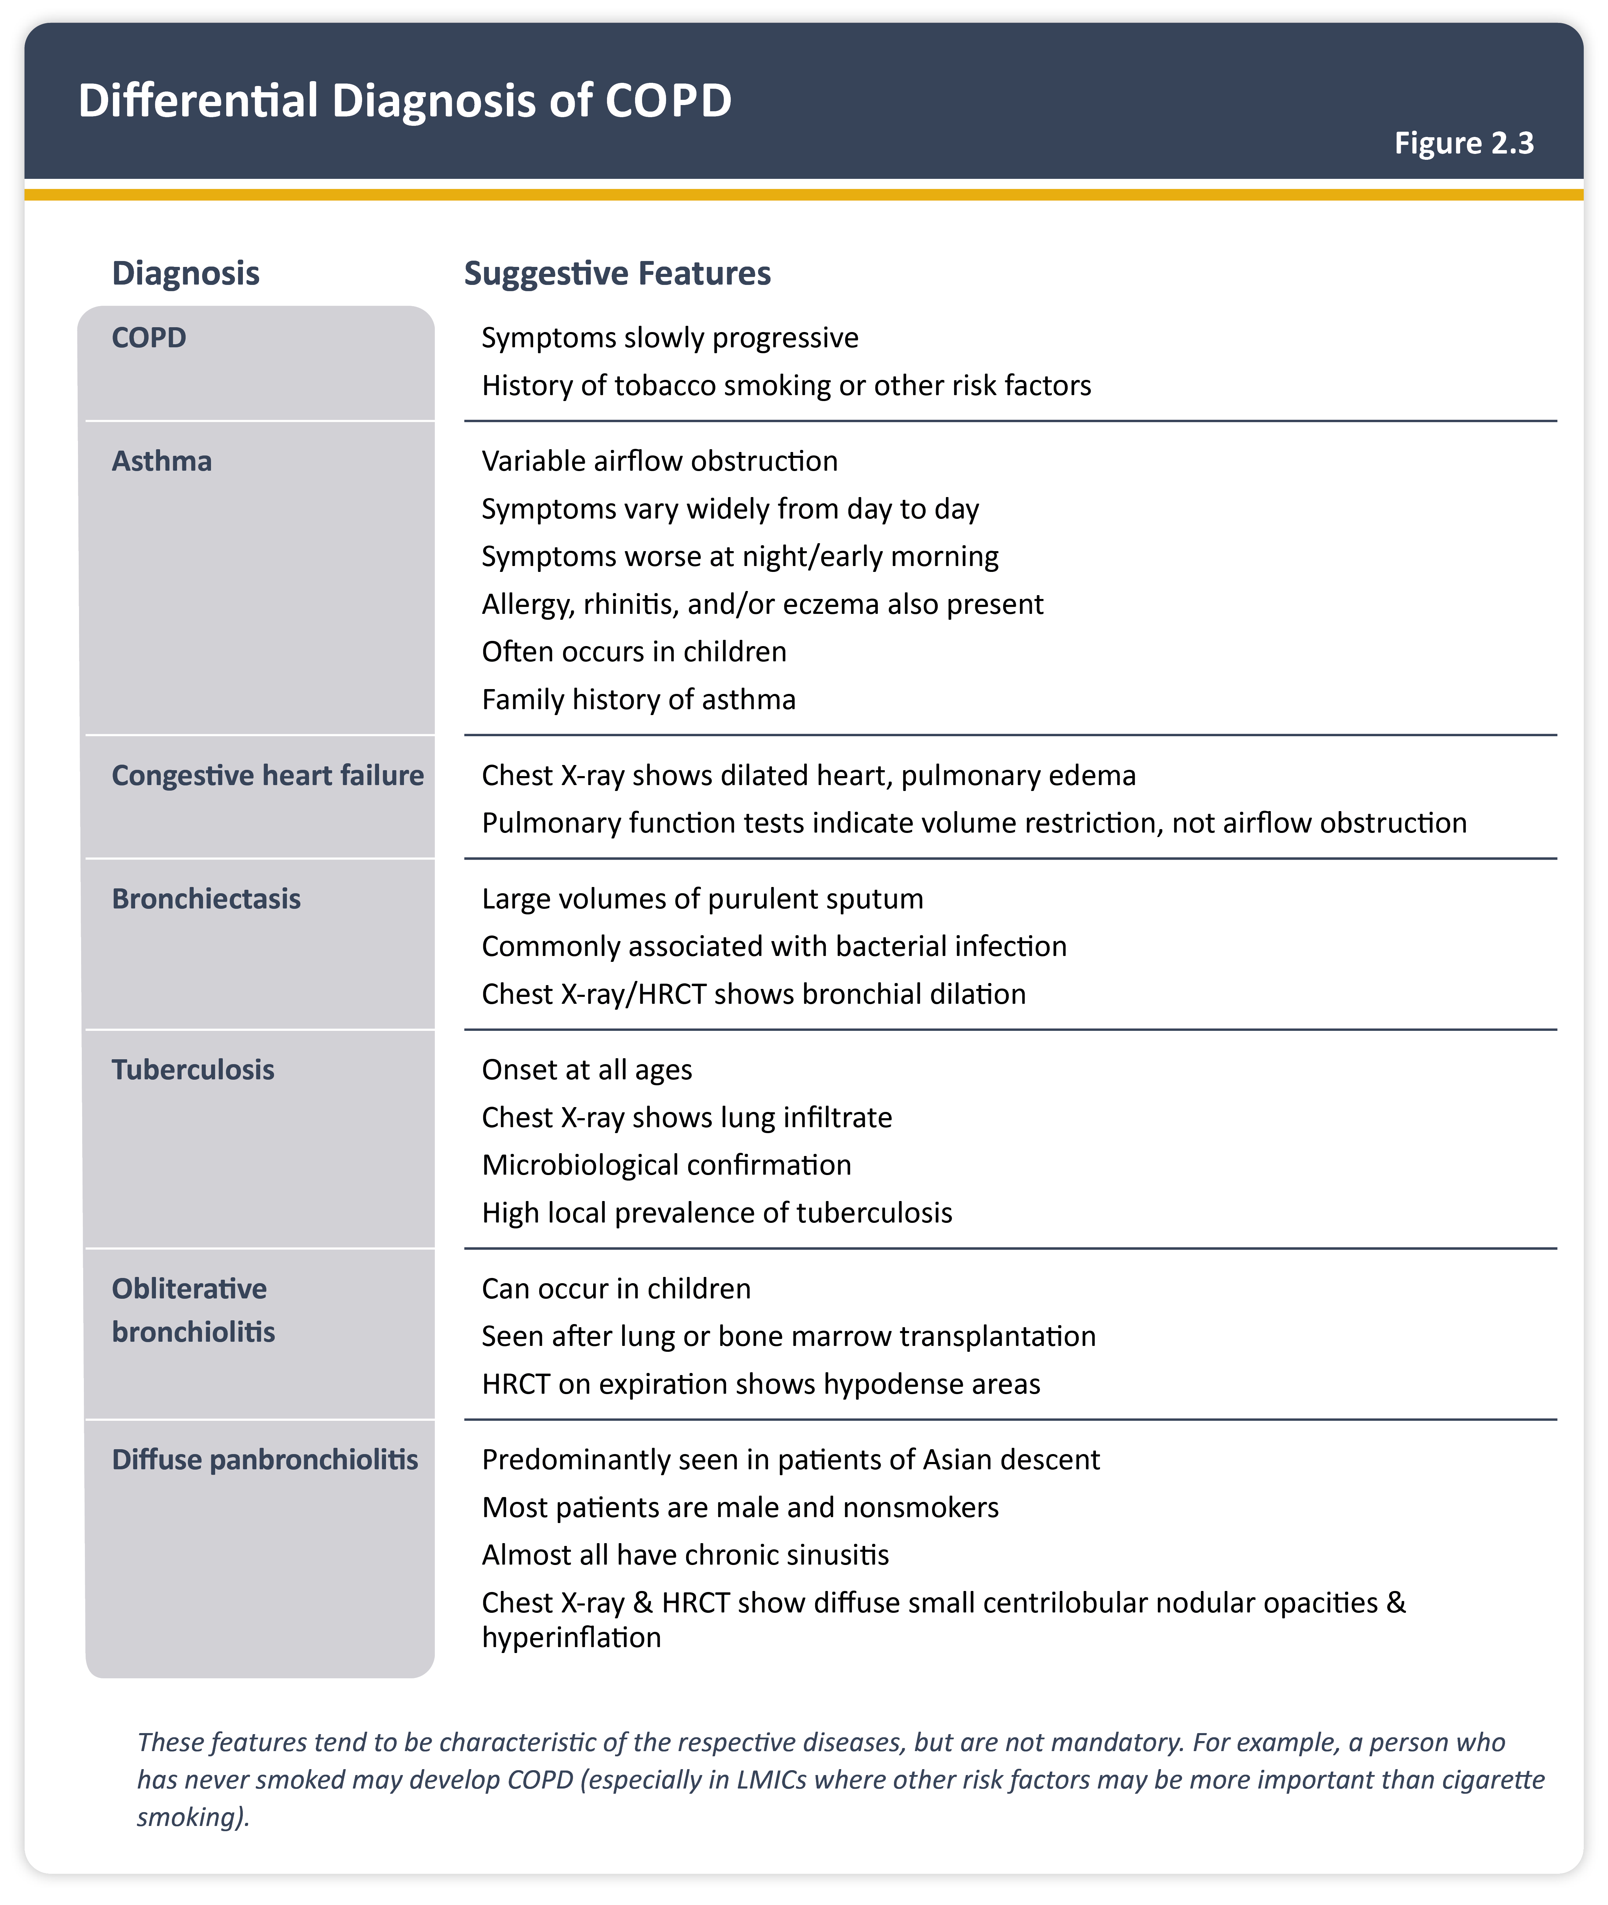
Teaching
Slide Set

Slide 8
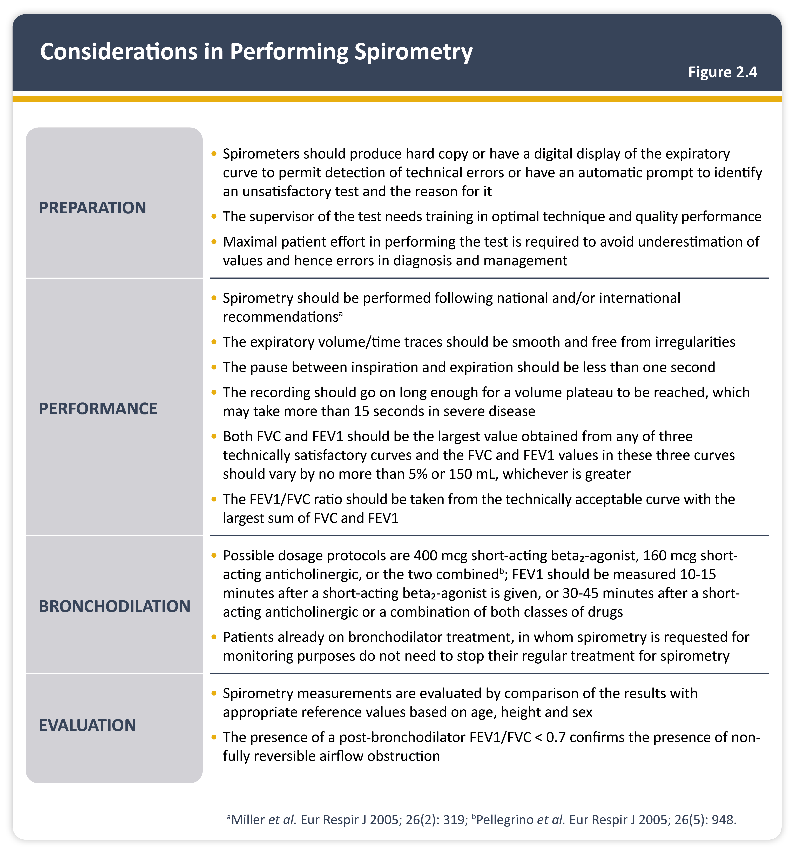
Teaching
Slide Set

Slide 9
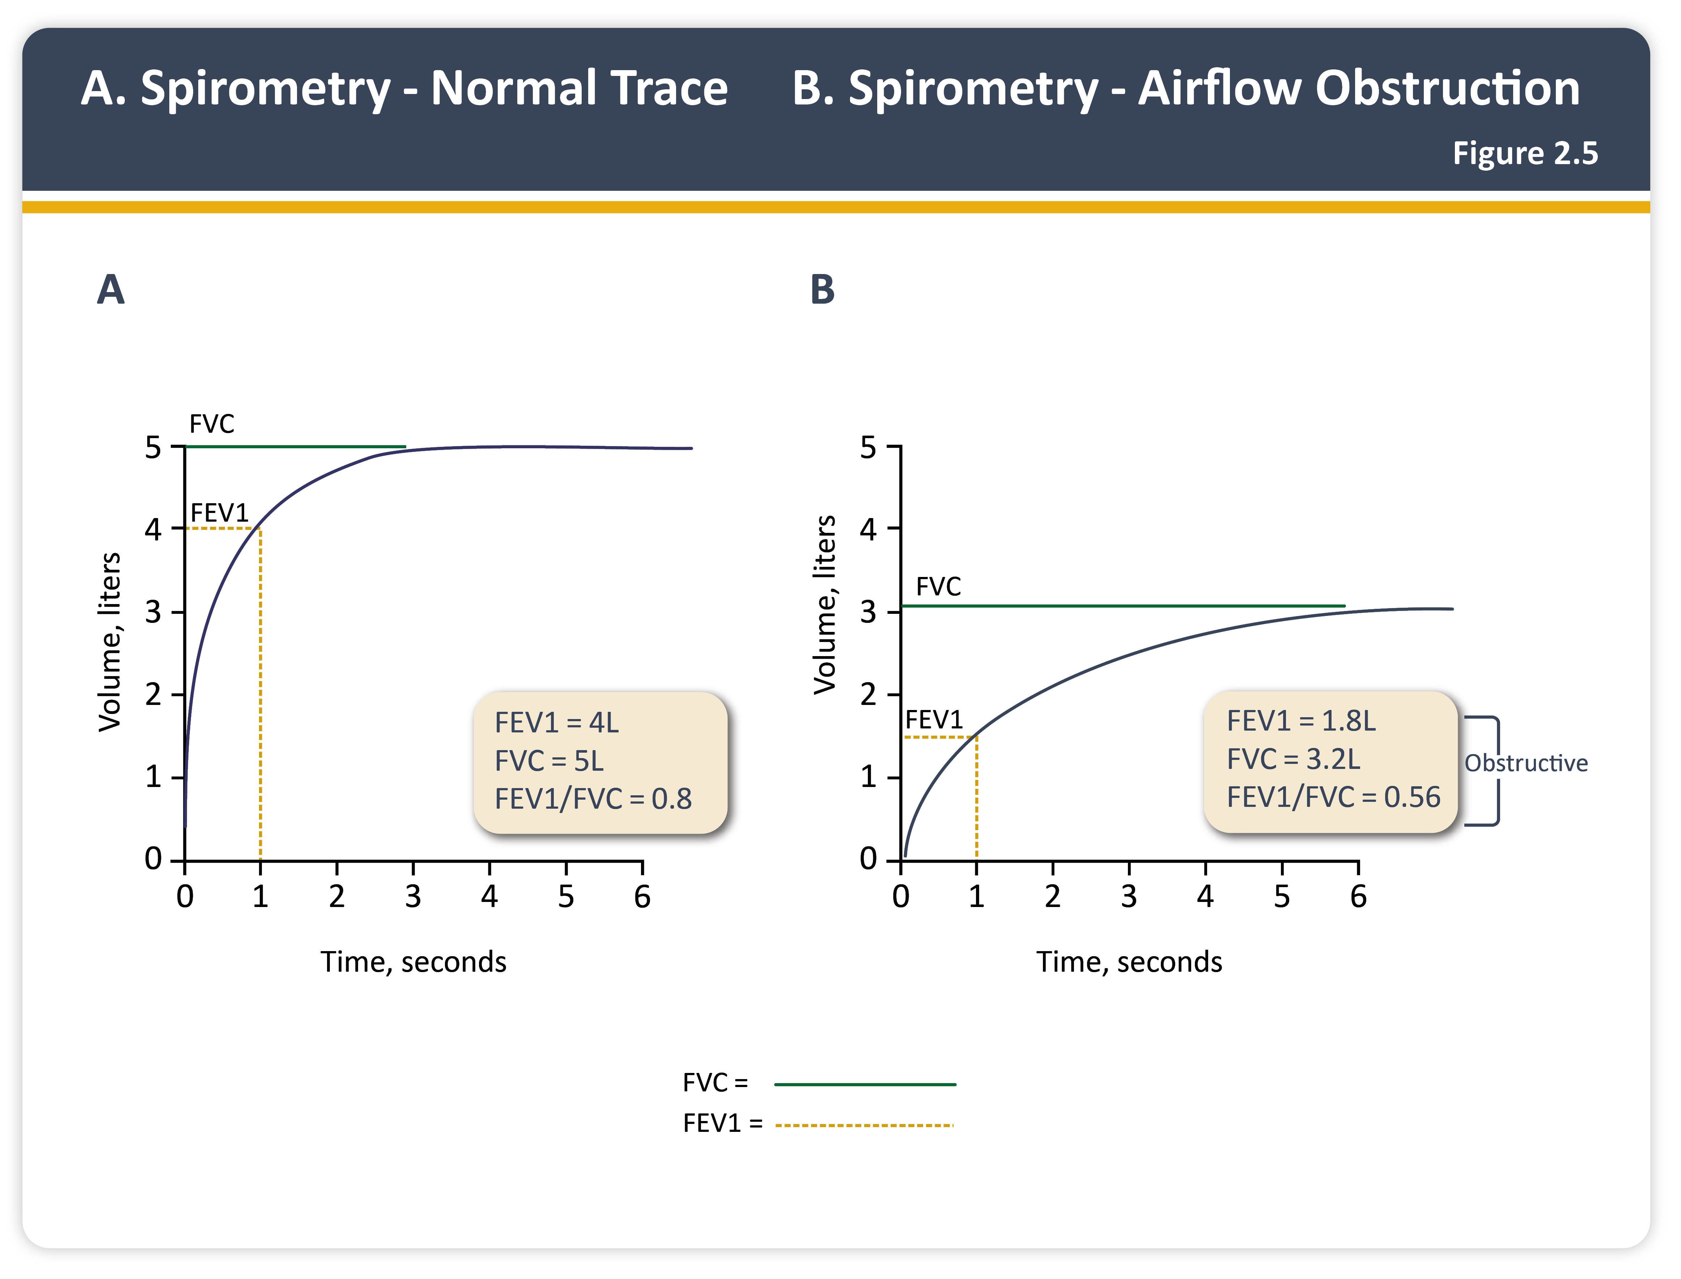
Teaching
Slide Set

Slide 10
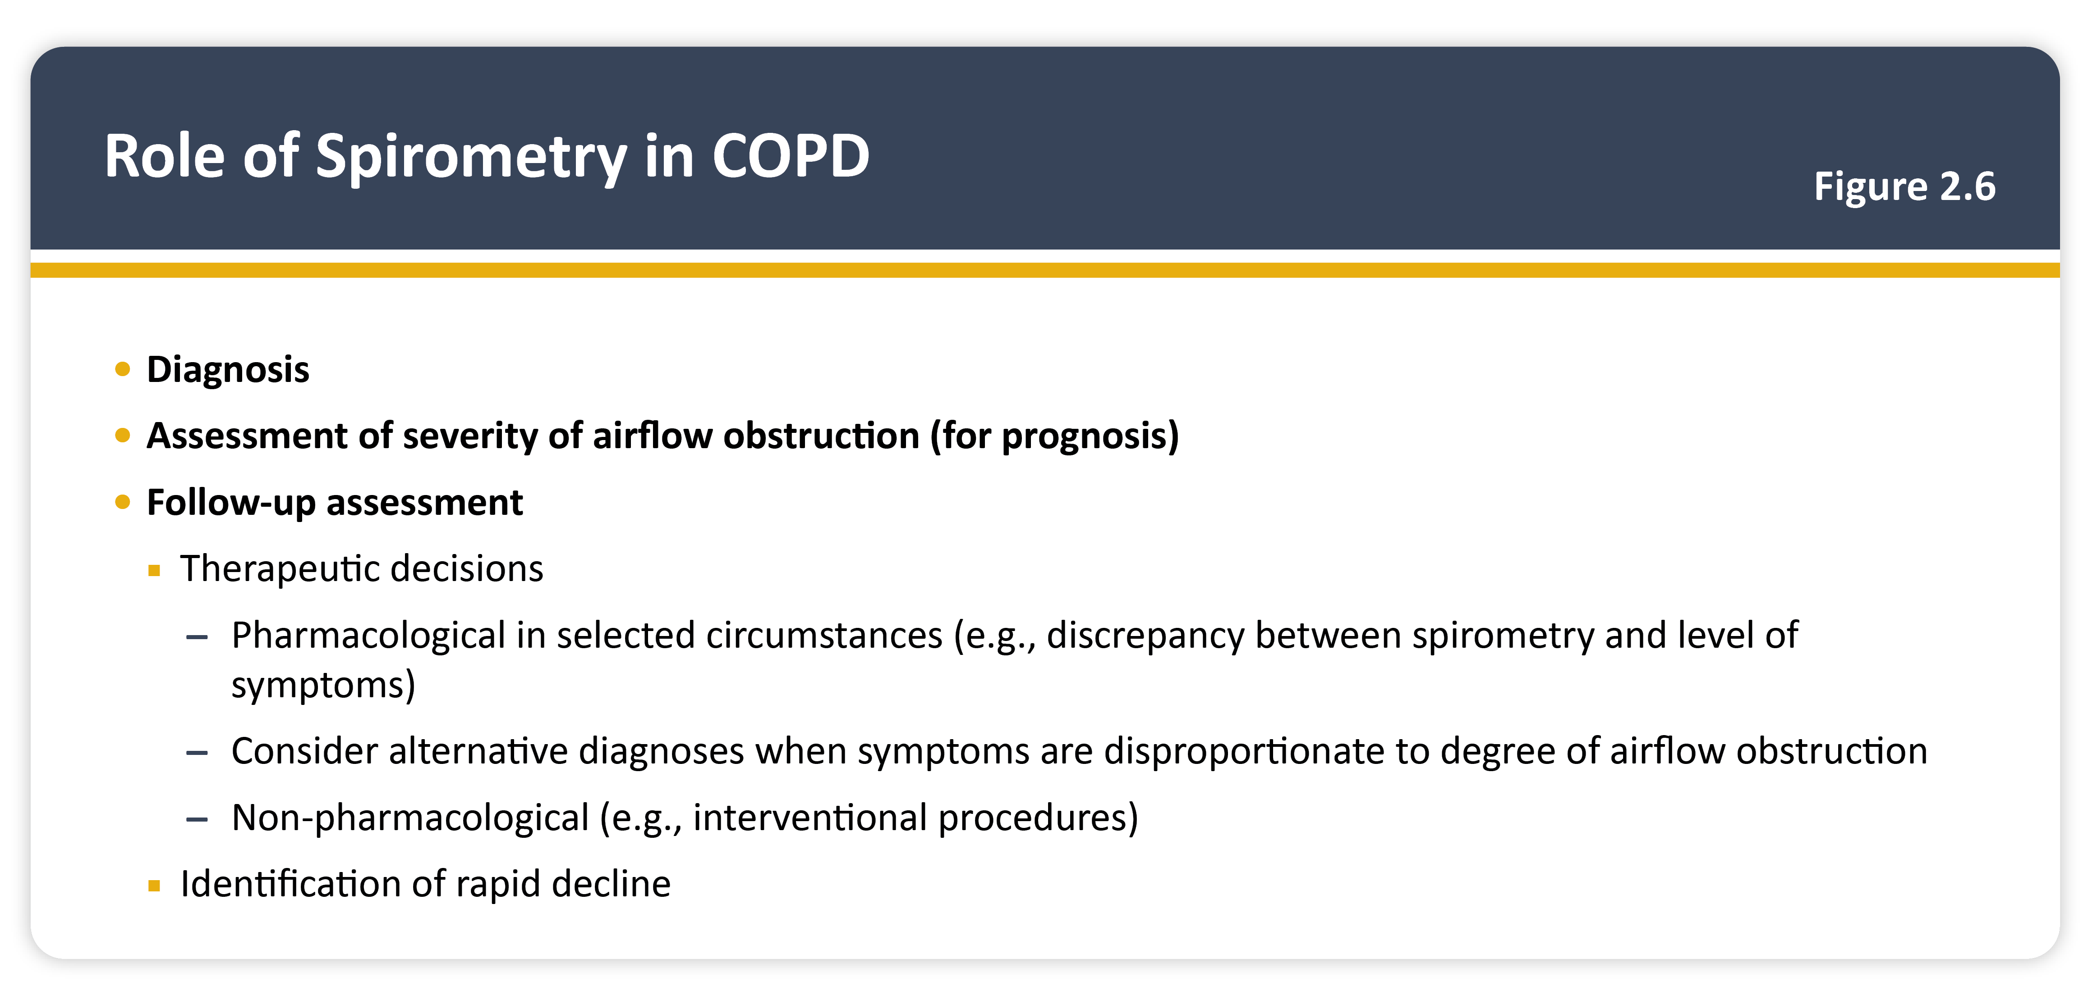
Teaching
Slide Set

Slide 11
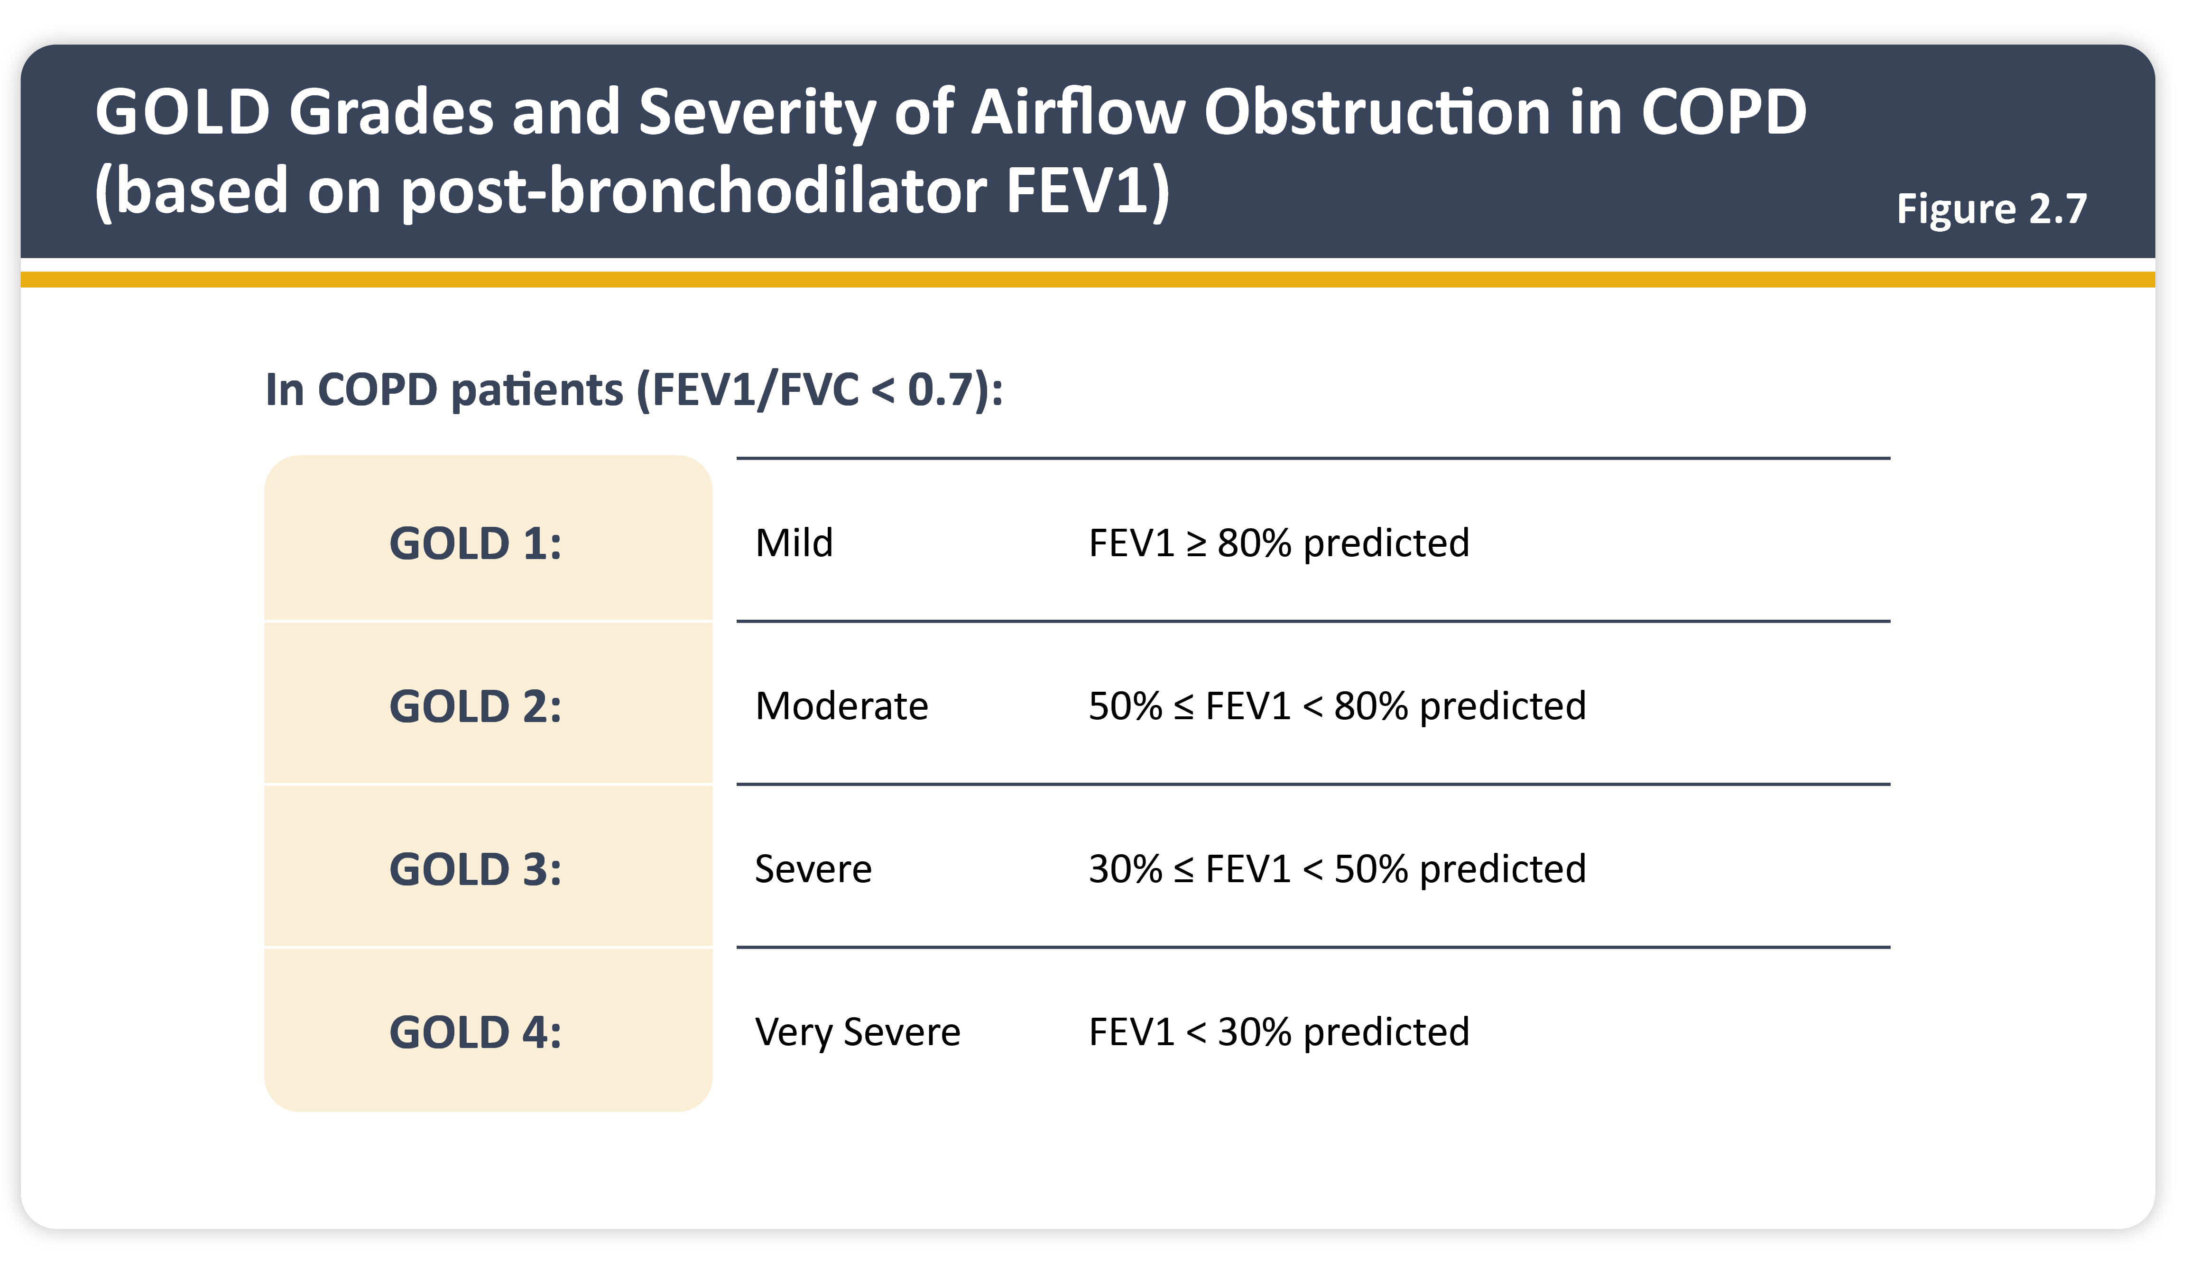
Teaching
Slide Set

Slide 12
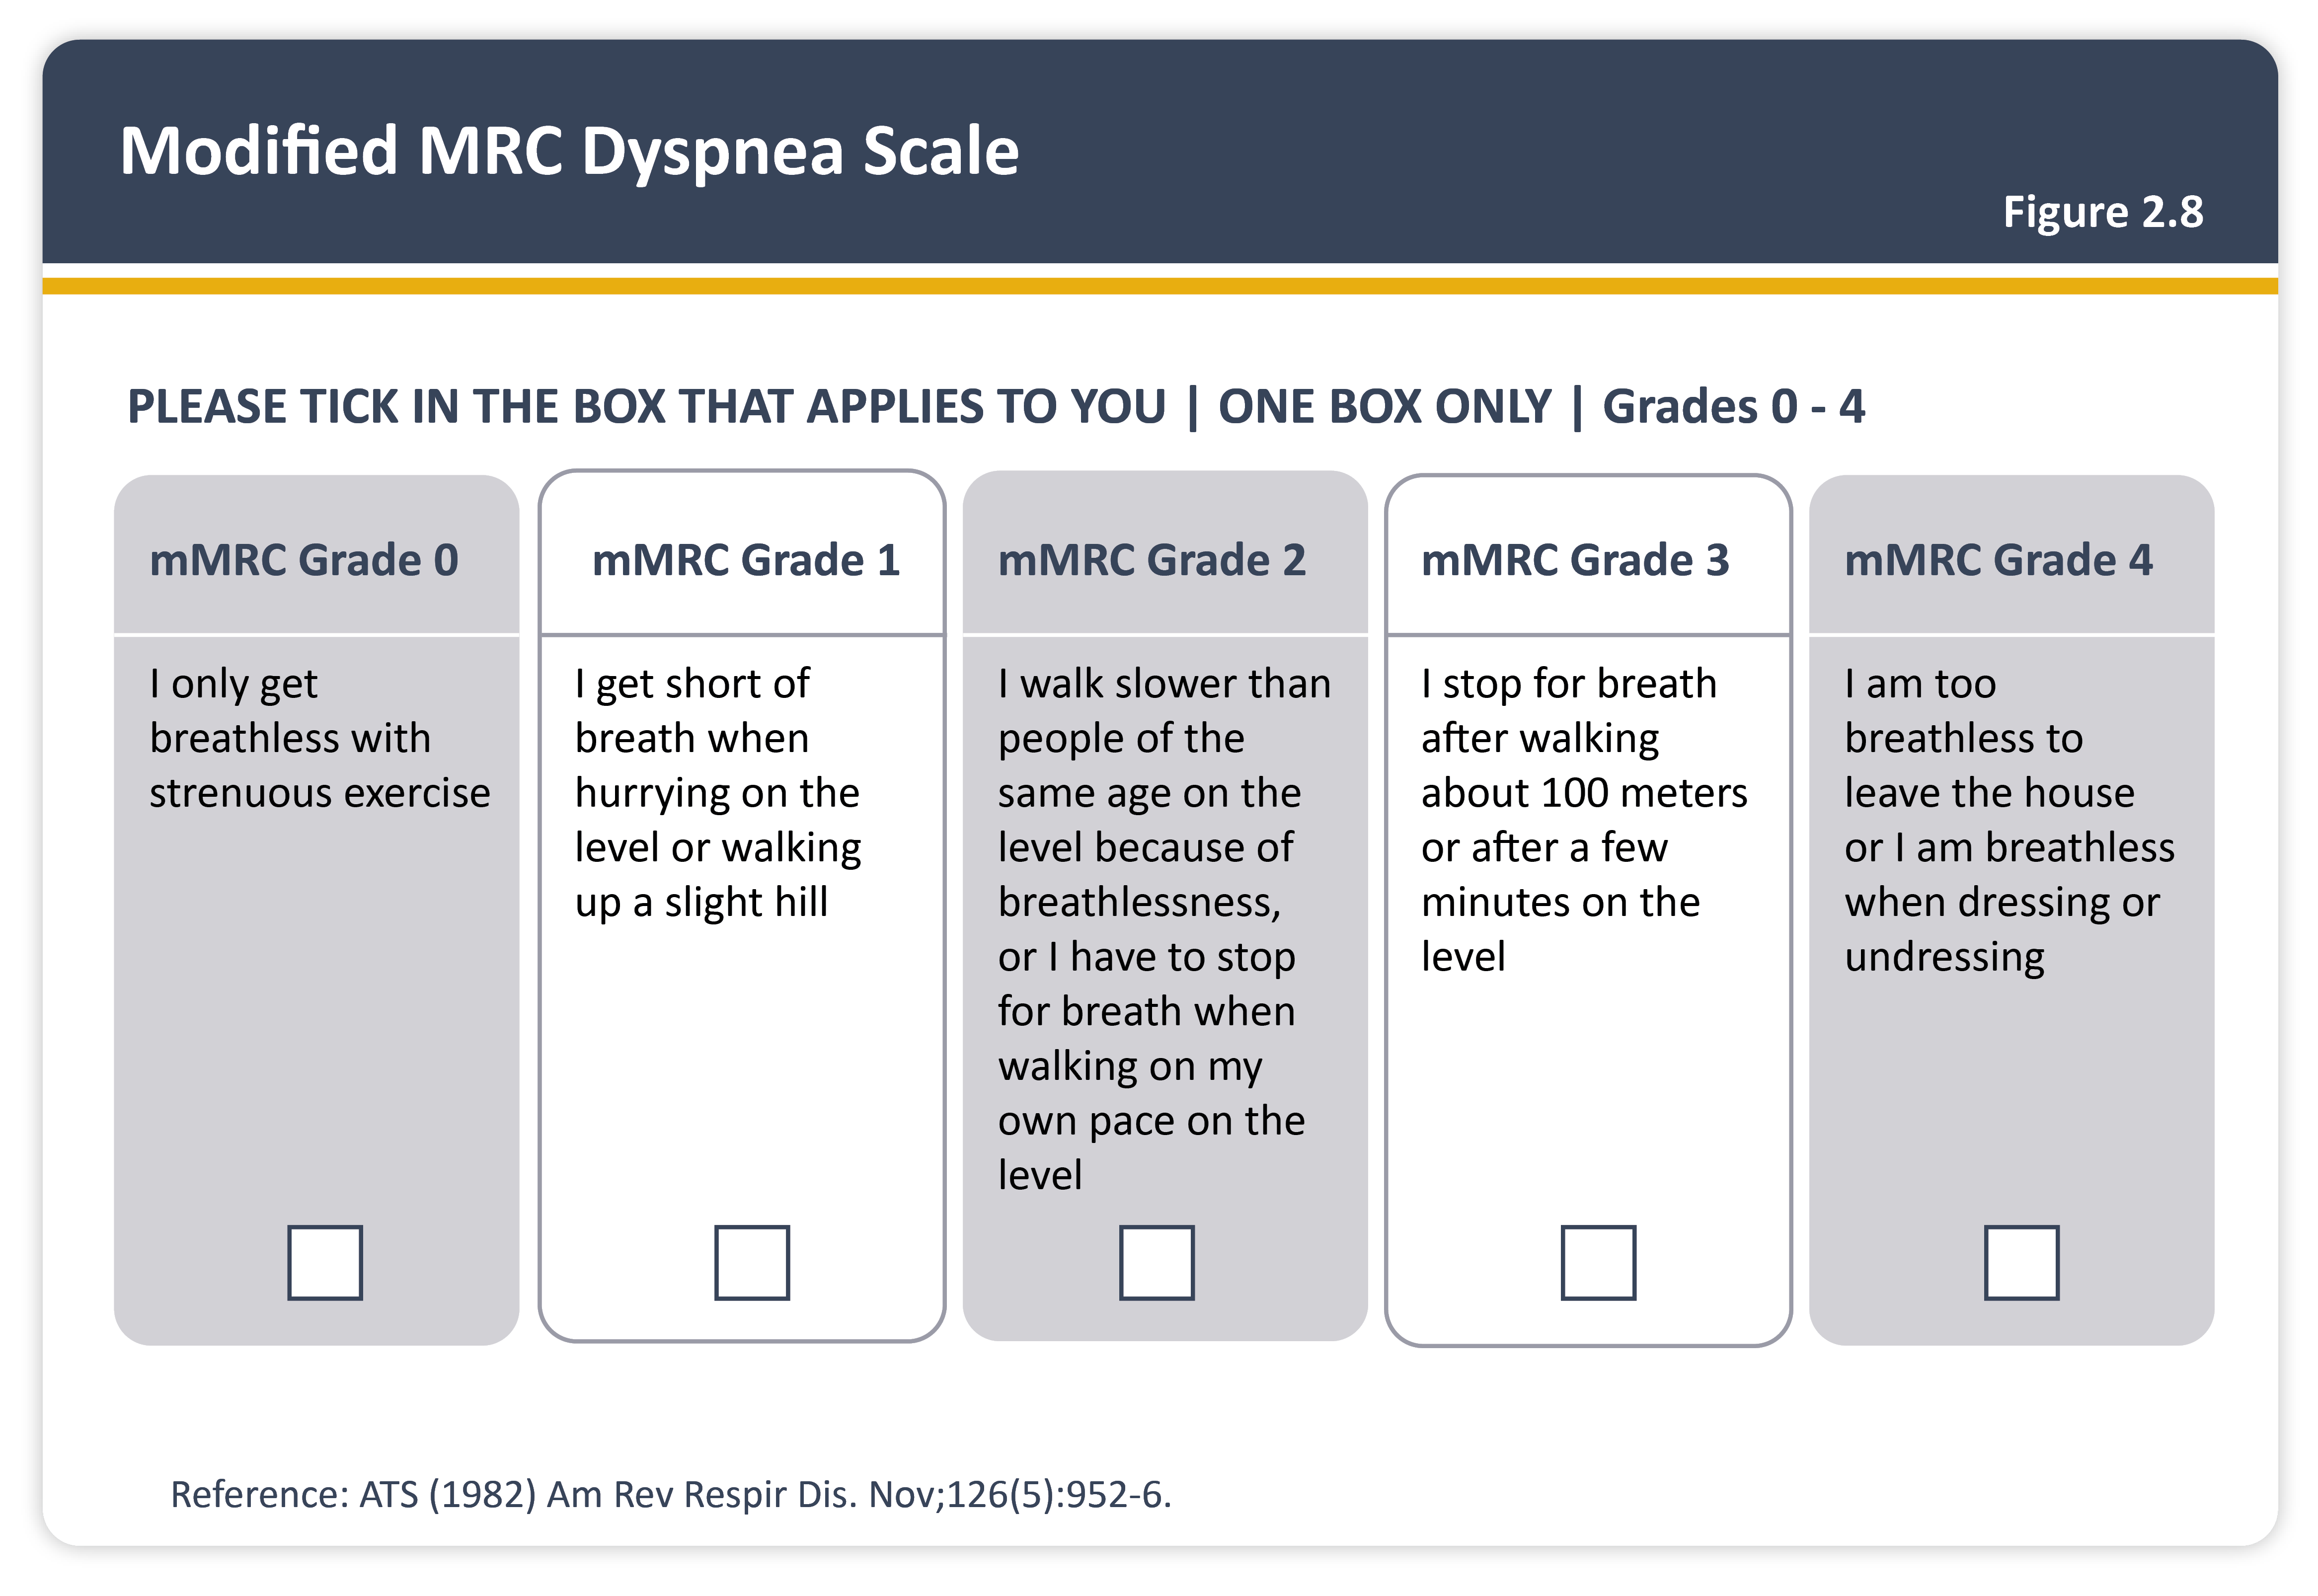
Teaching
Slide Set

Slide 13
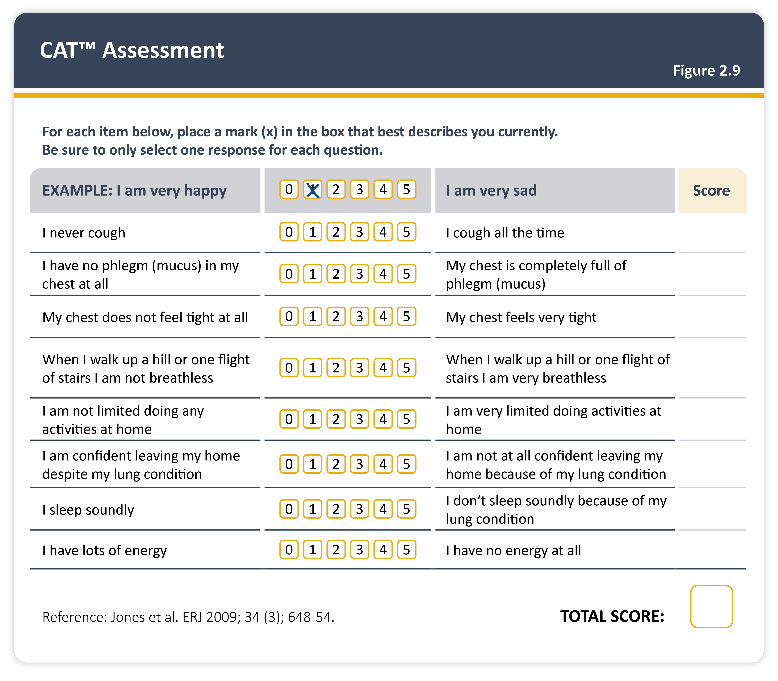
Teaching
Slide Set

Slide 14
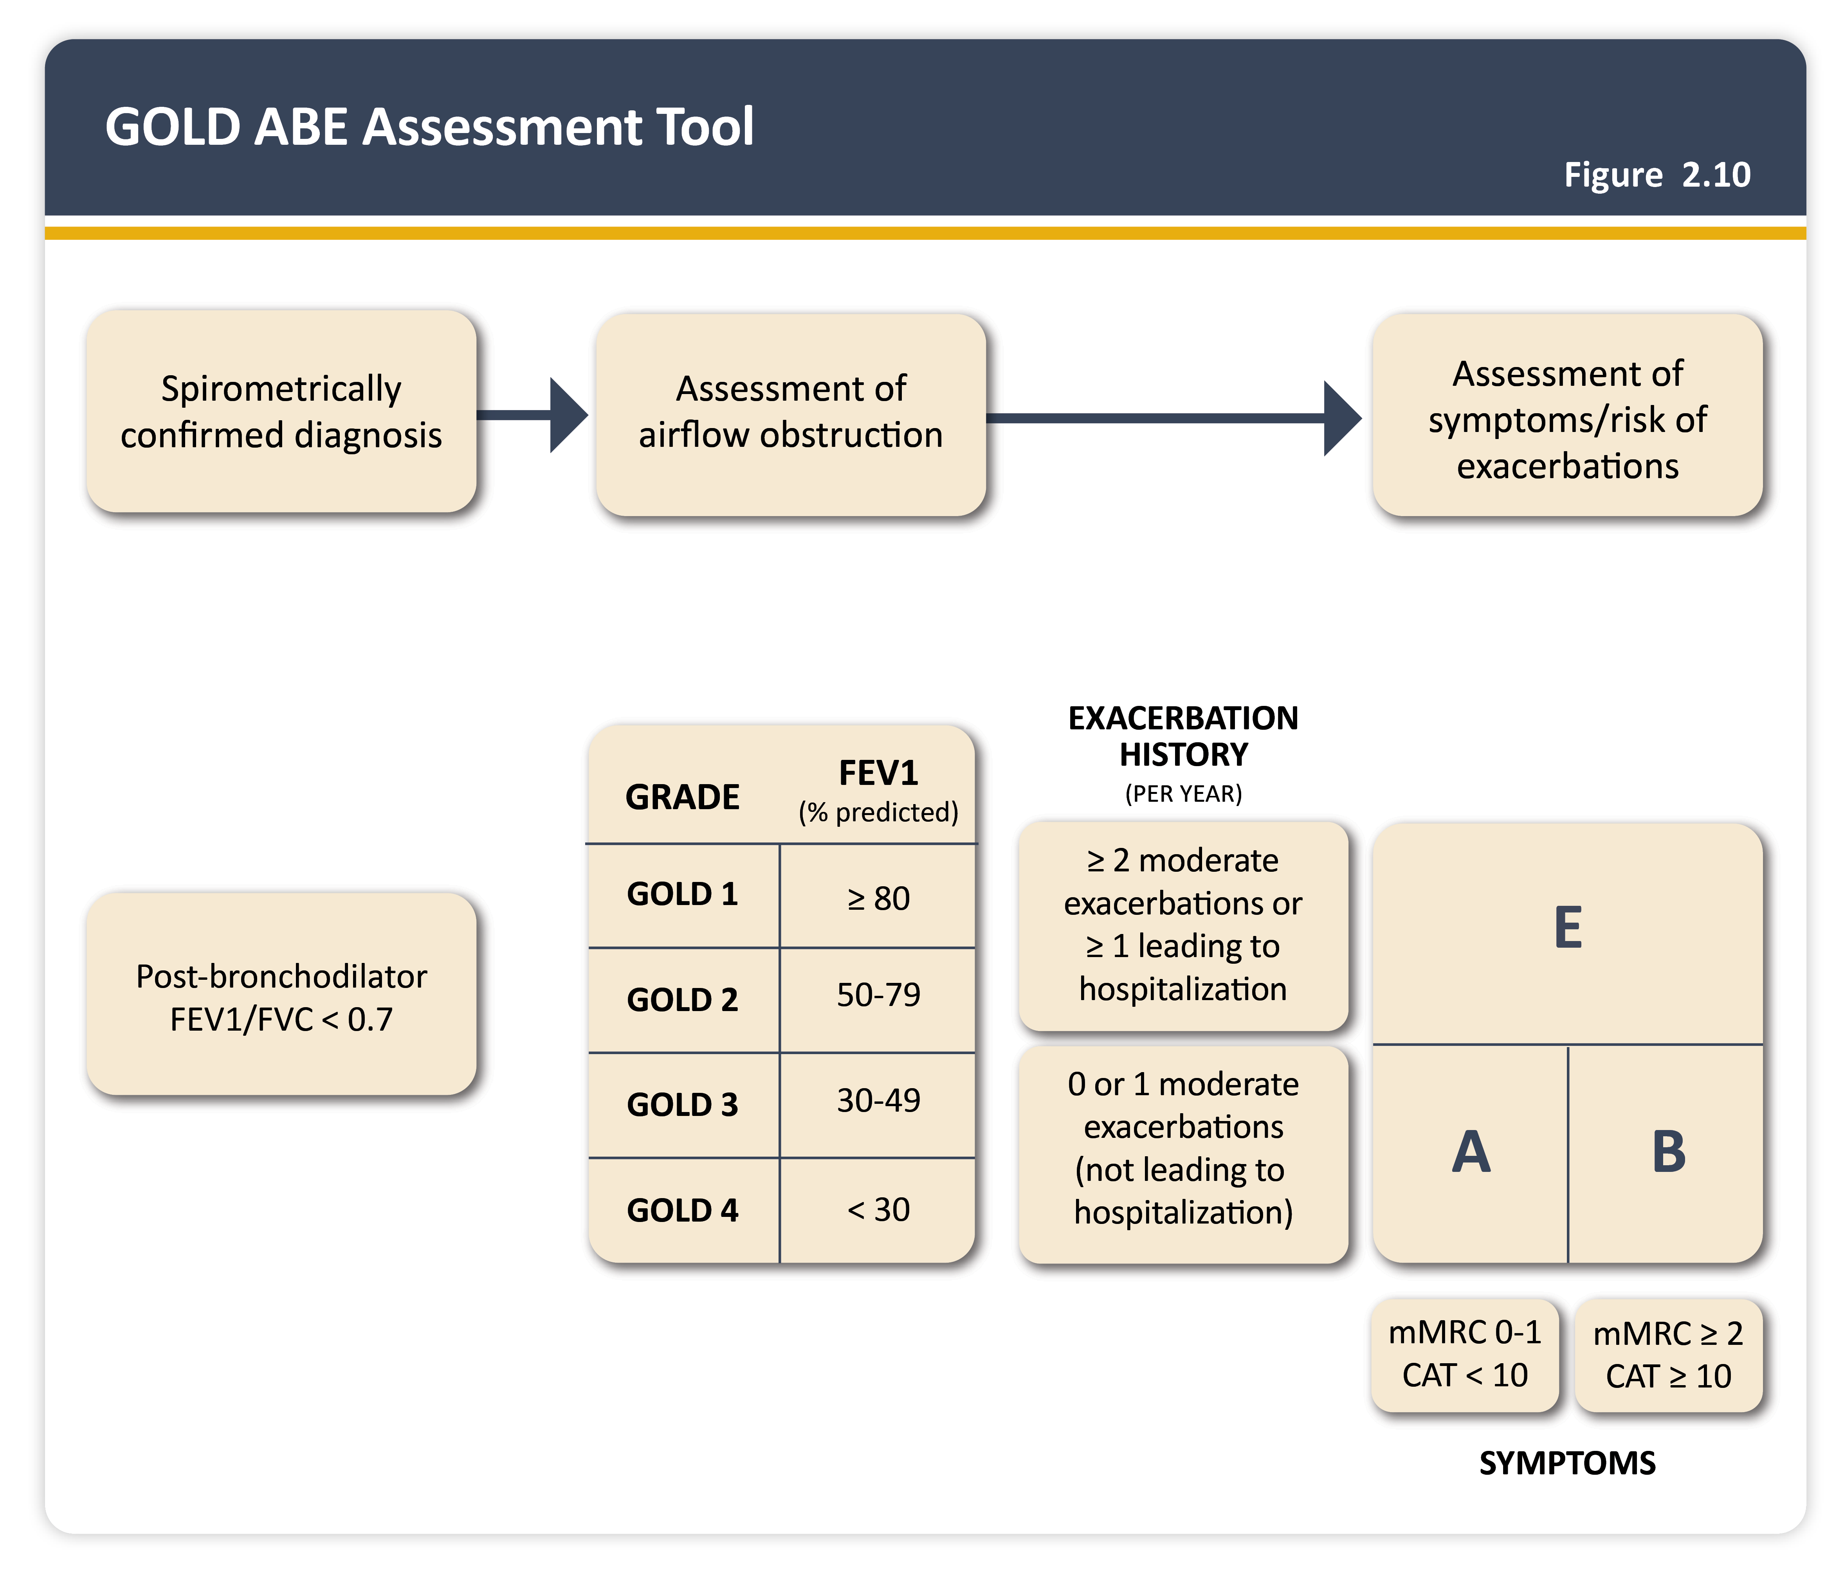
Teaching
Slide Set

Slide 15
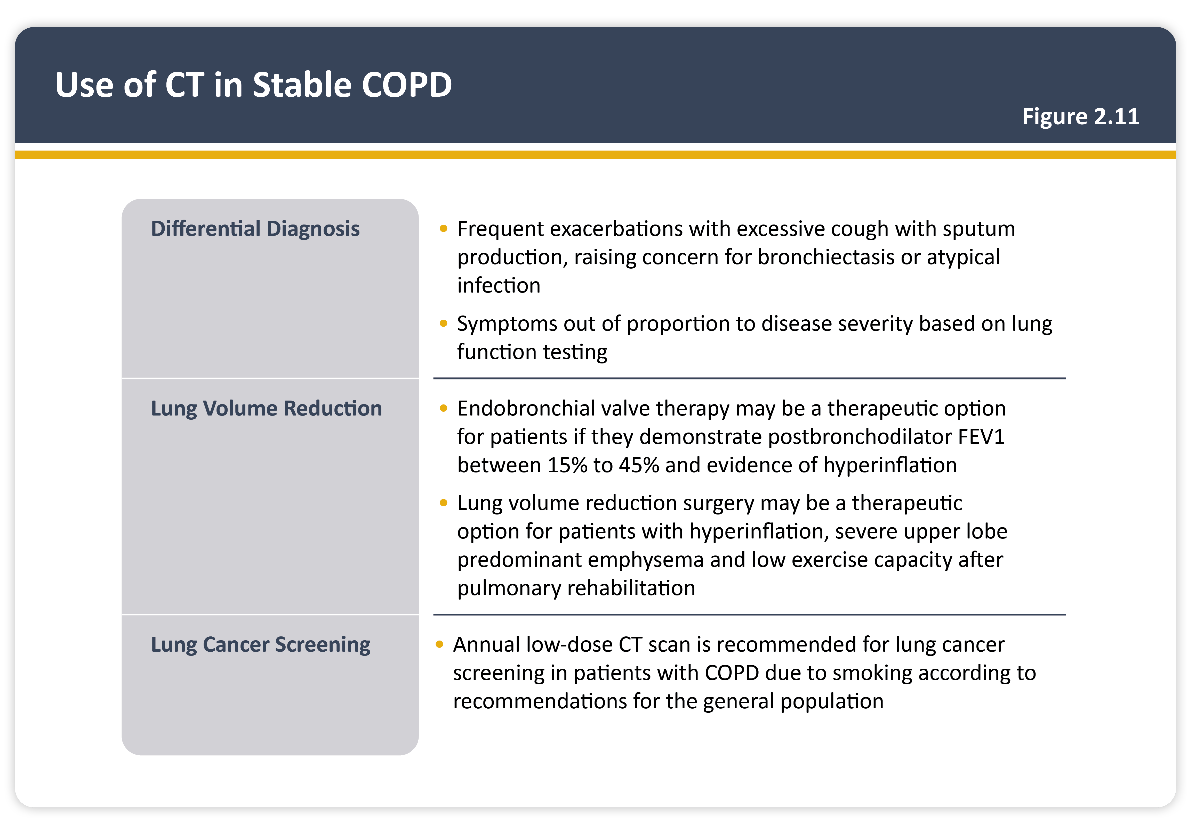
Teaching
Slide Set

Slide 16
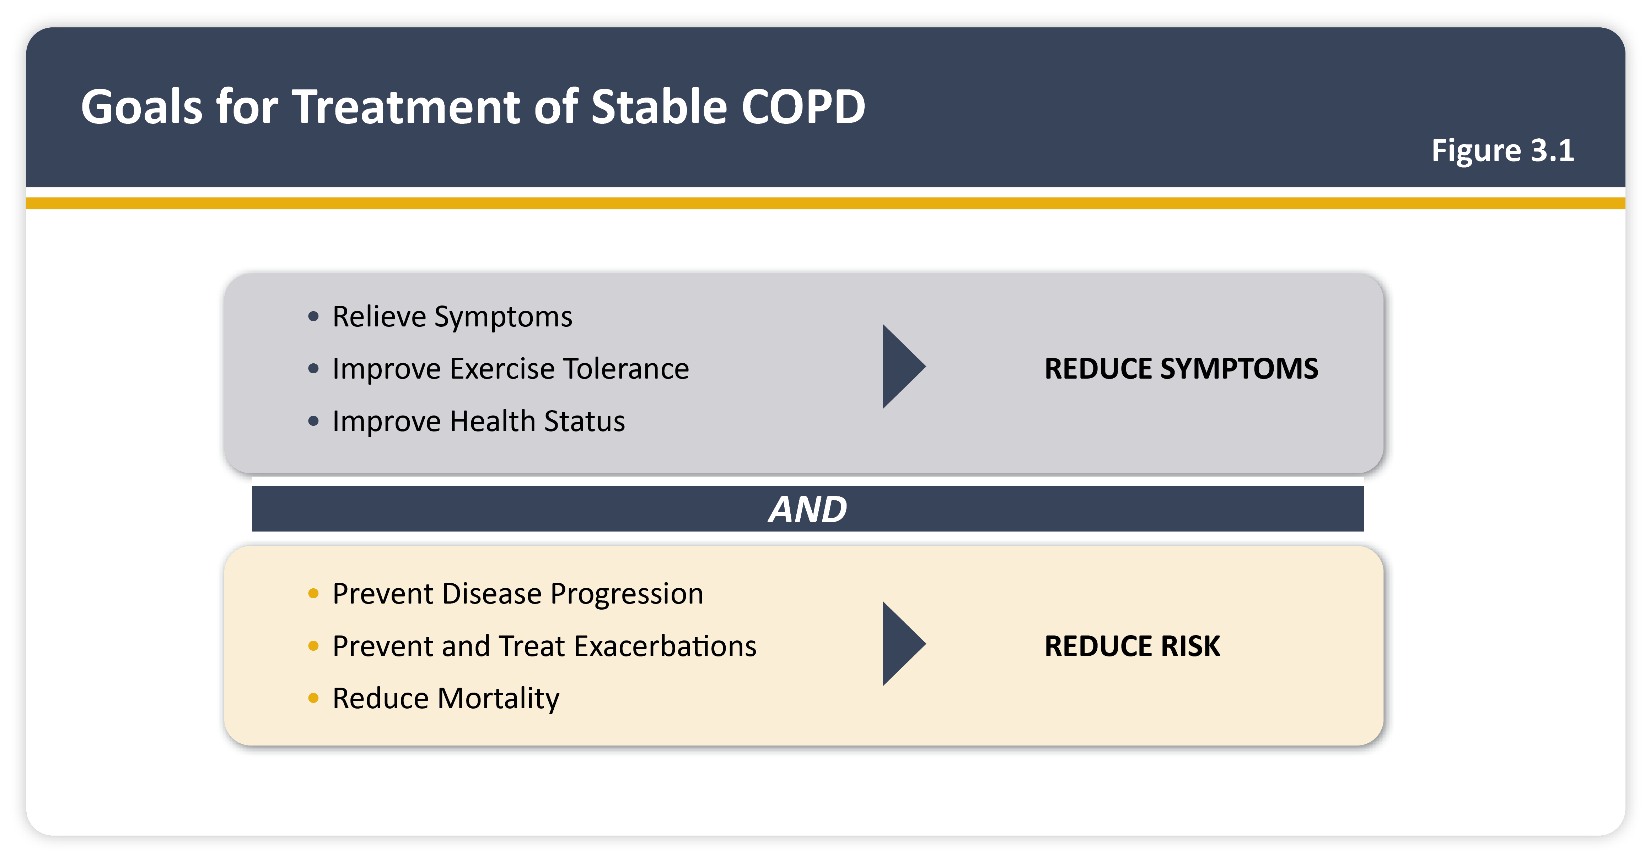
Teaching
Slide Set

Slide 17
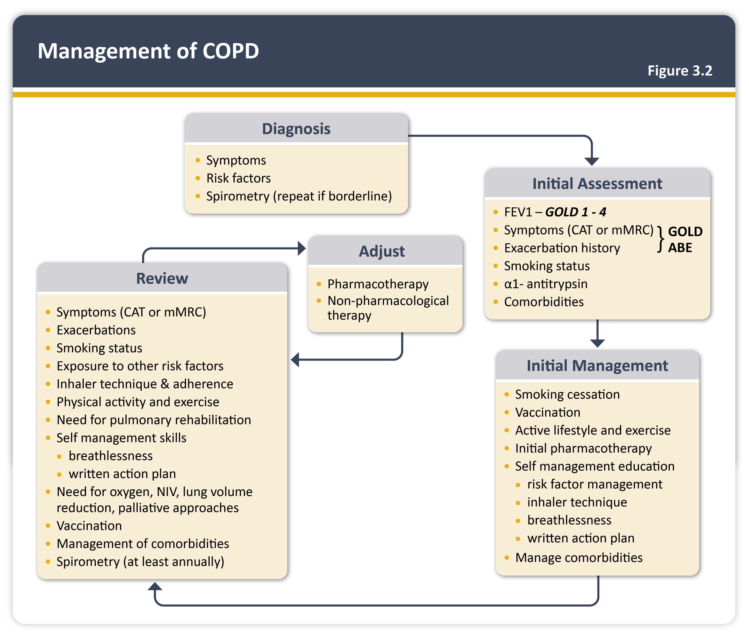
Teaching
Slide Set

Slide 18

Teaching
Slide Set

Slide 19
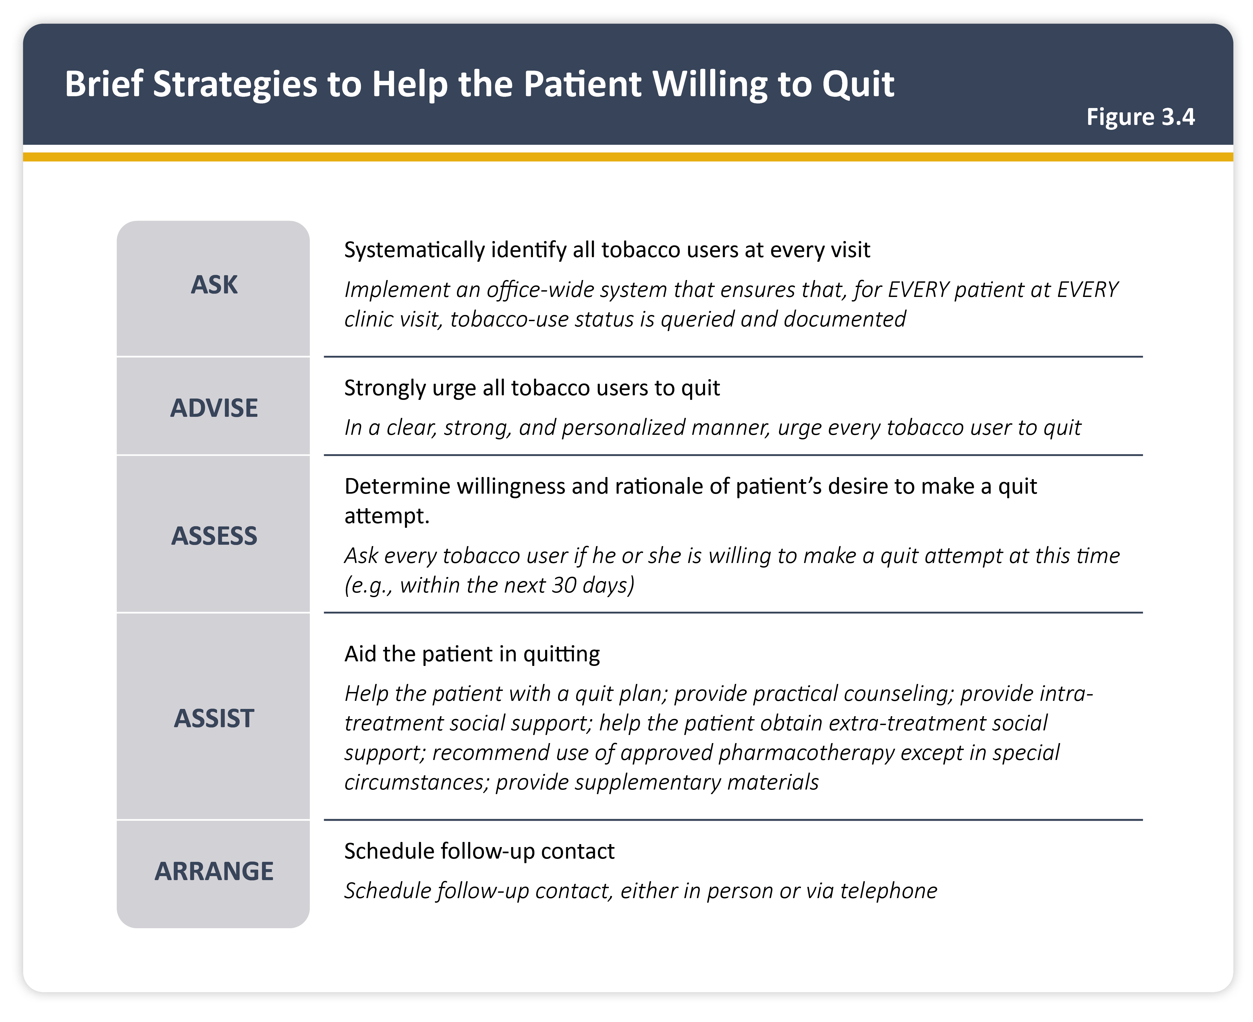
Teaching
Slide Set

Slide 20
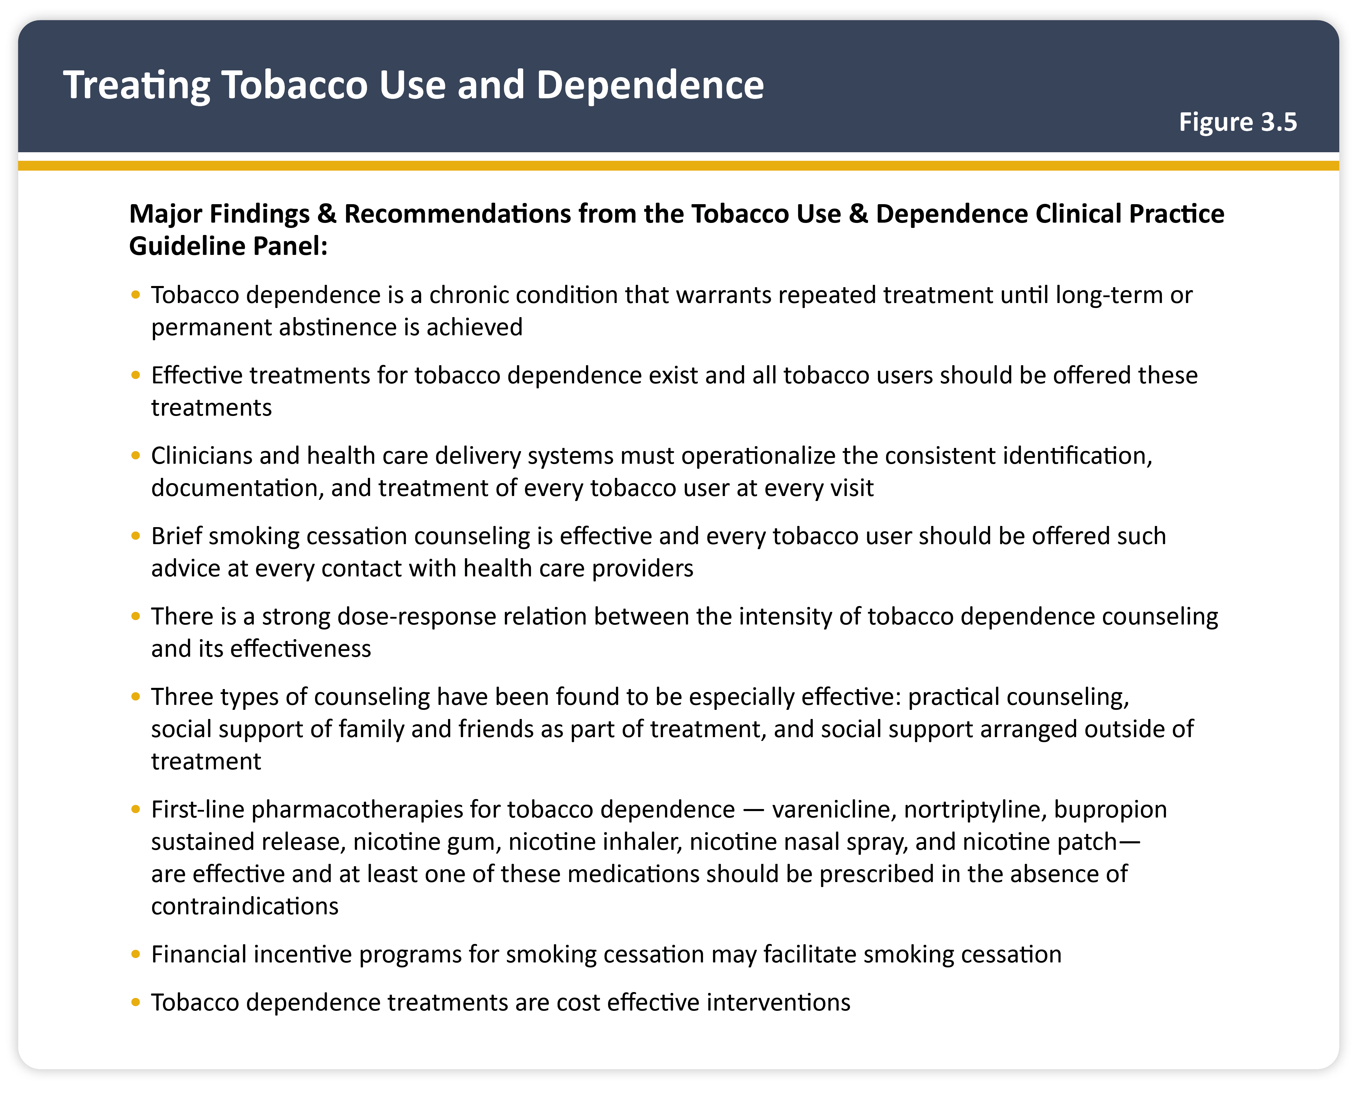
Teaching
Slide Set

Slide 21

Teaching
Slide Set

Slide 22
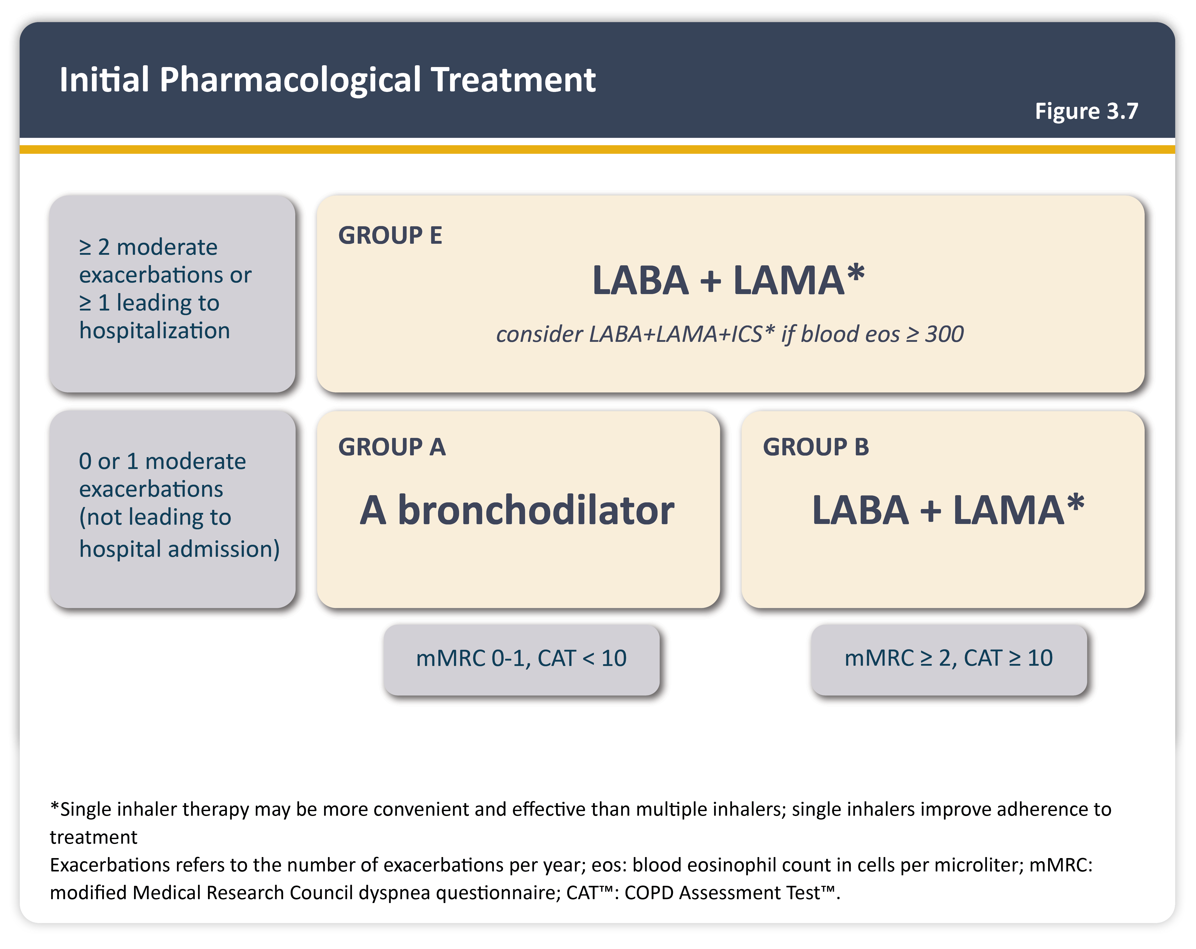
Teaching
Slide Set

Slide 23
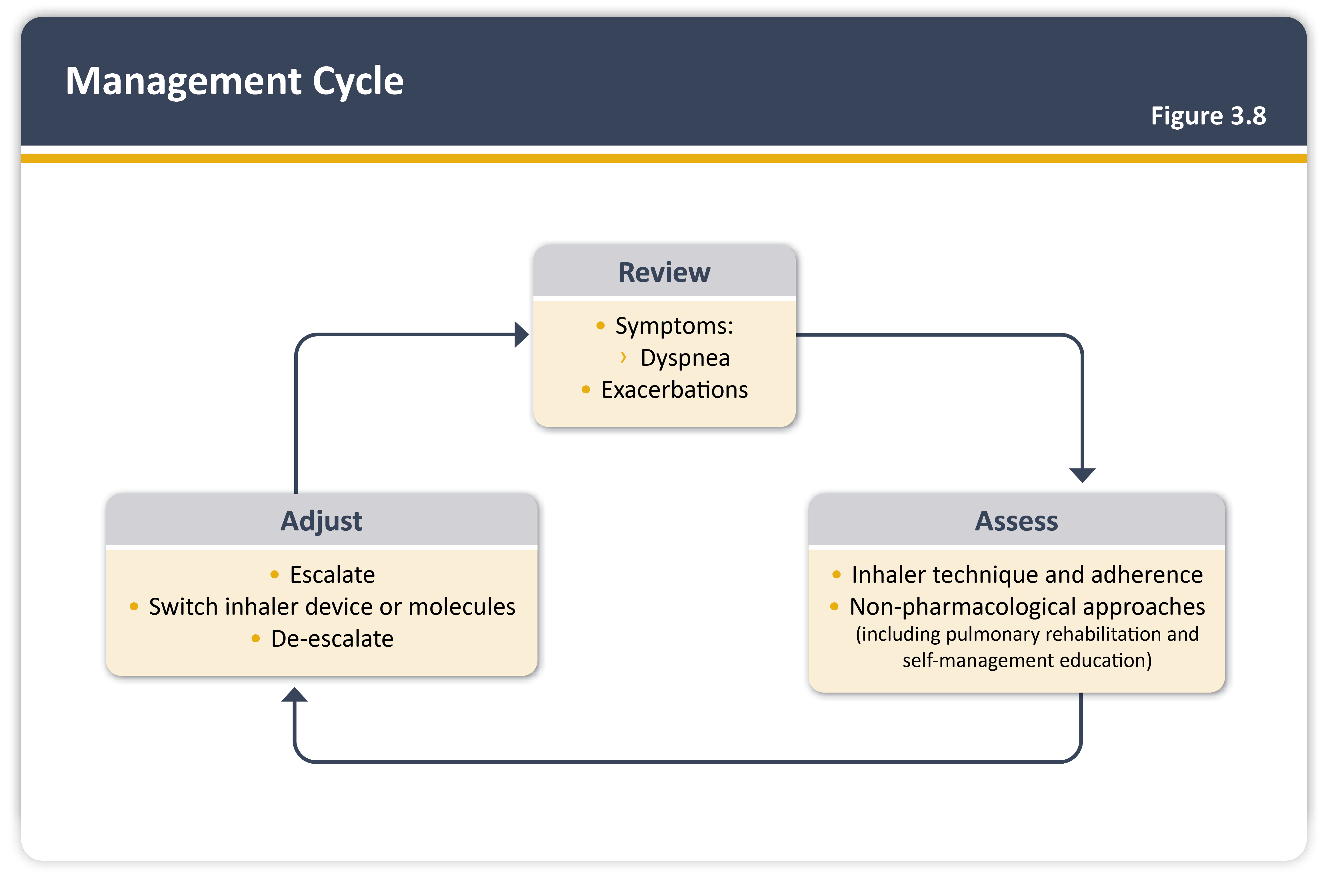
Teaching
Slide Set

Slide 24
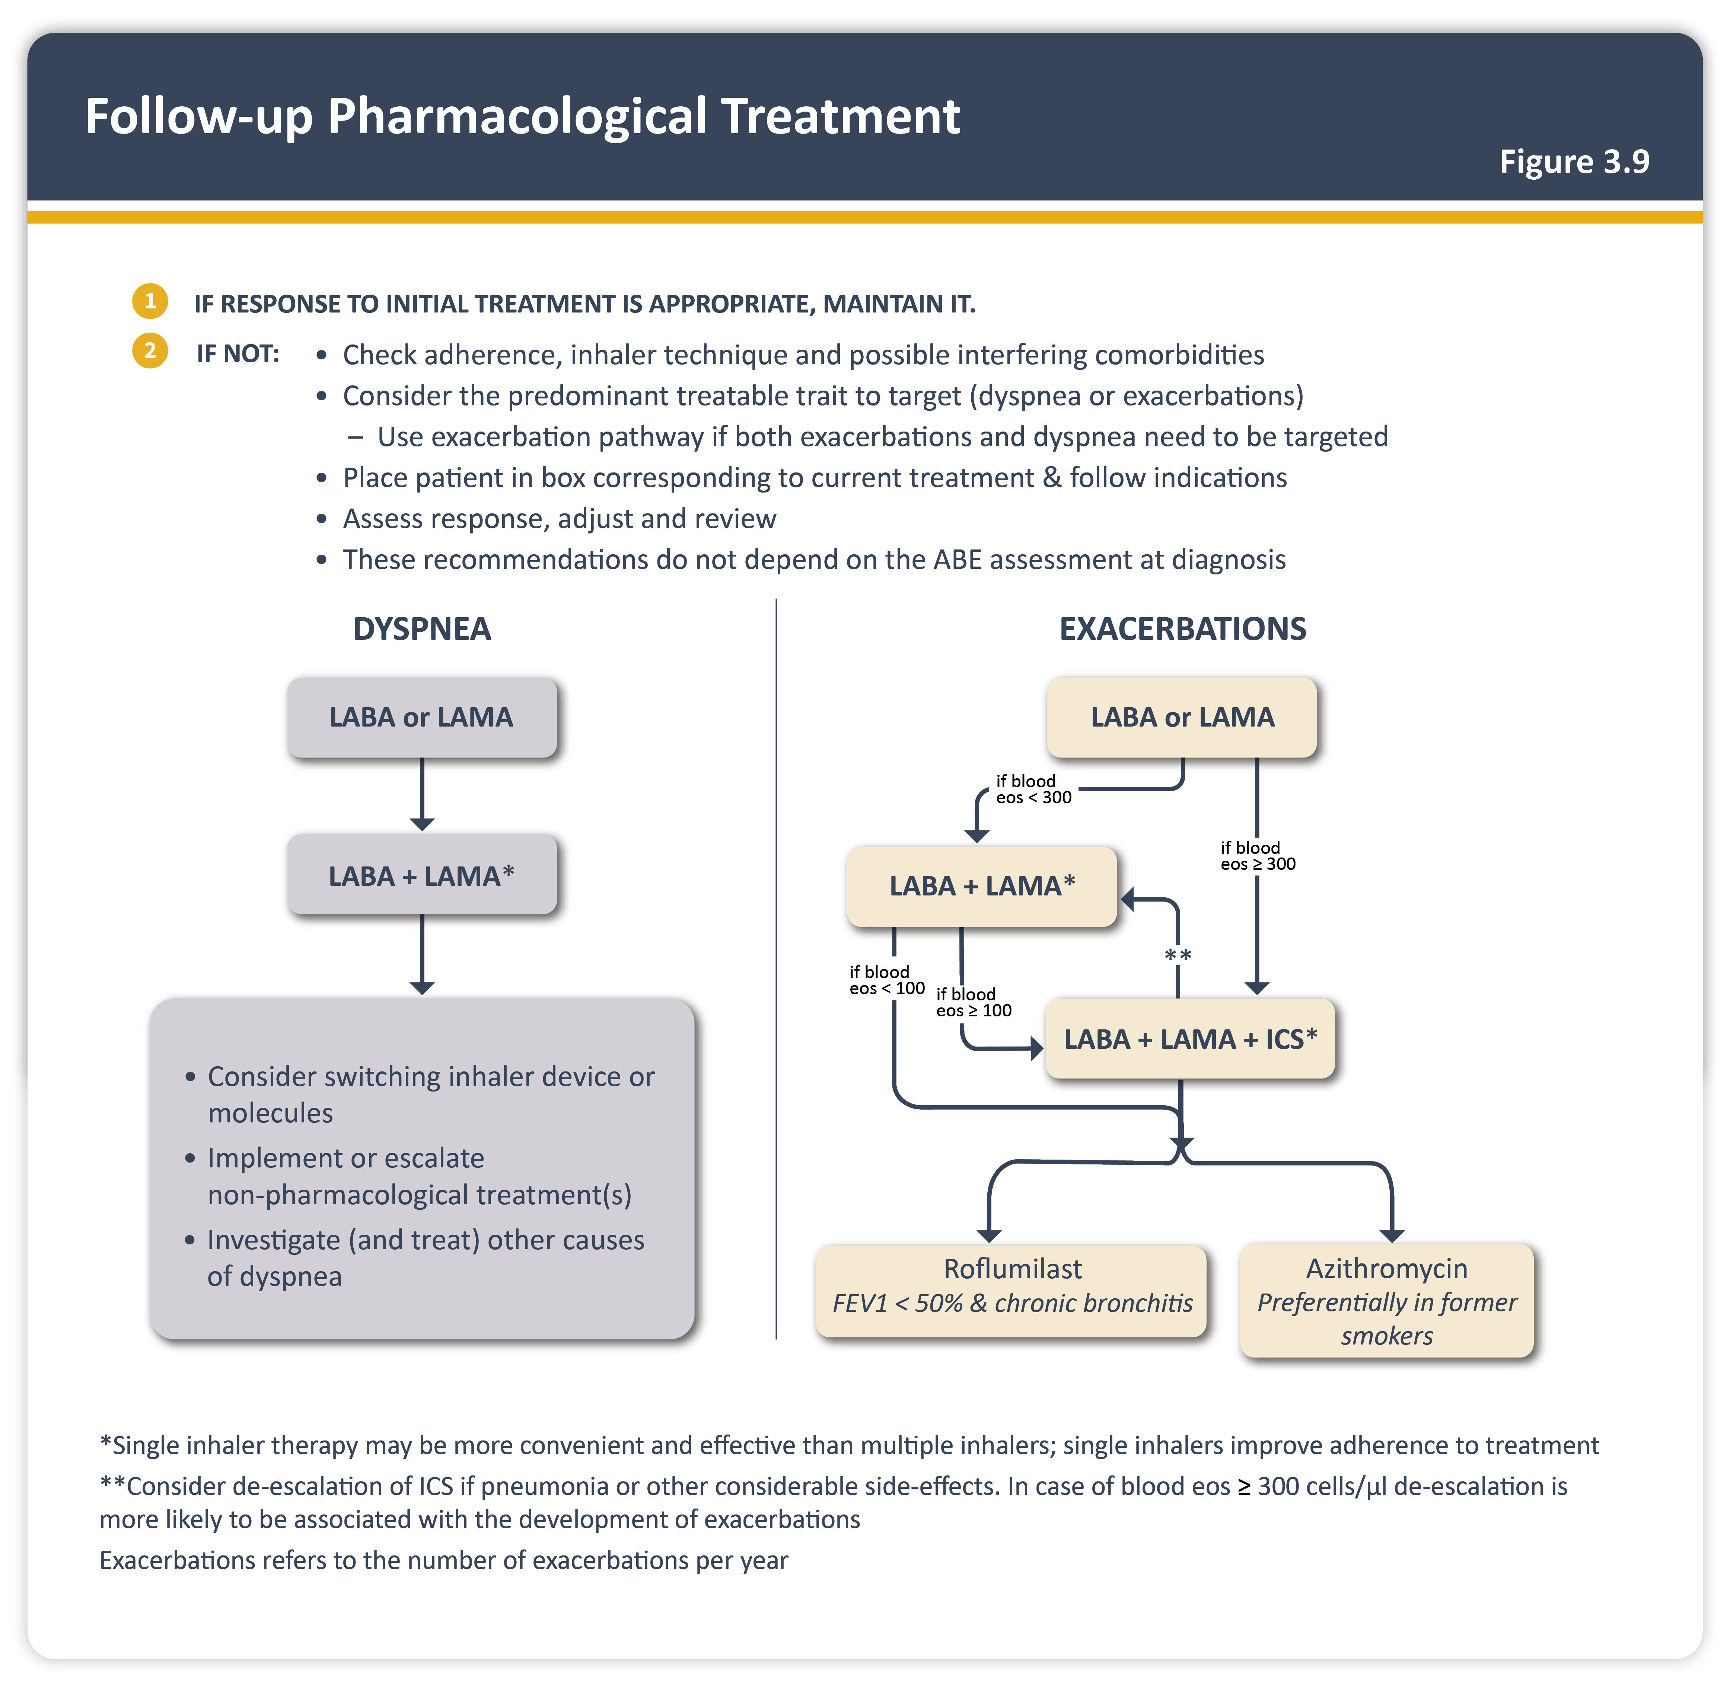
Teaching
Slide Set

Slide 25
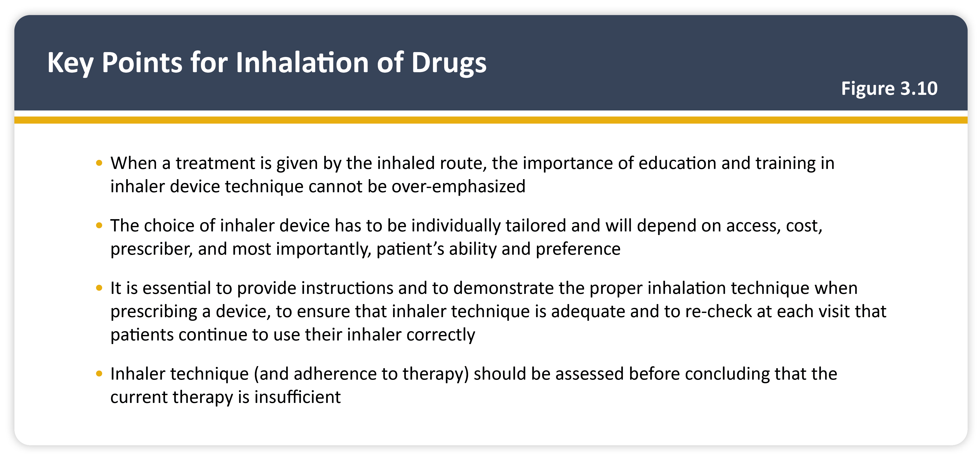
Teaching
Slide Set

Slide 26
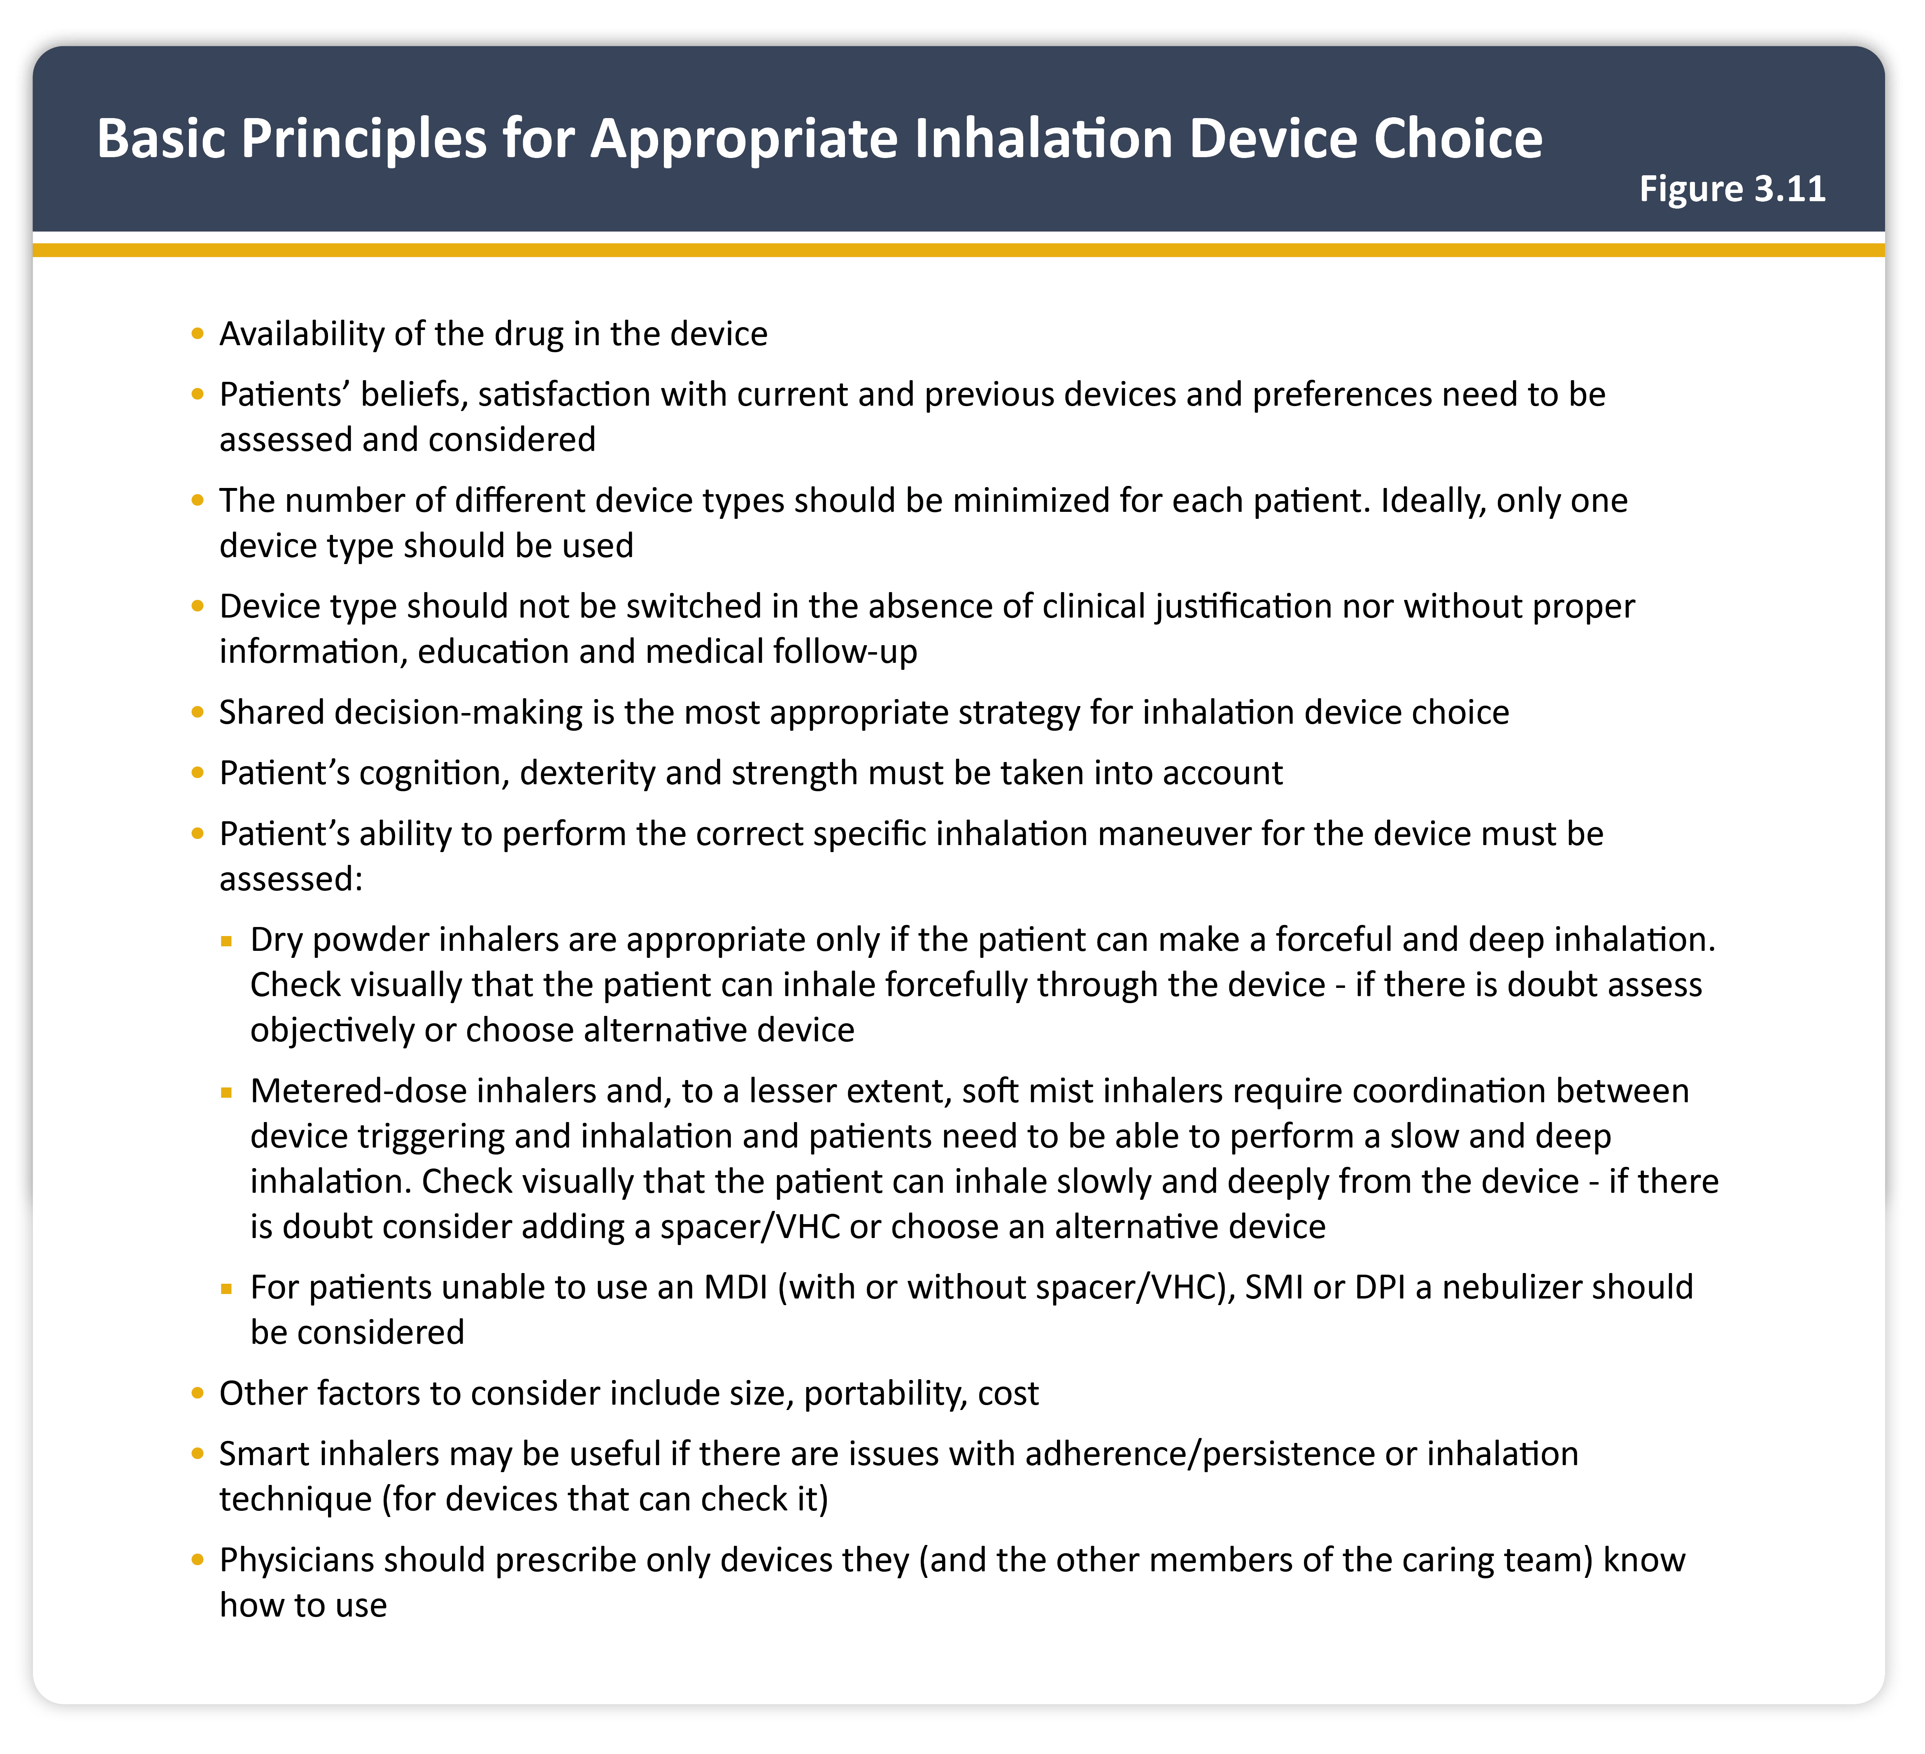
Teaching
Slide Set

Slide 27
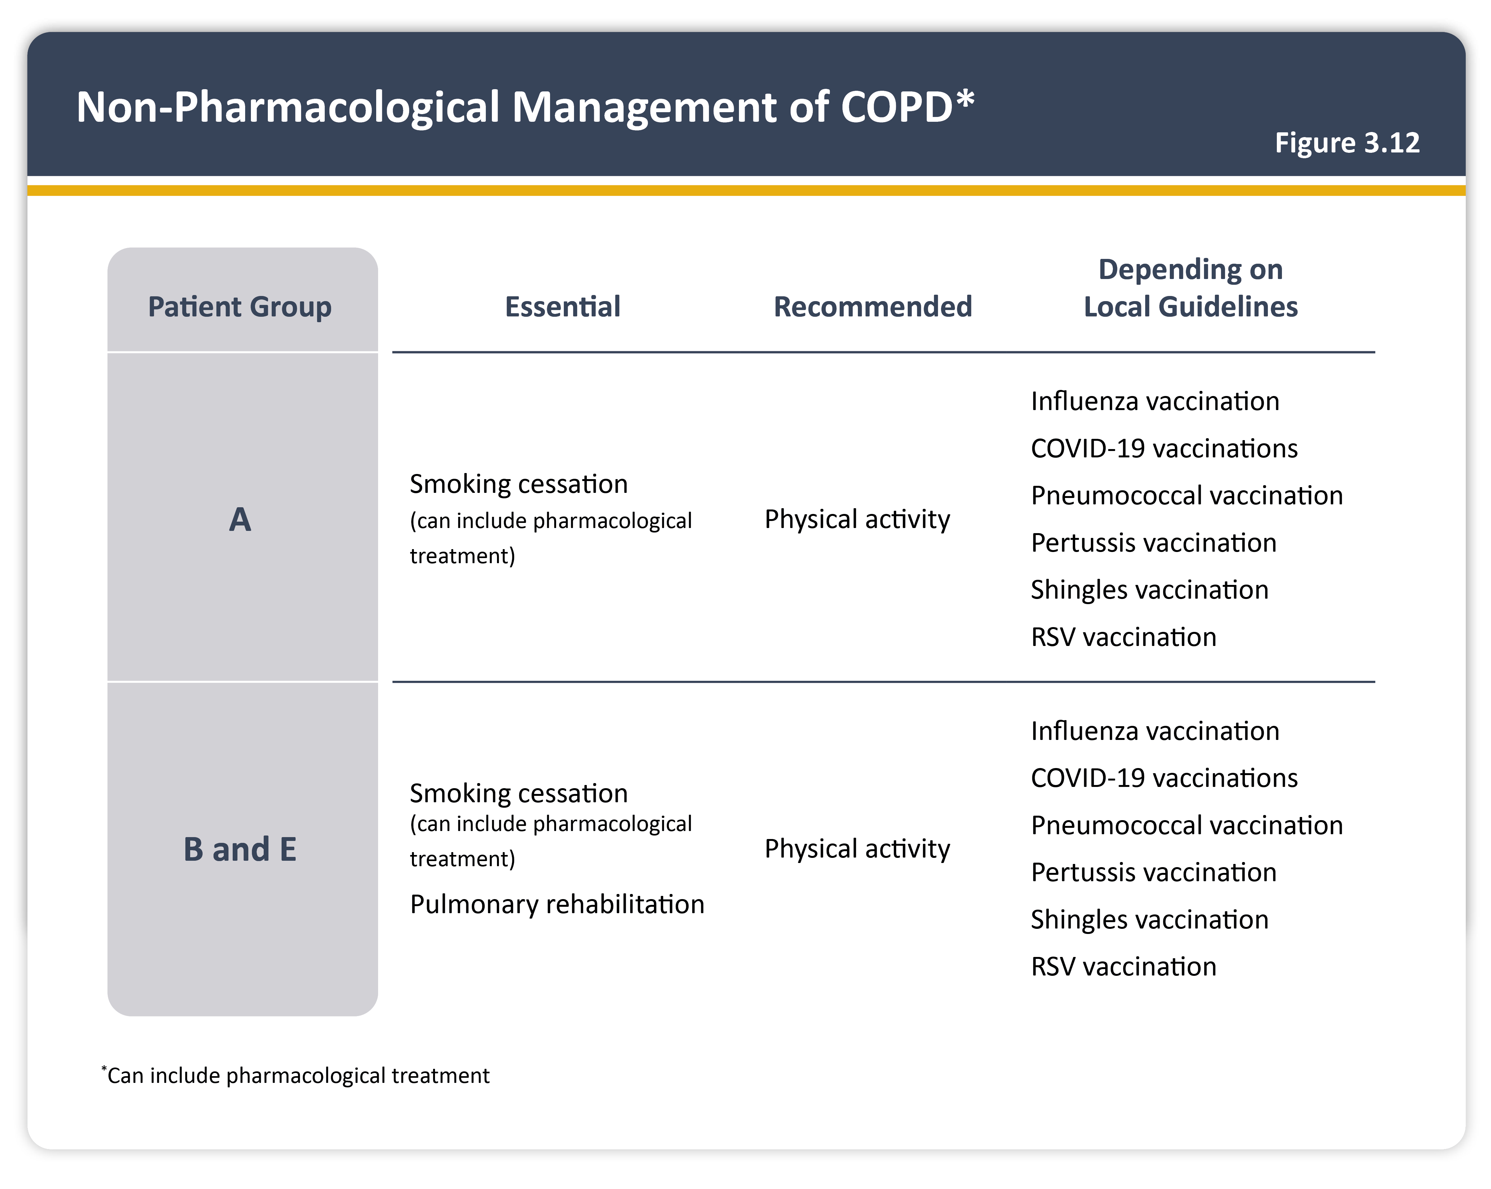
Teaching
Slide Set

Slide 28
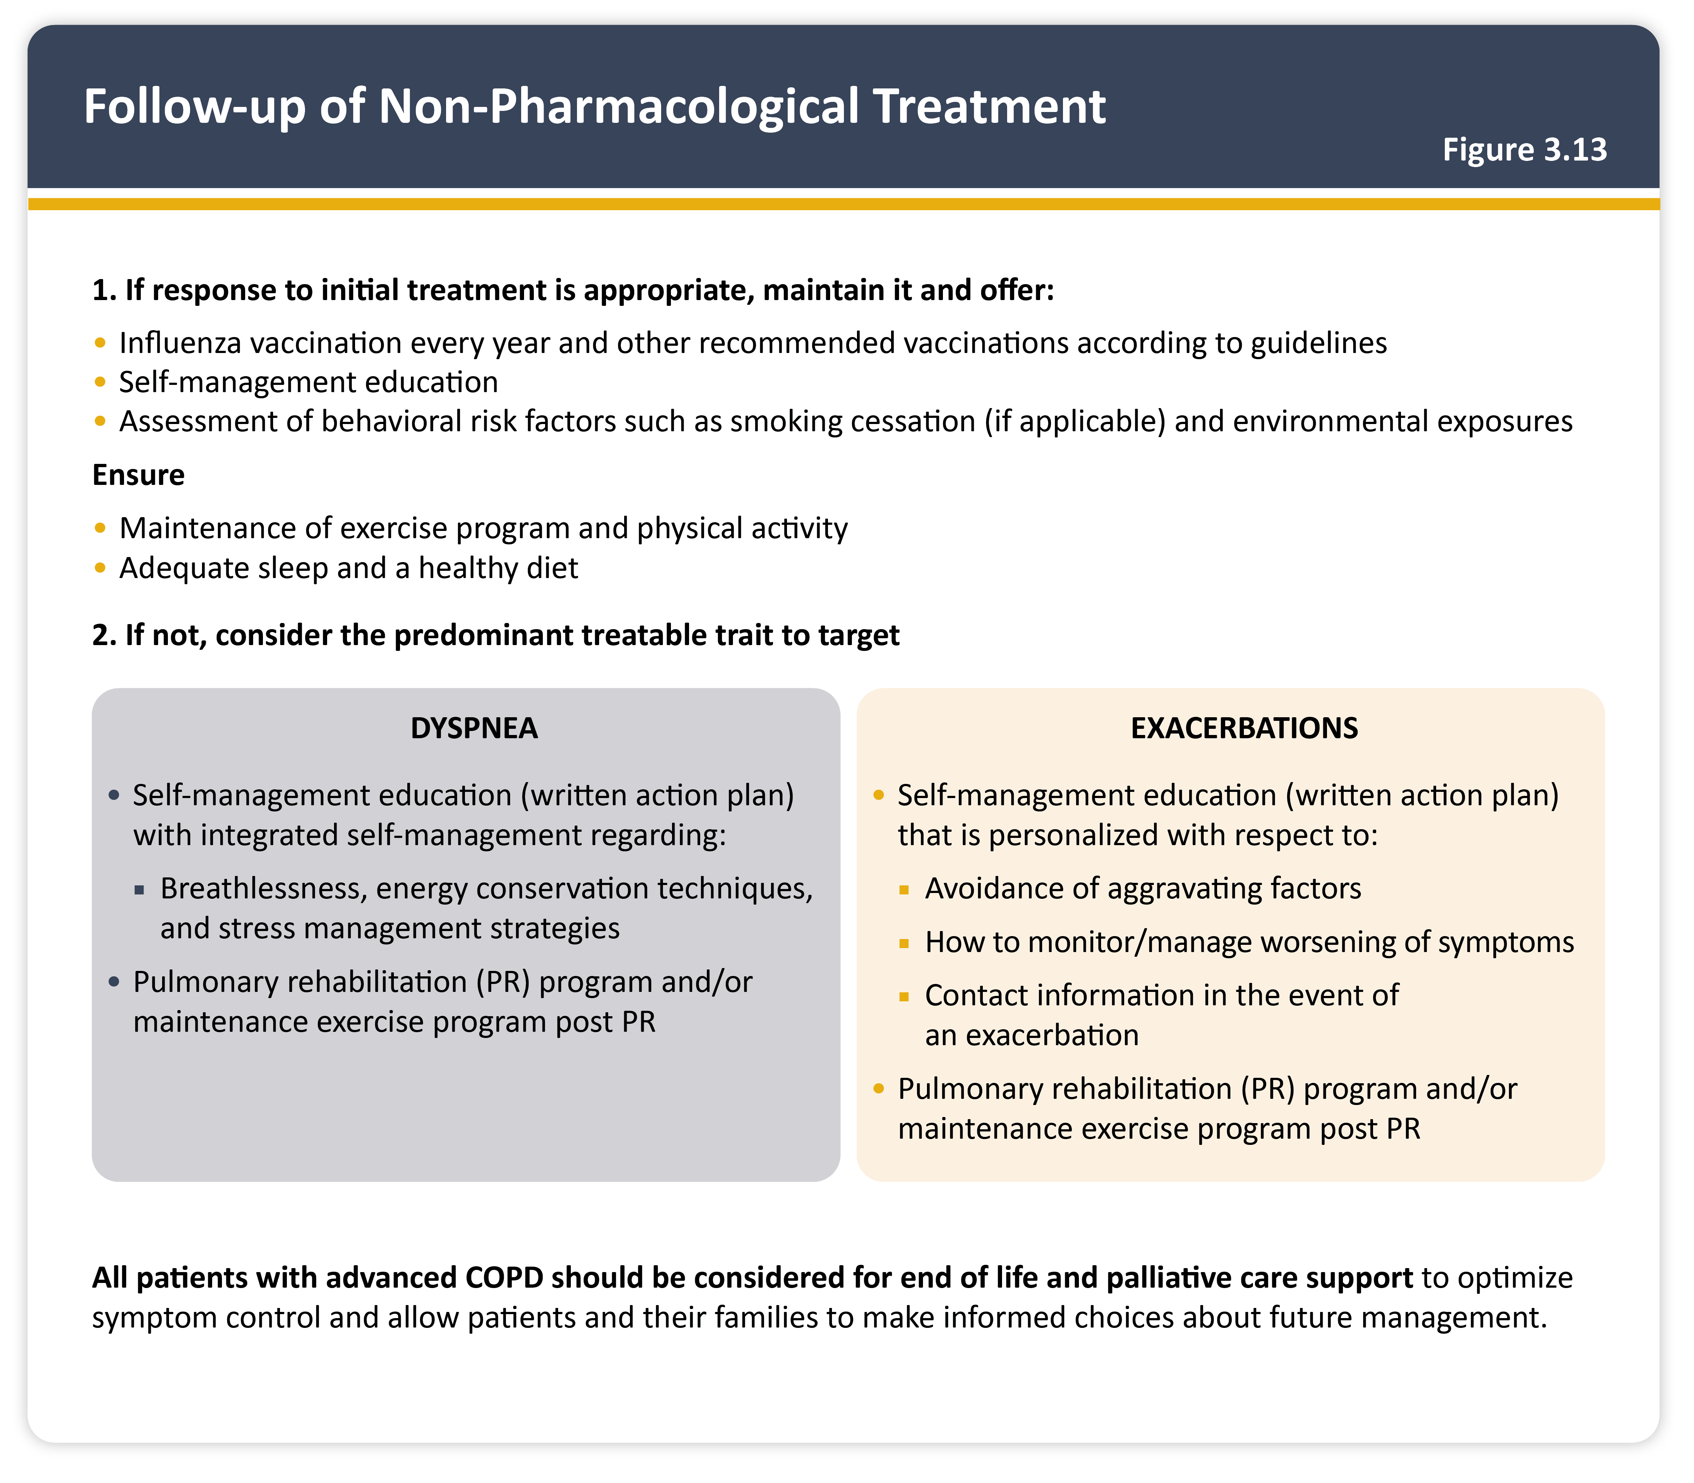
Teaching
Slide Set

Slide 29

Teaching
Slide Set

Slide 30
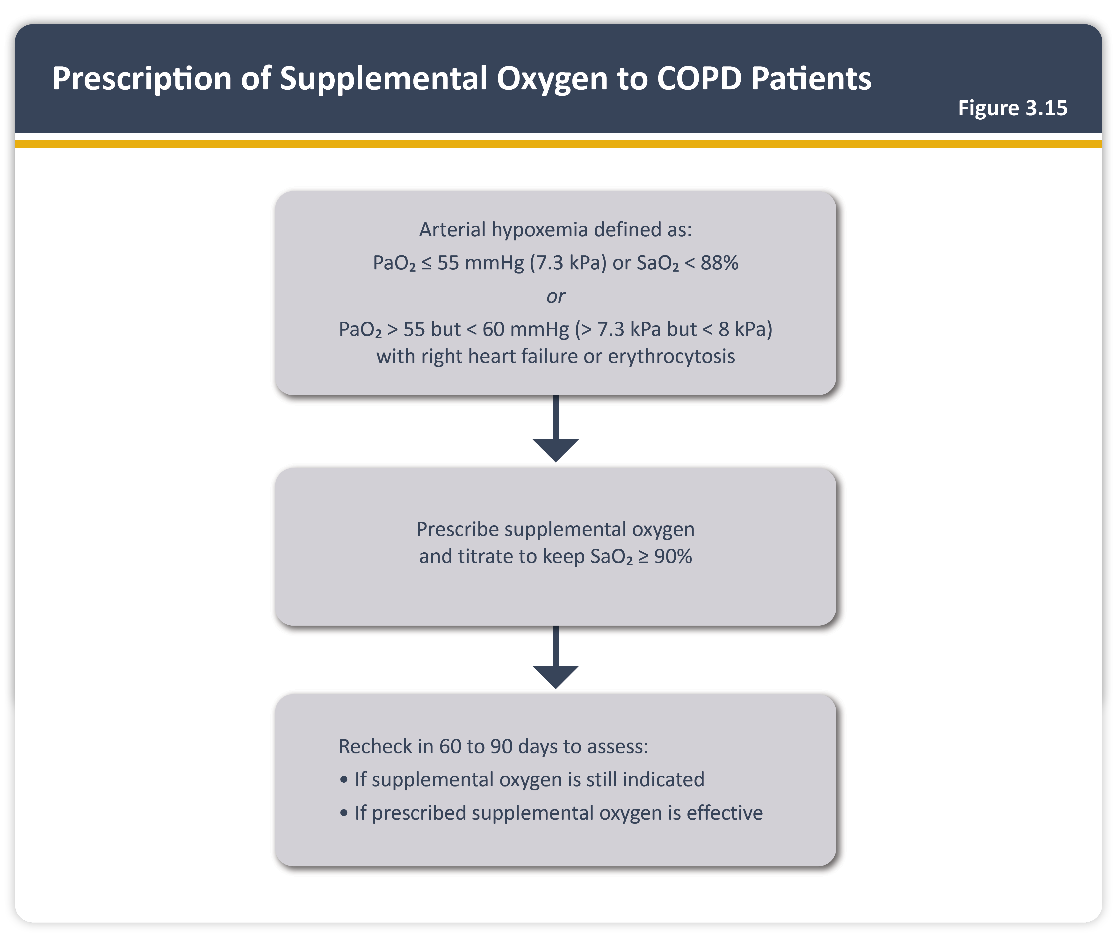
Teaching
Slide Set

Slide 31

Teaching
Slide Set

Slide 32
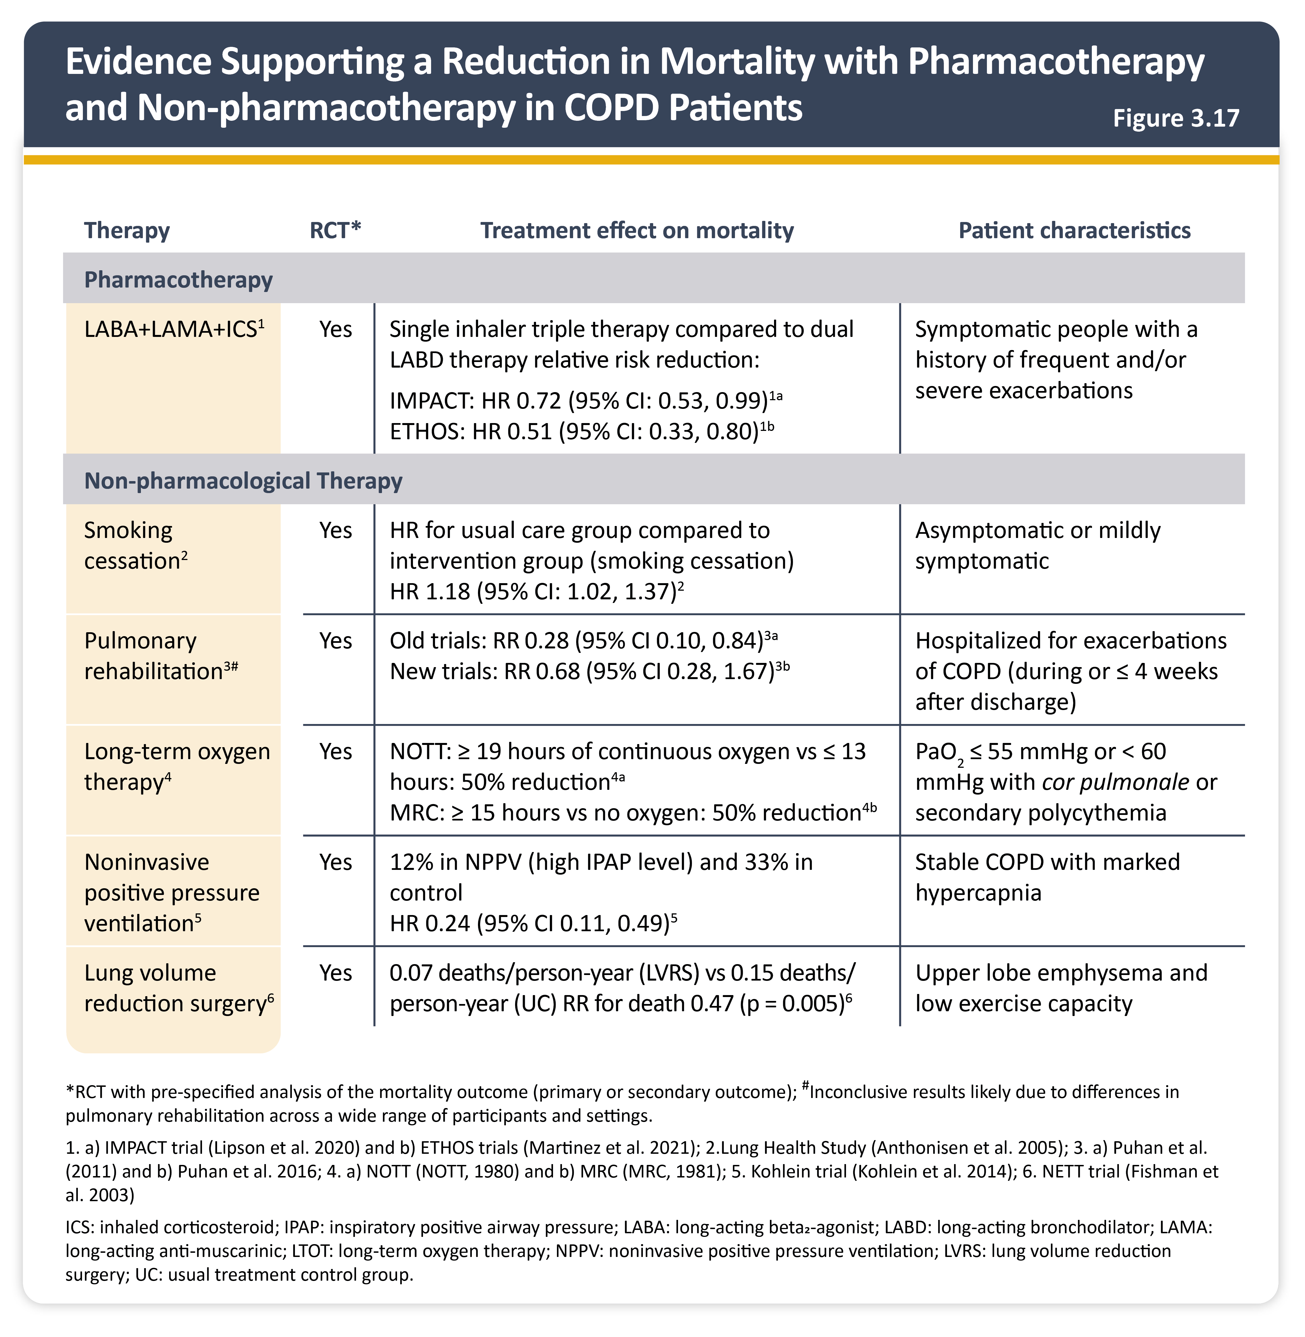
Teaching
Slide Set

Slide 33
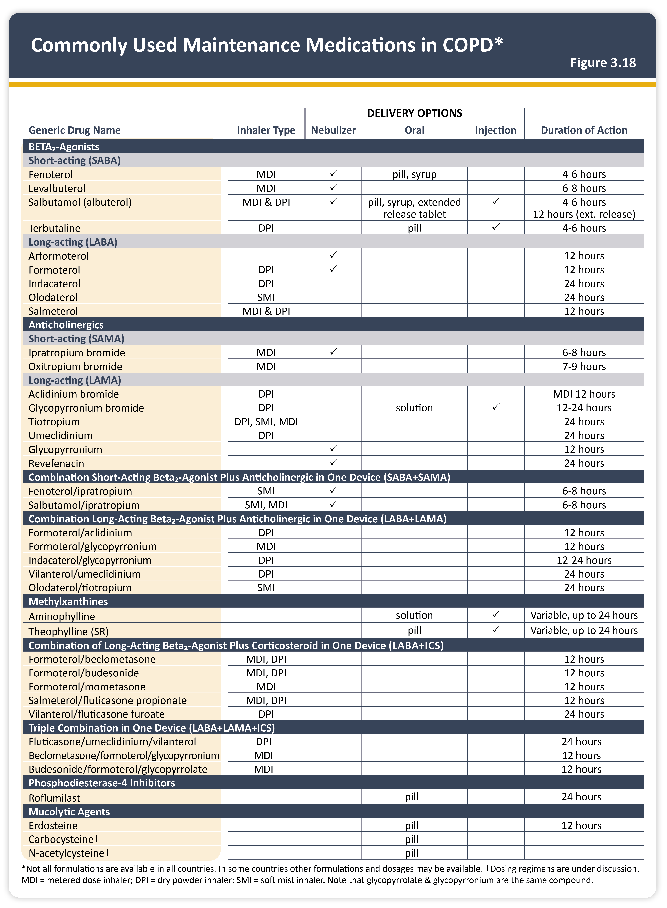
Teaching
Slide Set

Slide 34
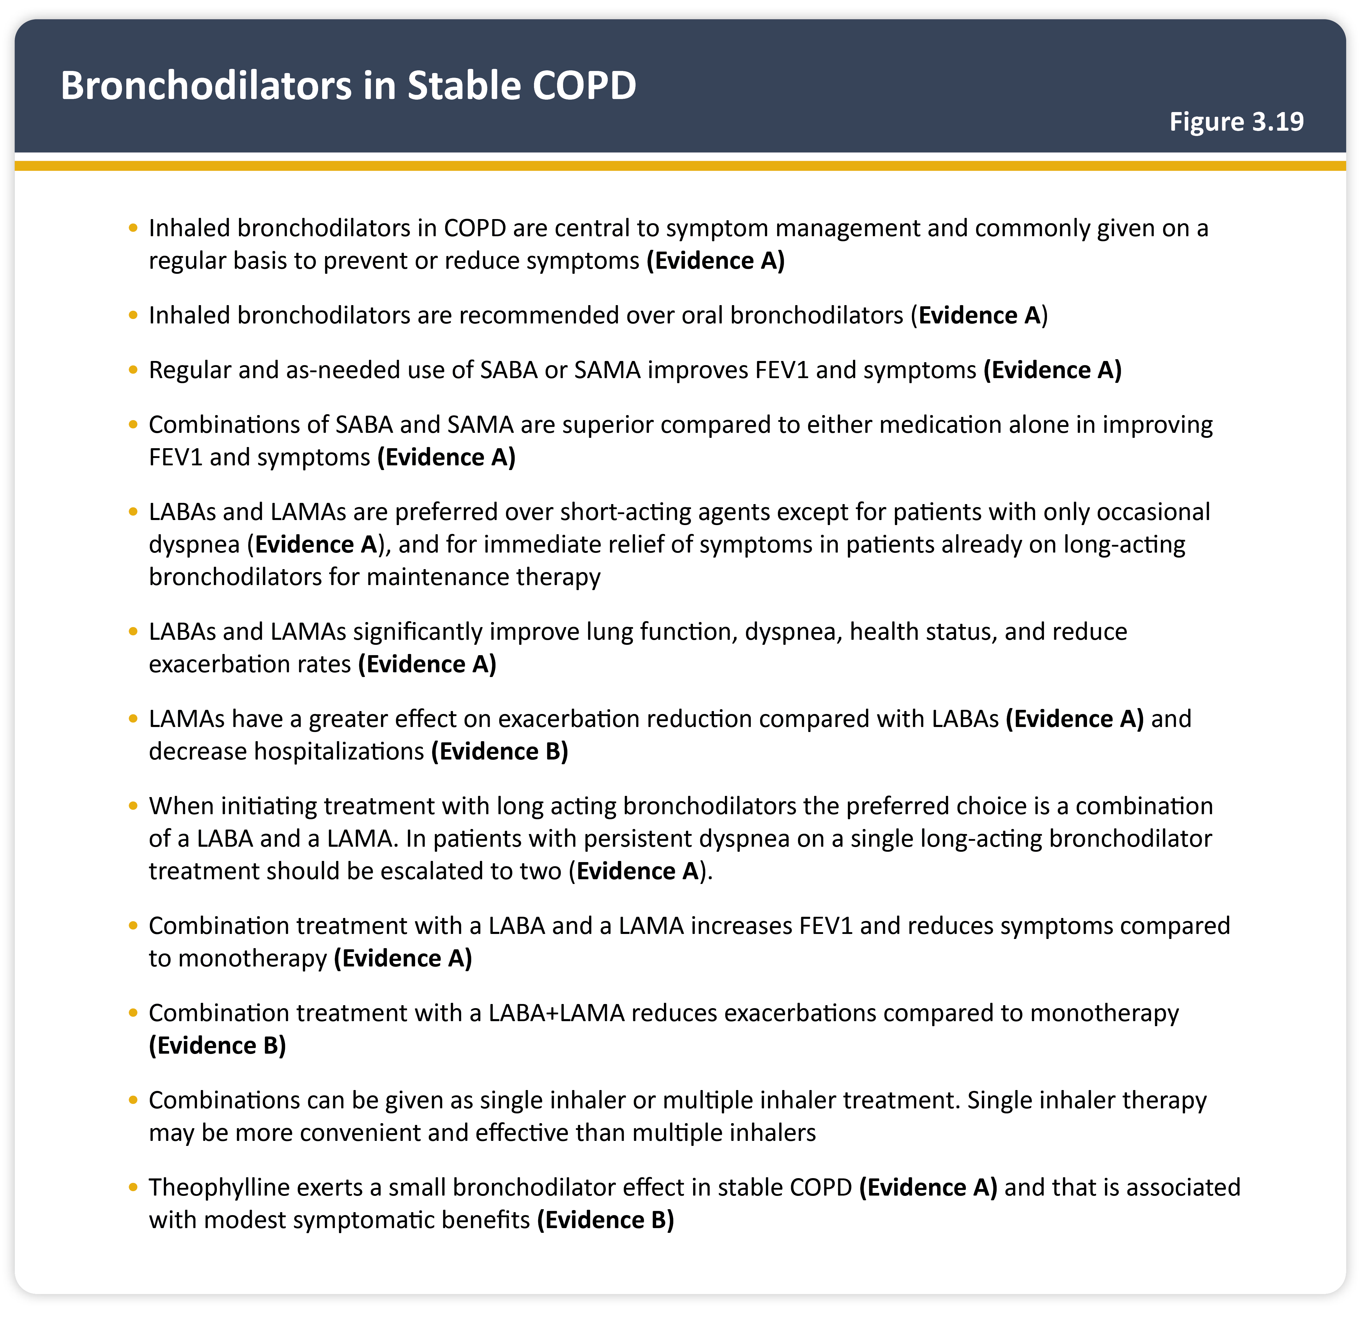
Teaching
Slide Set

Slide 35
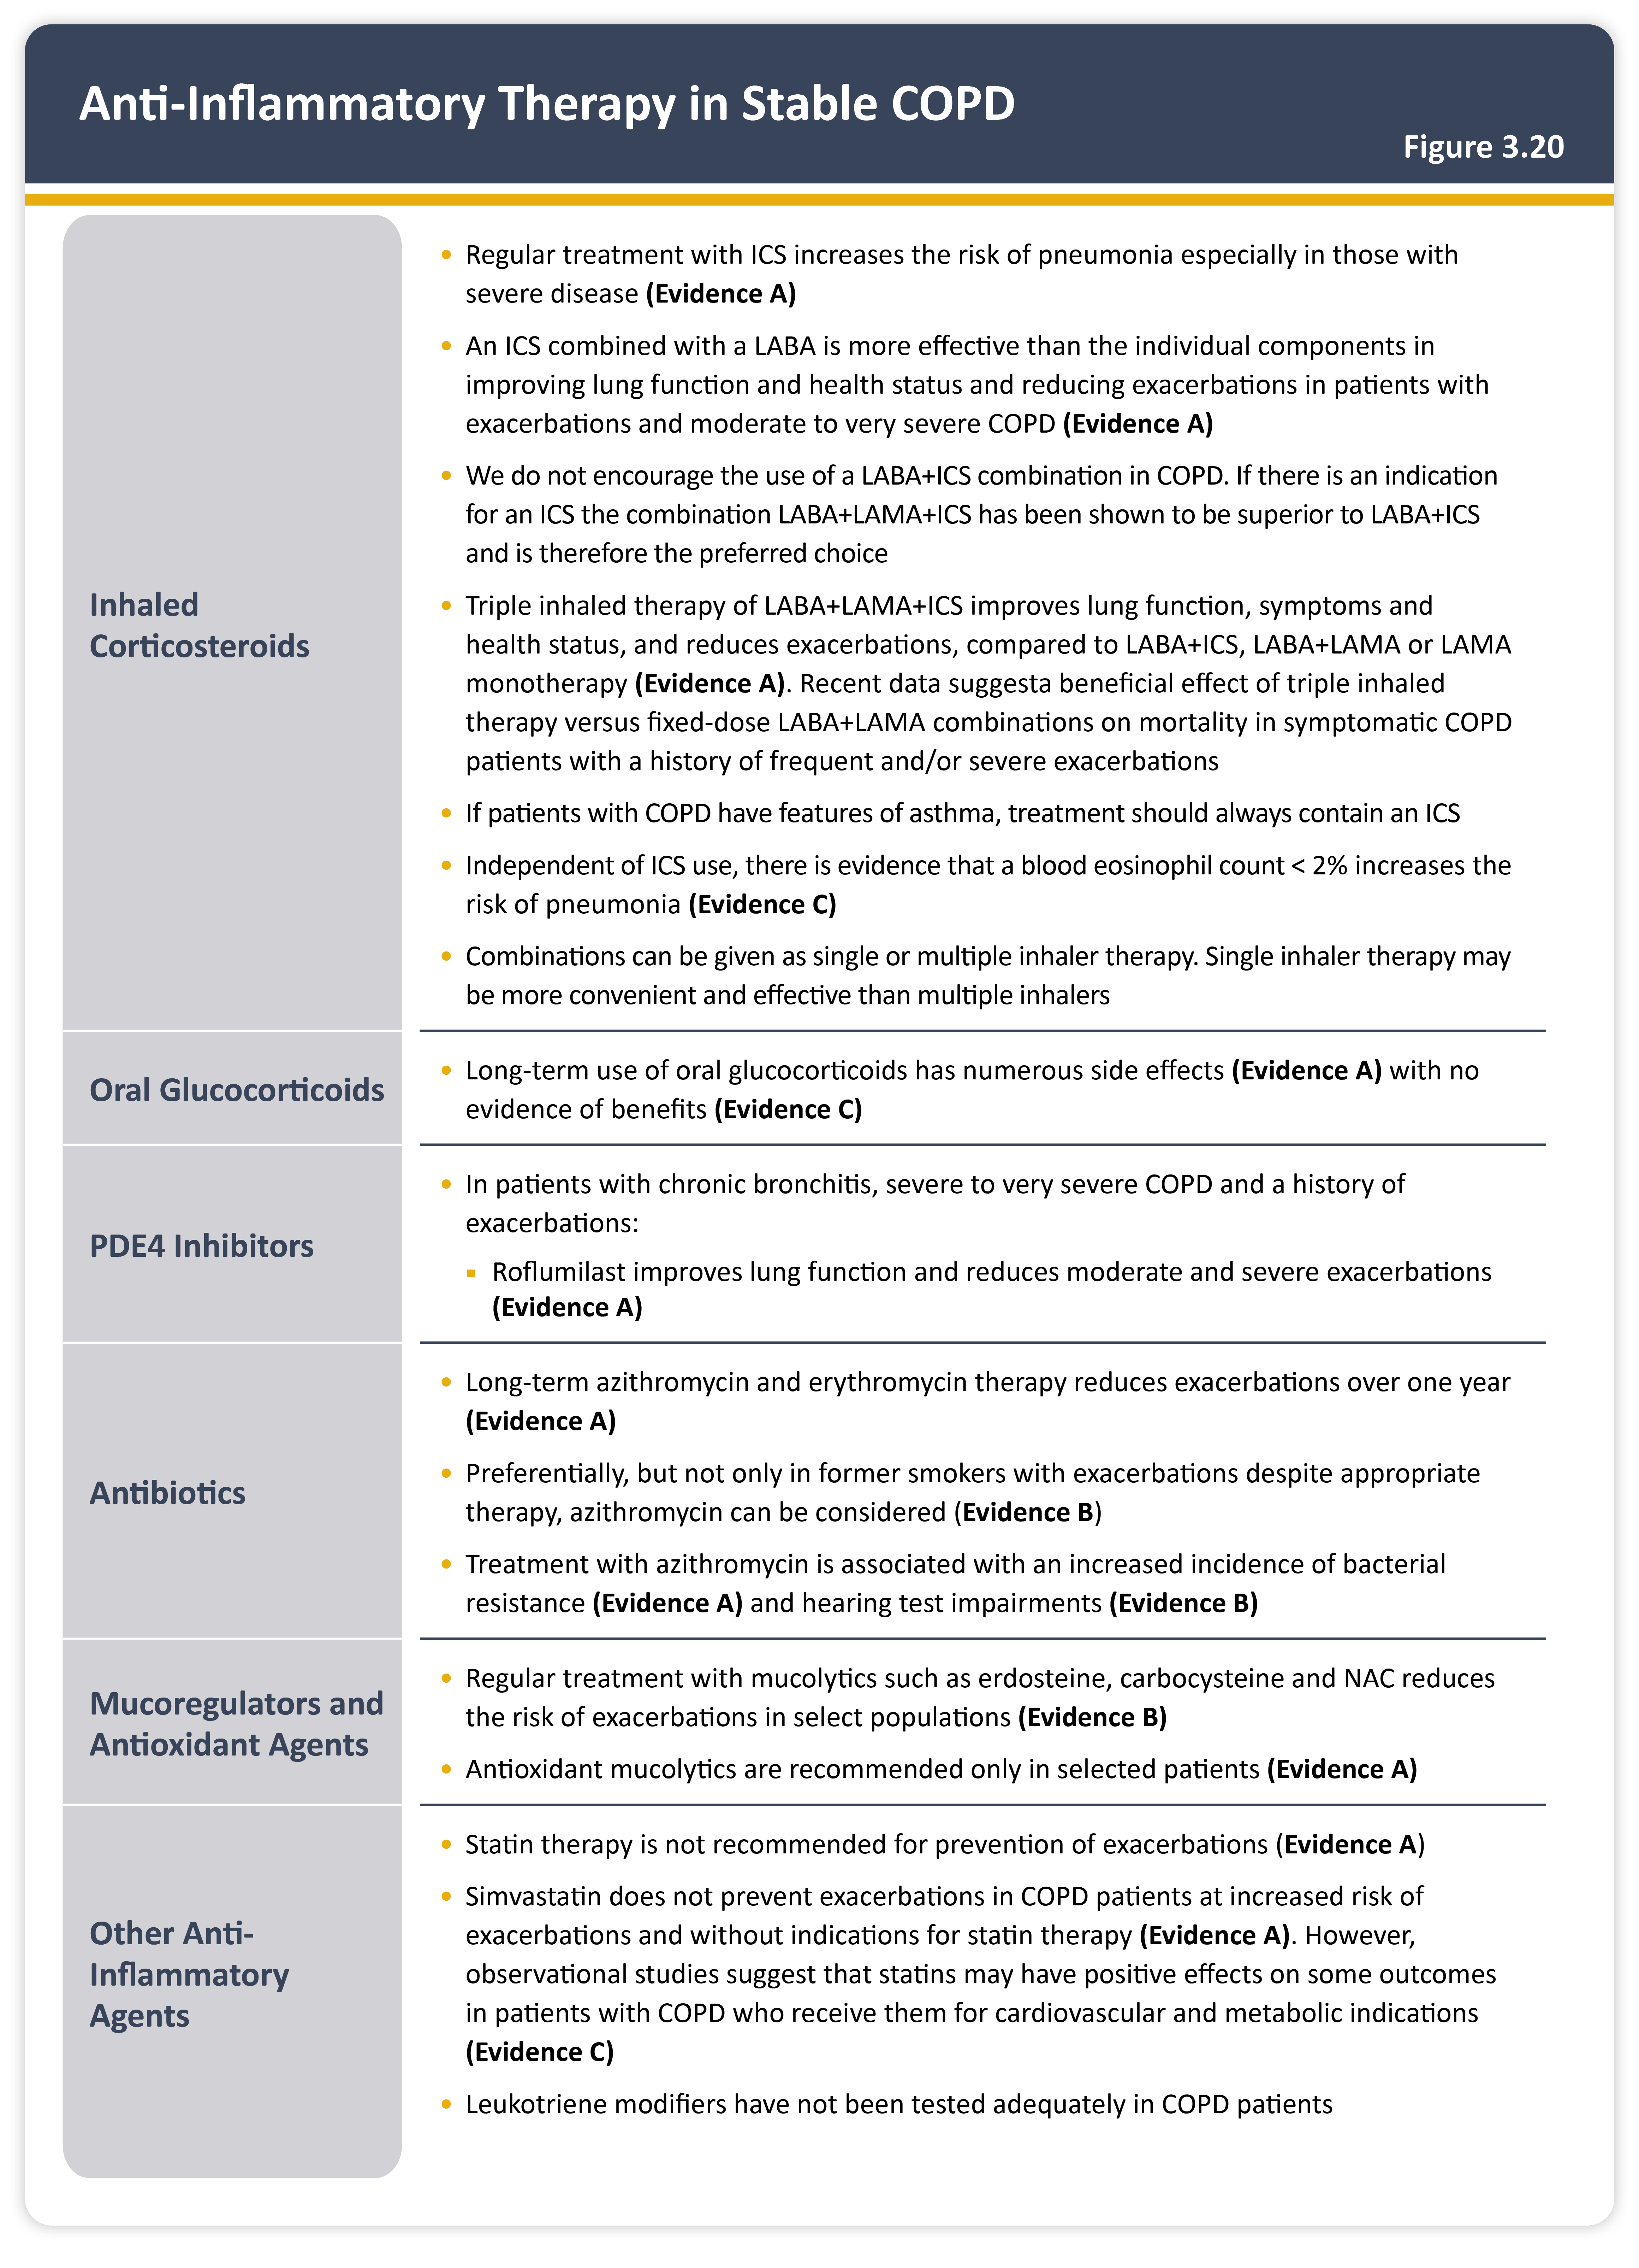
Teaching
Slide Set

Slide 36

Teaching
Slide Set

Slide 37
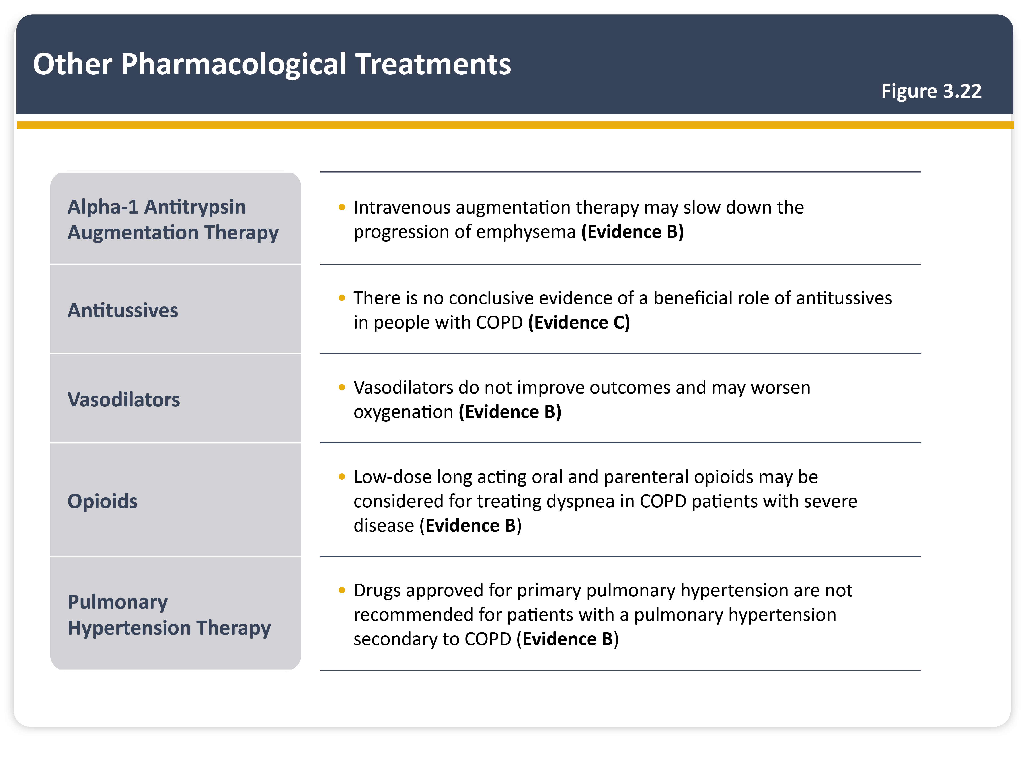
Teaching
Slide Set

Slide 38

Teaching
Slide Set

Slide 39
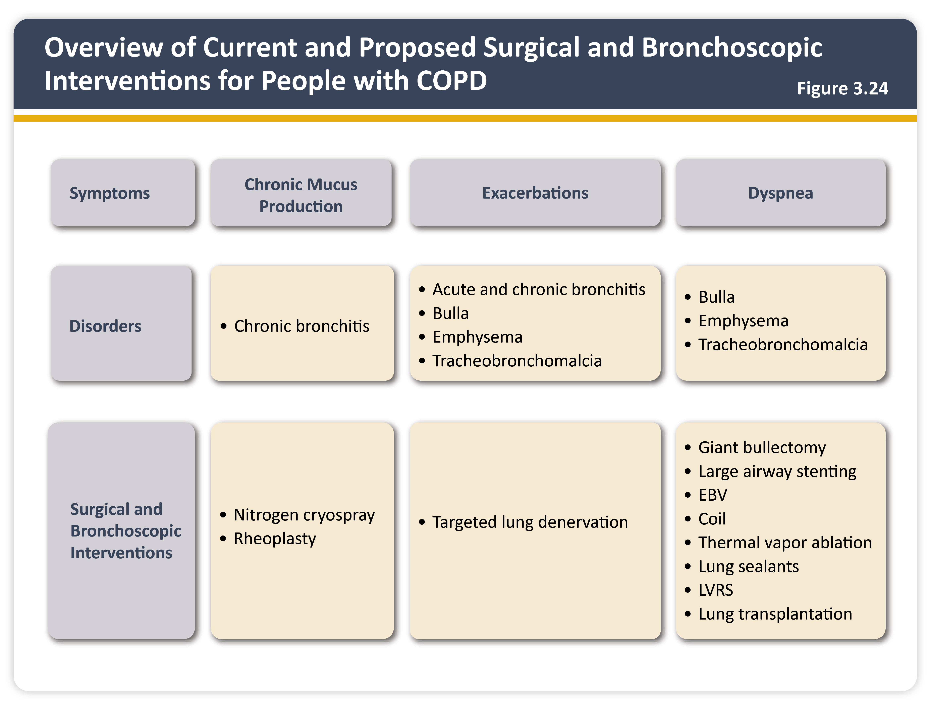
Teaching
Slide Set

Slide 40
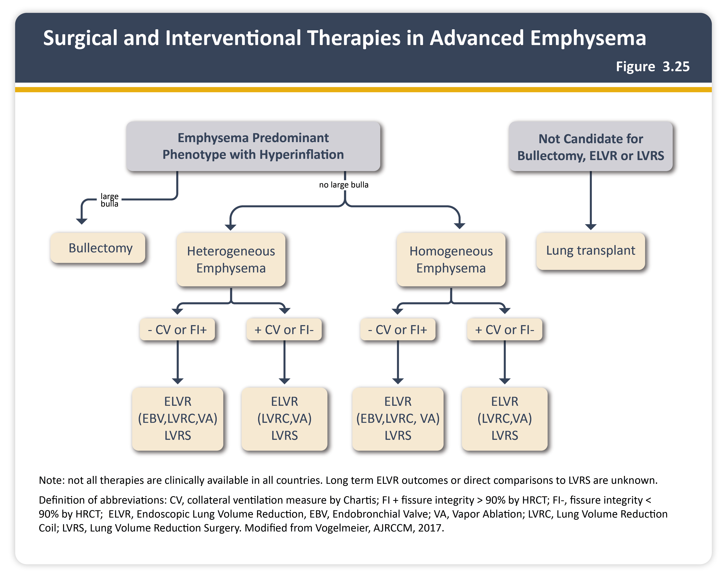
Teaching
Slide Set

Slide 41
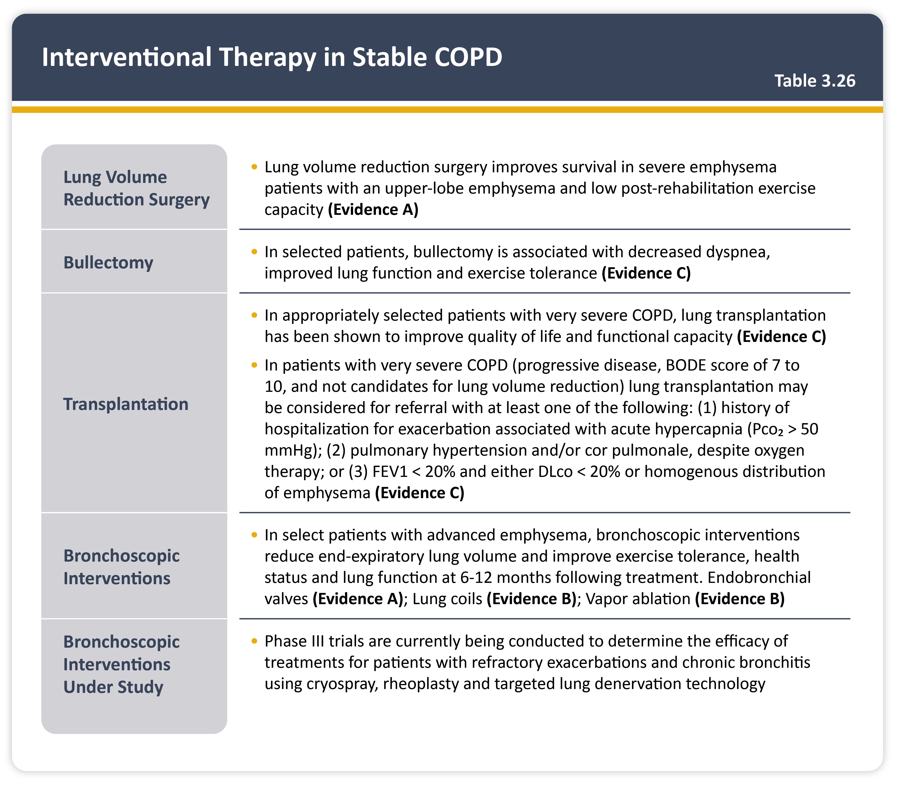
Teaching
Slide Set

Slide 42
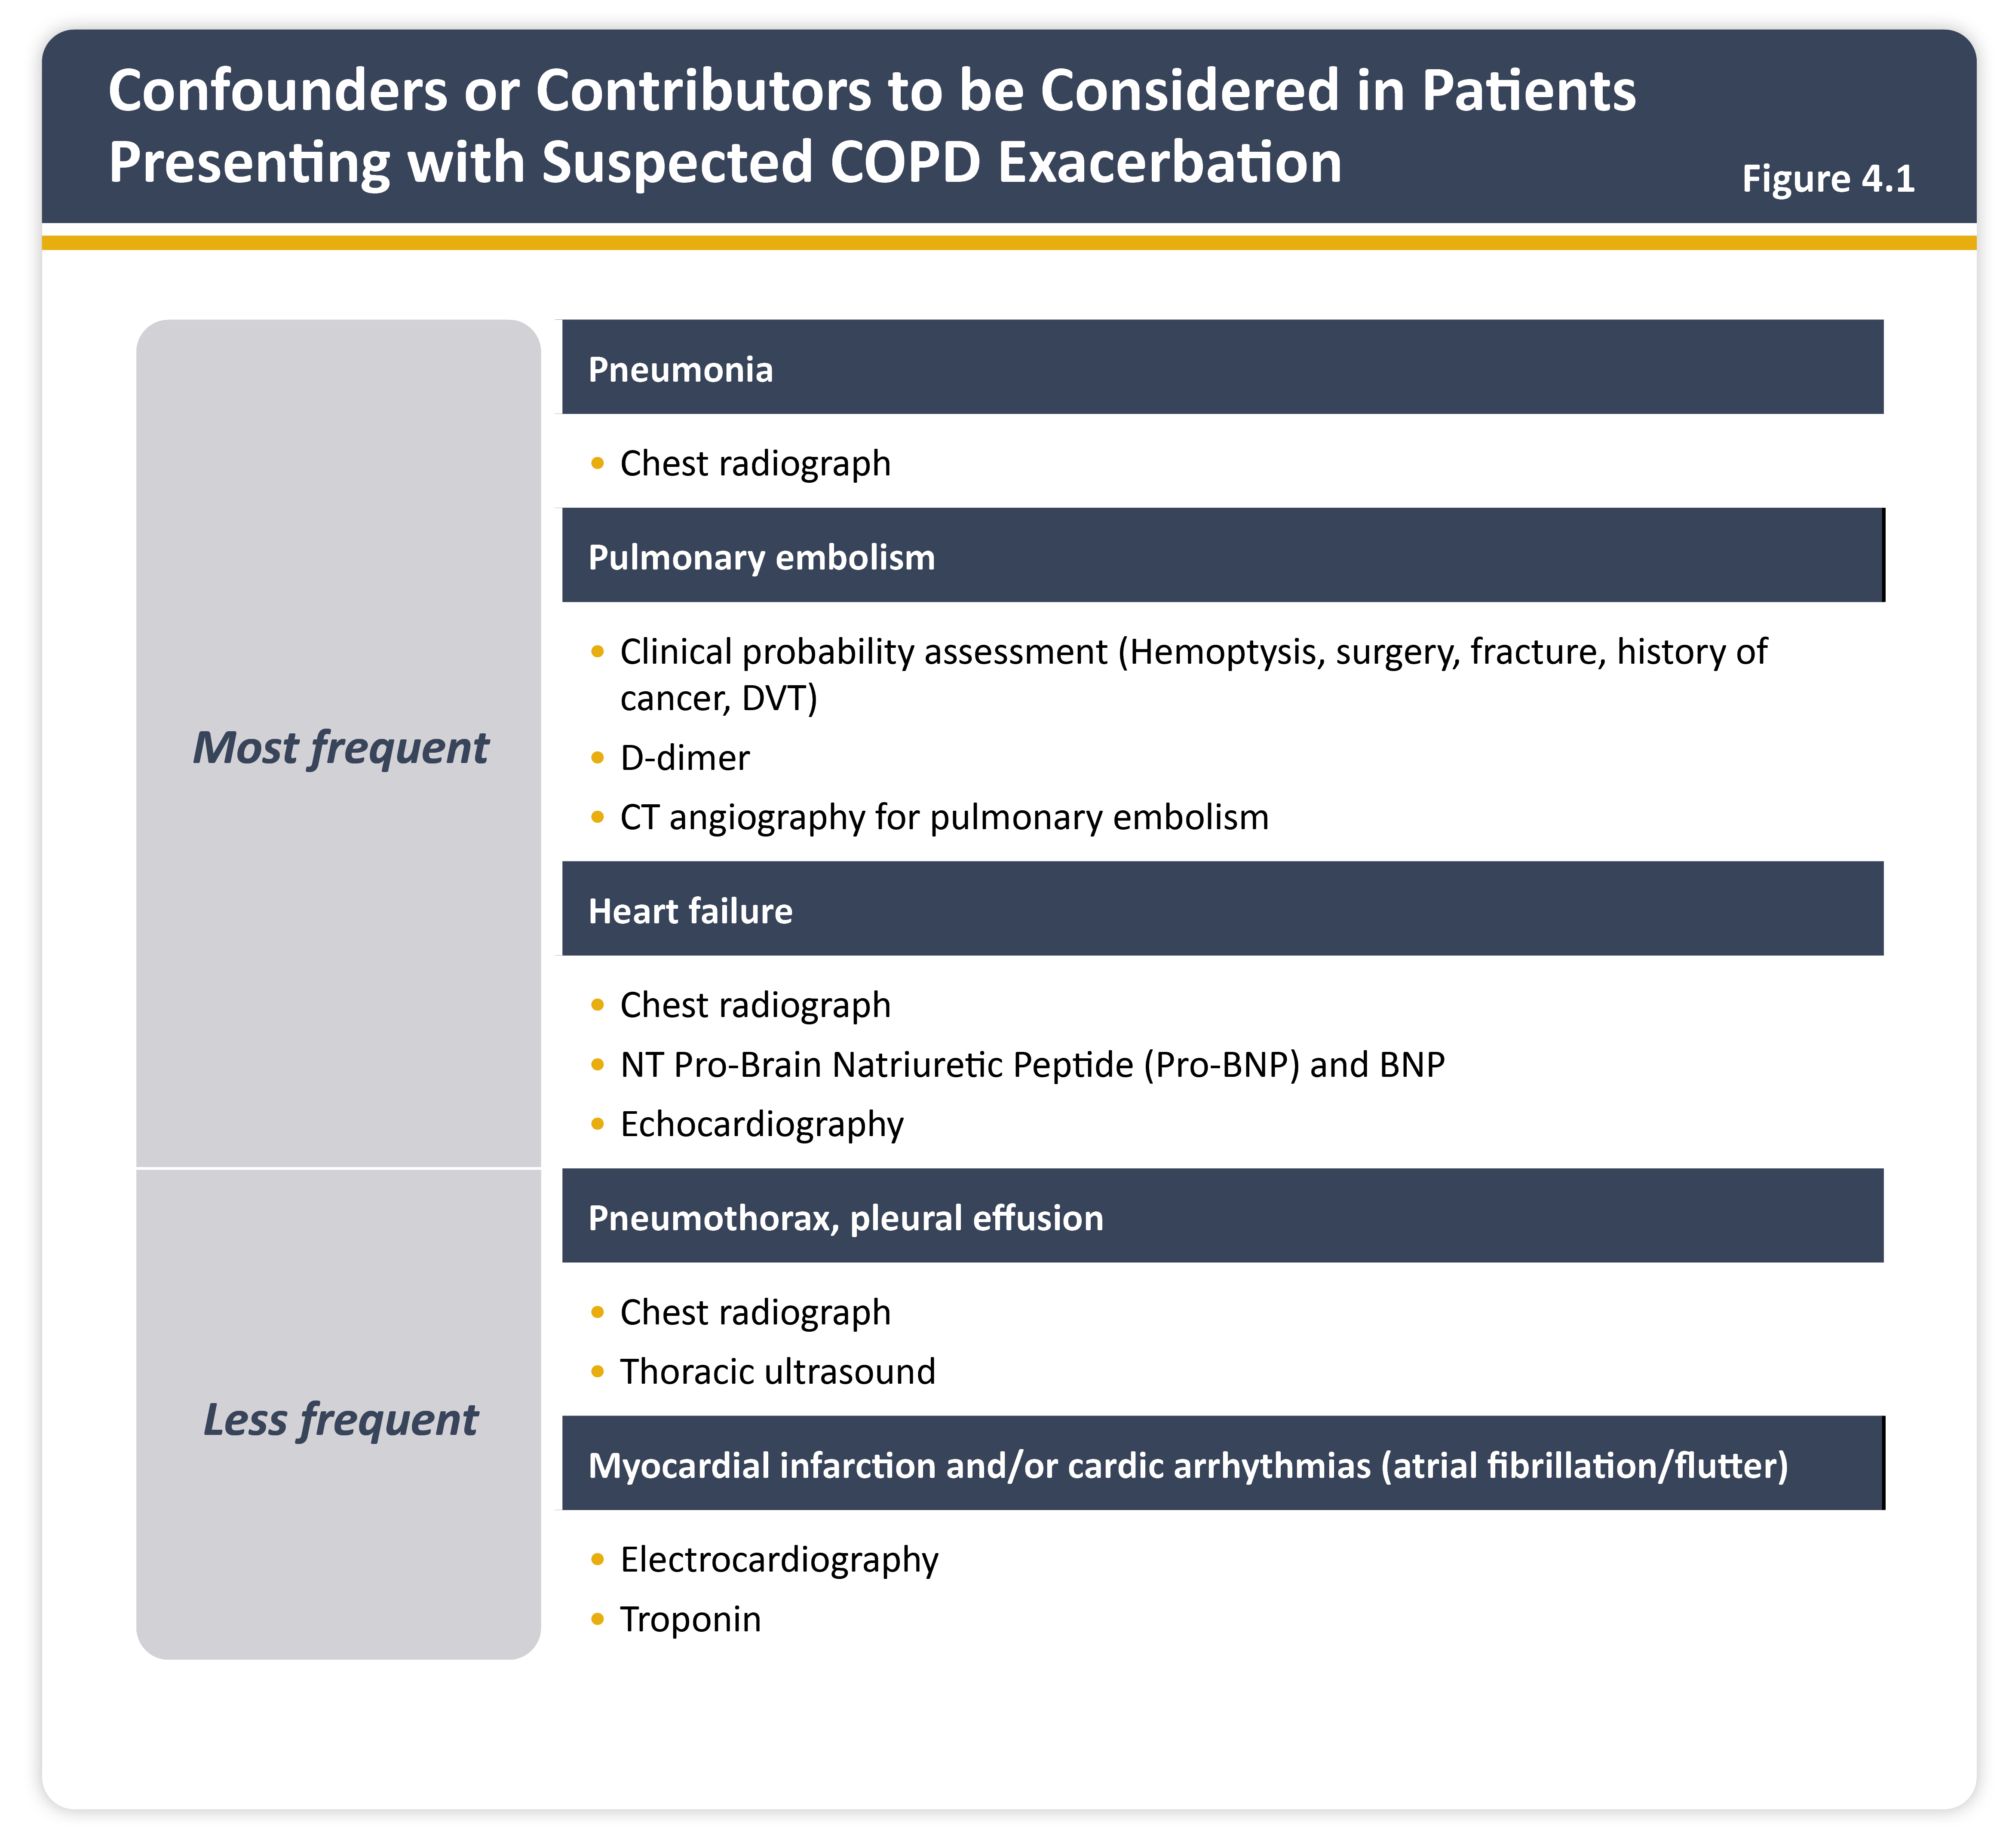
Teaching
Slide Set

Slide 43
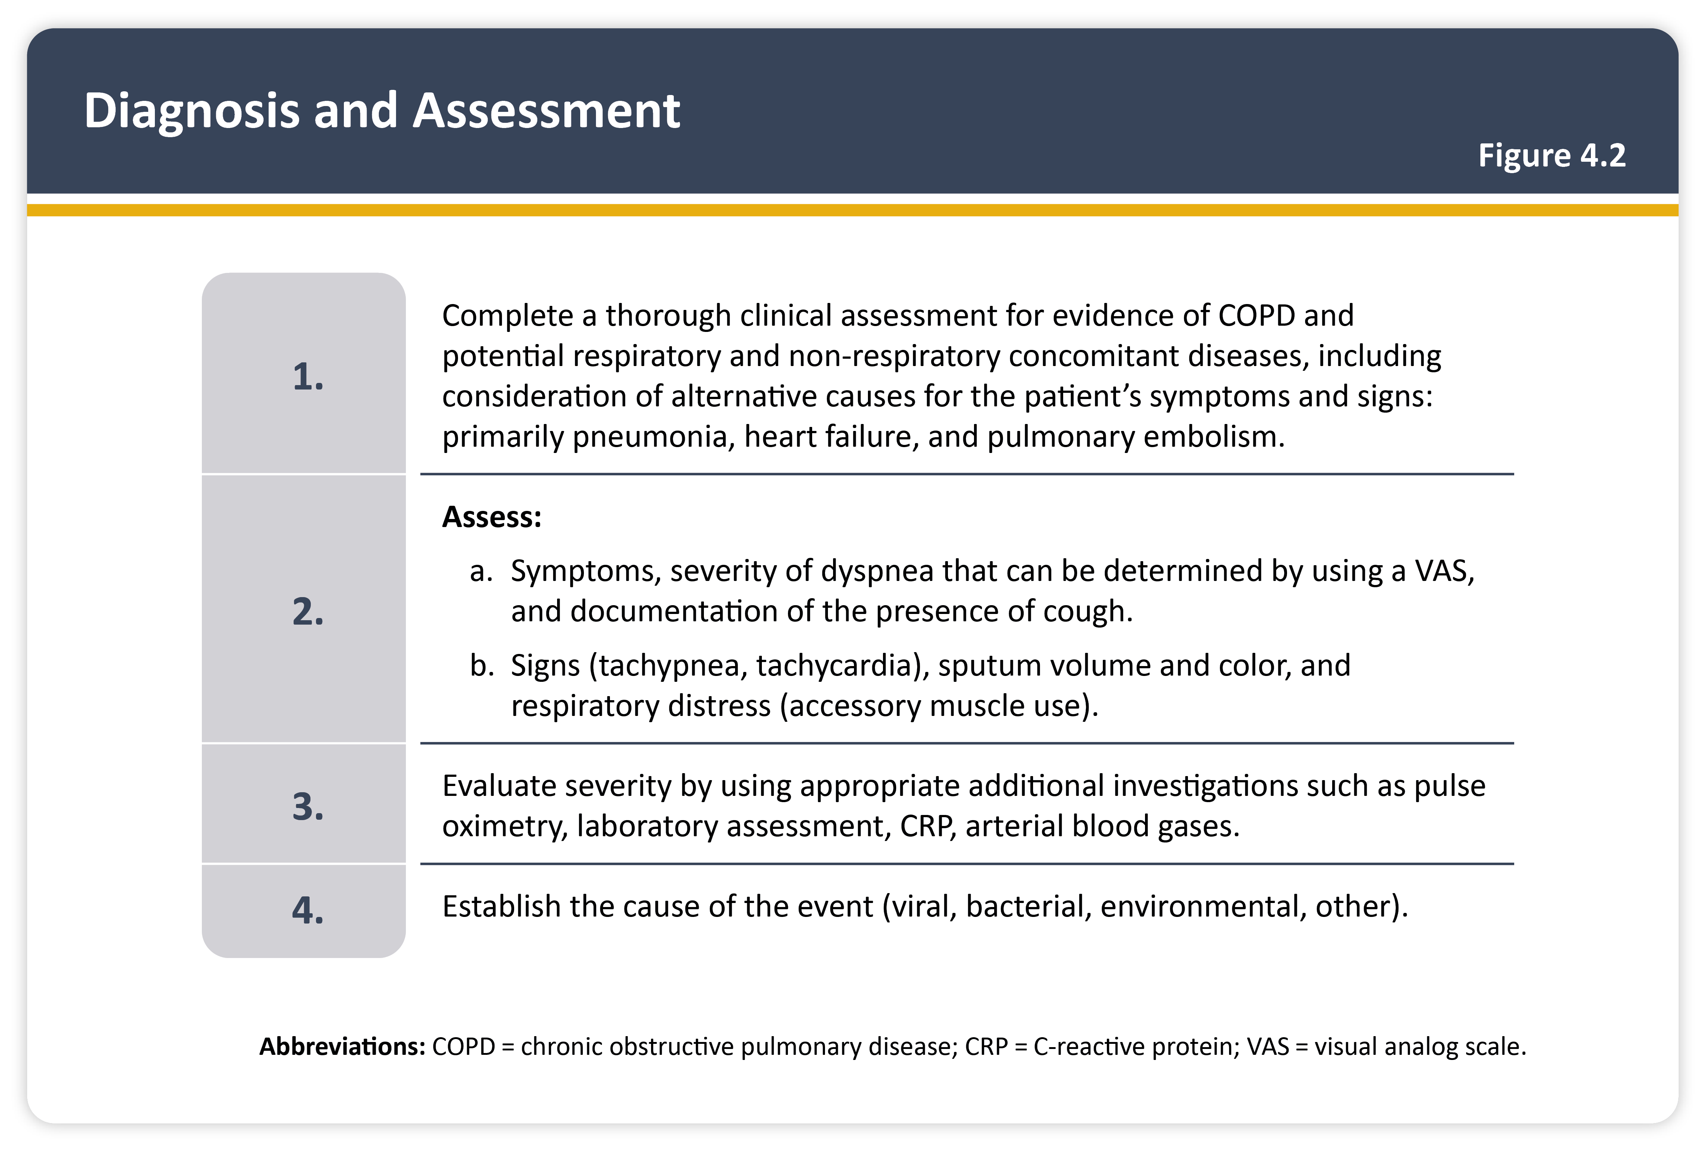
Teaching
Slide Set

Slide 44
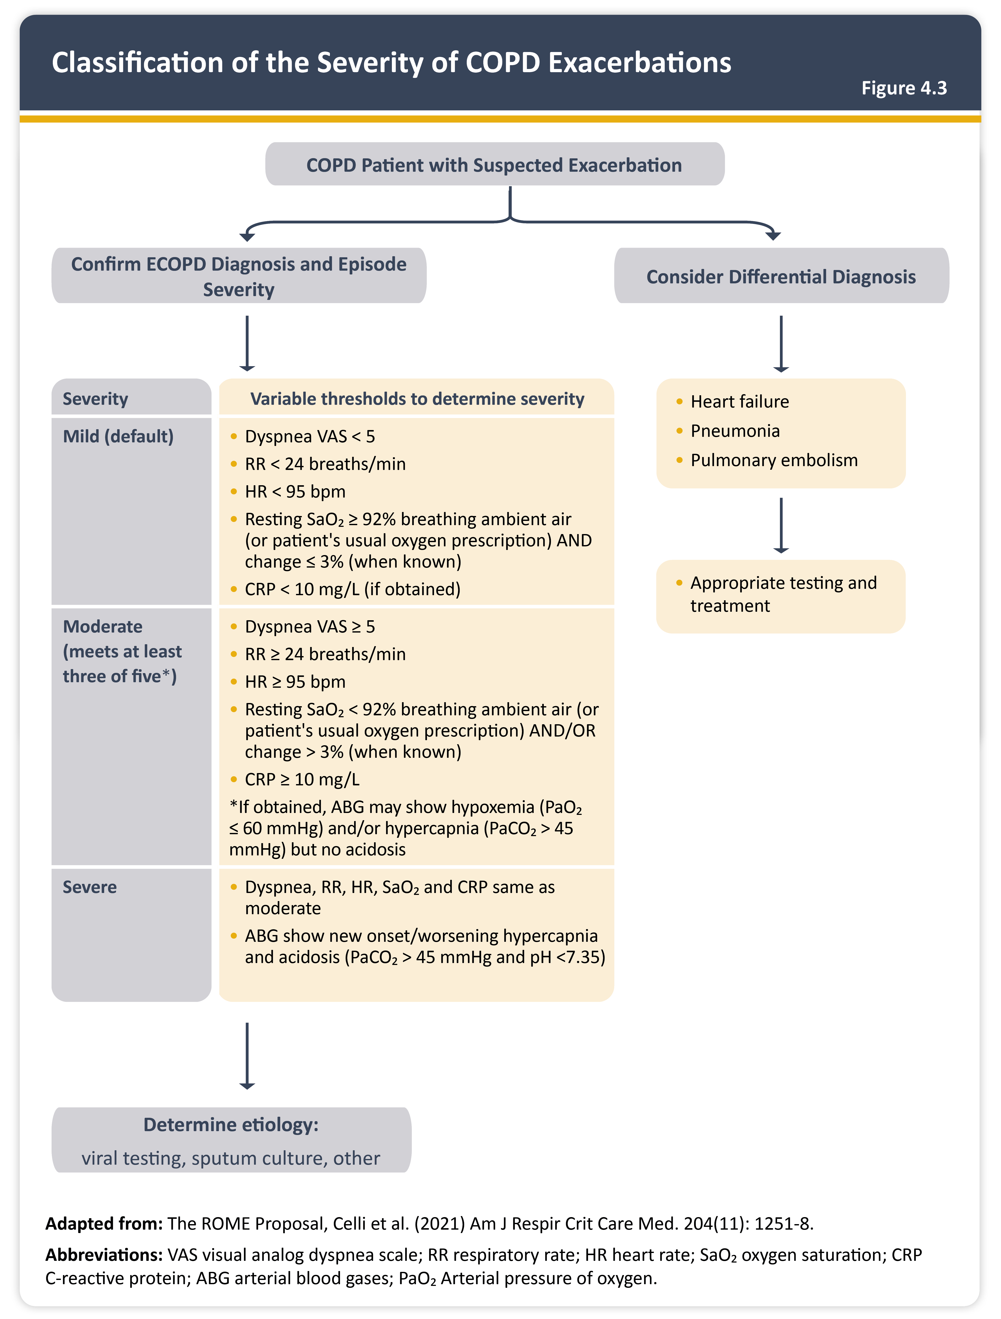
Teaching
Slide Set

Slide 45
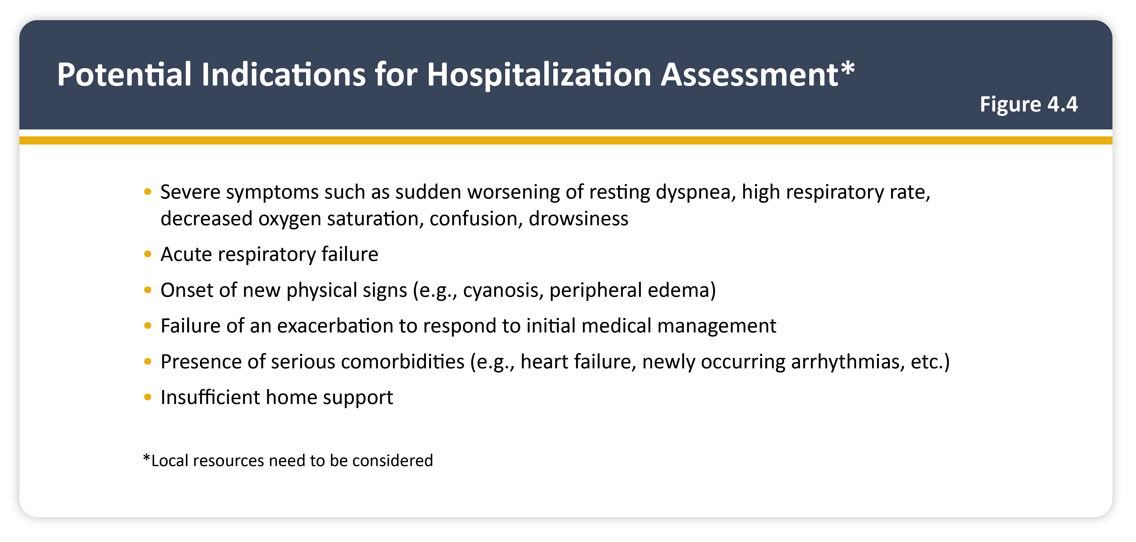
Teaching
Slide Set

Slide 46
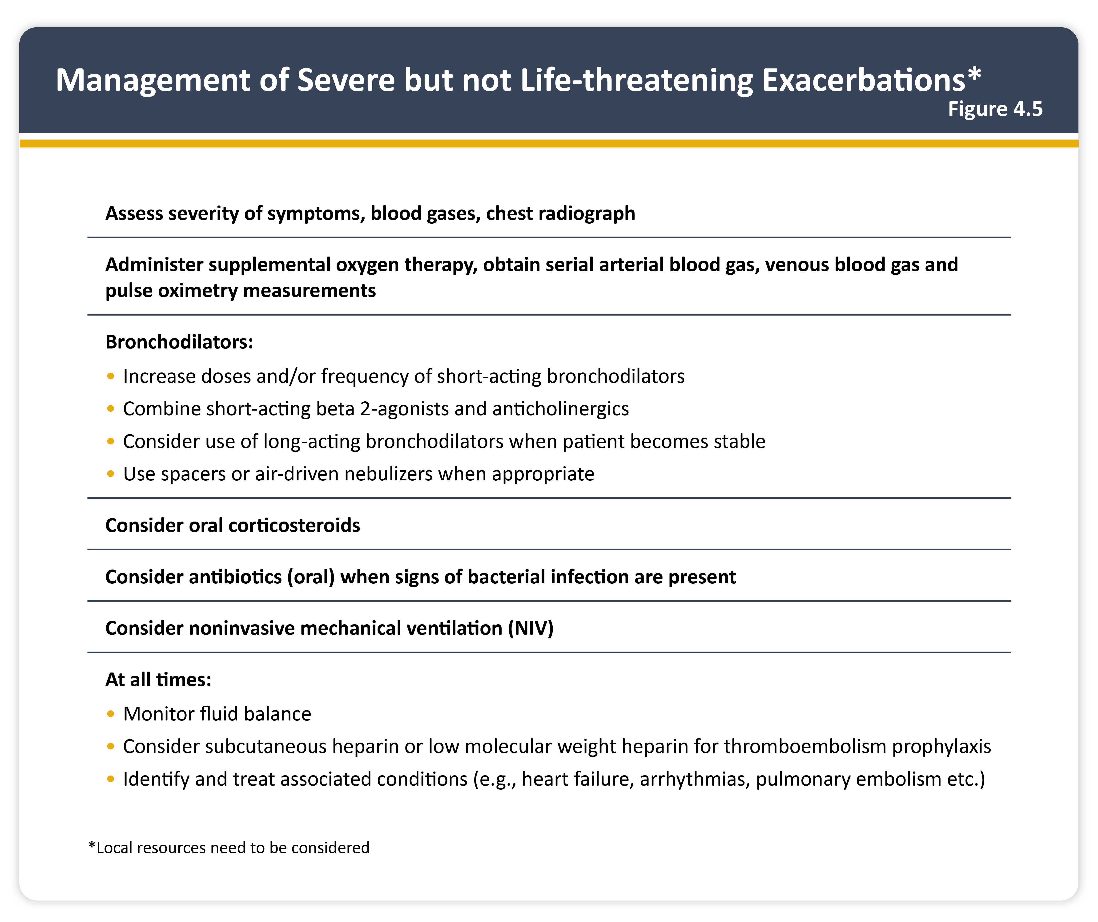
Teaching
Slide Set

Slide 47
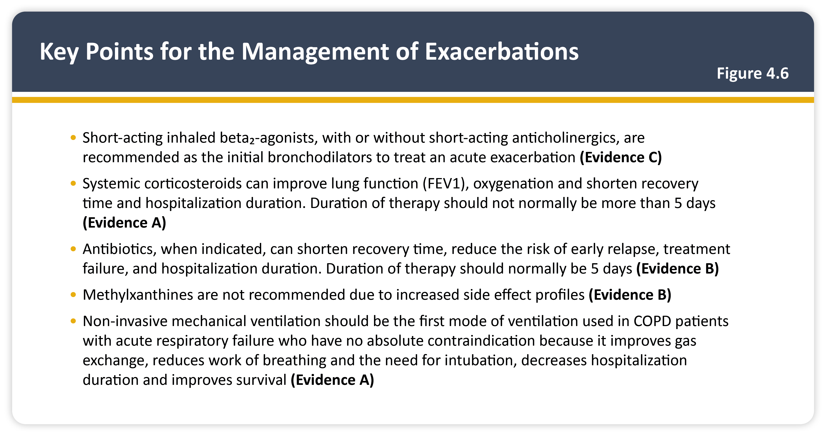
Teaching
Slide Set

Slide 48
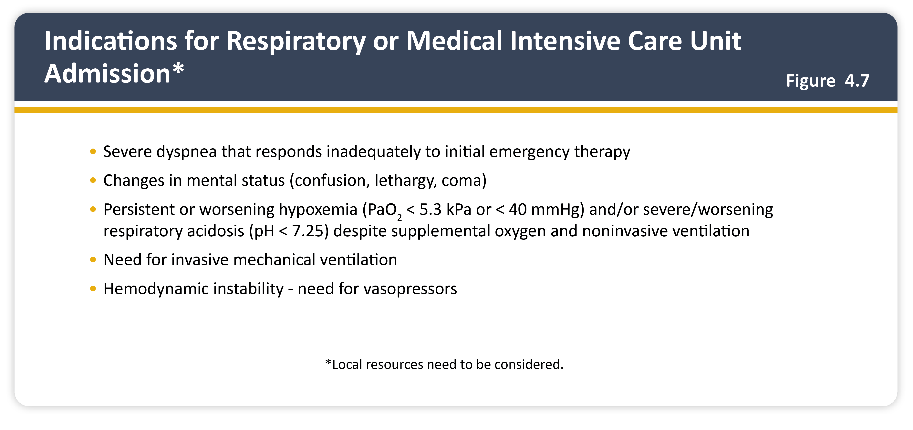
Teaching
Slide Set

Slide 49
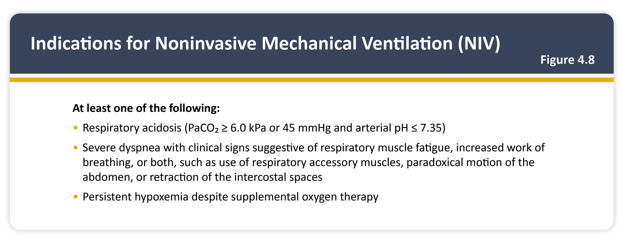
Teaching
Slide Set

Slide 50
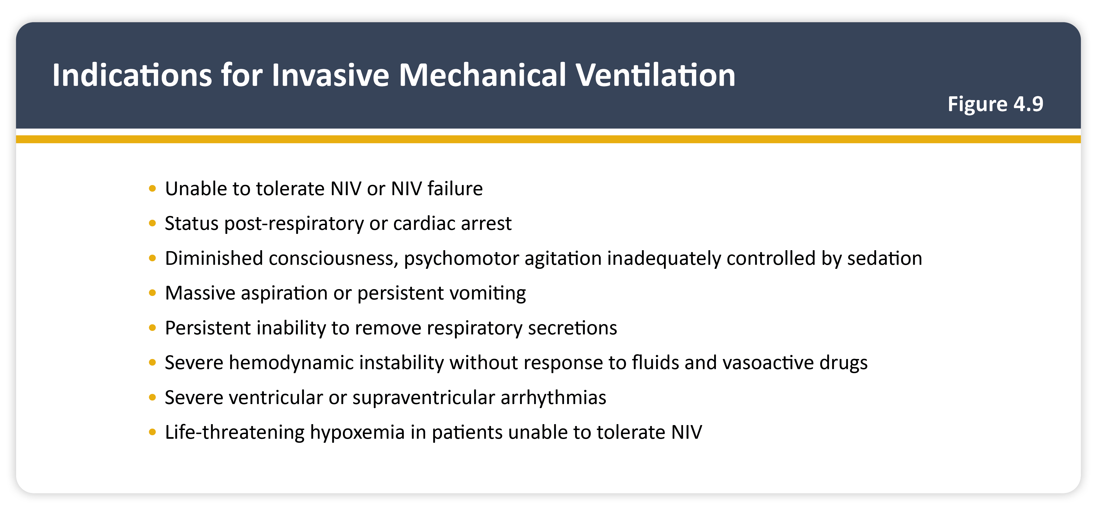
Teaching
Slide Set

Slide 51
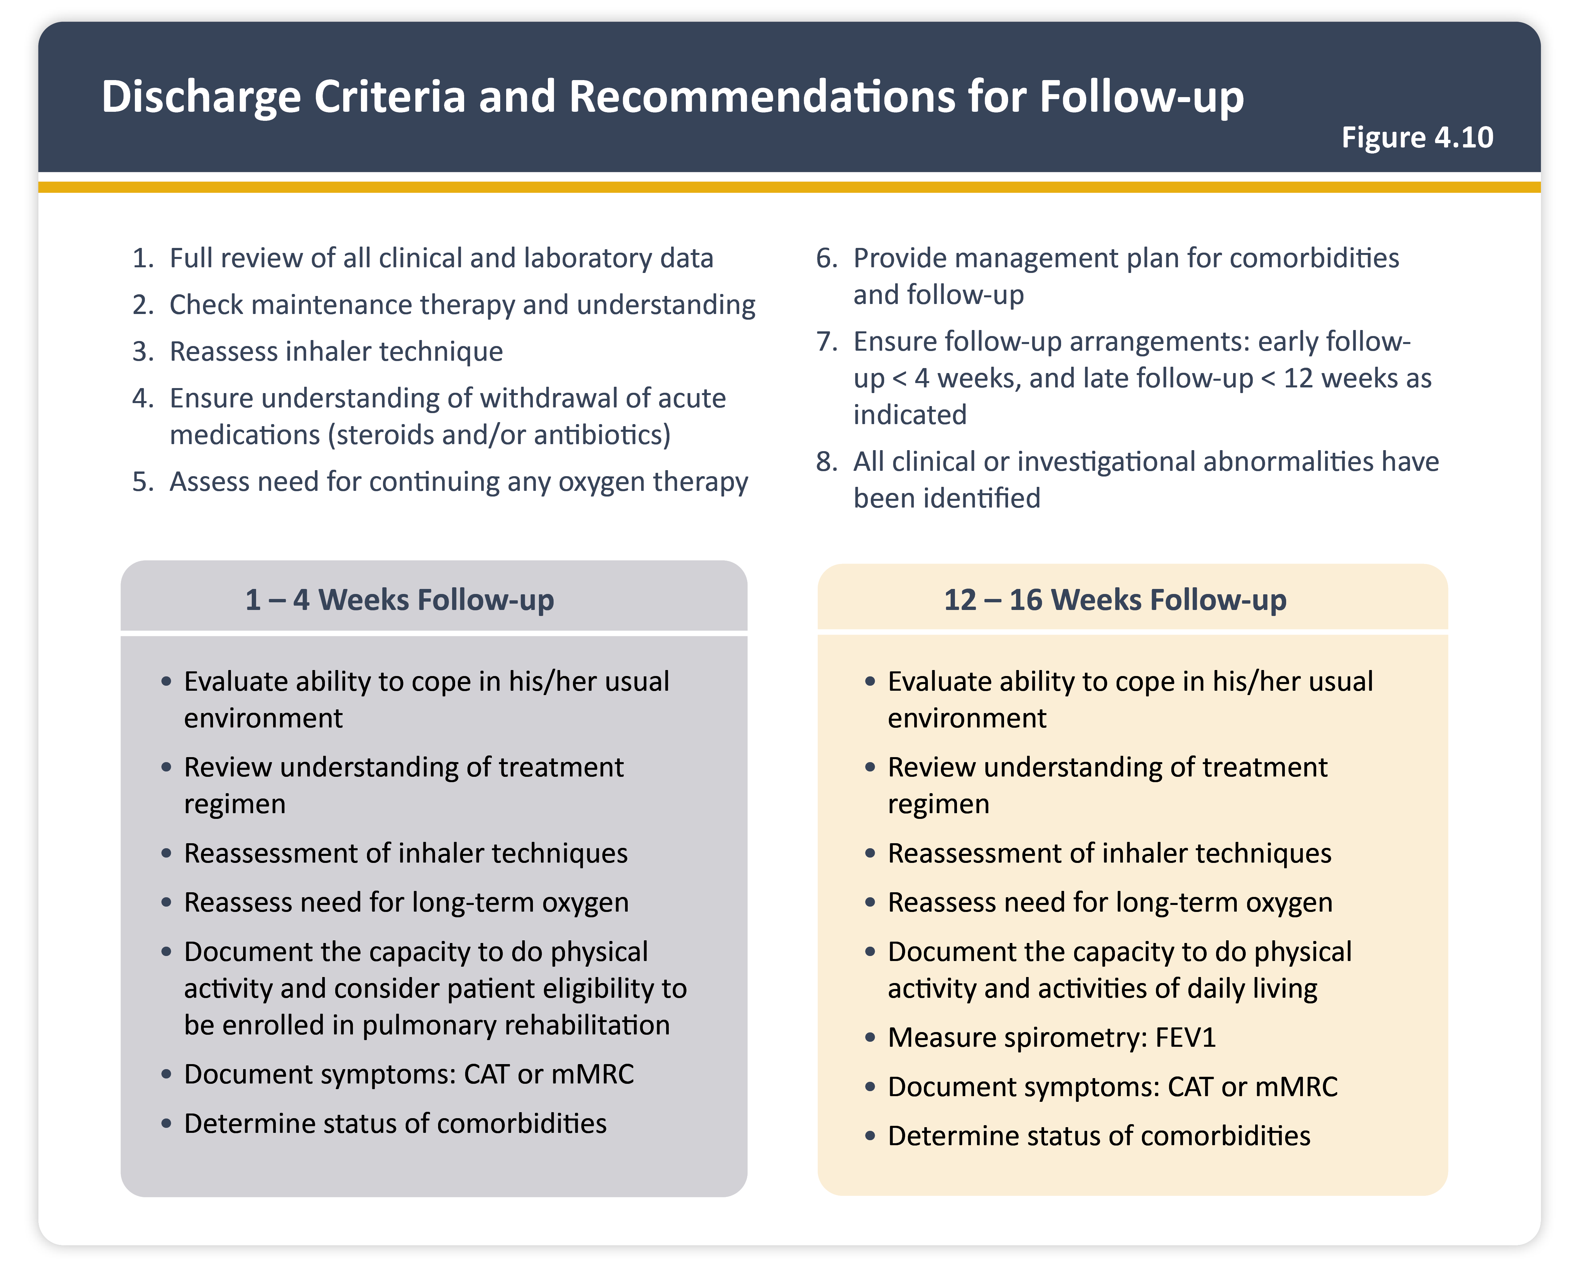
Teaching
Slide Set

Slide 52
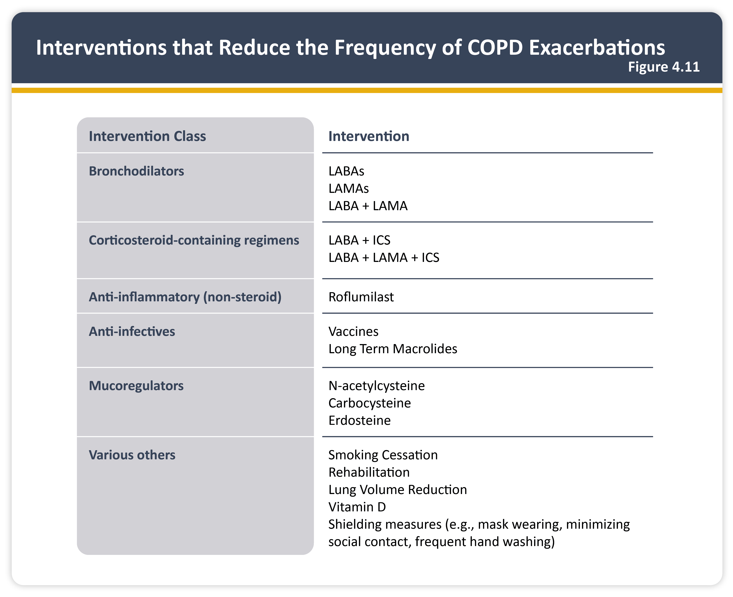
Teaching
Slide Set

Slide 53
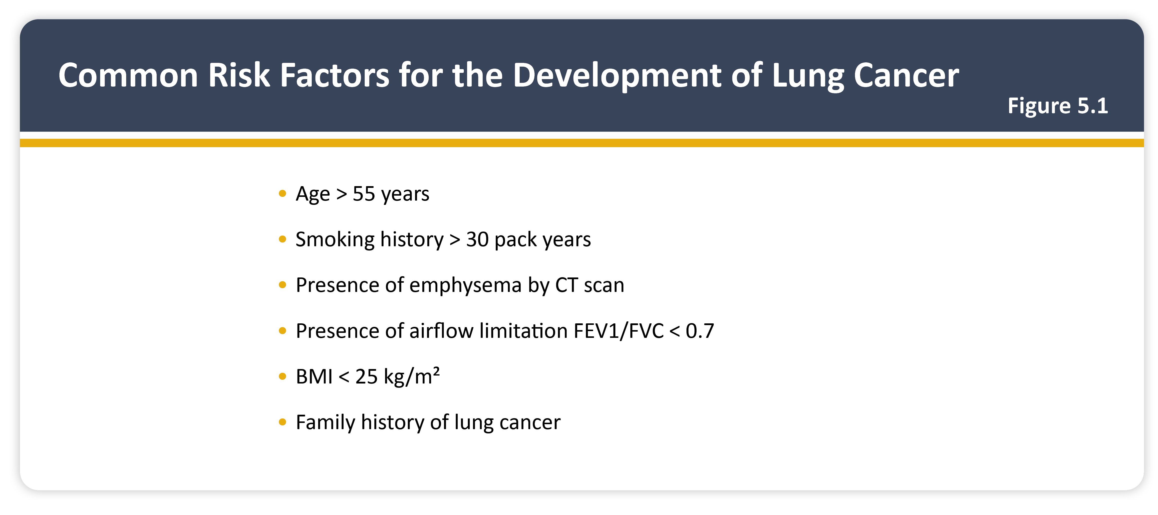
Teaching
Slide Set

Slide 54
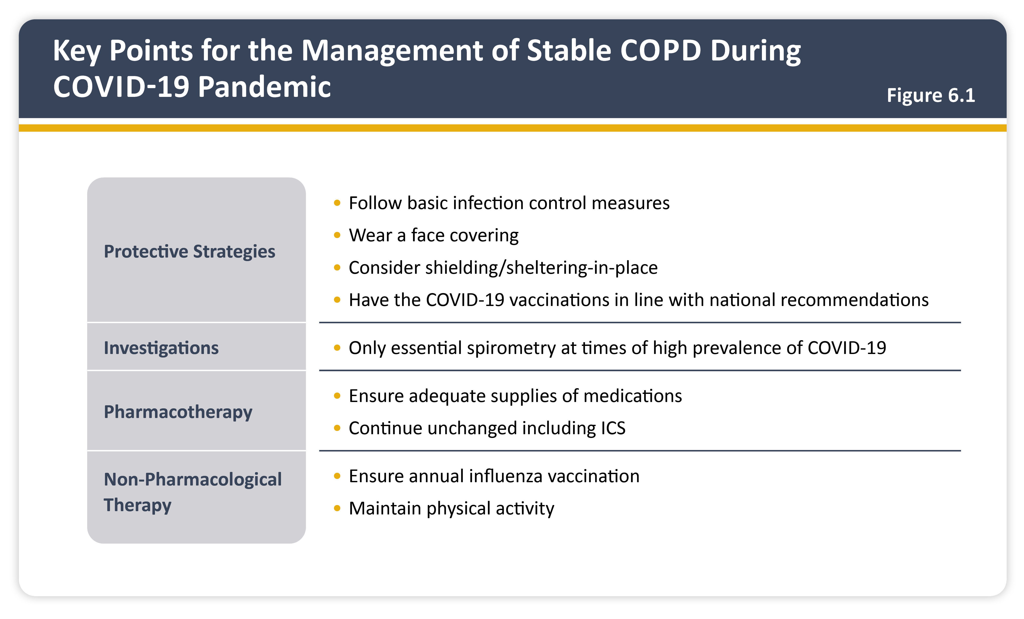
Teaching
Slide Set

Slide 55
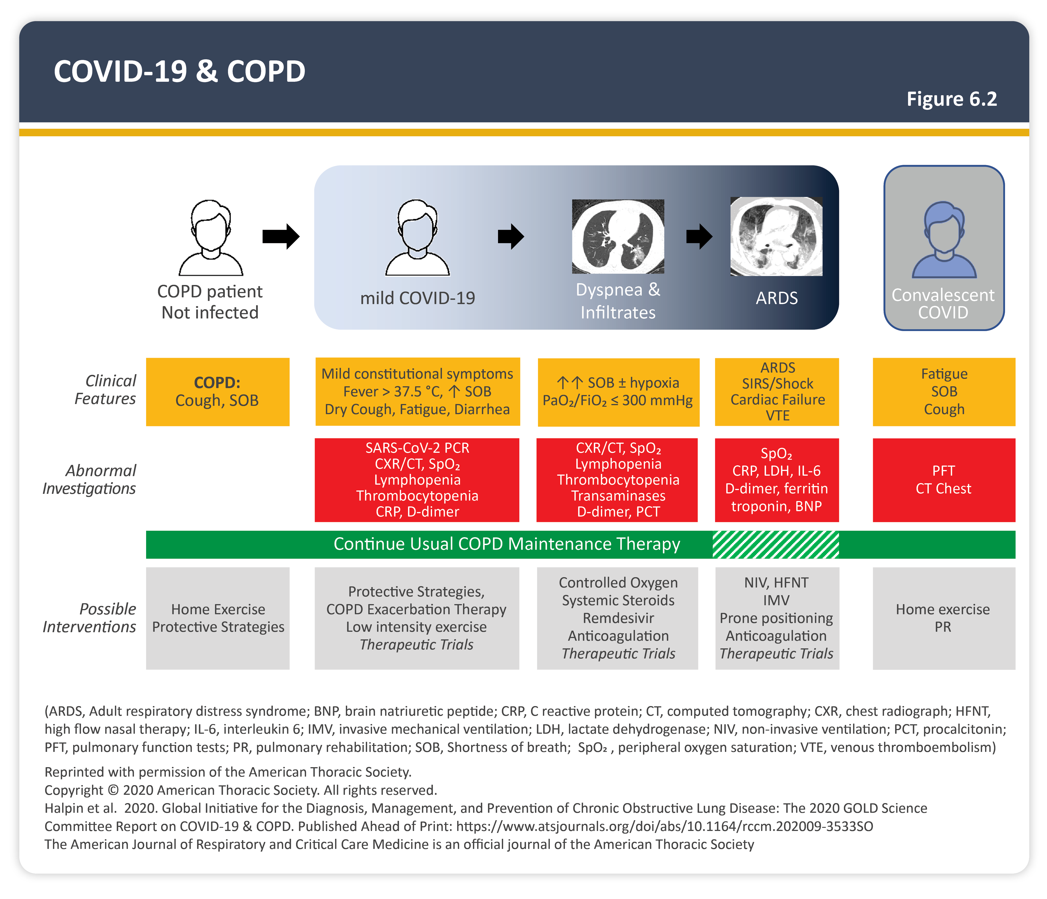
Teaching
Slide Set

Slide 56
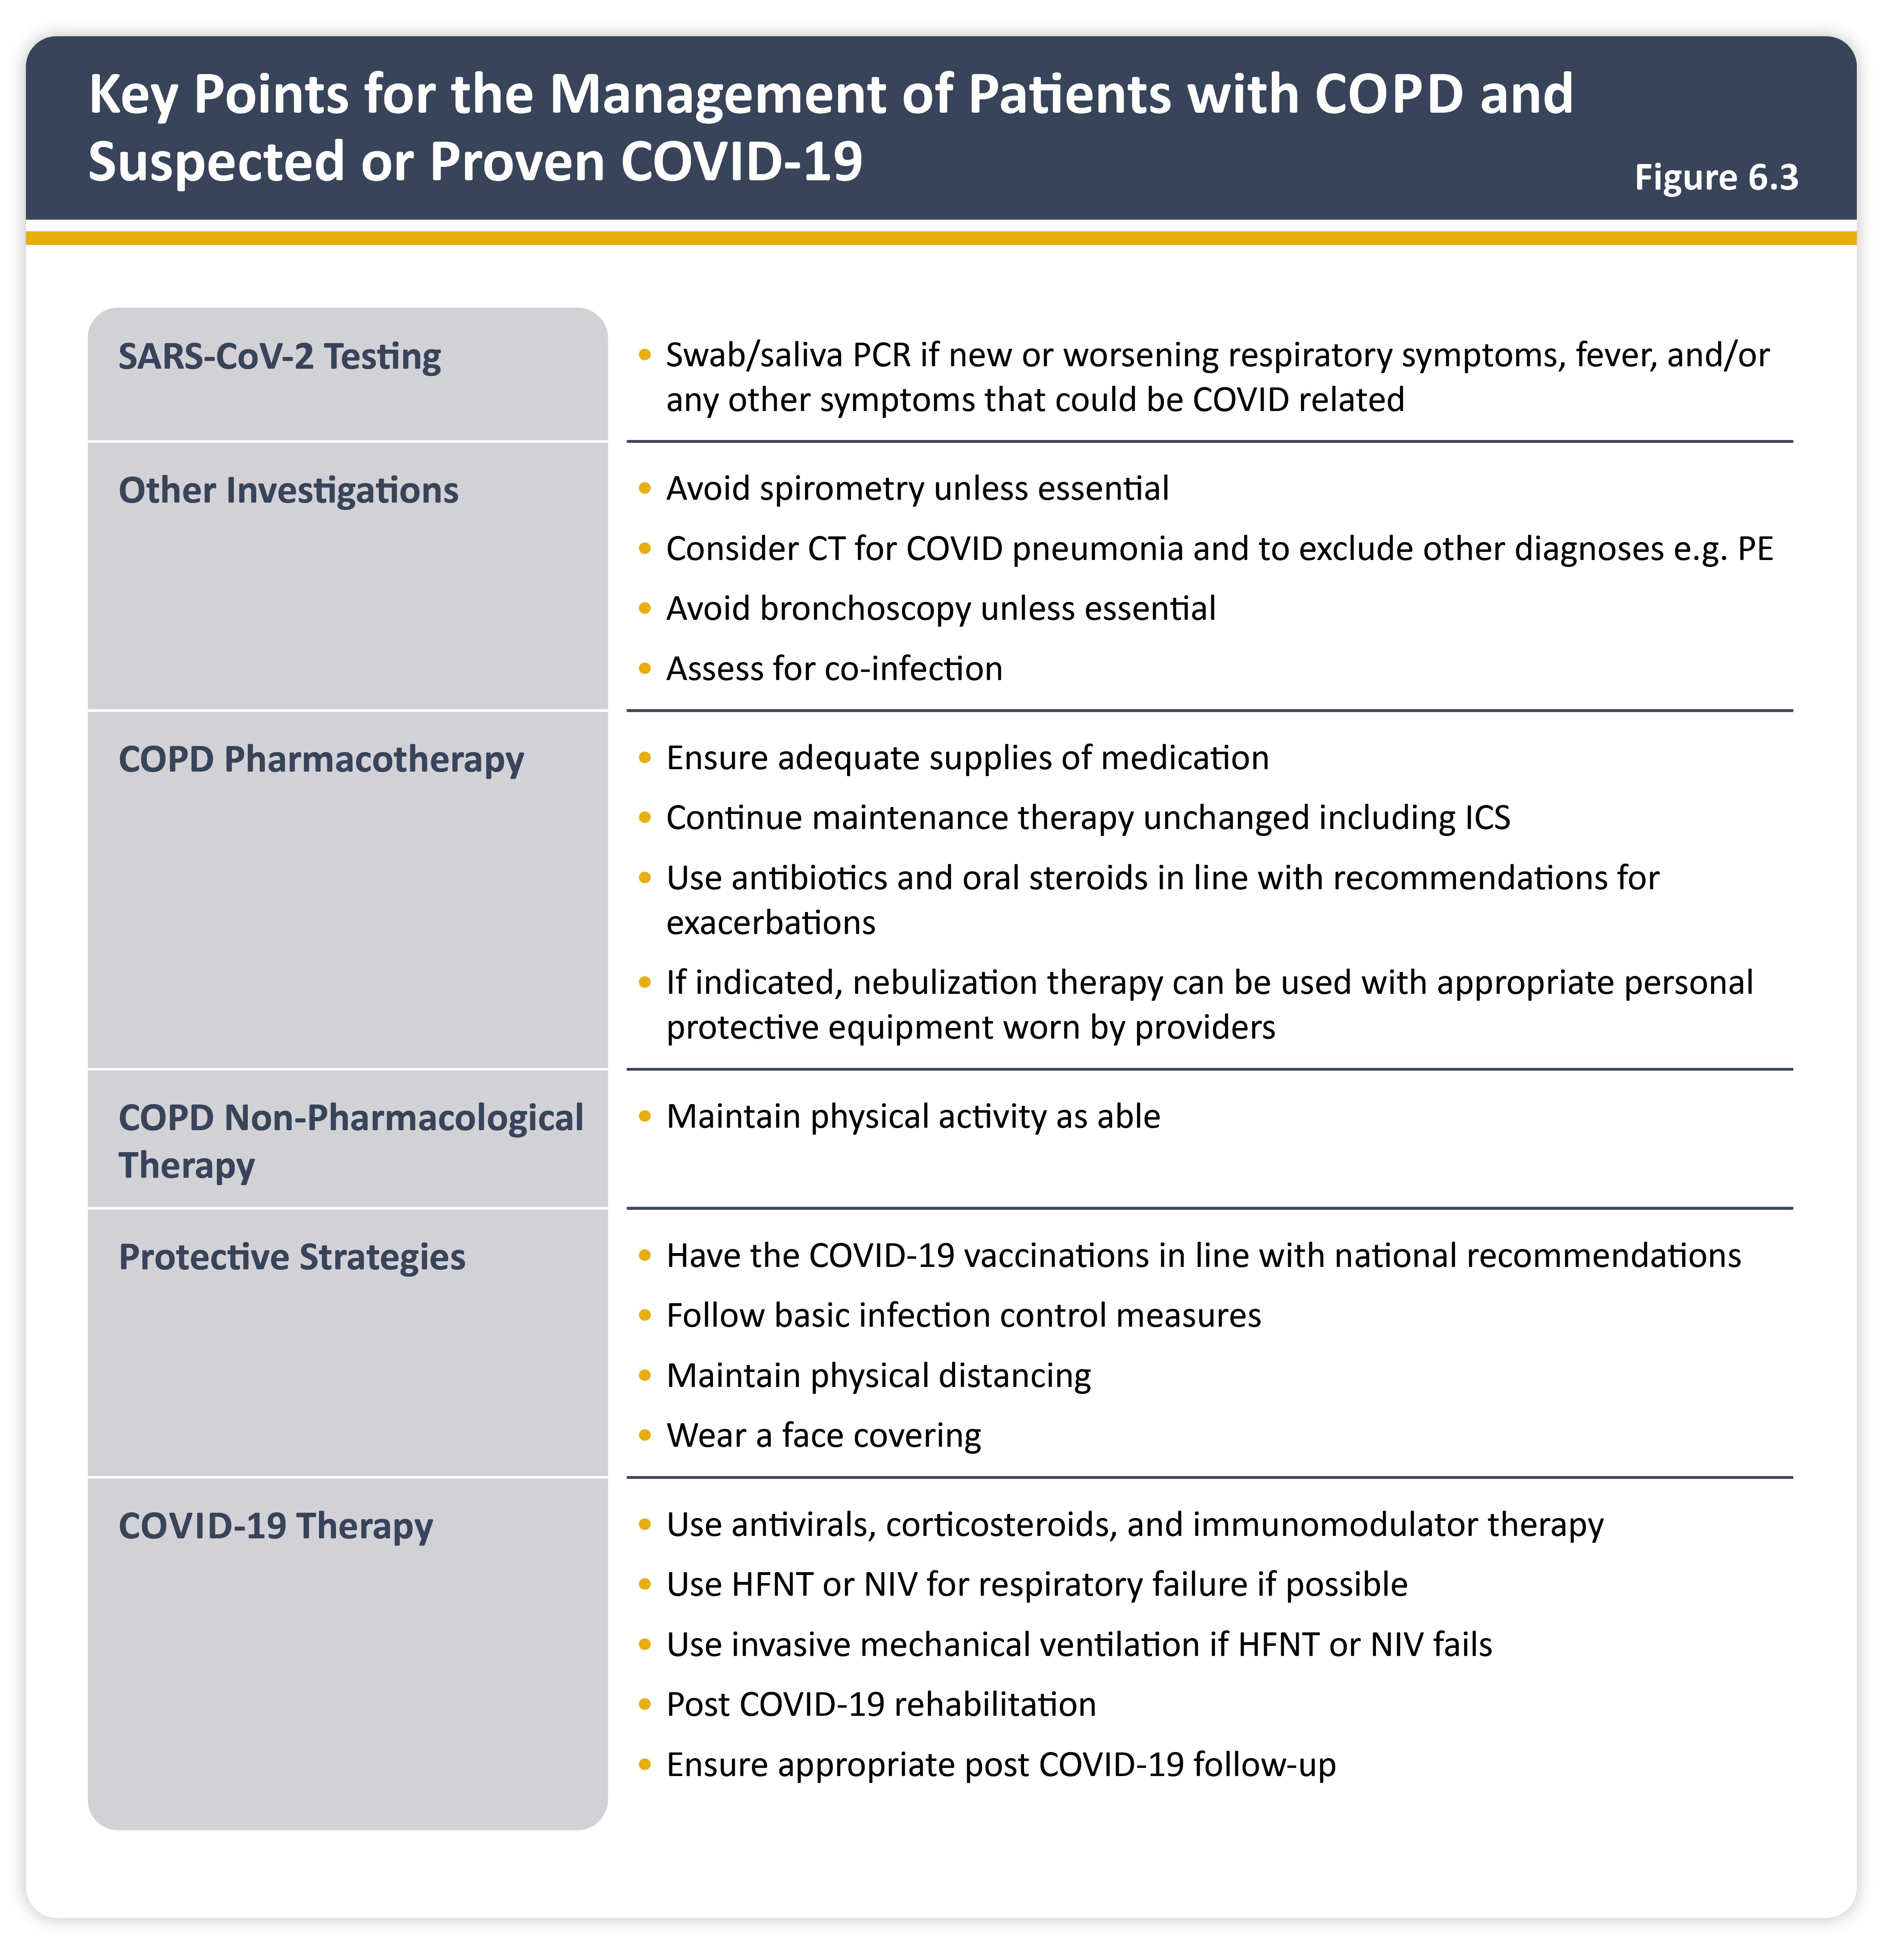
Teaching
Slide Set

Slide 57
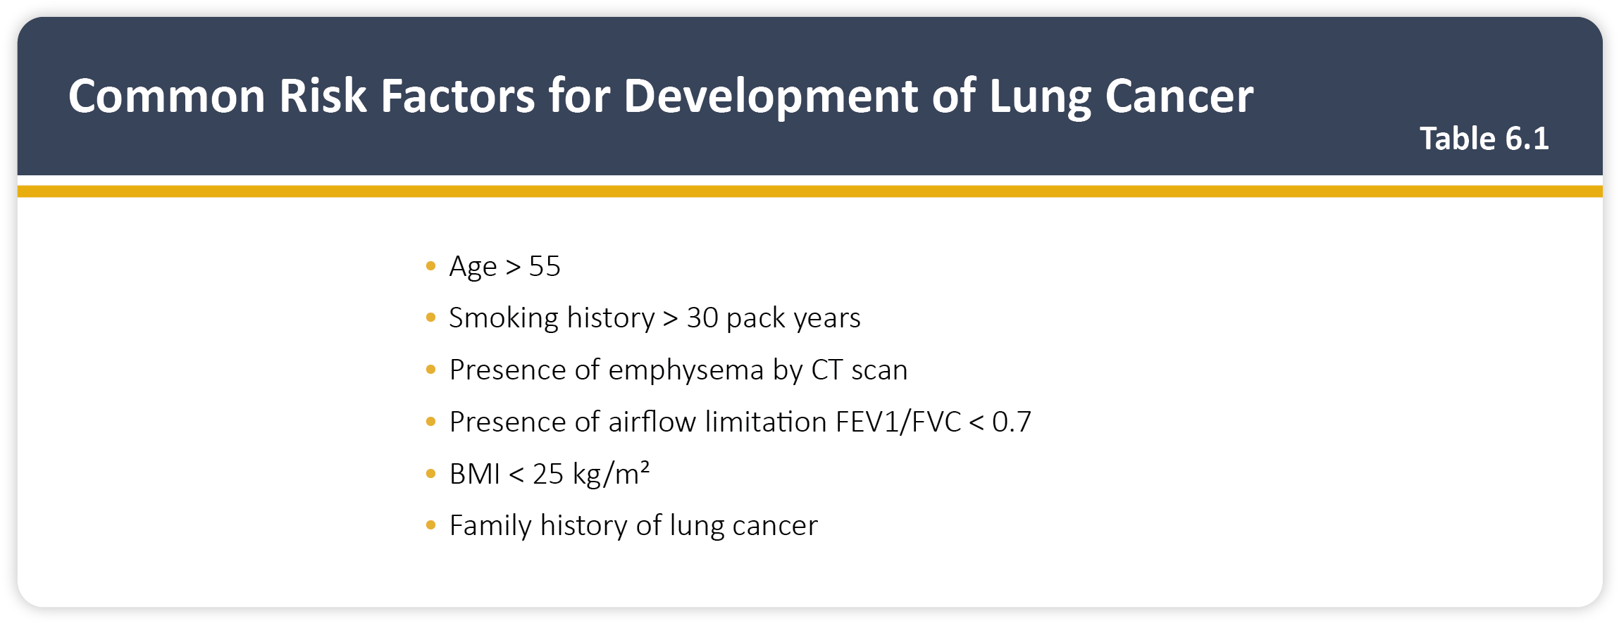
Teaching
Slide Set

Slide 58

Teaching
Slide Set

