Slide 1
GLOBAL INITIATIVE FOR CHRONIC OBSTRUCTIVE LUNG DISEASE (GOLD):
TEACHING SLIDE SET
2020
This slide set is restricted for academic and educational purposes only. Use of the slide set, or of individual slides, for commercial or promotional purposes requires approval from GOLD.

Slide 2
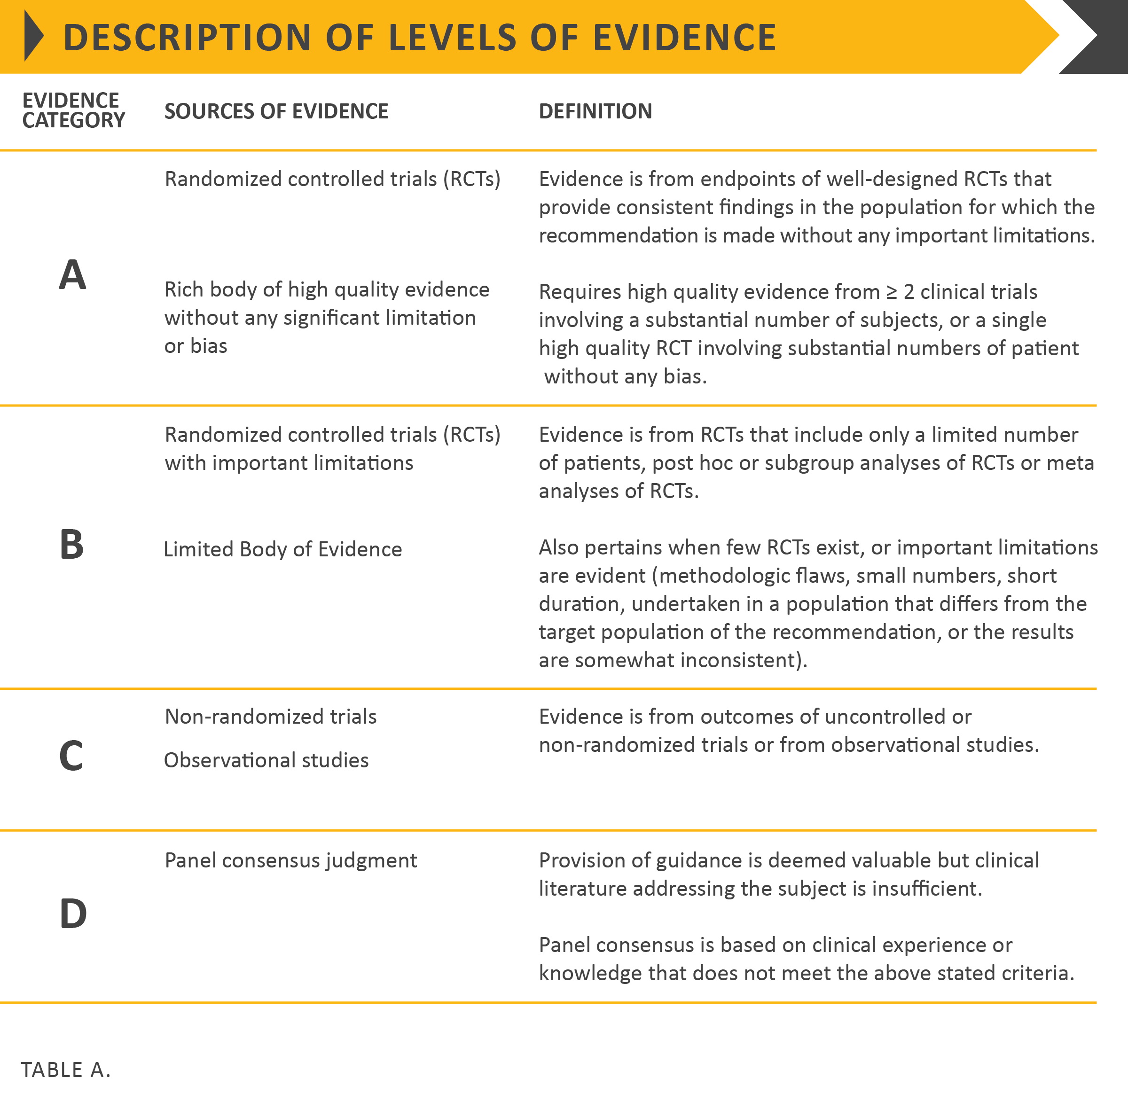

Slide 3
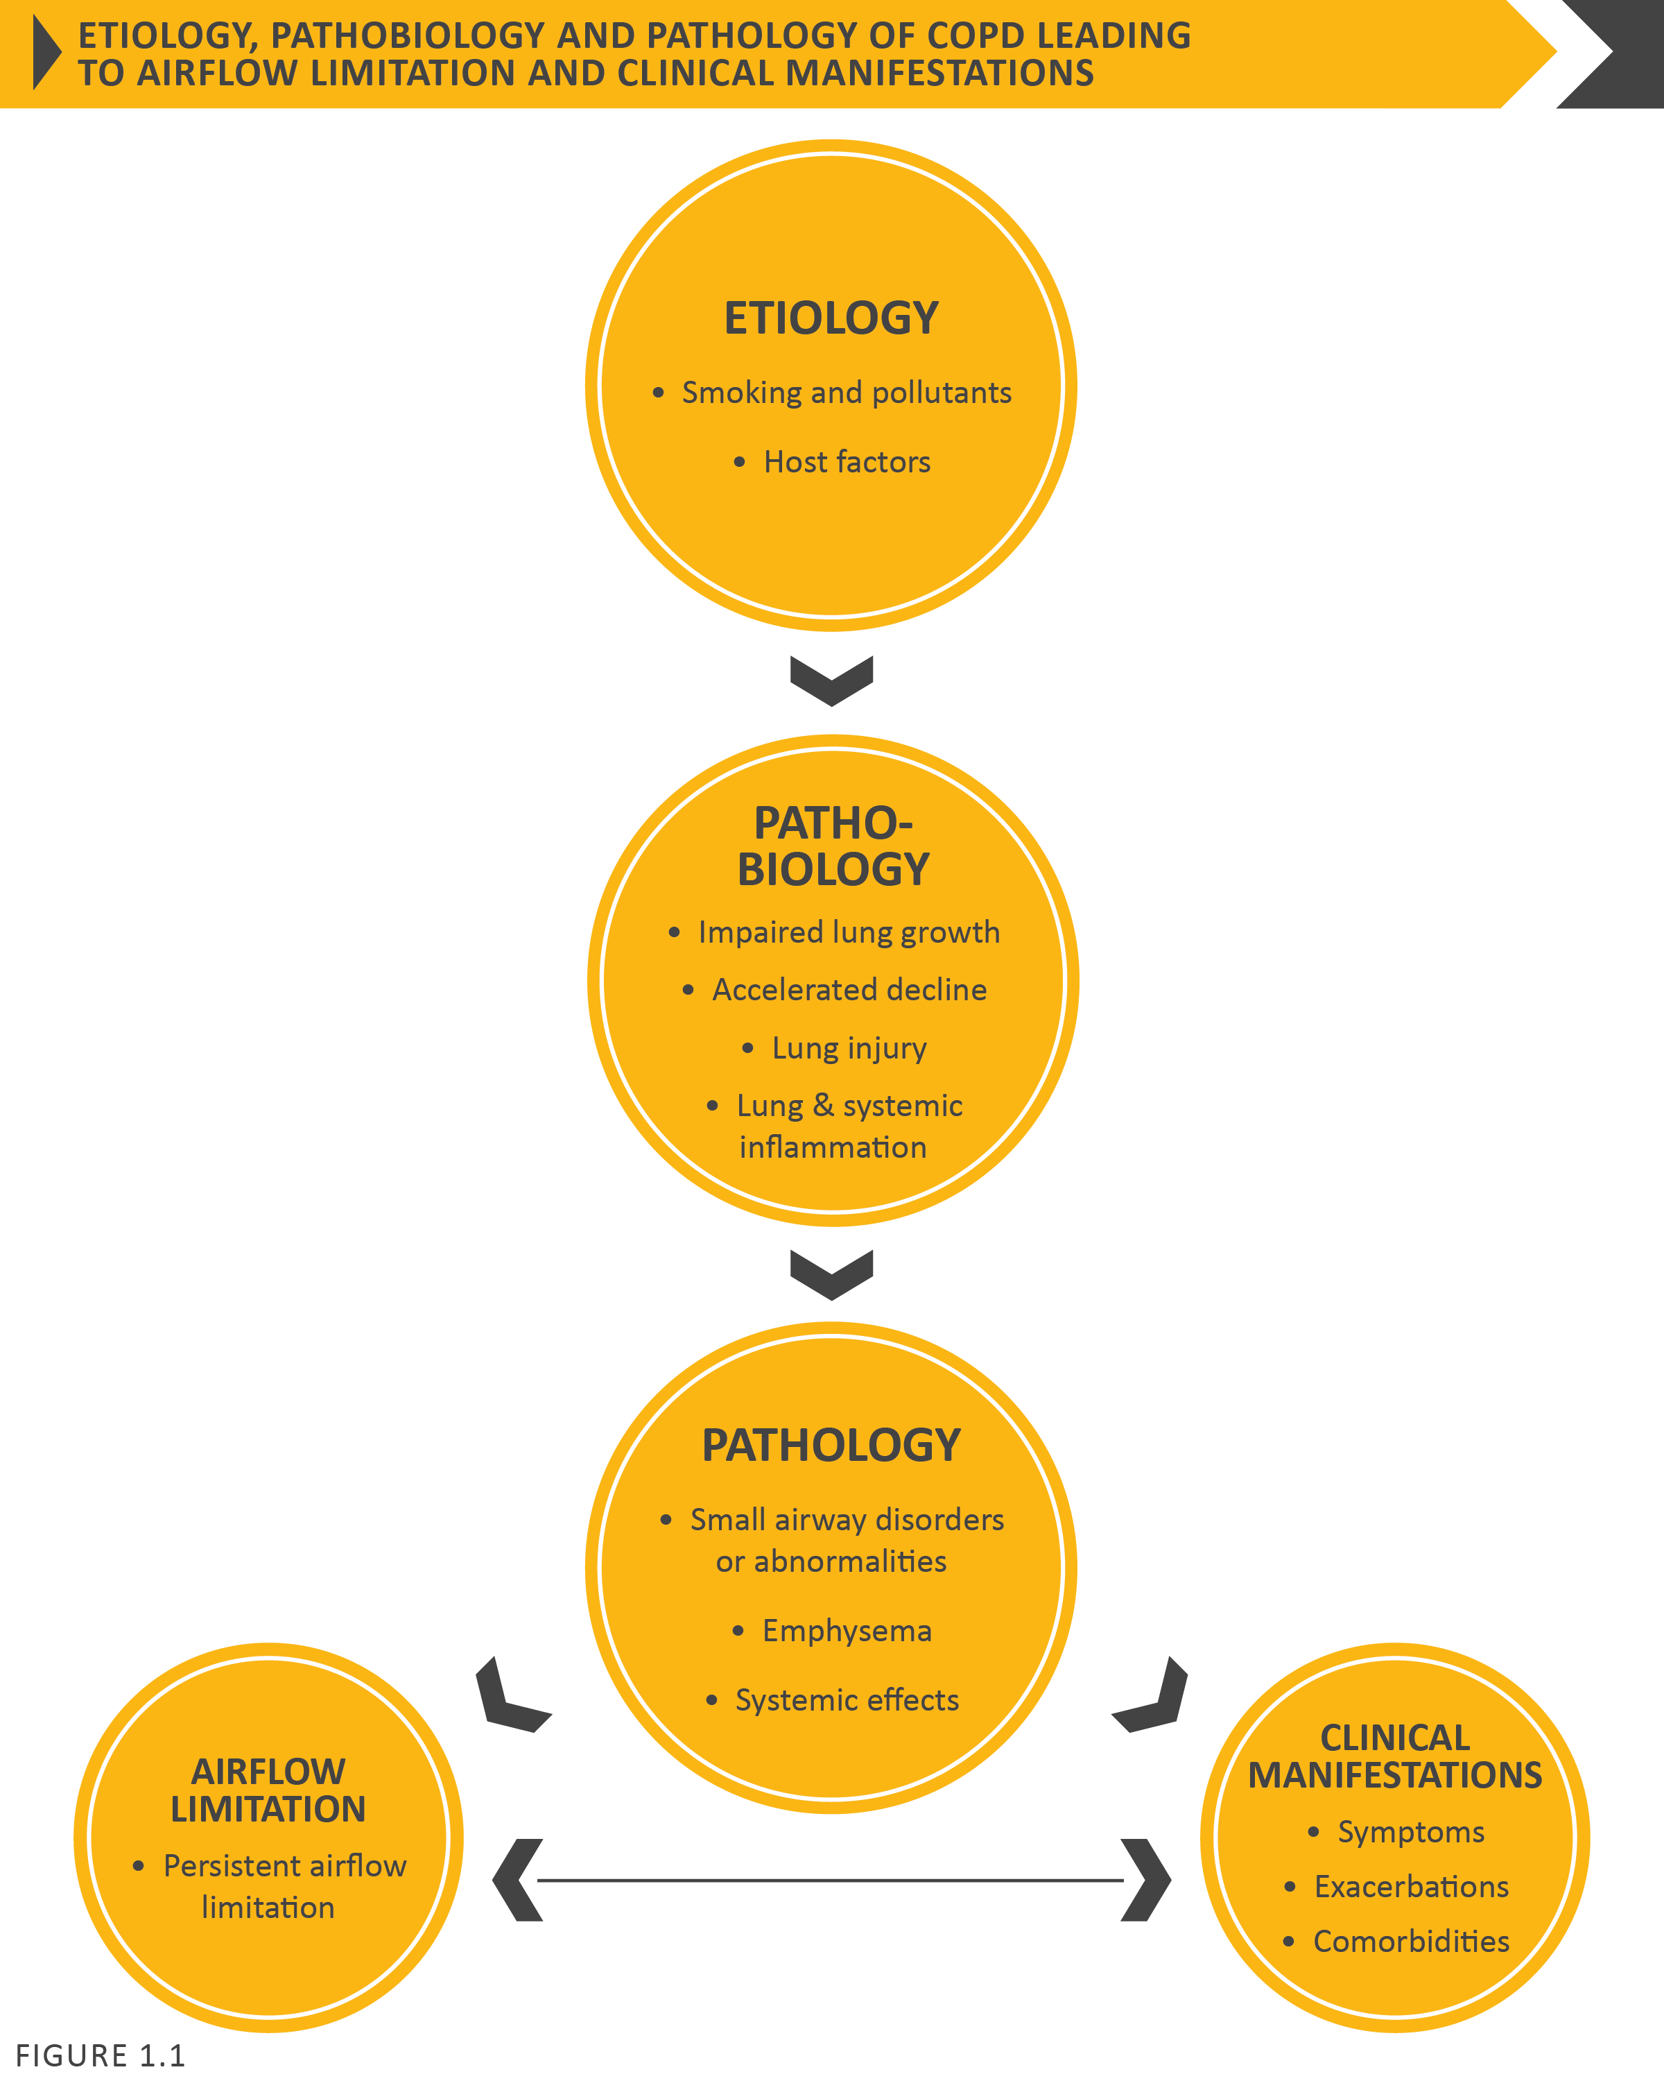

Slide 4
Note: This is a simplified diagram of FEV₁ progression over time. In reality, there is tremendous heterogeneity in the rate of decline in FEV₁
owing to the complex interactions of genes with environmental exposures and risk factors over an individual’s lifetime
[adapted from Lange et al. NEJM 2015;373:111-22].

Slide 5
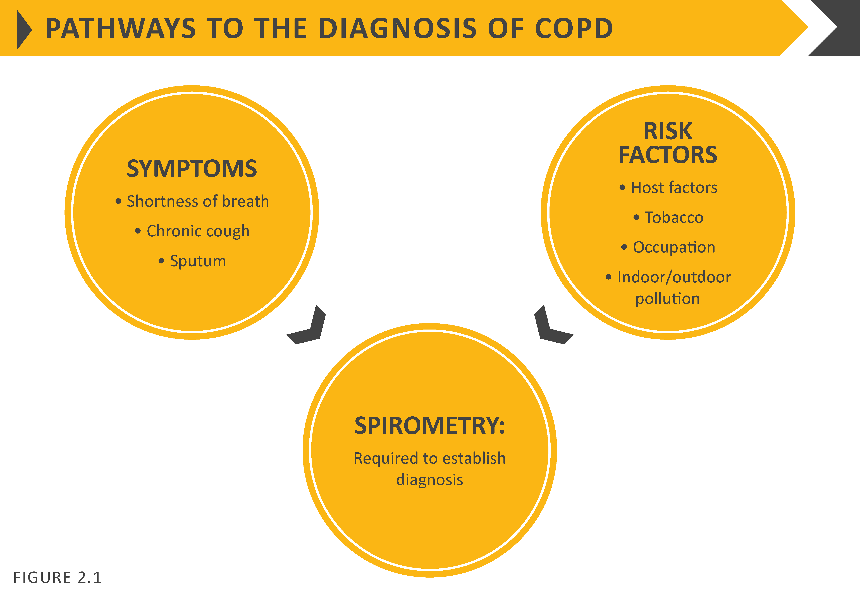

Slide 6
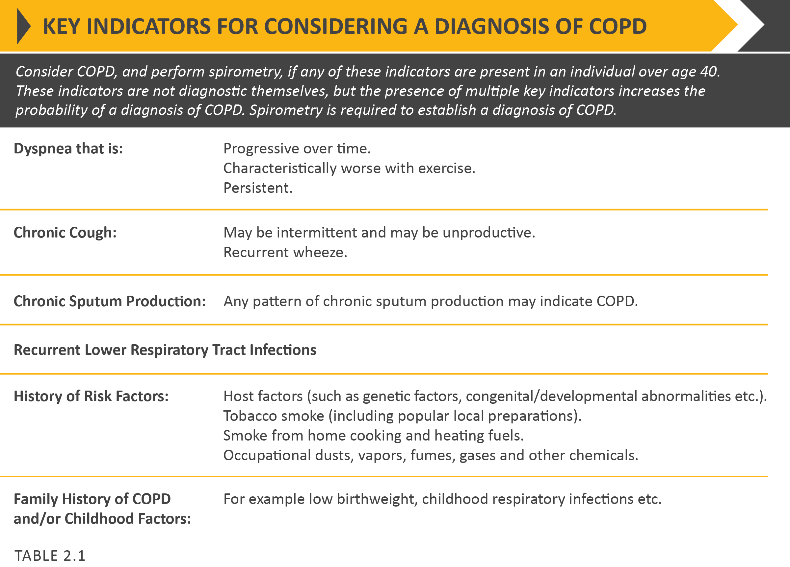

Slide 8
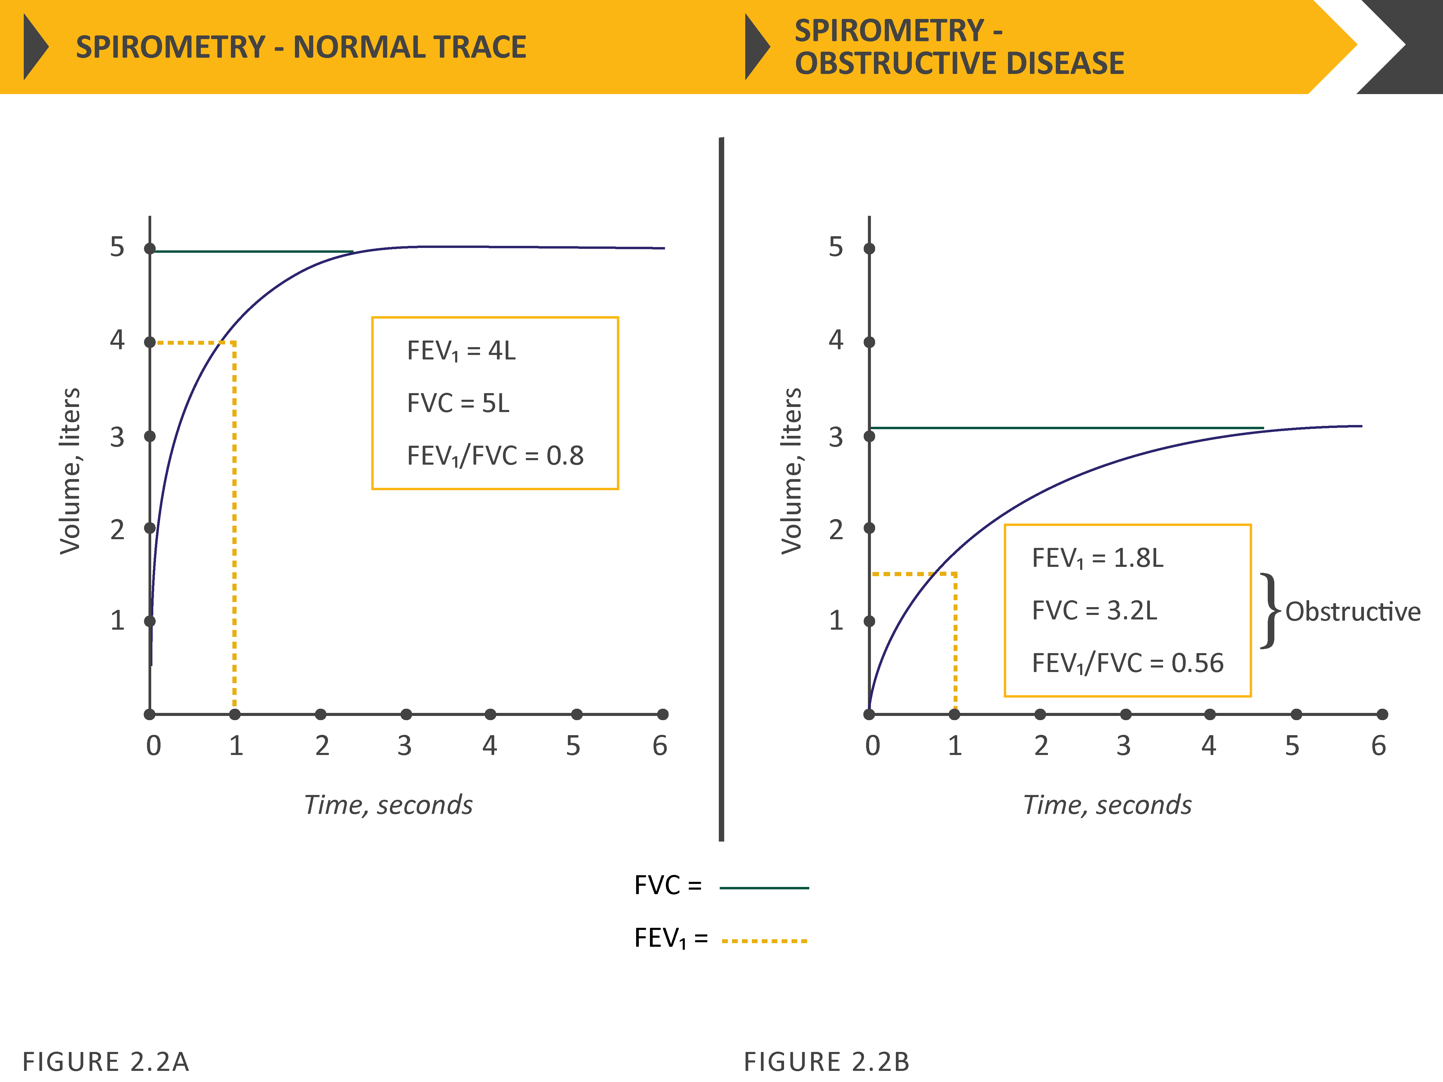

Slide 9
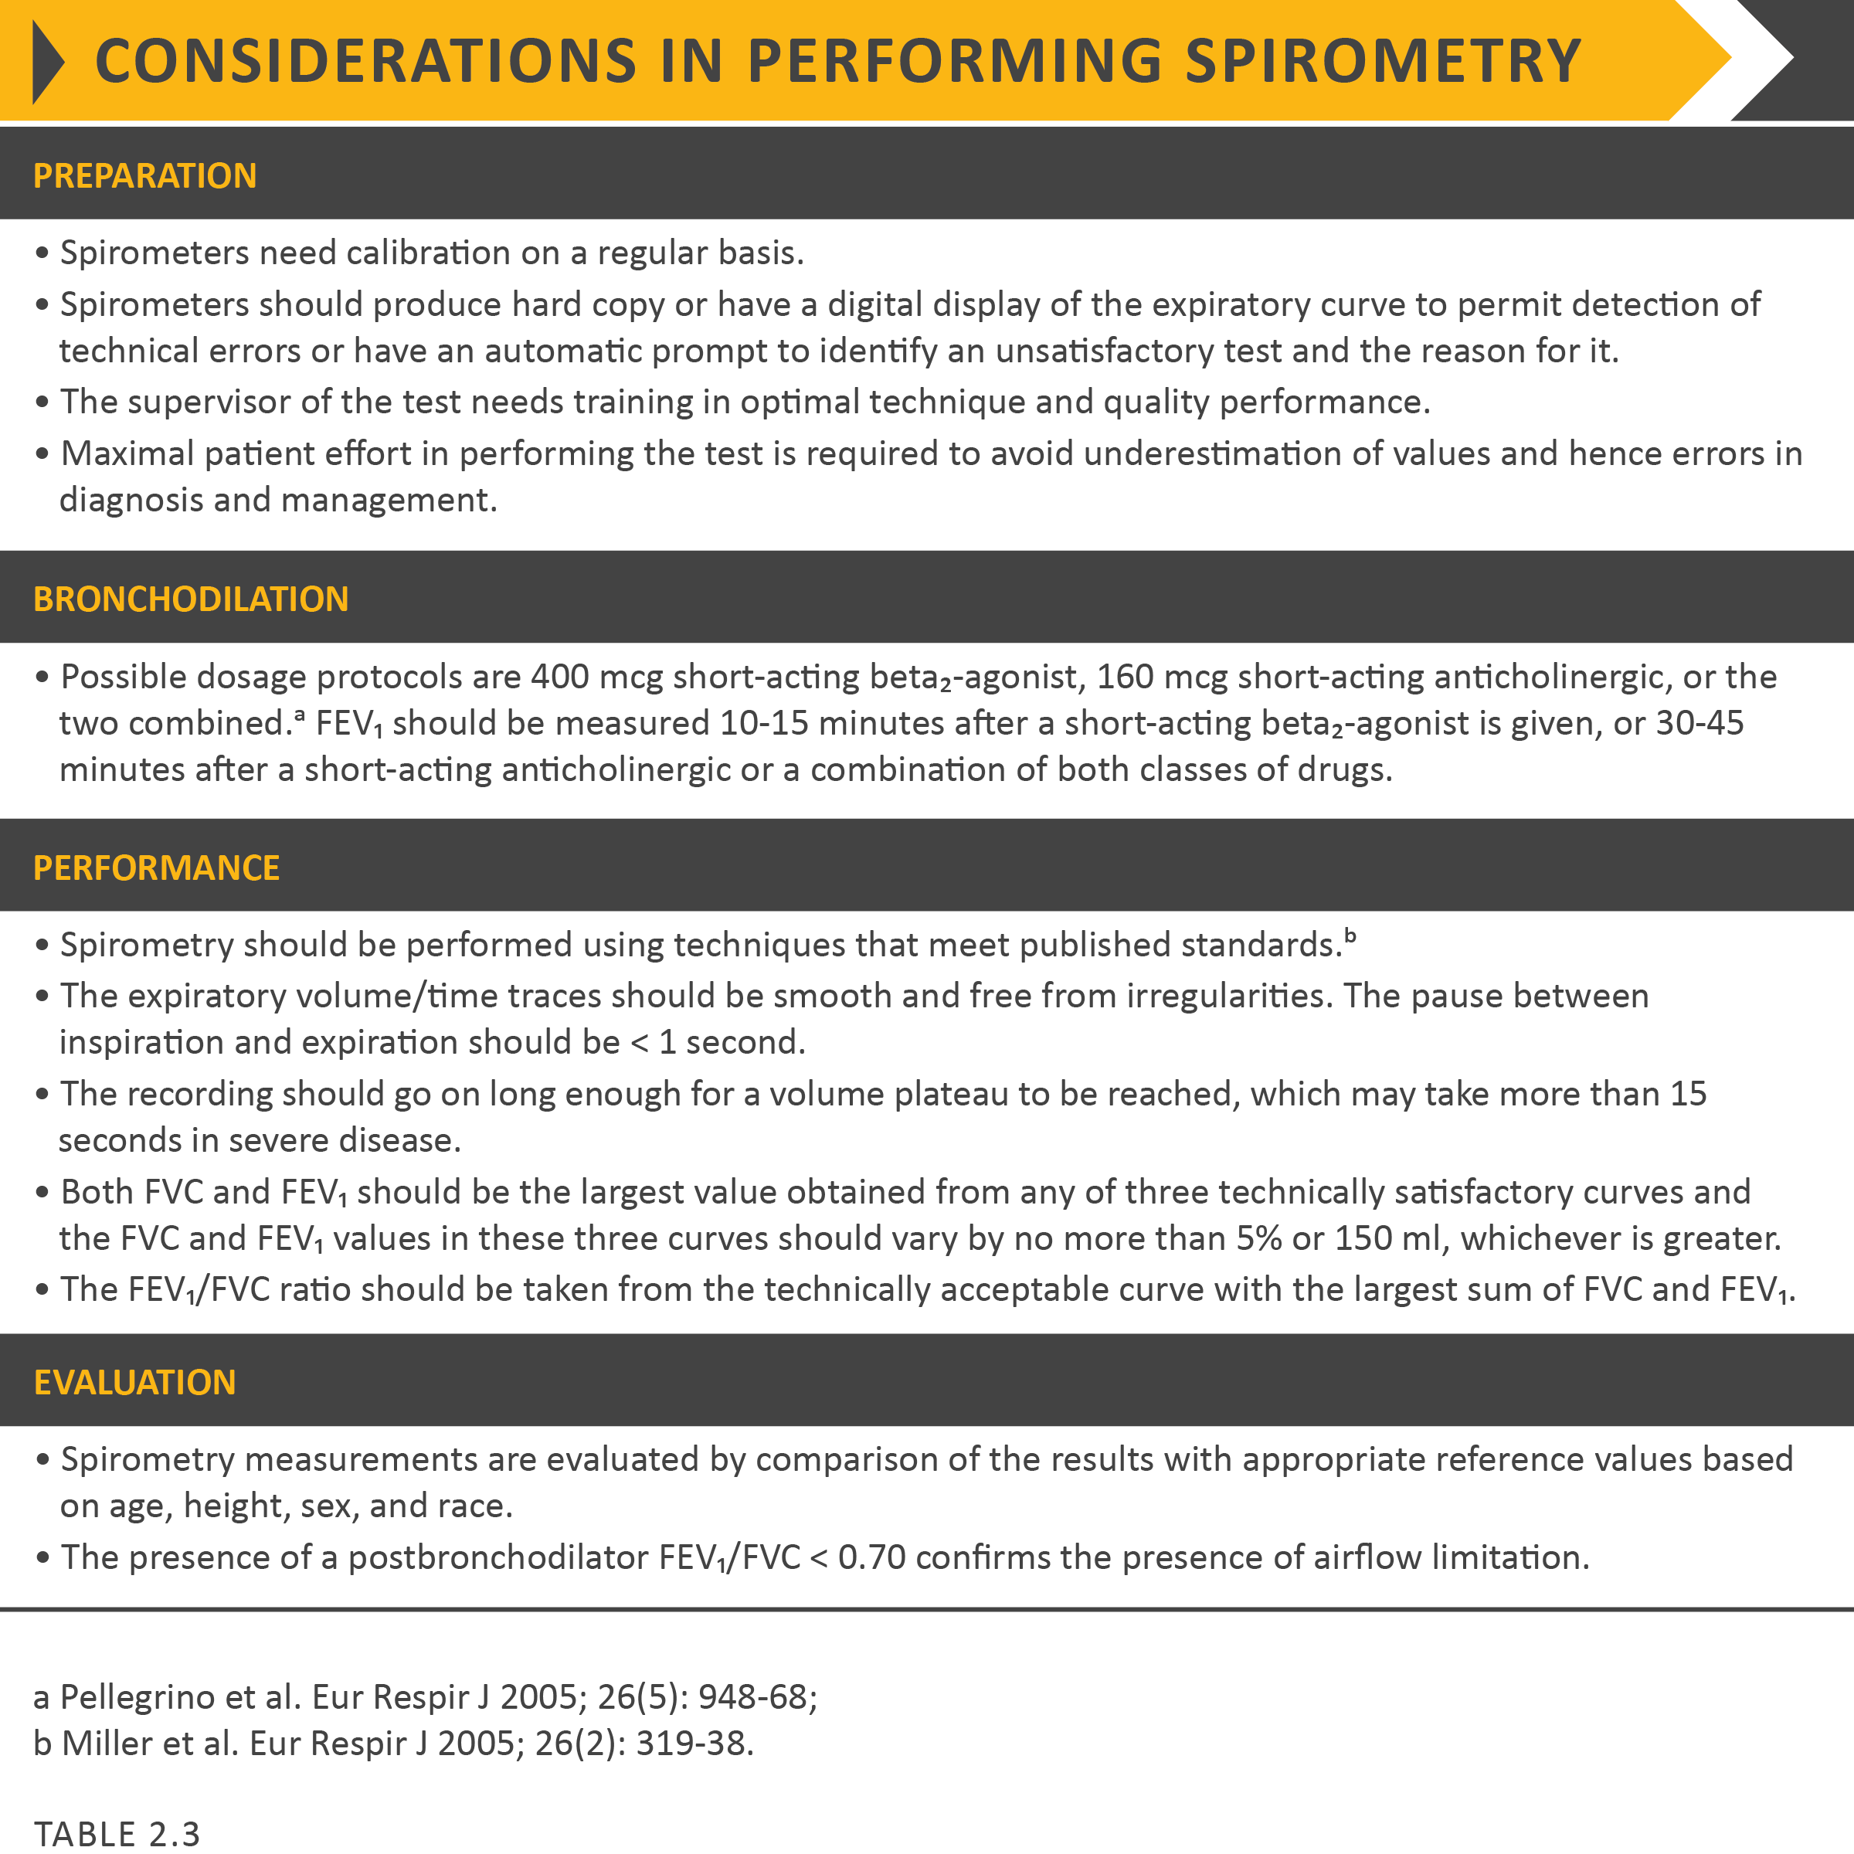

Slide 10
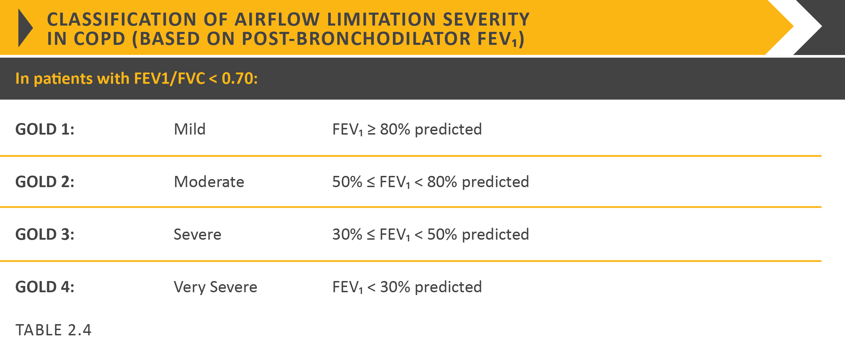

Slide 12
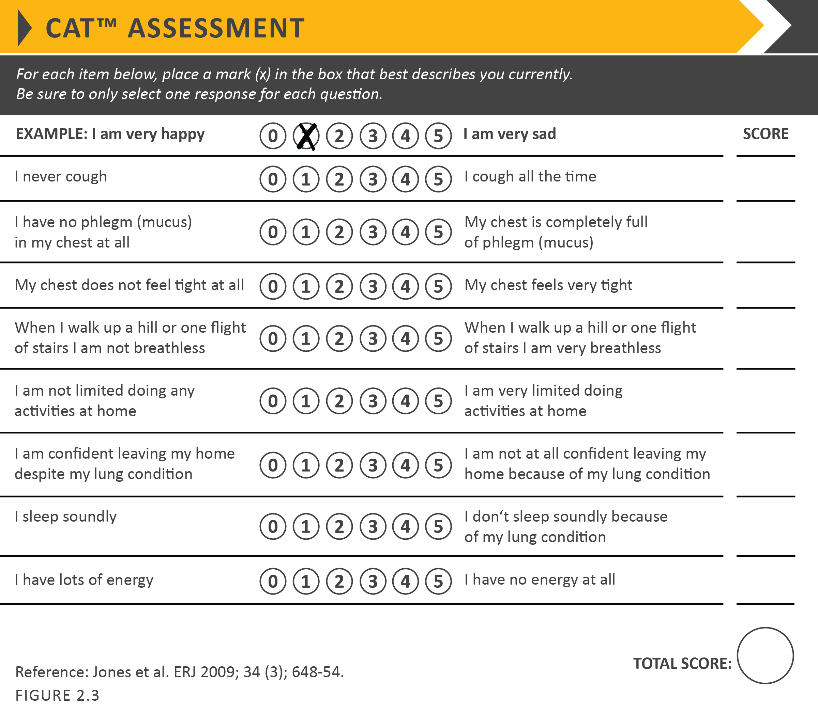

Slide 15
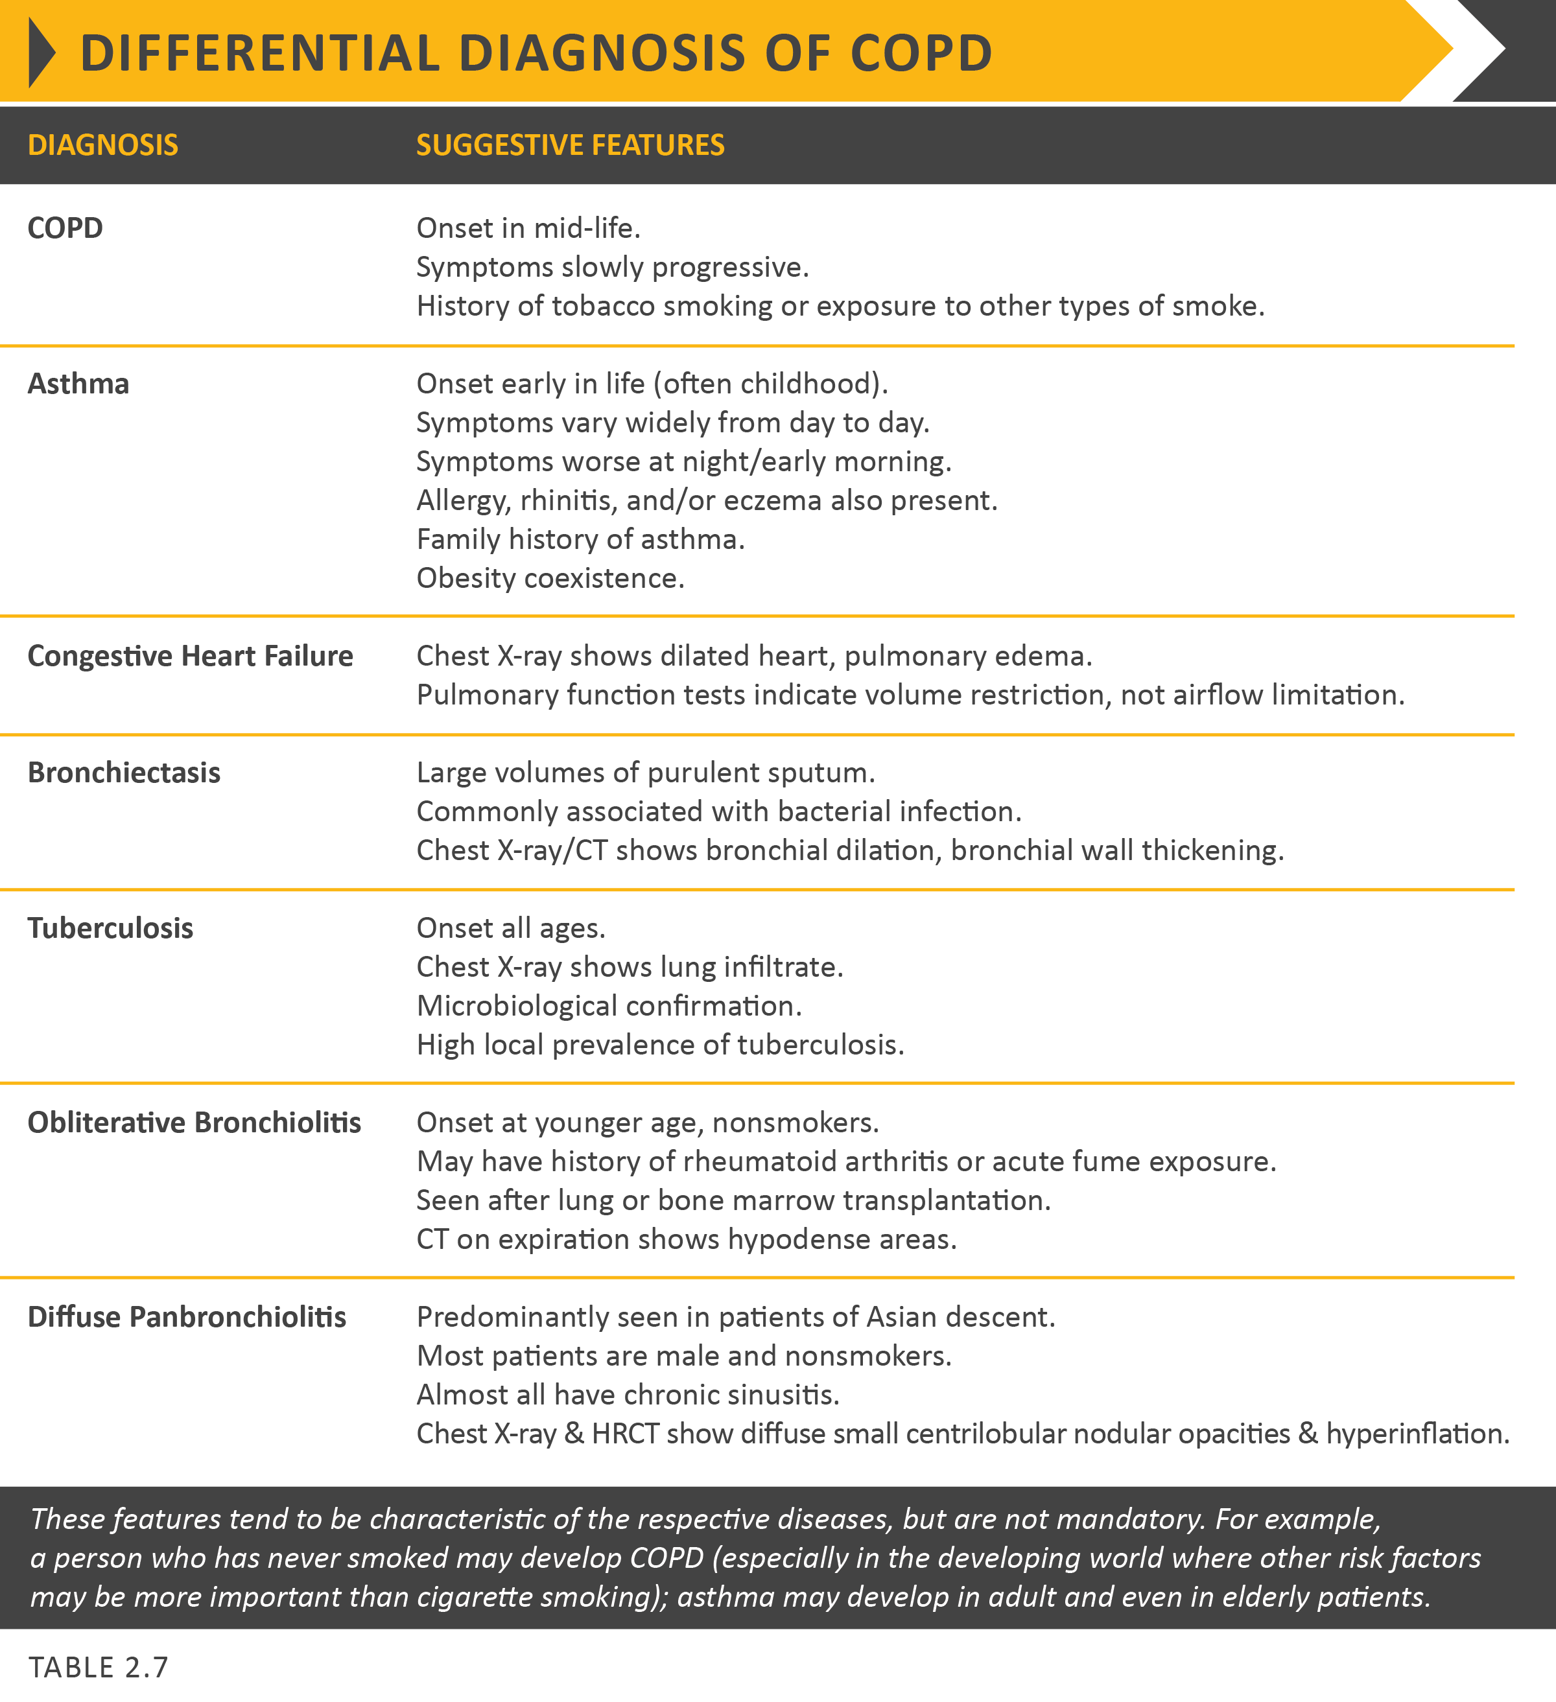

Slide 18
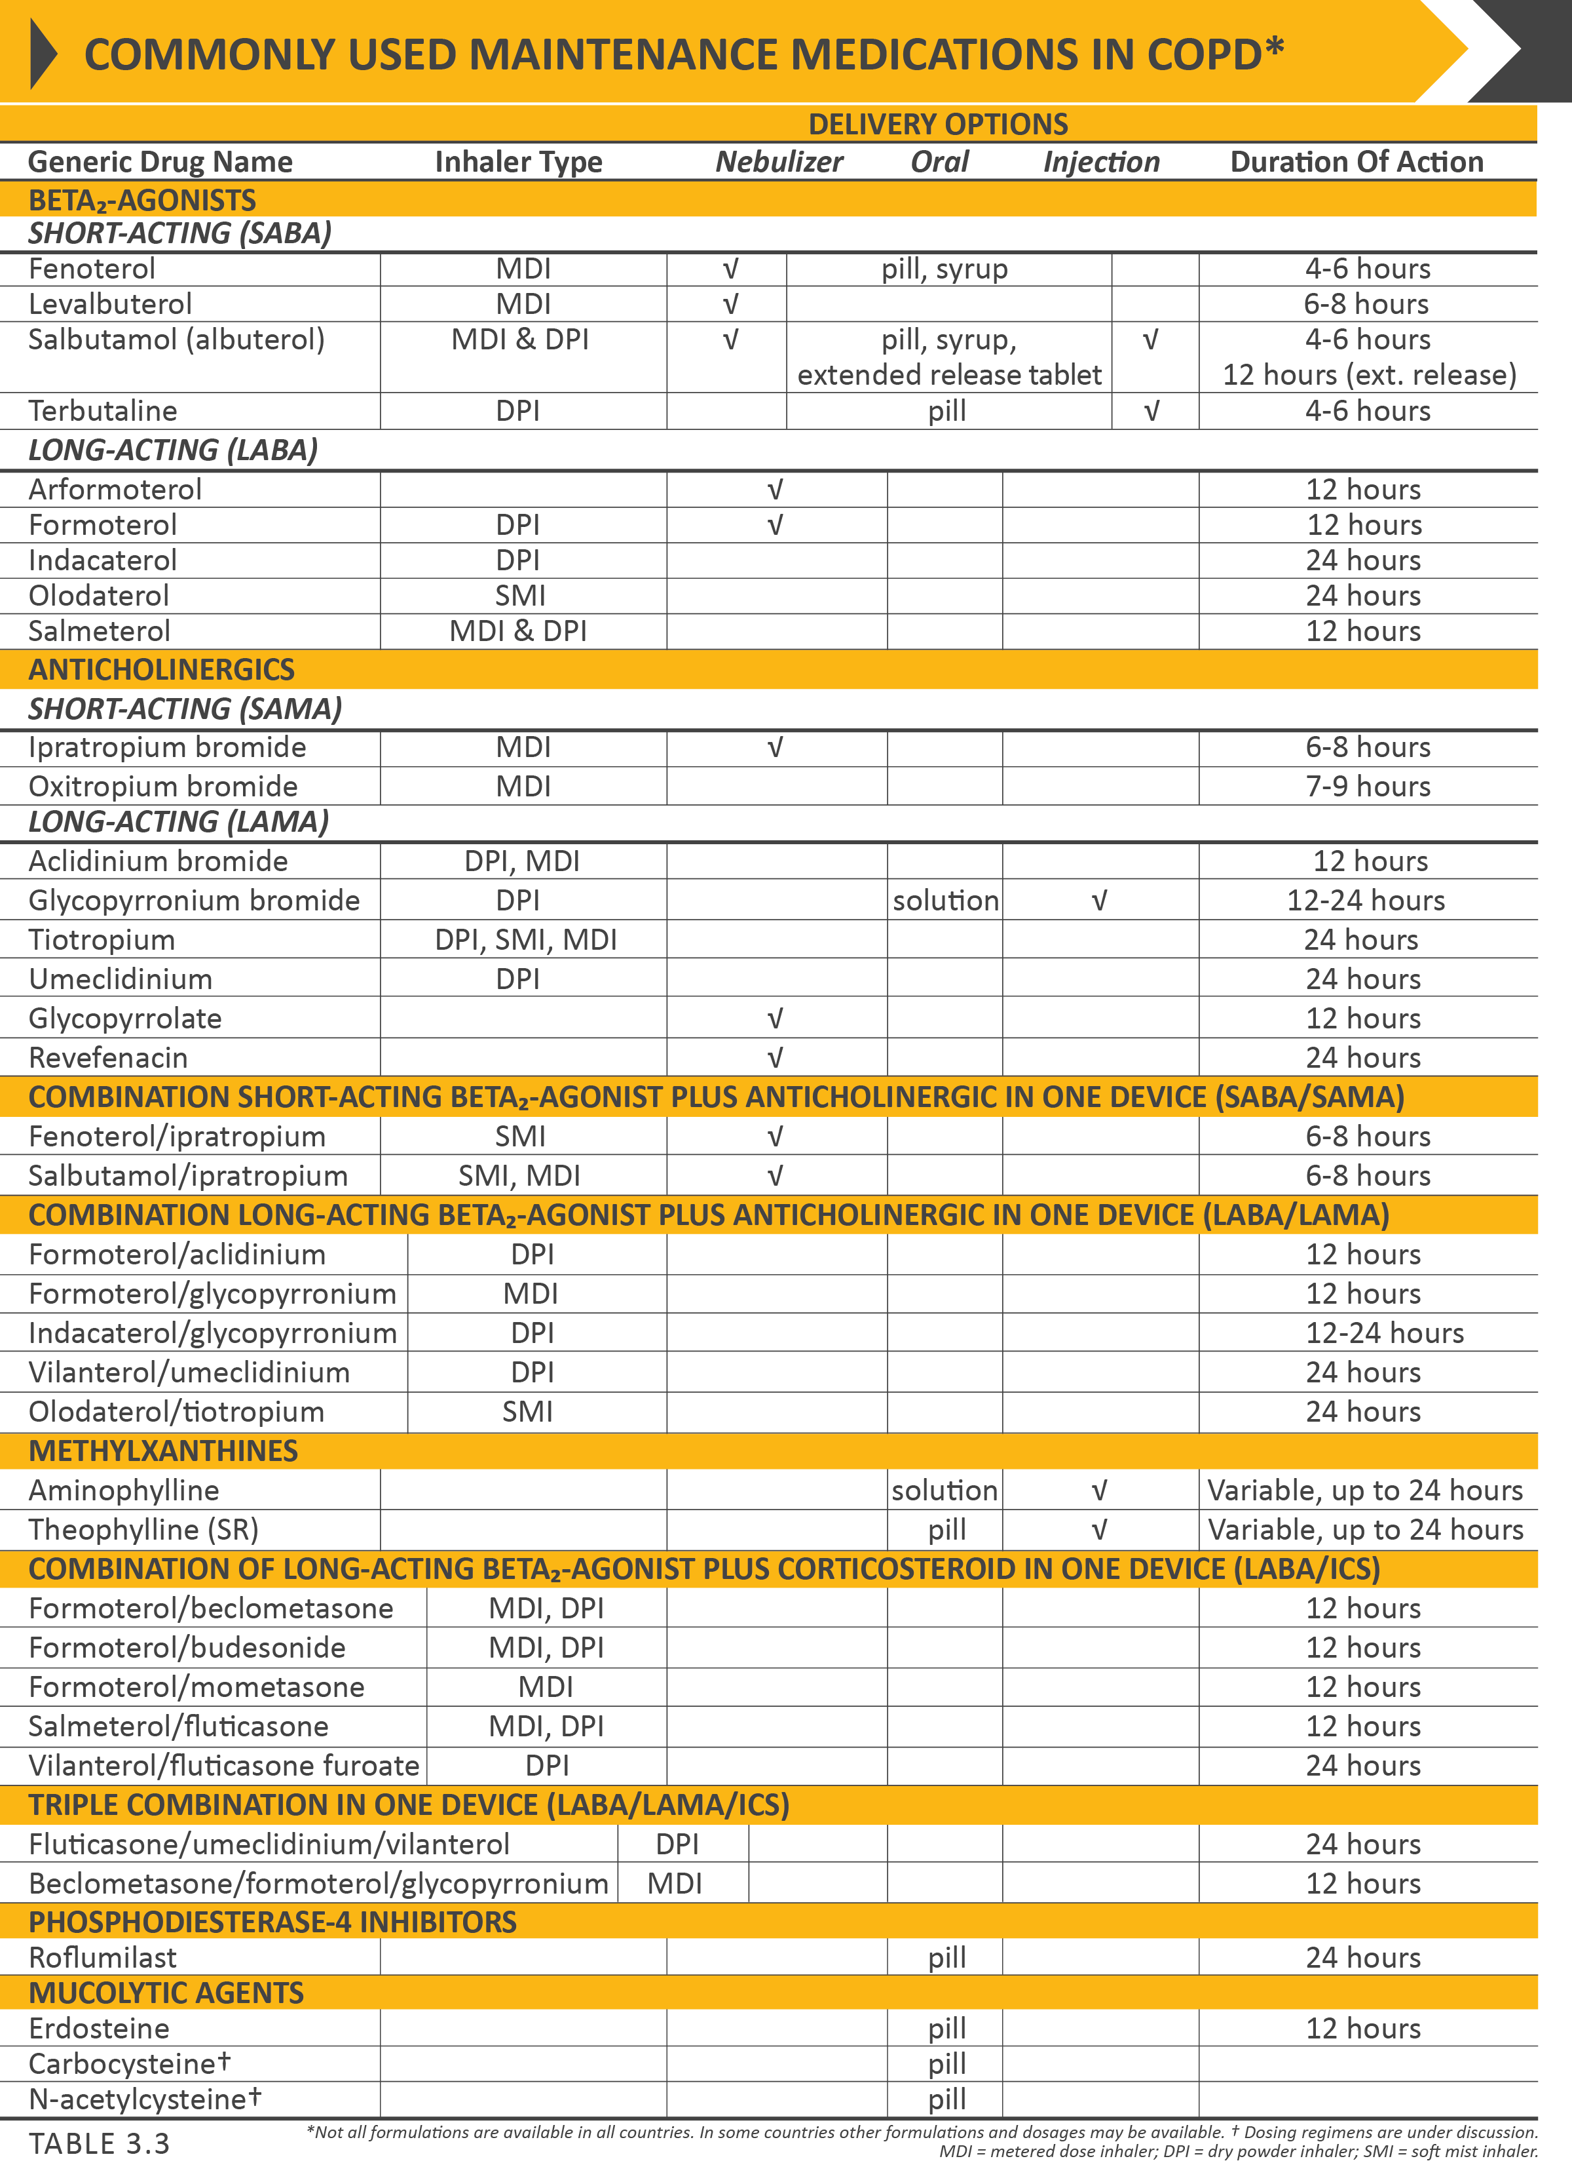
© 2020 Global Initiative for Chronic Obstructive Lung Disease

Slide 19
© 2020 Global Initiative for Chronic Obstructive Lung Disease

Slide 20
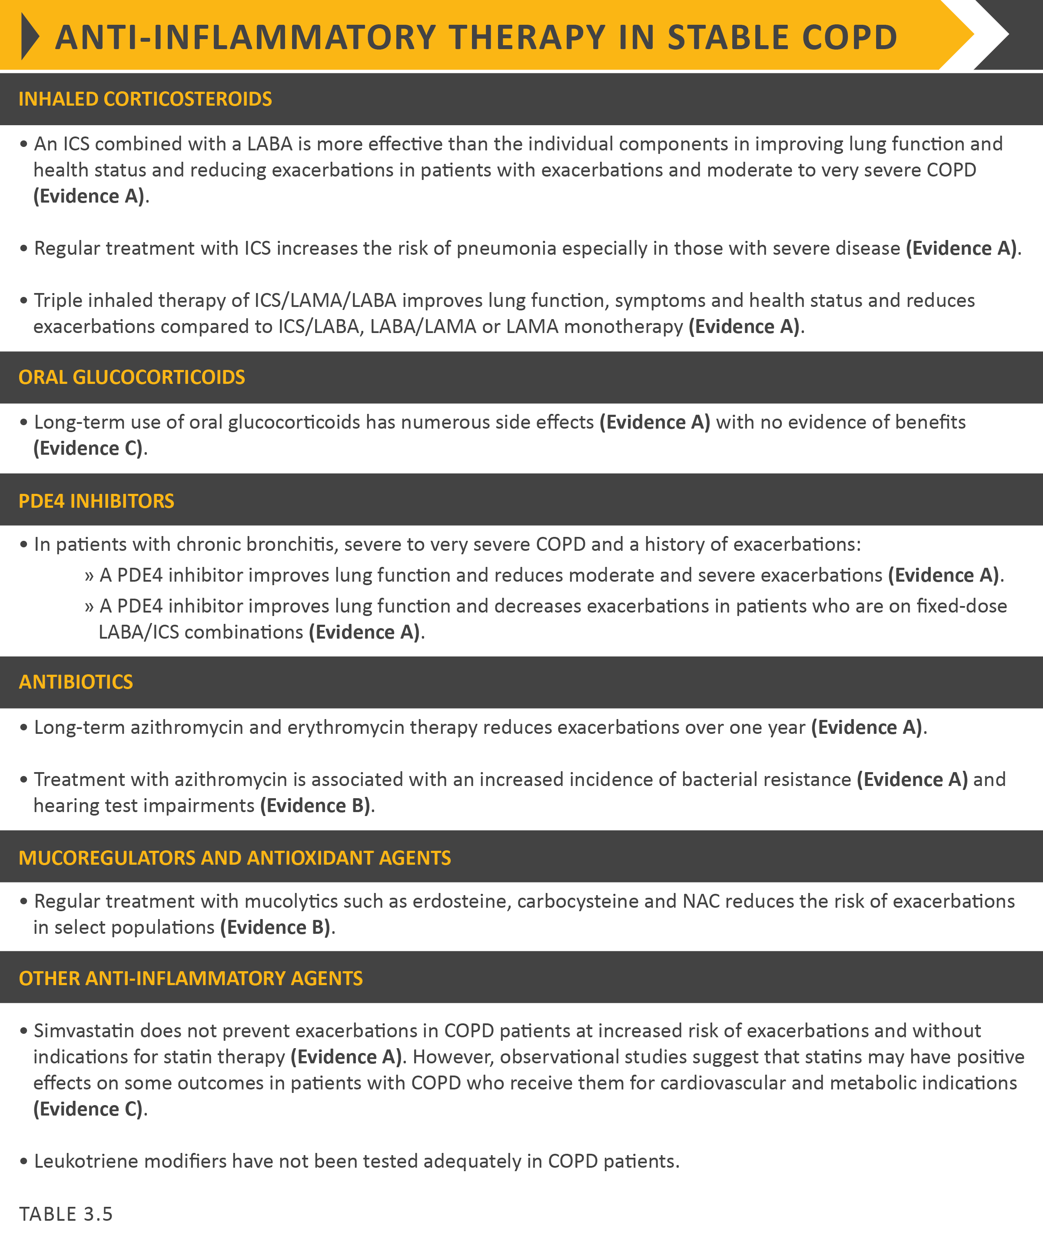

Slide 31
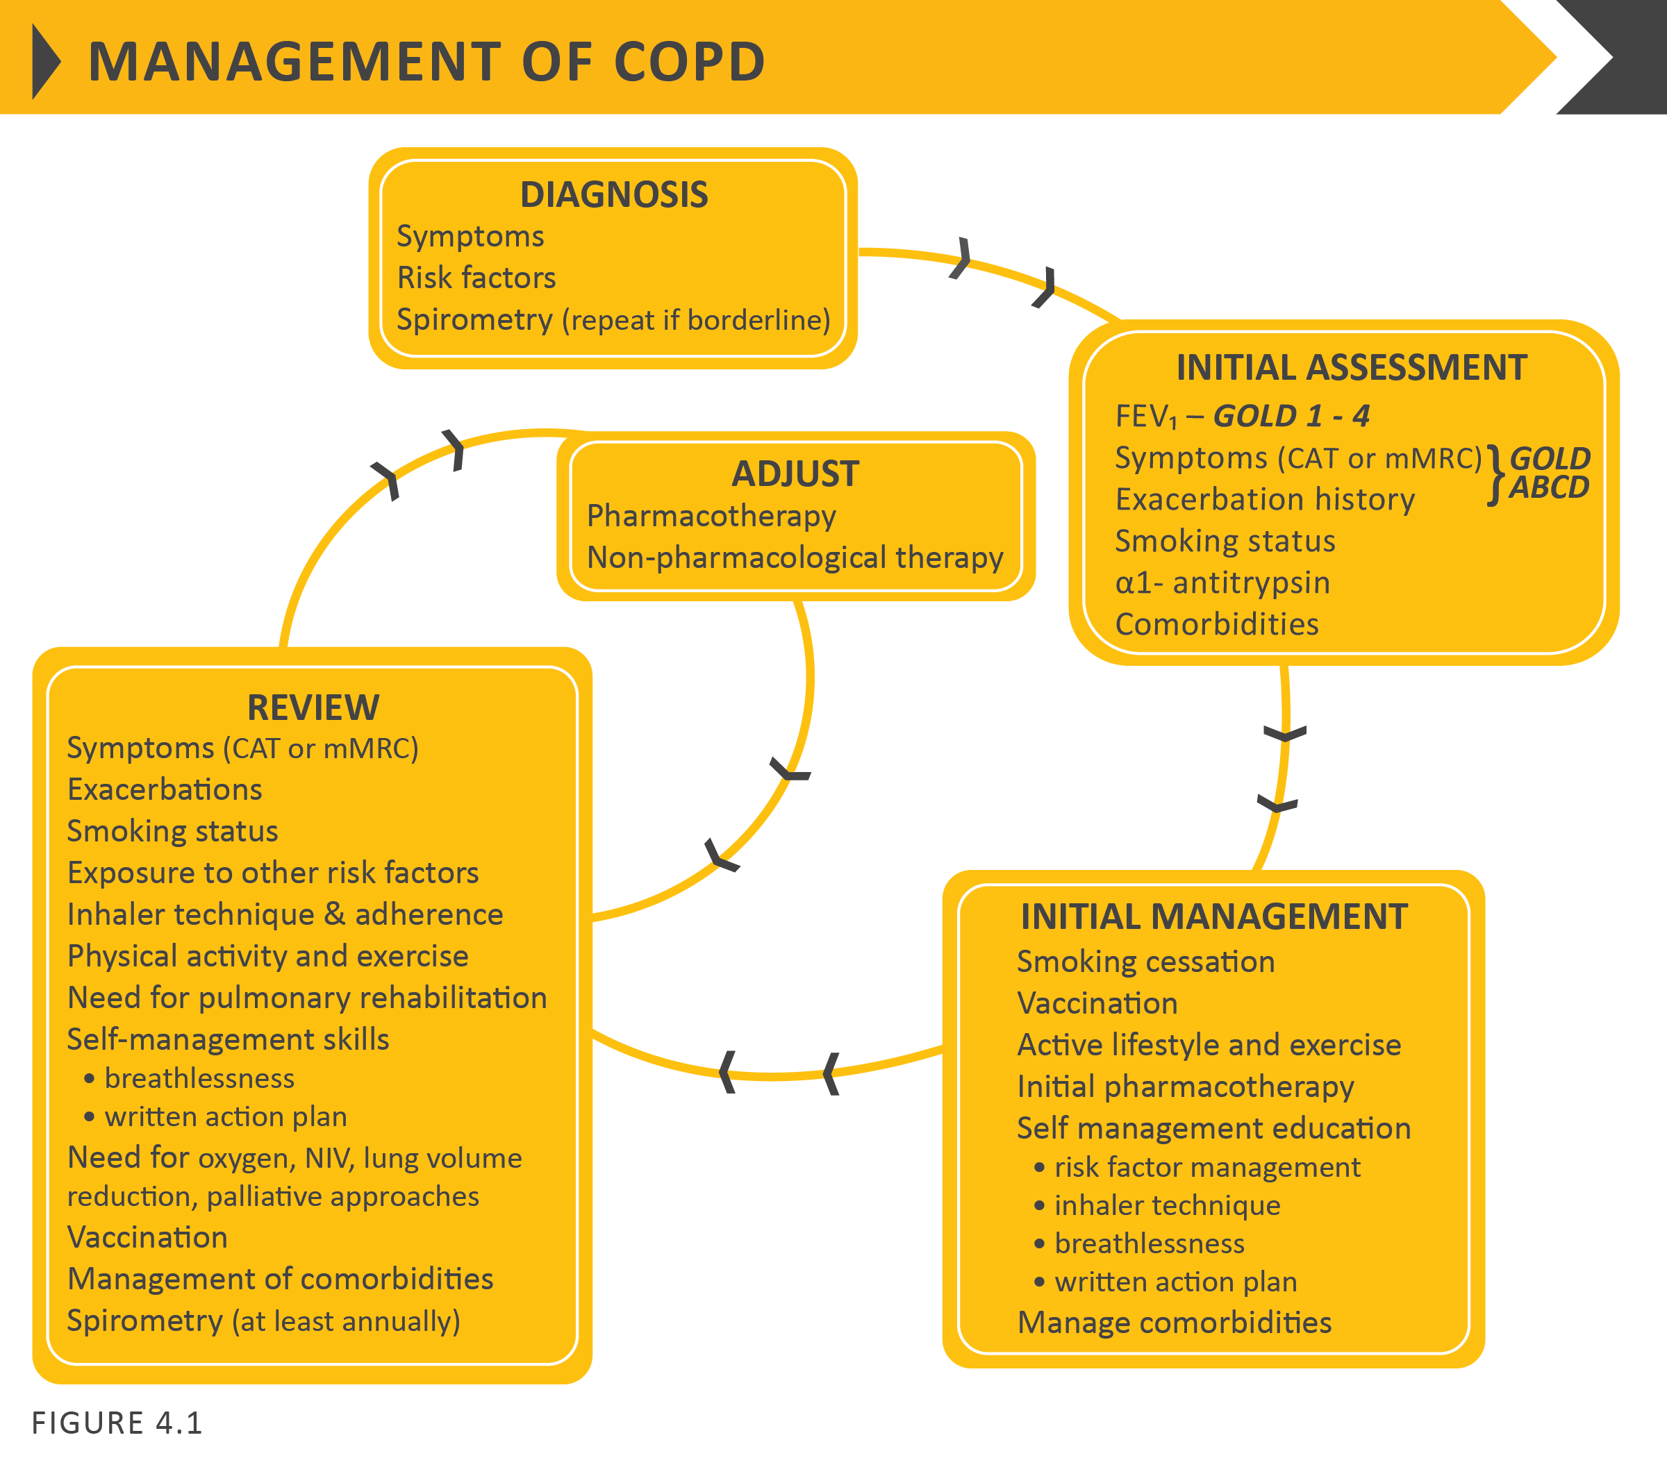

Slide 40
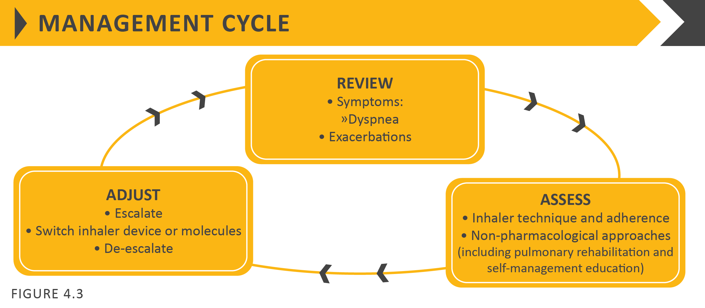

Slide 45
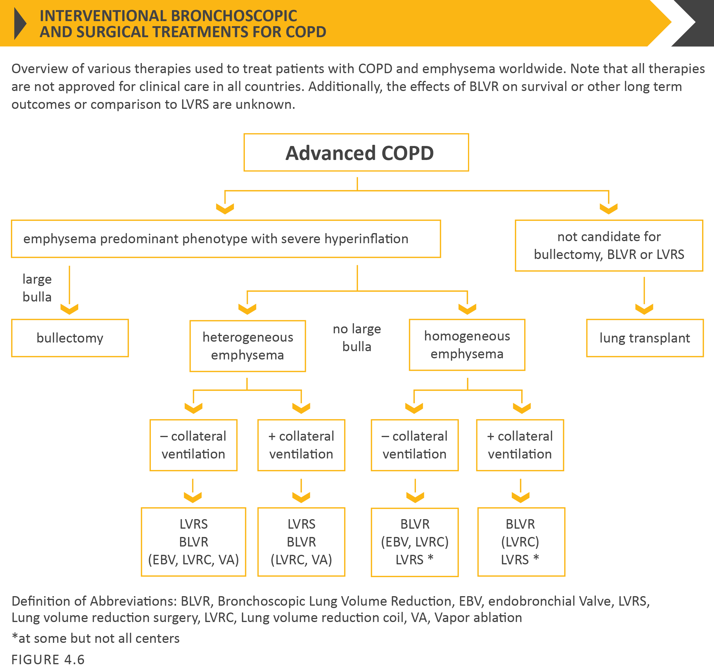

Slide 46
TABLE 4.10 (Part I)

Slide 47
TABLE 4.10 (Part II)

