Slide 1
GLOBAL INITIATIVE FOR CHRONIC OBSTRUCTIVE LUNG DISEASE (GOLD): TEACHING SLIDE SET
February 2017
This slide set is restricted for academic and educational purposes only. Use of the slide set, or of individual slides, for commercial or promotional purposes requires approval from GOLD.
© 2017 Global Initiative for Chronic Obstructive Lung Disease

Slide 2
© 2017 Global Initiative for Chronic Obstructive Lung Disease

Slide 3
GOLD Board of Directors 2017
Alvar Agusti, MD, Chair
Respiratory Institute,
Hospital Clinic, IDIBAPS
Univ. Barcelona and Ciberes
Barcelona, Spain
Marc Decramer, MD, Chair (to 05/16)
University of Leuven
Leuven, Belgium
Bartolome R. Celli, MD
Brigham and Women’s Hospital Boston, Massachusetts, USA
Rongchang Chen, MD
Guangzhou Institute of Respiratory Disease
Guangzhou, PRC
Gerard Criner, MD
Temple University School of Medicine
Philadelphia, Pennsylvania, USA
Peter Frith, MD
Repatriation General Hospital, Adelaide,
South Australia, Australia
David Halpin, MD
Royal Devon and Exeter Hospital
Devon, UK
M. Victorina López Varela, MD
Universidad de la República
Montevideo, Uruguay
Masaharu Nishimura, MD
Hokkaido University School of Medicine
Sapporo, Japan
Roberto Rodriguez-Roisin, MD
Respiratory Institute, Hospital Clinic, IDIBAPS
Univ. Barcelona and Ciberes
Barcelona, Spain
Claus Vogelmeier, MD
University of Marburg
Marburg, Germany
© 2017 Global Initiative for Chronic Obstructive Lung Disease

Slide 4
GOLD Science Committee 2017
Claus Vogelmeier, MD, Chair
University of Marburg
Marburg, Germany
Alvar Agusti, MD
Respiratory Institute, Hospital
Clinic, IDIBAPS
Univ. Barcelona and Ciberes
Barcelona, Spain
Antonio Anzueto, MD
University of Texas
Health Science Center
San Antonio, Texas, USA
Peter Barnes, MD
National Heart and Lung Institute
London, United Kingdom
Jean Bourbeau, MD
McGill University Health Centre
Montreal, Canada
Gerard Criner, MD
Temple University School of Medicine, Philadelphia, Pennsylvania, USA
Leonardo M. Fabbri, MD
University of Modena & Reggio Emilia
Modena, Italy
Fernando Martinez, MD, MS
New York-Presbyterian Hospital/
Weill Cornell Medical Center
New York, NY,USA
Nicolas Roche, MD
Hôpital Cochin
Paris, France
Roberto Rodriguez-Roisin, MD
Respiratory Institut, Hospital Clinic,
IDIBAPS, Univ. Barcelona and Ciberes, Barcelona, Spain
Donald Sin, MD
St. Paul’s Hospital,
University of British Columbia
Vancouver, Canada
Dave Singh, MD
University of Manchester
Manchester, UK
Robert Stockley, MD
University Hospital
Birmingham, UK
Jørgen Vestbo, MD
University of Manchester
Manchester, England, UK
Jadwiga A. Wedzicha, MD
Imperial College London
London, UK
PROGRAM DIRECTOR
Rebecca Decker, MSJ
Fontana, Wisconsin, USA
Suzanne Hurd, PhD
(Director to 12/15)
© 2017 Global Initiative for Chronic Obstructive Lung Disease

Slide 5
GOLD National Leaders
Perlat Kapisyzi, Albania
Eduardo A. Schiavi, Argentina
Otto Chris Burghuber, Austria
Mostafizur Rahman, Bangladesh
Kazi S. BENNOOR, Bangladesh
Wim Janssens, Belgium
Jose Roberto Jardim, Brazil
Aquiles Camelier, Brazil
Fernando Lundgren, Brazil
Yavor Ivanov, Bulgaria
Kosta Kostov, Bulgaria
Dennis E. O’Donnell, Canada
Manuel Barros, Chile
Nan-Shan Zhong, China
Jiangtao Lin, China
Chunxue Bai, China
Fu-Qiang Wen, China
Alejandro Casas, Colombia
Neven Miculinic, Croatia
Stanislav Kos, Czech Republic
Jaromir Musil, Czech Republic
Vladimir Vondra, Czech Republic
Ejvind Frausing Hansen, Denmark
Eduardo Gautreau de Windt, Dominican Republic
Hisham Tarraf, Egypt
Victor Castro Gòmez, El Salvador
Gerard Huchon, France
Maia Gotua, Georgia
Klaus Rabe, Germany
David S.C. Hui, Hong Kong
Thorarinn Gislason, Iceland
Gunnar Gudmundsson, Iceland
Rohini V. Chowgule, India
R.Narasimhan, India
Faisal Yunus, Indonesia
Masjedi Mohammad Reza, Iran
Mohammad Ashkan Moslehi, Iran
Timothy J. McDonnell, Ireland
Zvi G. Fridlender, Israel
Lorenzo Corbetta, Italy
Takahide Nagase, Japan
Michiaki Mishima, Japan
Bashar Nsour, Jordan
Jawad Hamad, Jordan
Damilya Nugmanova, Kazakhstan
Yeon-Mok Oh, Korea
Mousa Khadadah, Kuwait
Talant Sooronbaev, Kyrgyz Republic
Joseph M Cacciottolo, Malta
J. Javier Díaz Castañón, Mexico
Alexandru Corlateanu, Moldova
Dr Oyunchimeg, Mongolia
Harold Rea, New Zealand
Jorge Cuadra, Nicaragua
Amund Gulsvik, Norway
Ernst Omenaas, Norway
Javaid Khan, Pakistan
Jamil Ur Rehman Tahir, Pakistan
Mohammad Osman Yusuf, Pakistan
Teresita S. deGuia, Philippines
Ewa Nizankowska-Mogilnicka, Poland
Pawel Kuca, Poland
Florin Mihaltan, Romania
Ruxandra Ulmeanu, Romania
Alexander Chuchalin, Russia
Dmitri R. Rackita, Russia
Professor Alexandre Vizel, Russia
Professor Eugeny Shmelev, Russia
Kian-Chung Ong, Singapore
Wan-Cheng Tan, Singapore
Ruzena Tkacova, Slovak Republic
Stanislav Suskovic, Slovenia
EM Irusen, South Africa
Patricia Sobradillo, Spain
Daiana Stolz, Switzerland
Yousser Mohammad, Syria
Professor Ali Kocabas, Turkey
Hakan Gunen, Turkey
Maria Montes de Oca, Venezuela
Ngo Quy Chau, Vietnam
Le Thi Tuyet Lan, Vietnam
Sy Duong-Quy, Vietnam
Khaled Al-Shair, Yemen
© 2017 Global Initiative for Chronic Obstructive Lung Disease

Slide 6
GOLD Invited Contributors
Prof. Richard Beasley
Medical Research Institute of
New Zealand
Wellington, New Zealand
Peter M A Calverley, MD
University Hospital Aintree
Liverpool, UK
Ciro Casanova, MD
Hospital Universitario
Santa Cruz de Tenerife, Tenerife, Spain
James Donohue, MD
University of North Carolina
Chapel Hill, NC, USA
MeiLan Han, MD, MS
University of Michigan
Ann Arbor, MI, USA
Nicola Hanania, MBBS, MS
Baylor College of Medicine
Houston, TX, USA
Maria Montes de Oca, MD
Hospital Universitario de Caracas,
Universidad Central de Venezuela,
Caracas, Venezuela
Takahide Nagase, MD
The University of Tokyo,
Tokyo, Japan
Alberto Papi, MD
University of Ferarra
Ferrara, Italy
Ian Pavord, MD
University of Oxford
Oxford, UK
David Price, FRCGP
Observational and Pragmatic Research Institute, Singapore
University of Aberdeen, Aberdeen, Scotland, UK
© 2017 Global Initiative for Chronic Obstructive Lung Disease

Slide 7
GOLD Website Address
www.goldcopd.org
© 2017 Global Initiative for Chronic Obstructive Lung Disease

Slide 8
Chronic Obstructive Pulmonary Disease (COPD)
COPD is currently the fourth leading cause of death in the world.¹
COPD is projected to be the 3rd leading cause of death by 2020.²
More than 3 million people died of COPD in 2012 accounting for 6% of all deaths globally.
Globally, the COPD burden is projected to increase in coming decades because of continued exposure to COPD risk factors and aging of the population.
1. Lozano R, Naghavi M, Foreman K, et al. Global and regional mortality from 235 causes of death for 20 age groups in 1990 and 2010: a systematic analysis for the Global Burden of Disease Study 2010. Lancet 2012; 380(9859): 2095-128.
2. Mathers CD, Loncar D. Projections of global mortality and burden of disease from 2002 to 2030. PLoS Med 2006; 3(11): e442.
© 2017 Global Initiative for Chronic Obstructive Lung Disease

Slide 9
GOLD Objectives
To provide a non-biased review of the current evidence for the assessment, diagnosis and treatment of patients with COPD.
To highlight short-term and long-term treatment objectives organized into two groups:
Relieving and reducing the impact of symptoms, and
Reducing the risk of adverse health events that may affect the patient in the future.
To guide symptoms assessment and health status measurement.
© 2017 Global Initiative for Chronic Obstructive Lung Disease

Slide 10
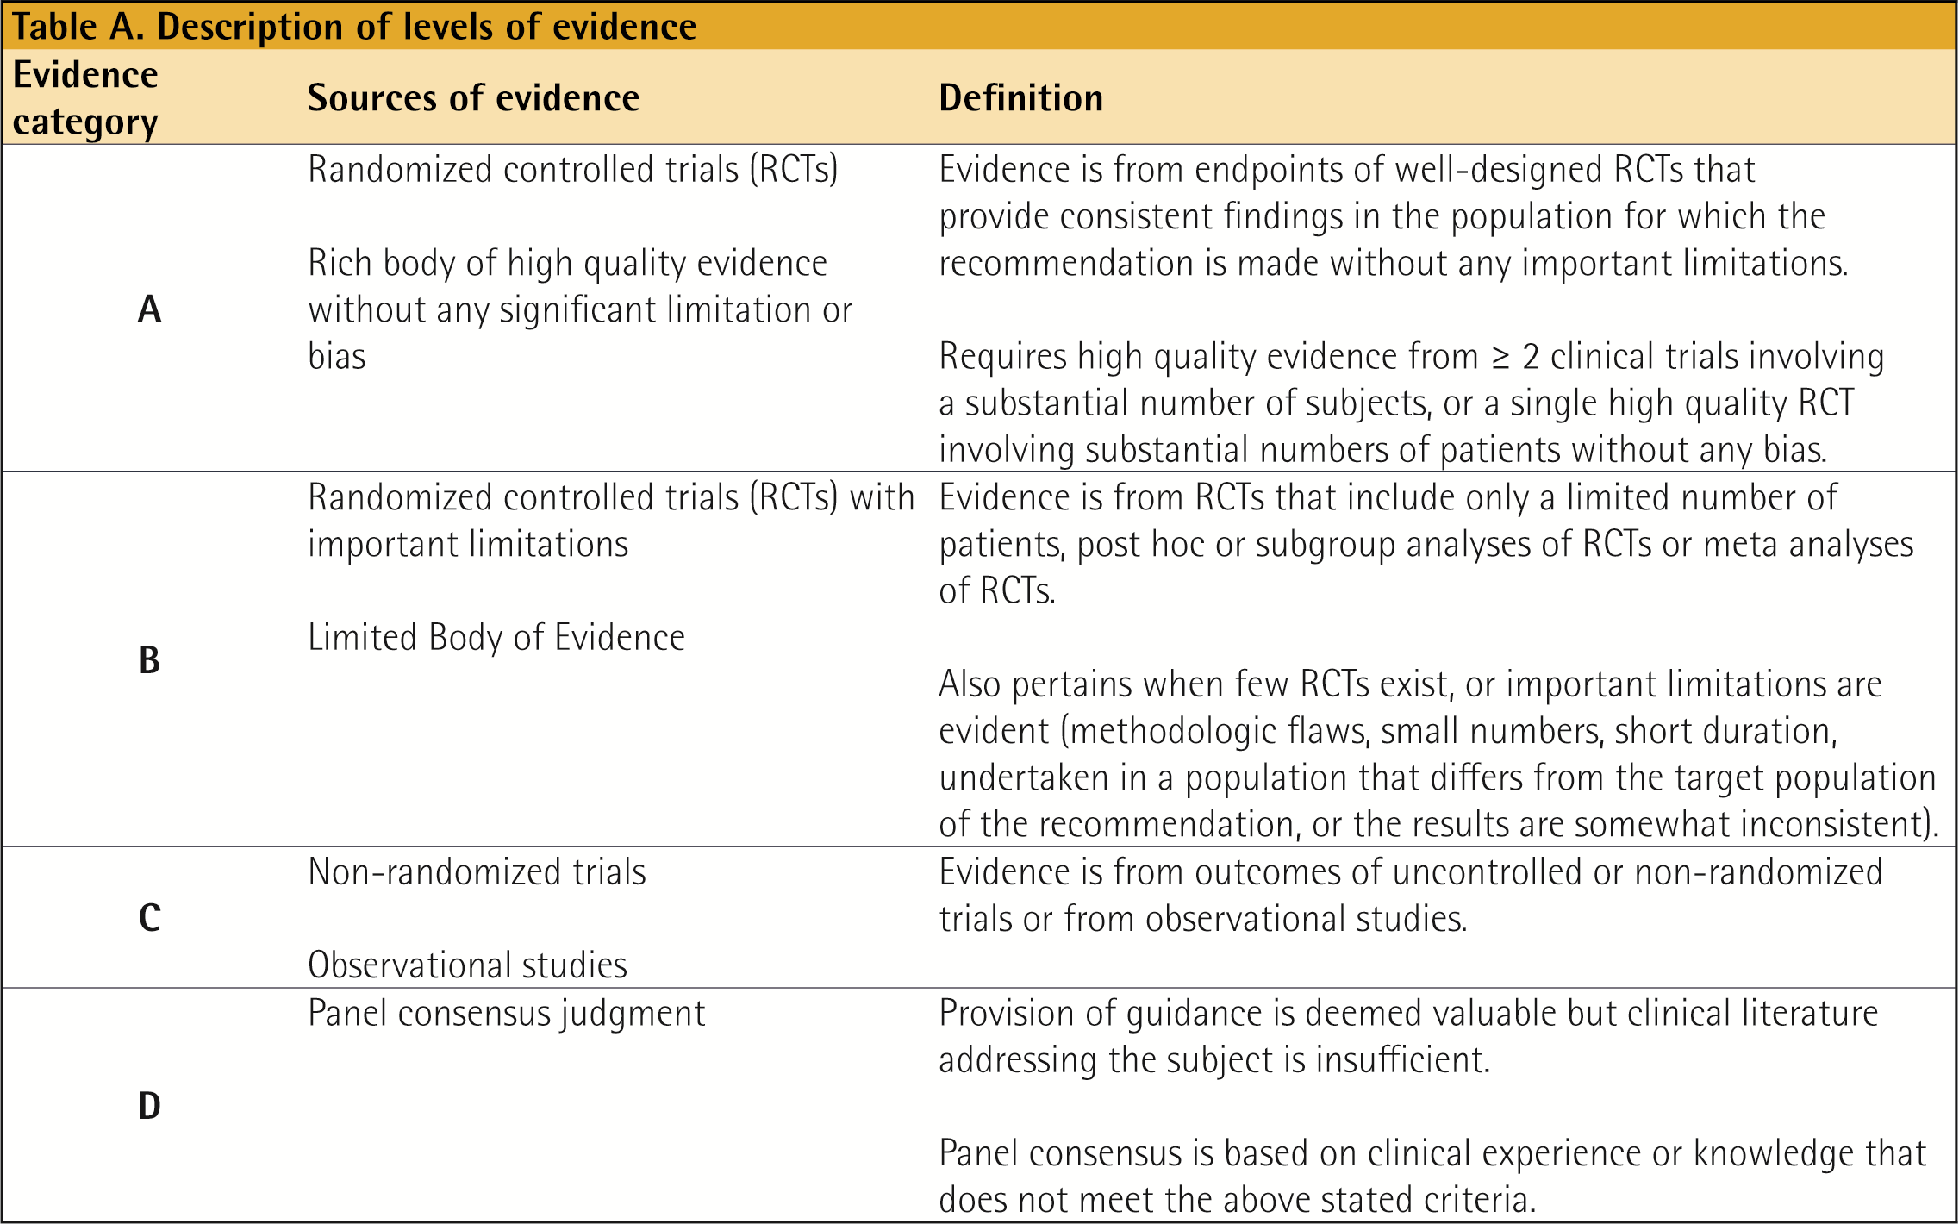
GOLD Levels of Evidence
© 2017 Global Initiative for Chronic Obstructive Lung Disease

Slide 11
GOLD Levels of Evidence
Levels of evidence have been assigned to evidence-based recommendations where appropriate.
Evidence levels are indicated in boldface type enclosed in parentheses after the relevant statement e.g., (Evidence A).
The methodological issues concerning the use of evidence from meta-analyses were carefully considered.
The evidence level scheme with categories A to D used throughout this document has been modified from that used in prior GOLD Reports and the evidence category definitions have been refined and updated.
© 2017 Global Initiative for Chronic Obstructive Lung Disease

Slide 12
GOLD 2017 Report: Chapters
Definition and Overview
Diagnosis and Initial Assessment
Evidence Supporting Prevention & Maintenance Therapy
Management of Stable COPD
Management of Exacerbations
COPD and Comorbidities
© 2017 Global Initiative for Chronic Obstructive Lung Disease

Slide 13
GOLD 2017 Report: Chapters
Definition and Overview
Diagnosis and Initial Assessment
Evidence Supporting Prevention & Maintenance Therapy
Management of Stable COPD
Management of Exacerbations
COPD and Comorbidities
© 2017 Global Initiative for Chronic Obstructive Lung Disease

Slide 14
COPD Definition
Chronic Obstructive Pulmonary Disease (COPD) is a common, preventable and treatable disease that is characterized by persistent respiratory symptoms and airflow limitation that is due to airway and/or alveolar abnormalities usually caused by significant exposure to noxious particles or gases.
© 2017 Global Initiative for Chronic Obstructive Lung Disease

Slide 15
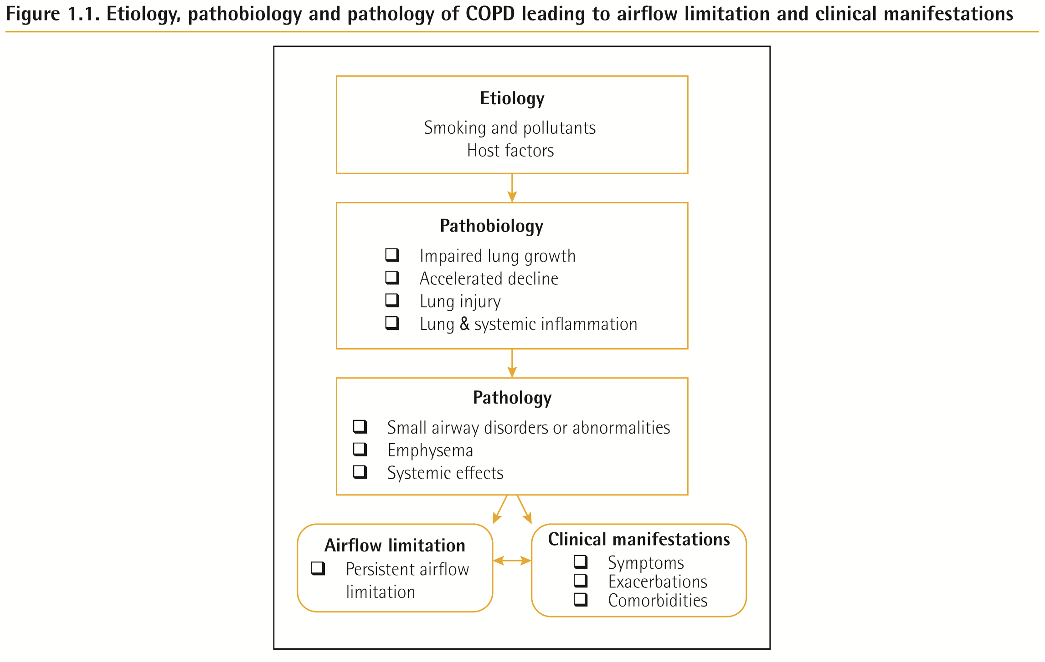
COPD Etiology, Pathobiology & Pathology
© 2017 Global Initiative for Chronic Obstructive Lung Disease

Slide 16
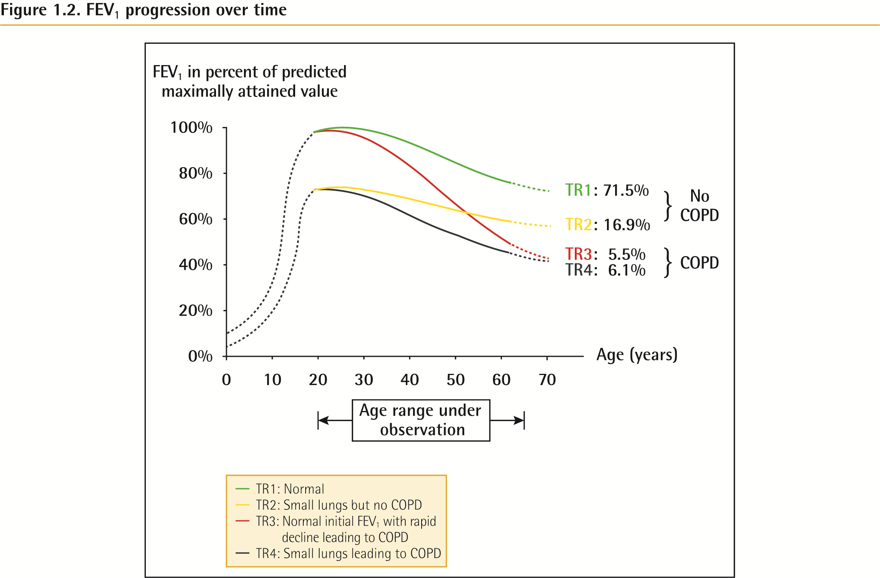
Definition and Overview
© 2017 Global Initiative for Chronic Obstructive Lung Disease

Slide 17
Definition and Overview
OVERALL KEY POINTS (1 of 2):
Chronic Obstructive Pulmonary Disease (COPD) is a common, preventable and treatable disease that is characterized by persistent respiratory symptoms and airflow limitation that is due to airway and/or alveolar abnormalities usually caused by significant exposure to noxious particles or gases.
The most common respiratory symptoms include dyspnea, cough and/or sputum production. These symptoms may be under-reported by patients.
The main risk factor for COPD is tobacco smoking but other environmental exposures such as biomass fuel exposure and air pollution may contribute.
© 2017 Global Initiative for Chronic Obstructive Lung Disease

Slide 18
Definition and Overview
OVERALL KEY POINTS (2 of 2):
Besides exposures, host factors predispose individuals to develop COPD. These include genetic abnormalities, abnormal lung development and accelerated aging.
COPD may be punctuated by periods of acute worsening of respiratory symptoms, called exacerbations.
In most patients, COPD is associated with significant concomitant chronic diseases, which increase its morbidity and mortality.
© 2017 Global Initiative for Chronic Obstructive Lung Disease

Slide 19
Prevalence
Prevalence of COPD
Systematic review and meta-analysis (Halbert et al, 2006)
Included studies carried out in 28 countries between 1990 and 2004
Prevalence of COPD was higher in smokers and ex-smokers compared to non-smokers
Higher ≥ 40 year group compared to those < 40
Higher in men than women.
© 2017 Global Initiative for Chronic Obstructive Lung Disease

Slide 20
Prevalence
Prevalence of COPD
Estimated 384 million COPD cases in 2010.
Estimated global prevalence of 11.7% (95% CI 8.4%–15.0%).
Three million deaths annually.
With increasing prevalence of smoking in developing countries, and aging populations in high-income countries, the prevalence of COPD is expected to rise over the next 30 years.
By 2030 predicted 4.5 million COPD related deaths annually.
© 2017 Global Initiative for Chronic Obstructive Lung Disease

Slide 21
Economic and Social Burden
Economic burden of COPD
COPD is associated with significant economic burden.
COPD exacerbations account for the greatest proportion of the total COPD burden.
European Union:
Direct costs of respiratory disease ~6% of the total healthcare budget
COPD accounting for 56% (38.6 billion Euros) of the cost of respiratory disease.
USA:
Direct costs of COPD are $32 billion
Indirect costs $20.4 billion.
© 2017 Global Initiative for Chronic Obstructive Lung Disease

Slide 22
Economic and Social Burden
Global Burden of Disease (GBD) study
Disability-Adjusted Life Year (DALY) = sum of years lost because of premature mortality and years of life lived with disability, adjusted for the severity of disability.
COPD is an increasing contributor to disability and mortality around the world.
In 2013 COPD was 5th leading cause of DALYs lost.
In the United States, COPD is the second leading cause of reduced DALYs, trailing only ischemic heart disease
© 2017 Global Initiative for Chronic Obstructive Lung Disease

Slide 23
Factors that influence disease progression
Genetic factors
Age and gender
Lung growth and development
Exposure to particles
Socioeconomic status
Asthma & airway hyper-reactivity
Chronic bronchitis
Infections
© 2017 Global Initiative for Chronic Obstructive Lung Disease

Slide 24
Pathology, pathogenesis & pathophysiology
Pathology
Chronic inflammation
Structural changes
Pathogenesis
Oxidative stress
Protease-antiprotease imbalance
Inflammatory cells
Inflammatory mediators
Peribronchiolar and interstitial fibrosis
Pathophysiology
Airflow limitation and gas trapping
Gas exchange abnormalities
Mucus hypersecretion
Pulmonary hypertension
© 2017 Global Initiative for Chronic Obstructive Lung Disease

Slide 25
GOLD 2017 Report: Chapters
Definition and Overview
Diagnosis and Initial Assessment
Evidence Supporting Prevention & Maintenance Therapy
Management of Stable COPD
Management of Exacerbations
COPD and Comorbidities
© 2017 Global Initiative for Chronic Obstructive Lung Disease

Slide 26
Diagnosis and Initial Assessment
OVERALL KEY POINTS (1 of 2):
COPD should be considered in any patient who has dyspnea, chronic cough or sputum production, and/or a history of exposure to risk factors for the disease.
Spirometry is required to make the diagnosis; the presence of a post-bronchodilator FEV1/FVC < 0.70 confirms the presence of persistent airflow limitation.
The goals of COPD assessment are to determine the level of airflow limitation, the impact of disease on the patient’s health status, and the risk of future events (such as exacerbations, hospital admissions, or death), in order to guide therapy.
© 2017 Global Initiative for Chronic Obstructive Lung Disease

Slide 27
Diagnosis and Initial Assessment
OVERALL KEY POINTS (2 of 2):
Concomitant chronic diseases occur frequently in COPD patients, including cardiovascular disease, skeletal muscle dysfunction, metabolic syndrome, osteoporosis, depression, anxiety, and lung cancer. These comorbidities should be actively sought and treated appropriately when present as they can influence mortality and hospitalizations independently.
© 2017 Global Initiative for Chronic Obstructive Lung Disease

Slide 28
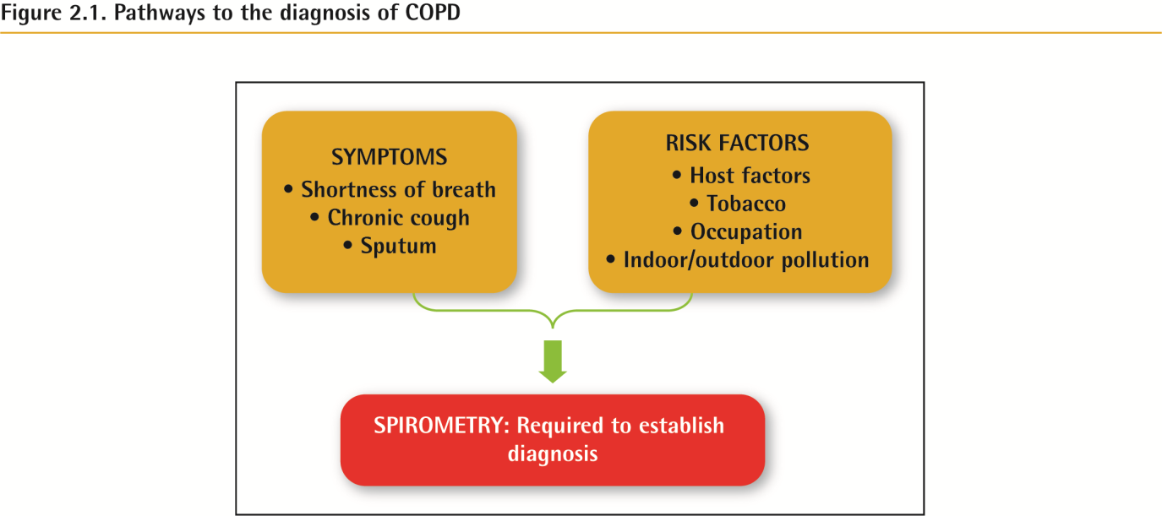
Diagnosis and Initial Assessment
© 2017 Global Initiative for Chronic Obstructive Lung Disease

Slide 29
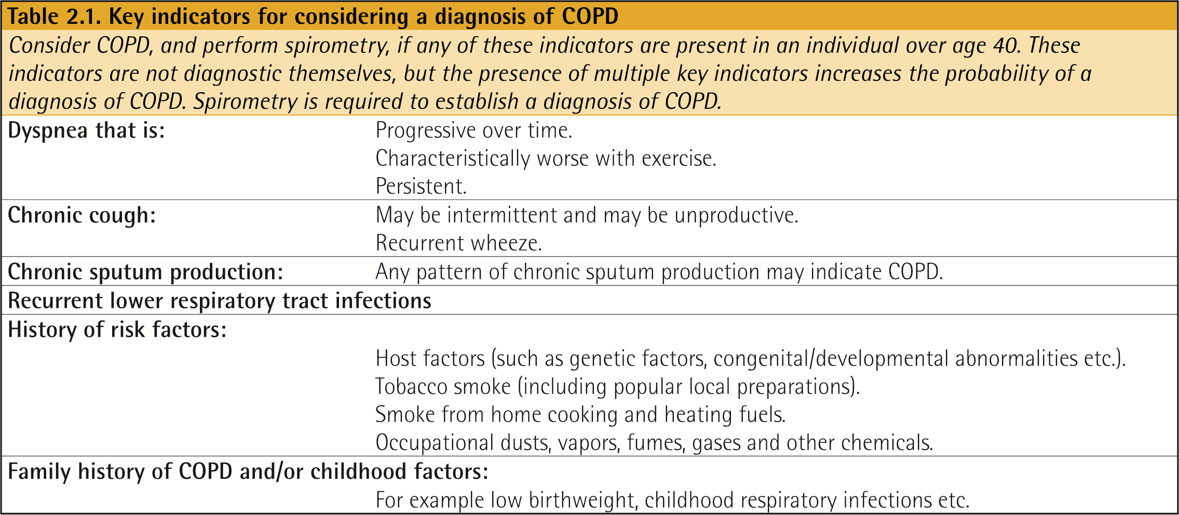
Diagnosis and Initial Assessment
© 2017 Global Initiative for Chronic Obstructive Lung Disease

Slide 30
Diagnosis and Initial Assessment
Symptoms of COPD
Chronic and progressive dyspnea
Cough
Sputum production
Wheezing and chest tightness
Others – including fatigue, weight loss, anorexia, syncope, rib fractures, ankle swelling, depression, anxiety.
© 2017 Global Initiative for Chronic Obstructive Lung Disease

Slide 31
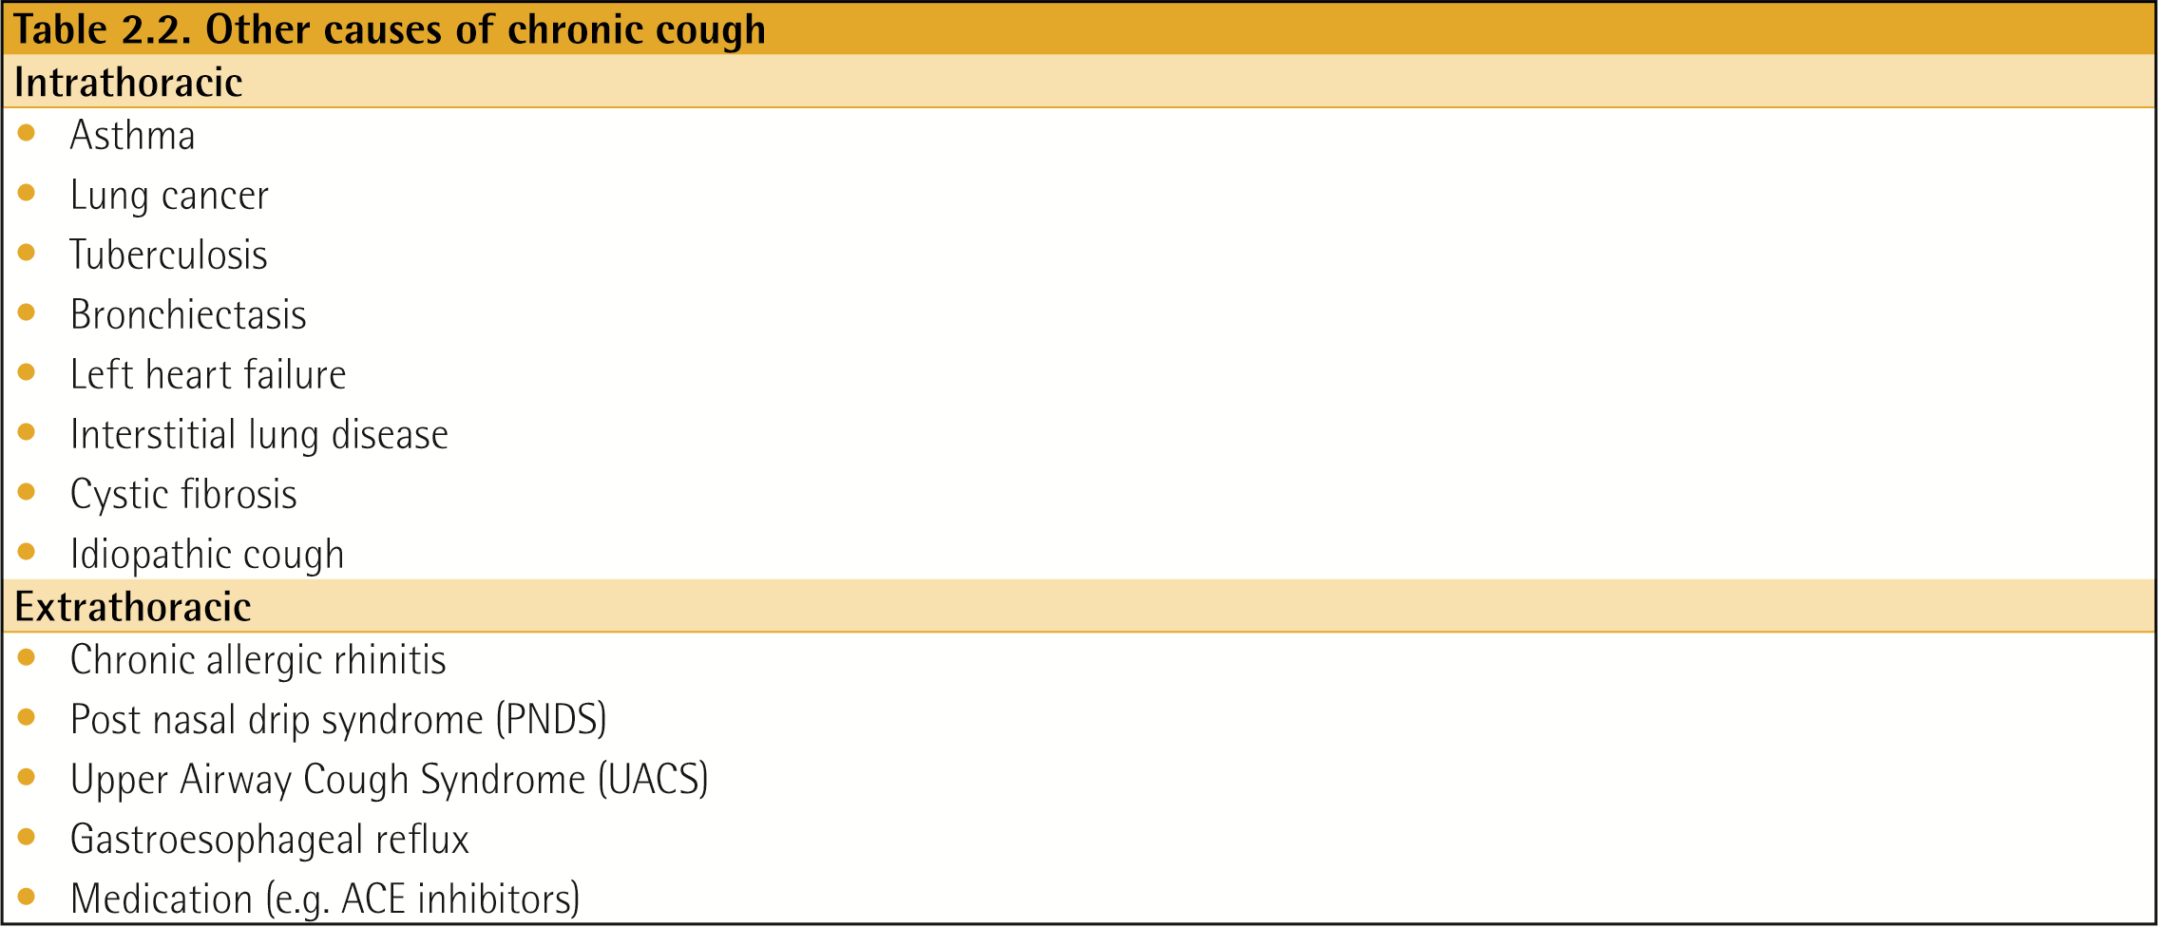
Diagnosis and Initial Assessment
© 2017 Global Initiative for Chronic Obstructive Lung Disease

Slide 32
Medical History
Patient’s exposure to risk factors
Past medical history
Family history of COPD or other chronic respiratory disease.
Pattern of symptom development
History of exacerbations or previous hospitalizations for respiratory disorder
Presence of comorbidities
Impact of disease on patient’s life
Social and family support available to the patient.
Possibilities for reducing risk factors, especially smoking cessation.
© 2017 Global Initiative for Chronic Obstructive Lung Disease

Slide 33
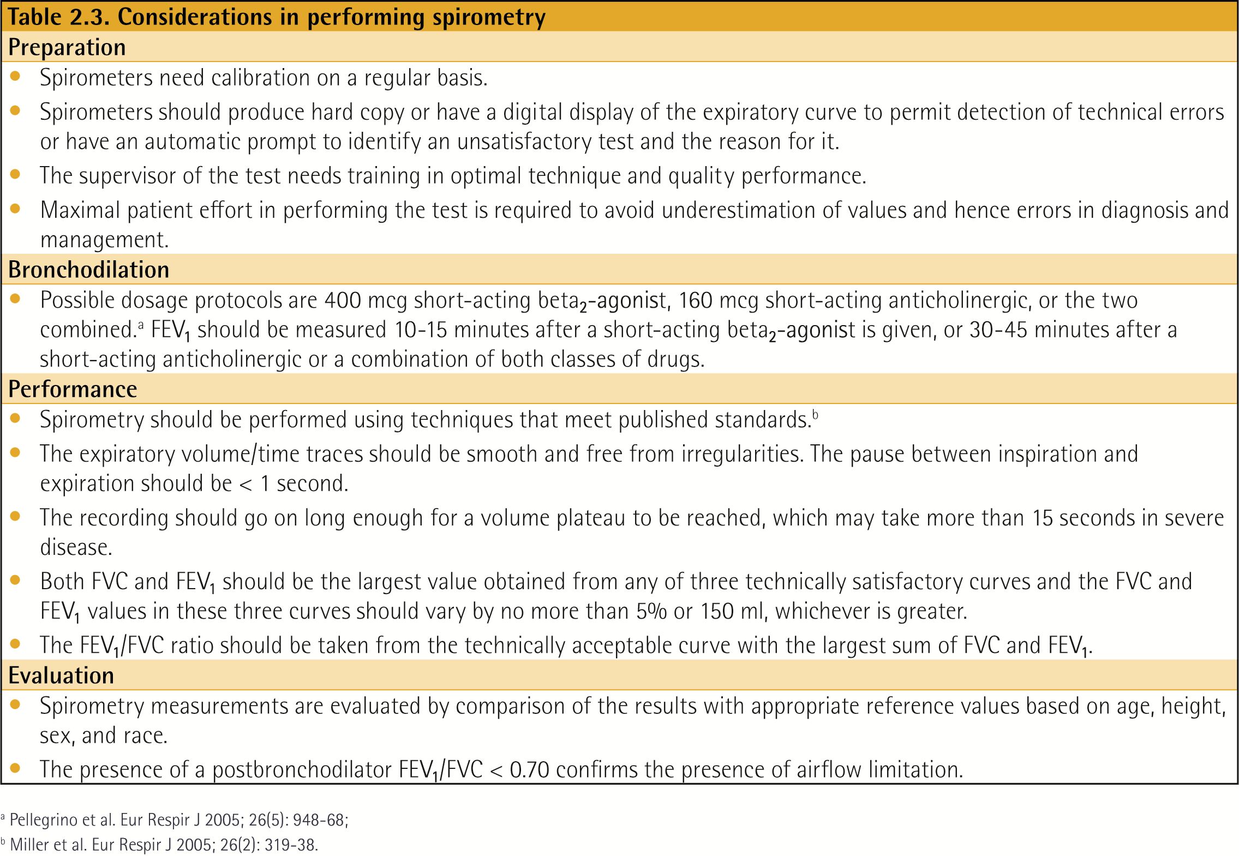
Diagnosis and Initial Assessment
© 2017 Global Initiative for Chronic Obstructive Lung Disease

Slide 34
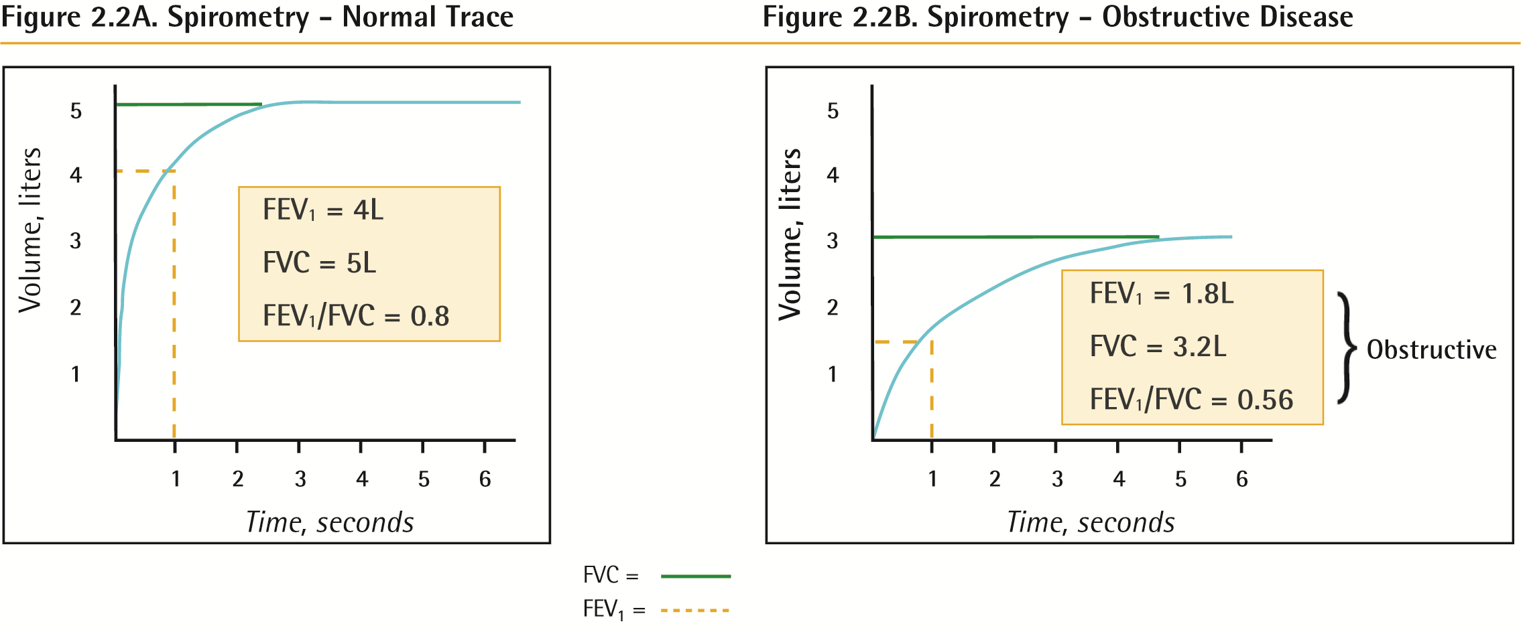
Spirometry
© 2017 Global Initiative for Chronic Obstructive Lung Disease

Slide 35
Classification of severity of airflow limitation
© 2017 Global Initiative for Chronic Obstructive Lung Disease

Slide 36
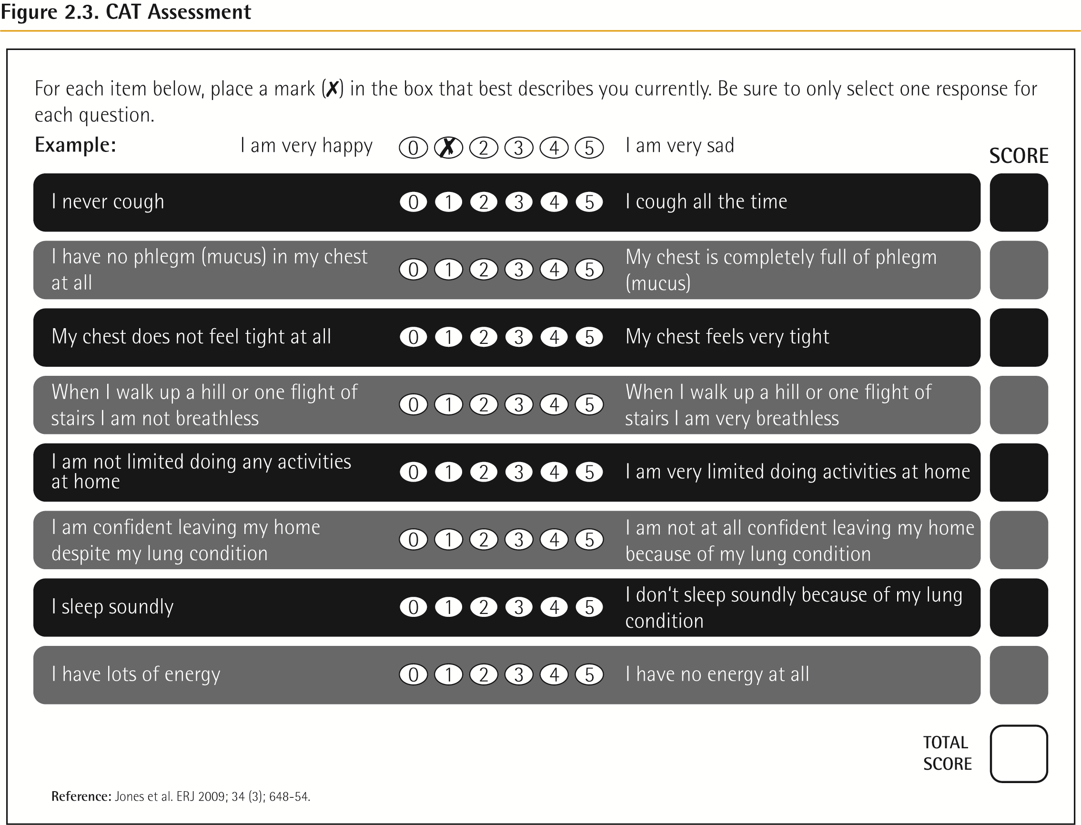
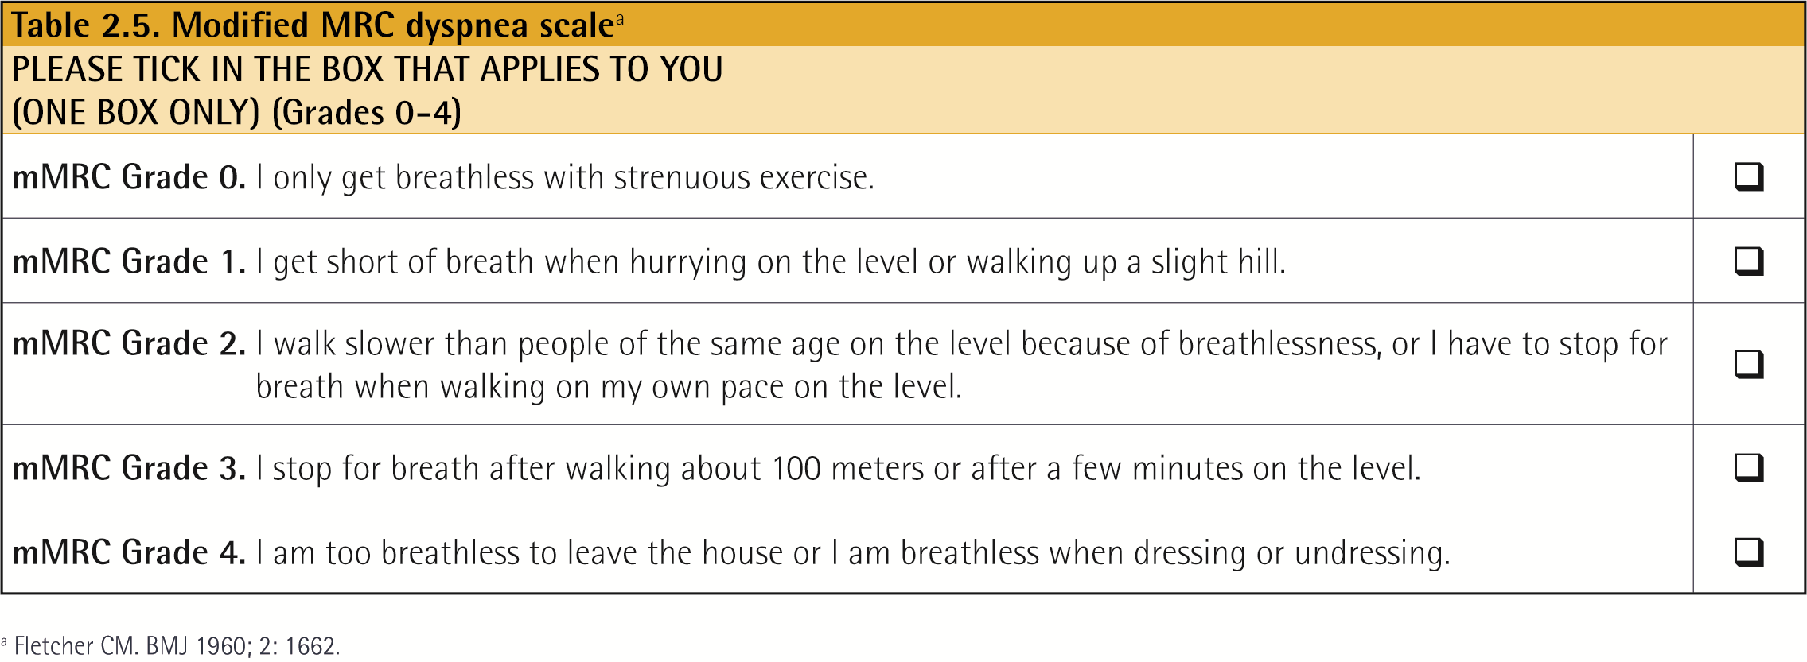
Choice of thresholds
COPD Assessment Test (CAT TM )
Chronic Respiratory Questionnaire (CCQ® )
St George’s Respiratory Questionnaire (SGRQ)
Chronic Respiratory Questionnaire (CRQ)
Modified Medical Research Council (mMRC) questionnaire
© 2017 Global Initiative for Chronic Obstructive Lung Disease

Slide 37
Assessment of Exacerbation Risk
COPD exacerbations are defined as an acute worsening of respiratory symptoms that result in additional therapy.
Classified as:
Mild (treated with SABDs only)
Moderate (treated with SABDs plus antibiotics and/or oral corticosteroids) or
Severe (patient requires hospitalization or visits the emergency room). Severe exacerbations may also be associated with acute respiratory failure.
Blood eosinophil count may also predict exacerbation rates (in patients treated with LABA without ICS).
© 2017 Global Initiative for Chronic Obstructive Lung Disease

Slide 38
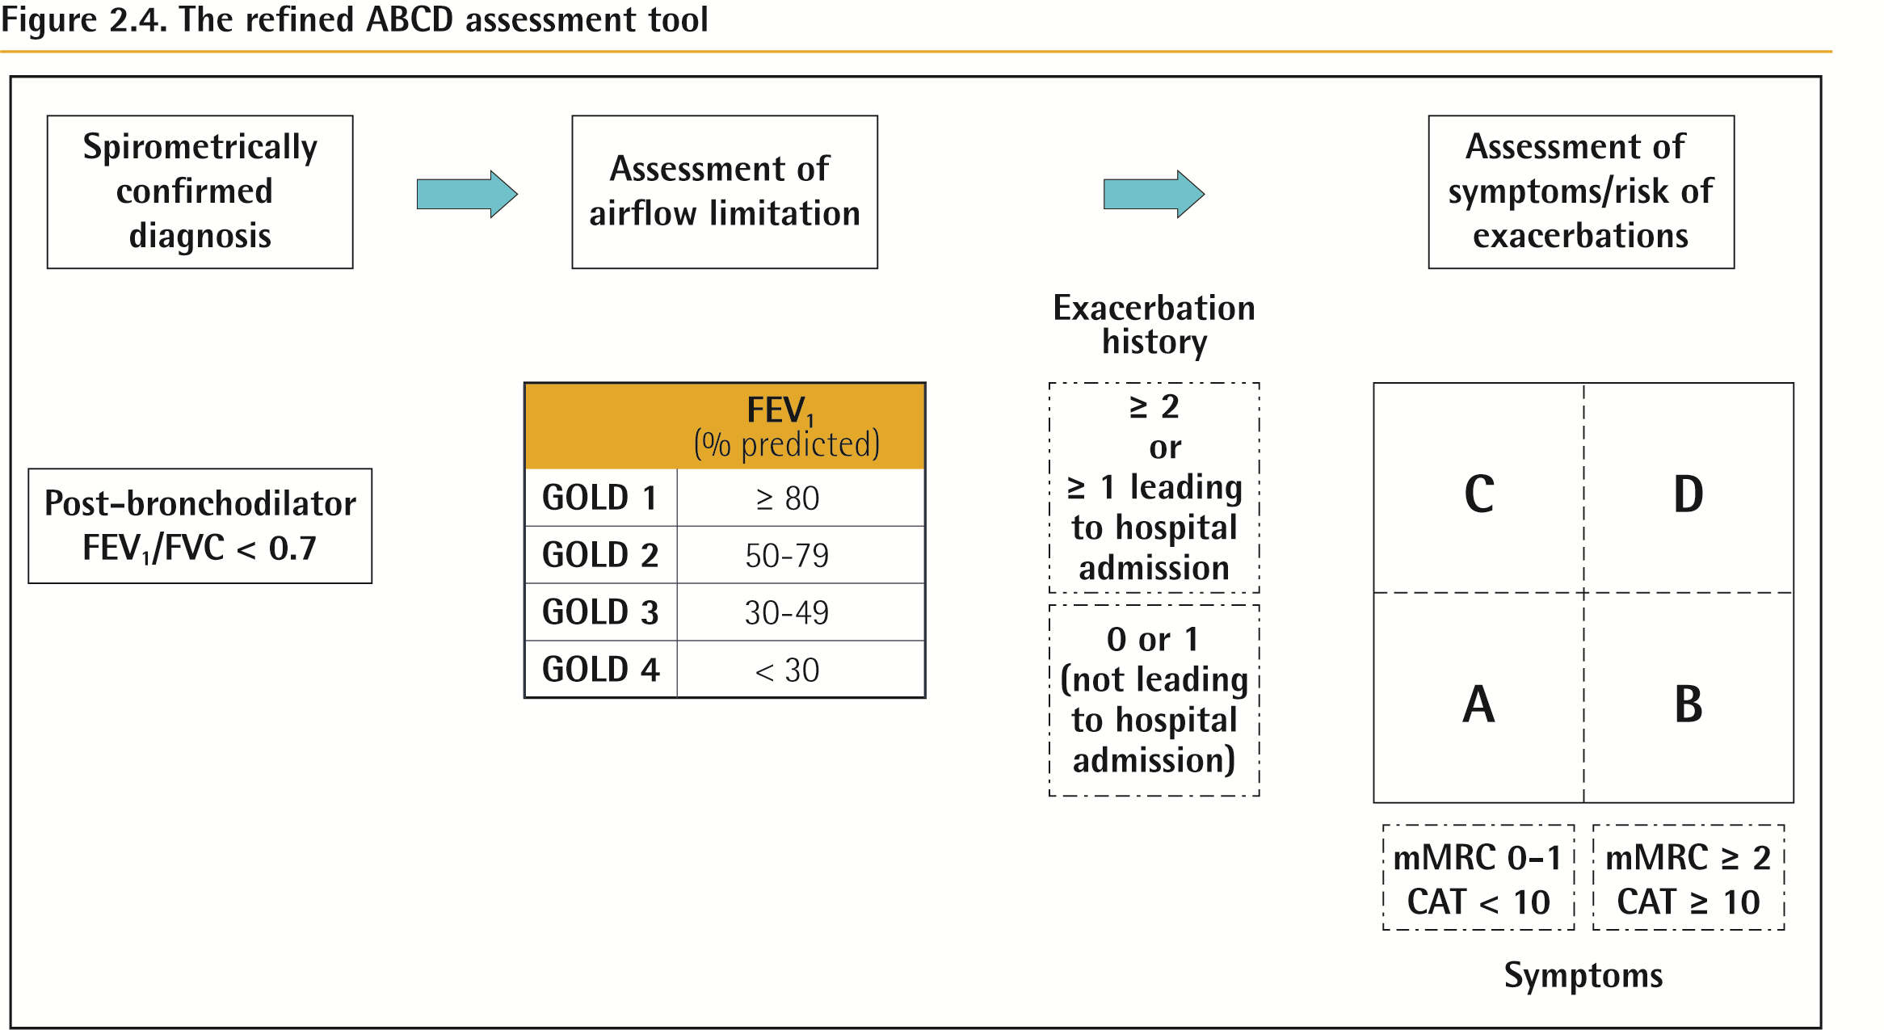
ABCD Assessment Tool
© 2017 Global Initiative for Chronic Obstructive Lung Disease

Slide 39
ABCD Assessment Tool
Example
Consider two patients:
Both patients with FEV₁ < 30% of predicted
Both with CAT scores of 18
But, one with 0 exacerbations in the past year and the other with 3 exacerbations in the past year.
Both would have been labelled GOLD D in the prior classification scheme.
With the new proposed scheme, the subject with 3 exacerbations in the past year would be labelled GOLD grade 4, group D.
The other patient, who has had no exacerbations, would be classified as GOLD grade 4, group B.
© 2017 Global Initiative for Chronic Obstructive Lung Disease

Slide 40
Summary
© 2017 Global Initiative for Chronic Obstructive Lung Disease

Slide 41
Alpha-1 antitrypsin deficiency (AATD)
AATD screening
The World Health Organization recommends that all patients with a diagnosis of COPD should be screened once especially in areas with high AATD prevalence.
AATD patients are typically < 45 years with panlobular basal emphysema
Delay in diagnosis in older AATD patients presents as more typical distribution of emphysema (centrilobular apical).
A low concentration (< 20% normal) is highly suggestive of homozygous deficiency.
© 2017 Global Initiative for Chronic Obstructive Lung Disease

Slide 42
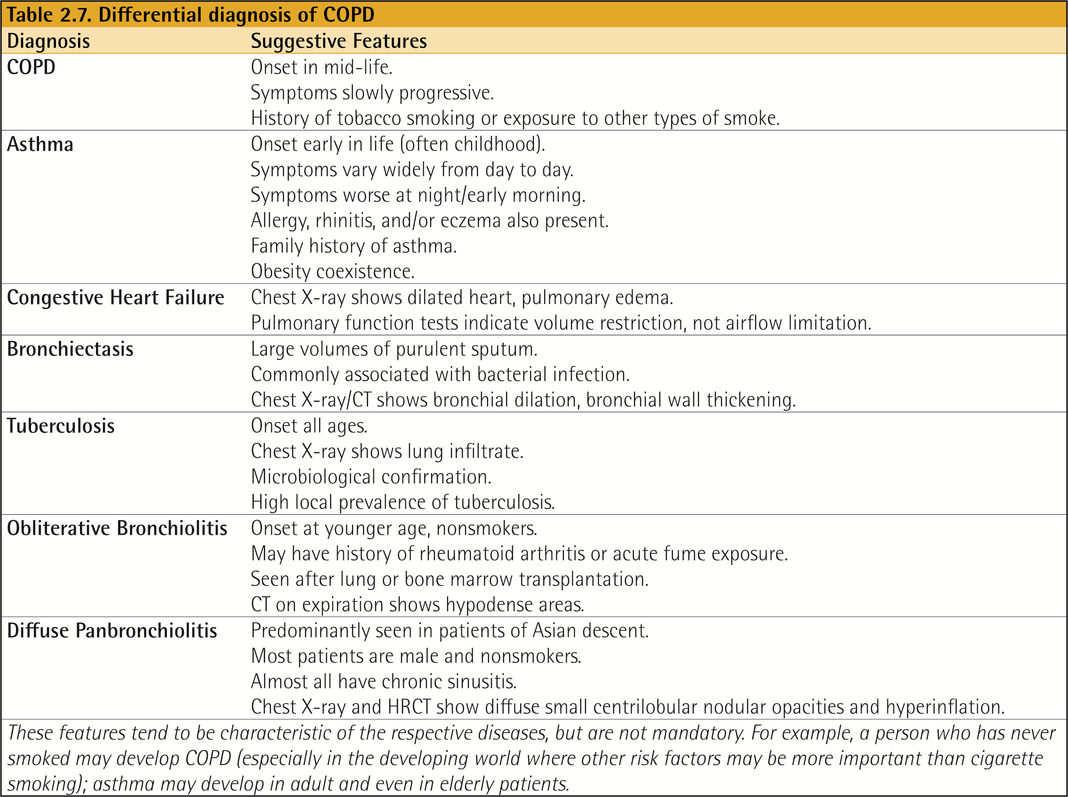
Differential Diagnosis
© 2017 Global Initiative for Chronic Obstructive Lung Disease

Slide 43
GOLD 2017 Report: Chapters
Definition and Overview
Diagnosis and Initial Assessment
Evidence Supporting Prevention & Maintenance Therapy
Management of Stable COPD
Management of Exacerbations
COPD and Comorbidities
© 2017 Global Initiative for Chronic Obstructive Lung Disease

Slide 44
Evidence Supporting Prevention & Maintenance Therapy
OVERALL KEY POINTS (1 of 3):
Smoking cessation is key. Pharmacotherapy and nicotine replacement reliably increase long-term smoking abstinence rates.
The effectiveness and safety of e-cigarettes as a smoking cessation aid is uncertain at present.
Pharmacologic therapy can reduce COPD symptoms, reduce the frequency and severity of exacerbations, and improve health status and exercise tolerance.
Each pharmacologic treatment regimen should be individualized and guided by the severity of symptoms, risk of exacerbations, side-effects, comorbidities, drug availability and cost, and the patient’s response, preference and ability to use various drug delivery devices.
Inhaler technique needs to be assessed regularly.
© 2017 Global Initiative for Chronic Obstructive Lung Disease

Slide 45
Evidence Supporting Prevention & Maintenance Therapy
OVERALL KEY POINTS (2 of 3):
Influenza vaccination decreases the incidence of lower respiratory tract infections.
Pneumococcal vaccination decreases lower respiratory tract infections.
Pulmonary rehabilitation improves symptoms, quality of life, and physical and emotional participation in everyday activities.
In patients with severe resting chronic hypoxemia, long-term oxygen therapy improves survival.
In patients with stable COPD and resting or exercise-induced moderate desaturation, long-term oxygen treatment should not be prescribed routinely. However, individual patient factors must be considered when evaluating the patient’s need for supplemental oxygen.
© 2017 Global Initiative for Chronic Obstructive Lung Disease

Slide 46
Evidence Supporting Prevention & Maintenance Therapy
OVERALL KEY POINTS (3 of 3):
In patients with severe chronic hypercapnia and a history of hospitalization for acute respiratory failure, long-term non-invasive ventilation may decrease mortality and prevent re-hospitalization.
In select patients with advanced emphysema refractory to optimized medical care, surgical or bronchoscopic interventional treatments may be beneficial.
Palliative approaches are effective in controlling symptoms in advanced COPD.
© 2017 Global Initiative for Chronic Obstructive Lung Disease

Slide 47
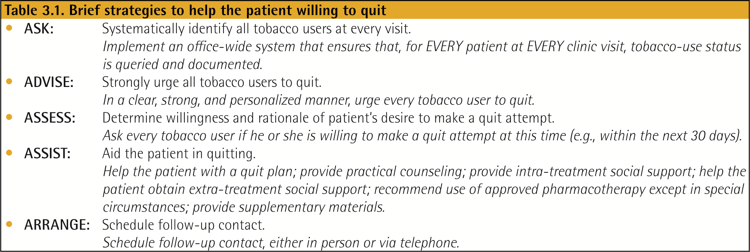
Smoking Cessation
Smoking cessation has the greatest capacity to influence the natural history of COPD.
If effective resources and time are dedicated to smoking cessation, long-term quit success rates of up to 25% can be achieved.
© 2017 Global Initiative for Chronic Obstructive Lung Disease

Slide 48
Vaccination
Influenza vaccination can reduce serious illness (such as lower respiratory tract infections requiring hospitalization)24 and death in COPD patients.
Pneumococcal vaccinations, PCV13 and PPSV23, are recommended for all patients ≥ 65 years of age
© 2017 Global Initiative for Chronic Obstructive Lung Disease

Slide 49
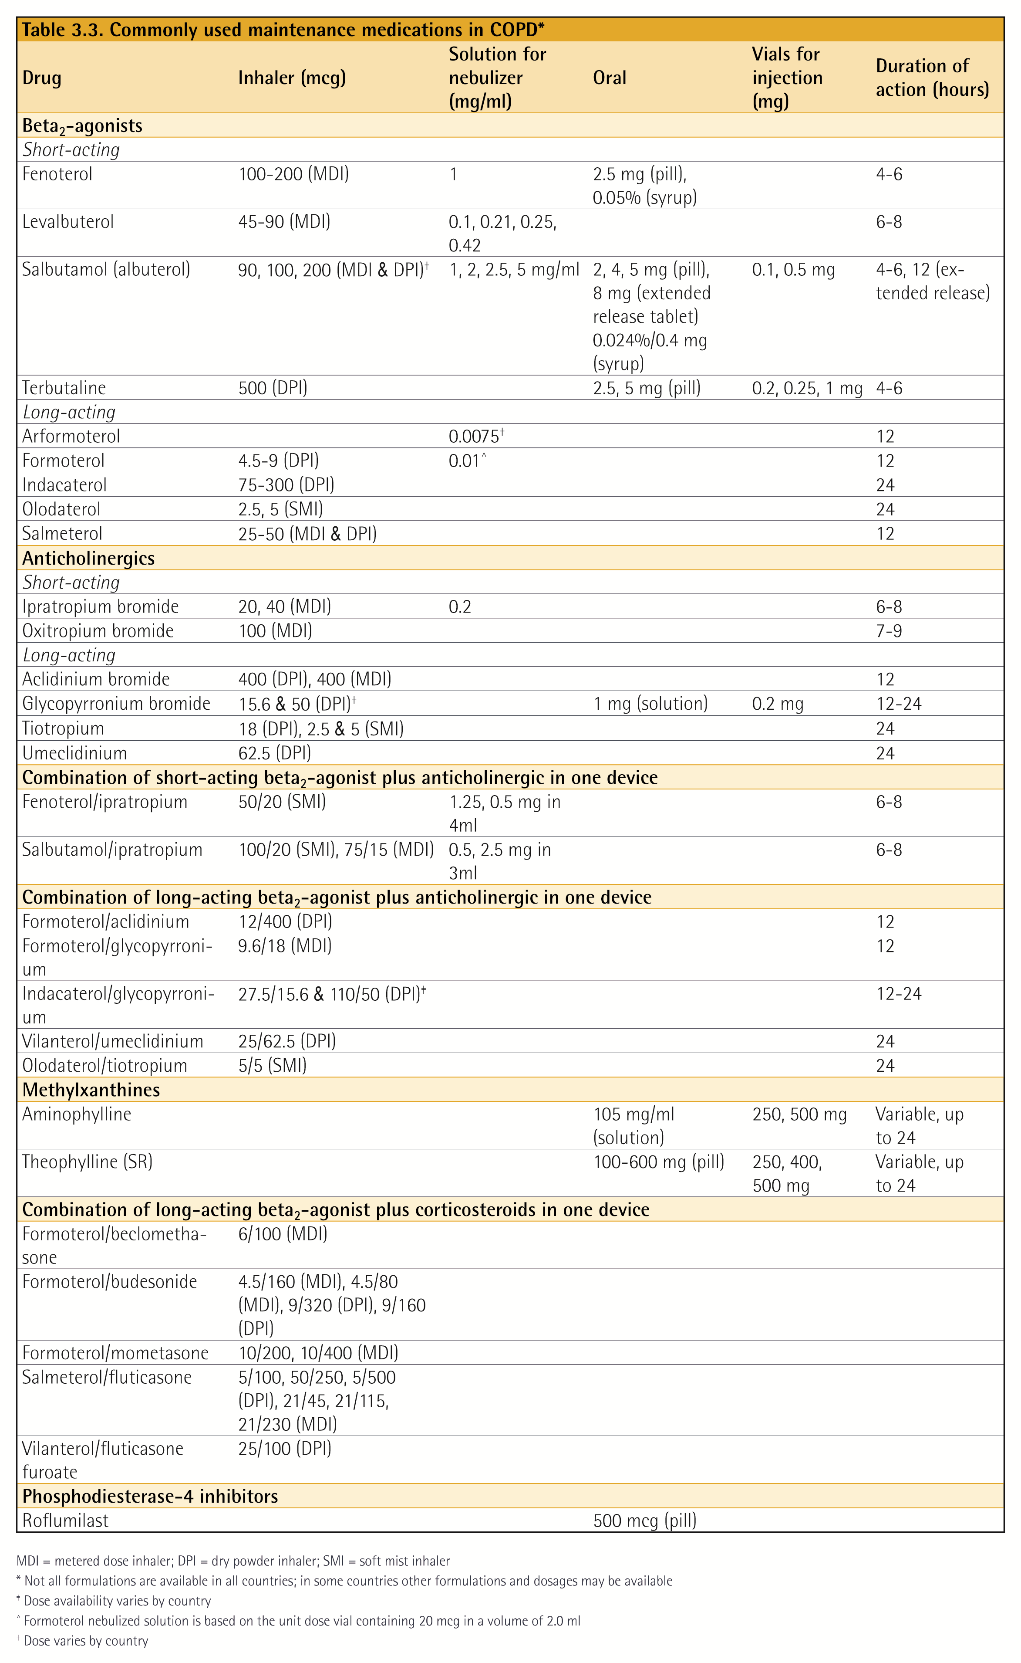
Pharmacologic Therapy
© 2017 Global Initiative for Chronic Obstructive Lung Disease

Slide 50
Pharmacologic Therapy
© 2017 Global Initiative for Chronic Obstructive Lung Disease

Slide 51
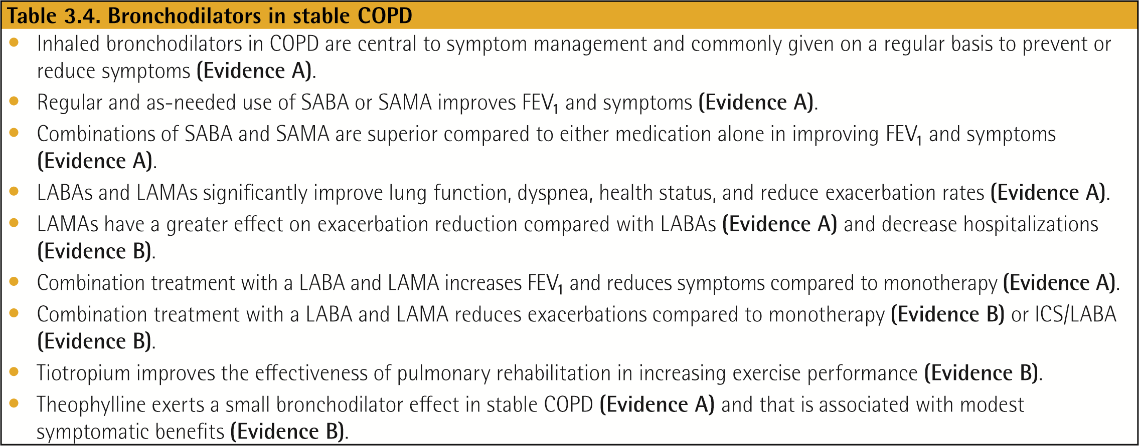
Bronchodilators in Stable COPD
© 2017 Global Initiative for Chronic Obstructive Lung Disease

Slide 52
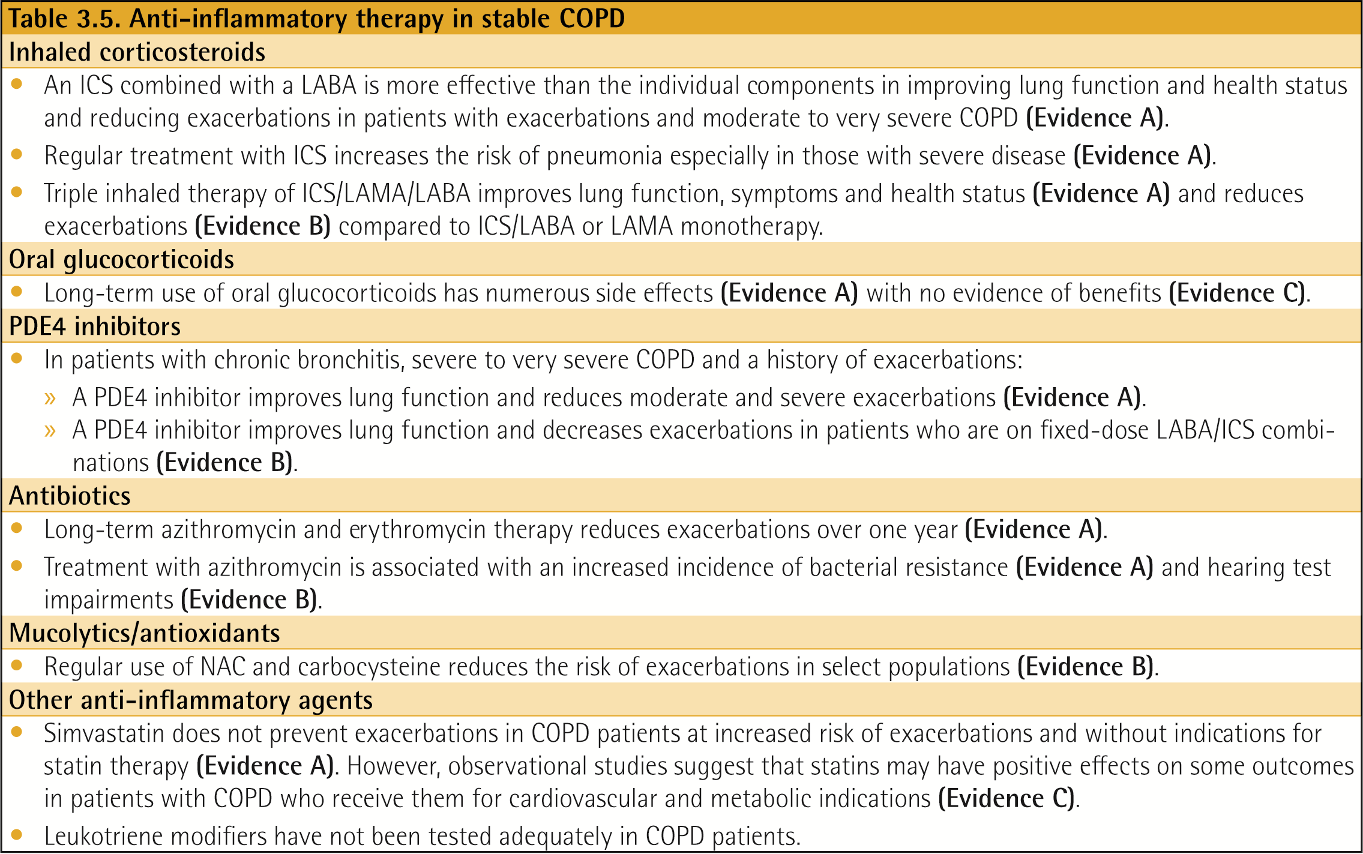
Anti-inflammatory Therapy in Stable COPD
© 2017 Global Initiative for Chronic Obstructive Lung Disease

Slide 53
The Inhaled Route
© 2017 Global Initiative for Chronic Obstructive Lung Disease

Slide 54
Other Pharmacologic Treatments
© 2017 Global Initiative for Chronic Obstructive Lung Disease

Slide 55
Rehabilitation, Education & Self-Management
© 2017 Global Initiative for Chronic Obstructive Lung Disease

Slide 56
Palliative, End of Life & Hospice Care
In many patients, the disease trajectory in COPD is marked by a gradual decline in health status and increasing symptoms, punctuated by acute exacerbations that are associated with an increased risk of dying.
Although mortality rates following hospitalization for an acute exacerbation of COPD are declining, reported rates still vary from 23% to 80%.
© 2017 Global Initiative for Chronic Obstructive Lung Disease

Slide 57
Oxygen Therapy & Ventilatory Support in Stable COPD
During exacerbations of COPD. Noninvasive ventilation (NIV) in the form of noninvasive positive pressure ventilation (NPPV) is the standard of care for decreasing morbidity and mortality in patients hospitalized with an exacerbation of COPD and acute respiratory failure
© 2017 Global Initiative for Chronic Obstructive Lung Disease

Slide 58
Oxygen Therapy & Ventilatory Support in Stable COPD
During exacerbations of COPD. Noninvasive ventilation (NIV) in the form of noninvasive positive pressure ventilation (NPPV) is the standard of care for decreasing morbidity and mortality in patients hospitalized with an exacerbation of COPD and acute respiratory failure
© 2017 Global Initiative for Chronic Obstructive Lung Disease

Slide 59
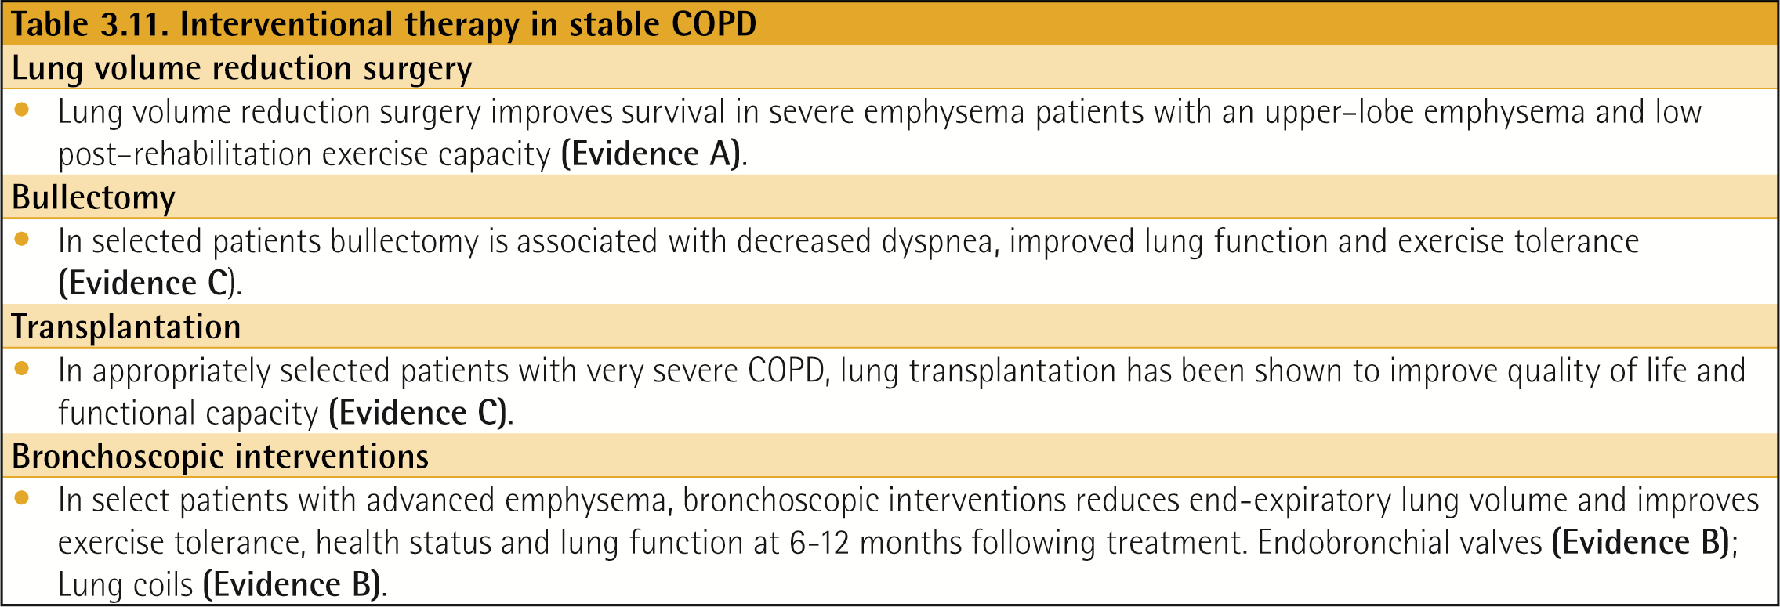
Interventional Therapy in Stable COPD
Lung volume reduction surgery (LVRS). LVRS is a surgical procedure in which parts of the lungs are resected to reduce hyperinflation,261 making respiratory muscles more effective pressure generators by improving their mechanical efficiency.
© 2017 Global Initiative for Chronic Obstructive Lung Disease

Slide 60
Interventional Therapy in Stable COPD
Lung volume reduction surgery (LVRS) is a surgical procedure in which parts of the lungs are resected to reduce hyperinflation,261 making respiratory muscles more effective pressure generators by improving their mechanical efficiency.
Due to the morbidity and mortality associated with LVRS, less invasive bronchoscopic approaches to lung reduction have been examined.
© 2017 Global Initiative for Chronic Obstructive Lung Disease

Slide 61
GOLD 2017 Report: Chapters
Definition and Overview
Diagnosis and Initial Assessment
Evidence Supporting Prevention & Maintenance Therapy
Management of Stable COPD
Management of Exacerbations
COPD and Comorbidities
© 2017 Global Initiative for Chronic Obstructive Lung Disease

Slide 62
Management of Stable COPD
OVERALL KEY POINTS:
The management strategy for stable COPD should be predominantly based on the individualized assessment of symptoms and future risk of exacerbations.
All individuals who smoke should be strongly encouraged and supported to quit.
The main treatment goals are reduction of symptoms and future risk of exacerbations.
Management strategies are not limited to pharmacologic treatments, and should be complemented by appropriate non-pharmacologic interventions.
© 2017 Global Initiative for Chronic Obstructive Lung Disease

Slide 63
Management of Stable COPD
Once COPD has been diagnosed, effective management should be based on an individualized assessment to reduce both current symptoms and future risks of exacerbations.
© 2017 Global Initiative for Chronic Obstructive Lung Disease

Slide 64
Management of Stable COPD
Identify and reduce exposure to known risk factors
Identification and reduction of exposure to risk factors is important in the treatment and prevention of COPD.
Cigarette smoking is the most commonly encountered and easily identifiable risk factor for COPD, and smoking cessation should be continually encouraged for all individuals who smoke.
Reduction of total personal exposure to occupational dusts, fumes, and gases, and to indoor and outdoor air pollutants, should also be addressed.
© 2017 Global Initiative for Chronic Obstructive Lung Disease

Slide 65
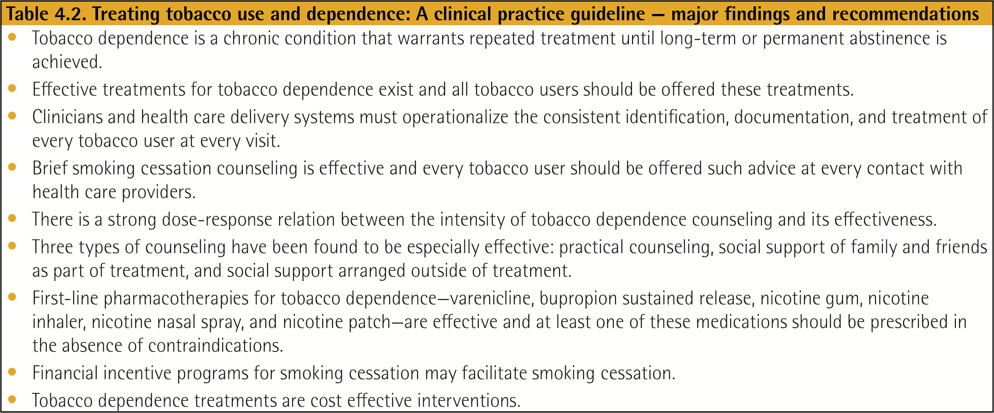
Management of Stable COPD
© 2017 Global Initiative for Chronic Obstructive Lung Disease

Slide 66
Treatment of Stable COPD
Pharmacologic treatment
Pharmacologic therapies can reduce symptoms, and the risk and severity of exacerbations, as well as improve health status and exercise tolerance.
Most of the drugs are inhaled so proper inhaler technique is of high relevance.
© 2017 Global Initiative for Chronic Obstructive Lung Disease

Slide 67
Treatment of Stable COPD
Pharmacologic treatment
© 2017 Global Initiative for Chronic Obstructive Lung Disease

Slide 68
Treatment of Stable COPD
Pharmacologic treatment
© 2017 Global Initiative for Chronic Obstructive Lung Disease

Slide 69
Treatment of Stable COPD
Pharmacologic treatment algorithms
A proposed model for the initiation, and then subsequent escalation and/or de-escalation of pharmacologic management of COPD according to the individualized assessment of symptoms and exacerbation risk is shown.
We suggest escalation (and de-escalation) strategies.
The recommendations made are based on available efficacy as well as safety data.
It should be noted that there is a lack of direct evidence supporting the therapeutic recommendations for patients in groups C and D. These recommendations will be re-evaluated as additional data become available.
© 2017 Global Initiative for Chronic Obstructive Lung Disease

Slide 70
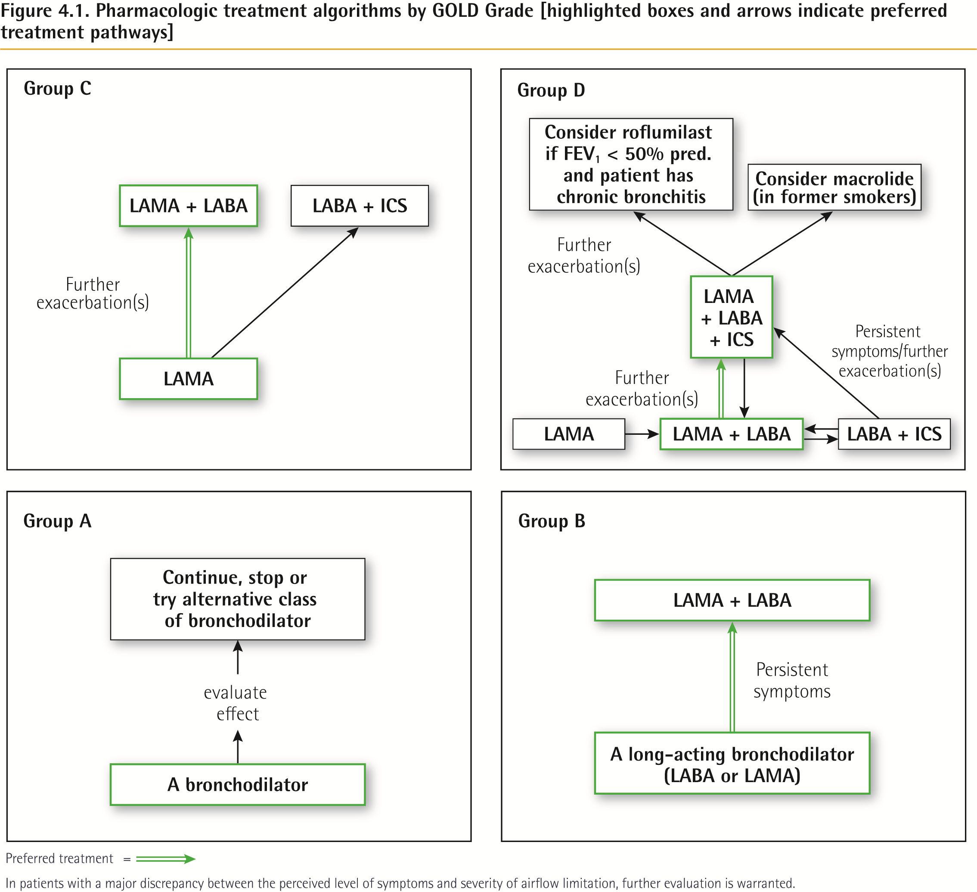
Treatment of Stable COPD
© 2017 Global Initiative for Chronic Obstructive Lung Disease

Slide 71
Pharmacologic treatment algorithms
Group A
All Group A patients should be offered bronchodilator treatment based on its effect on breathlessness. This can be either a short- or a long-acting bronchodilator.
This should be continued if symptomatic benefit is documented.
© 2017 Global Initiative for Chronic Obstructive Lung Disease

Slide 72
Pharmacologic treatment algorithms
Group B
Initial therapy should consist of a long acting bronchodilator. Long-acting inhaled bronchodilators are superior to short-acting bronchodilators taken as needed i.e., pro re nata (prn) and are therefore recommended.
There is no evidence to recommend one class of long-acting bronchodilators over another for initial relief of symptoms in this group of patients. In the individual patient, the choice should depend on the patient’s perception of symptom relief.
For patients with persistent breathlessness on monotherapy the use of two bronchodilators is recommended.
© 2017 Global Initiative for Chronic Obstructive Lung Disease

Slide 73
Pharmacologic treatment algorithms
Group B (continued)
For patients with severe breathlessness initial therapy with two bronchodilators may be considered.
If the addition of a second bronchodilator does not improve symptoms, we suggest the treatment could be stepped down again to a single bronchodilator.
Group B patients are likely to have comorbidities that may add to their symptomatology and impact their prognosis, and these possibilities should be investigated.
© 2017 Global Initiative for Chronic Obstructive Lung Disease

Slide 74
Pharmacologic treatment algorithms
Group C
Initial therapy should consist of a single long acting bronchodilator. In two head-to head comparisons the tested LAMA was superior to the LABA regarding exacerbation prevention, therefore we recommend starting therapy with a LAMA in this group.
Patients with persistent exacerbations may benefit from adding a second long acting bronchodilator (LABA/LAMA) or using a combination of a long acting beta₂-agonist and an inhaled corticosteroid (LABA/ICS). As ICS increases the risk for developing pneumonia in some patients, our primary choice is LABA/LAMA.
© 2017 Global Initiative for Chronic Obstructive Lung Disease

Slide 75
Pharmacologic treatment algorithms
Group D
We recommend starting therapy with a LABA/LAMA combination because:
In studies with patient reported outcomes as the primary endpoint LABA/LAMA combinations showed superior results compared to the single substances. If a single bronchodilator is chosen as initial treatment, a LAMA is preferred for exacerbation prevention based on comparison to LABAs (for details see GOLD 2017 Chapter 3).
A LABA/LAMA combination was superior to a LABA/ICS combination in preventing exacerbations and other patient reported outcomes in Group D patients (for details see GOLD 2017 Chapter 3).
Group D patients are at higher risk of developing pneumonia when receiving treatment with ICS.
© 2017 Global Initiative for Chronic Obstructive Lung Disease

Slide 76
Pharmacologic treatment algorithms
Group D (continued)
In some patients initial therapy with LABA/ICS may be the first choice. These patients may have a history and/or findings suggestive of asthma-COPD overlap. High blood eosinophil counts may also be considered as a parameter to support the use of ICS, although this is still under debate (for details see Chapter 2 and Appendix).
In patients who develop further exacerbations on LABA/LAMA therapy we suggest two alternative pathways:
Escalation to LABA/LAMA/ICS. Studies are underway comparing the effects of LABA/LAMA vs. LABA/LAMA/ICS for exacerbation prevention.
Switch to LABA/ICS. However, there is no evidence that switching from LABA/LAMA to LABA/ICS results in better exacerbation prevention. If LABA/ICS therapy does not positively impact exacerbations/symptoms, a LAMA can be added.
© 2017 Global Initiative for Chronic Obstructive Lung Disease

Slide 77
Pharmacologic treatment algorithms
Group D (continued)
If patients treated with LABA/LAMA/ICS still have exacerbations the following options may be considered:
Add roflumilast. This may be considered in patients with an FEV1 < 50% predicted and chronic bronchitis,13 particularly if they have experienced at least one hospitalization for an exacerbation in the previous year.
Add a macrolide. The best available evidence exists for the use of azithromycin. Consideration to the development of resistant organisms should be factored into decision making.
Stopping ICS. A reported lack of efficacy, an elevated risk of adverse effects (including pneumonia) and evidence showing no significant harm from withdrawal supports this recommendation (see Chapter 3 for further details).
© 2017 Global Initiative for Chronic Obstructive Lung Disease

Slide 78
Non-Pharmacologic Treatment
Education and self-management
Physical activity
Pulmonary rehabilitation programs
Exercise training
Self-management education
End of life and palliative care
Nutritional support
Vaccination
Oxygen therapy
© 2017 Global Initiative for Chronic Obstructive Lung Disease

Slide 79
Non-Pharmacologic Treatment
Education and self-management
Self-management education and coaching by healthcare professionals should be a major component of the “Chronic Care Model” within the context of the healthcare delivery system.
The aim of self-management education is to motivate, engage and coach the patients to positively adapt their health behavior(s) and develop skills to better manage their disease.
© 2017 Global Initiative for Chronic Obstructive Lung Disease

Slide 80
Non-Pharmacologic Treatment
Oxygen therapy
Long-term oxygen therapy is indicated for stable patients who have:
PaO₂ at or below 7.3 kPa (55 mmHg) or SaO₂ at or below 88%, with or without hypercapnia confirmed twice over a three week period; or
PaO₂ between 7.3 kPa (55 mmHg) and 8.0 kPa (60 mmHg), or SaO₂ of 88%, if there is evidence of pulmonary hypertension, peripheral edema suggesting congestive cardiac failure, or polycythemia (hematocrit > 55%).
© 2017 Global Initiative for Chronic Obstructive Lung Disease

Slide 81
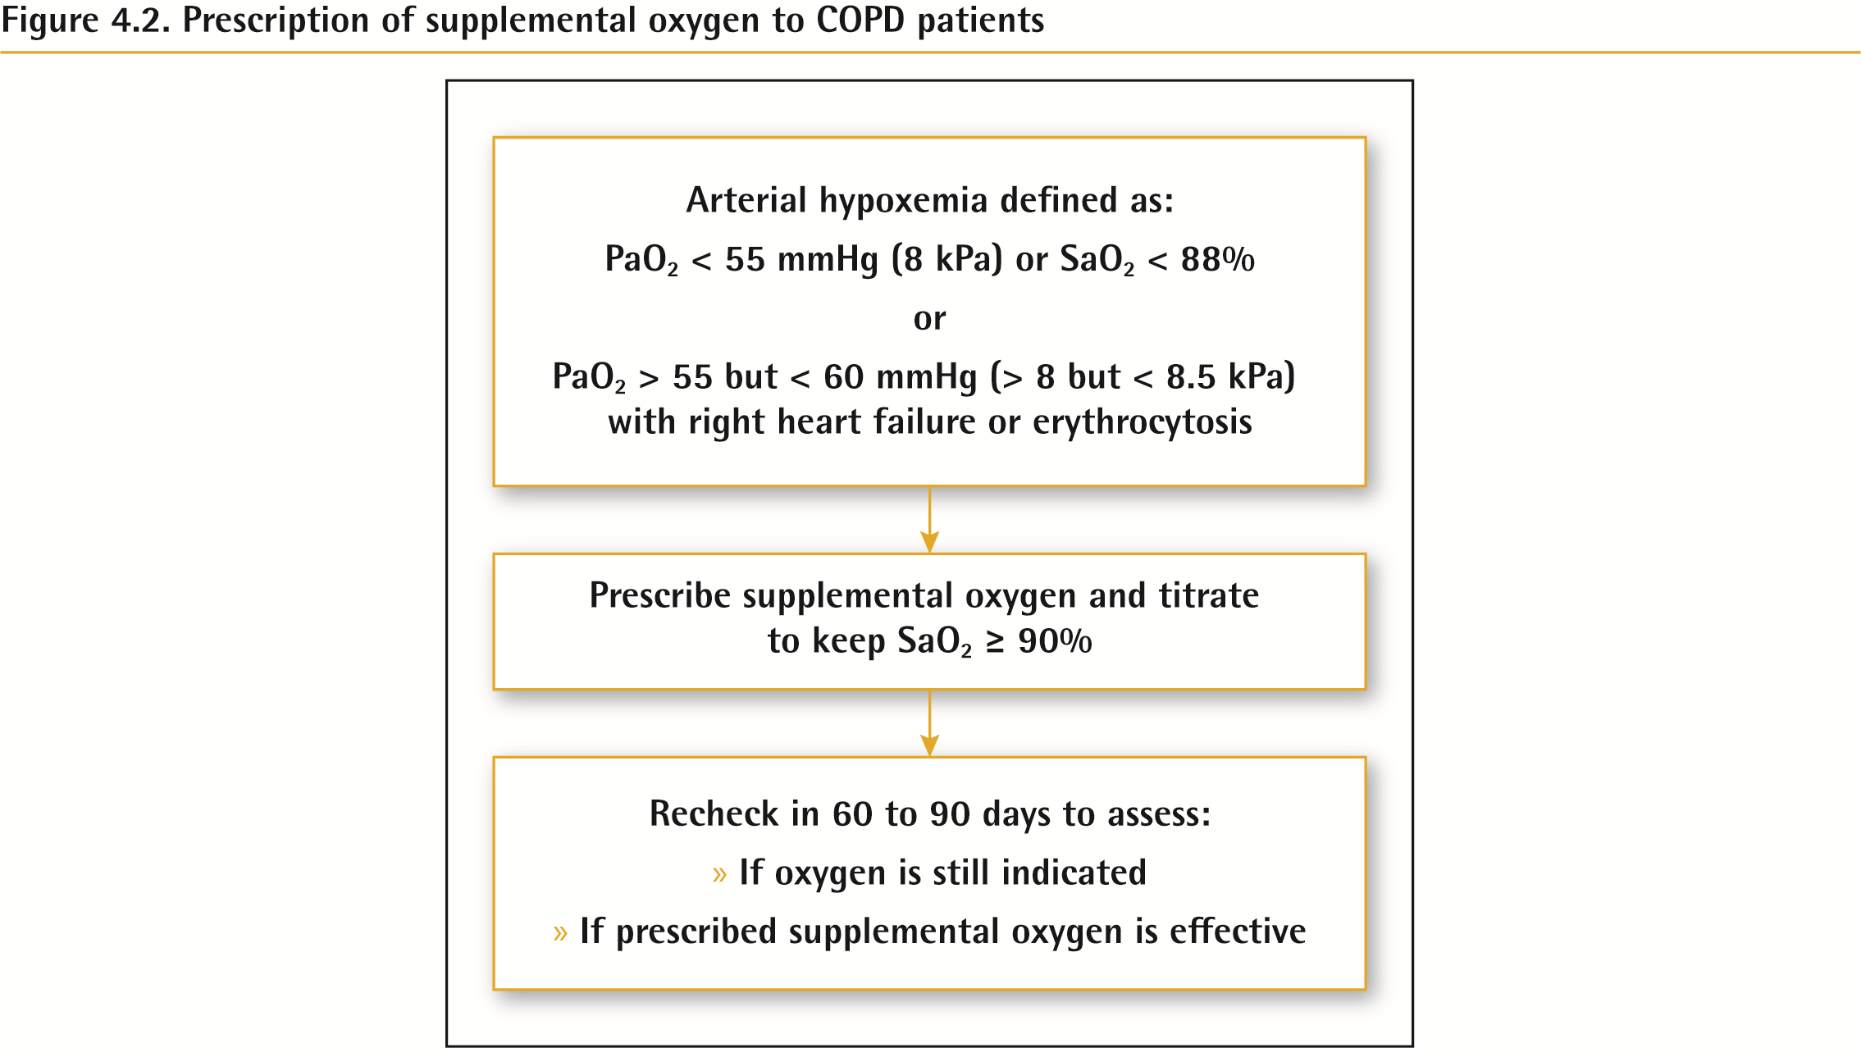
Non-Pharmacologic Treatment
© 2017 Global Initiative for Chronic Obstructive Lung Disease

Slide 82
Non-Pharmacologic Treatment
Interventional bronchoscopy and surgery
In selected patients with heterogeneous or homogenous emphysema and significant hyperinflation refractory to optimized medical care, surgical or bronchoscopic modes of lung volume reduction (e.g., endobronchial one-way valves or lung coils) may be considered.
In selected patients with a large bulla, surgical bullectomy may be considered.
In selected patients with very severe COPD and without relevant contraindications, lung transplantation may be considered.
© 2017 Global Initiative for Chronic Obstructive Lung Disease

Slide 83
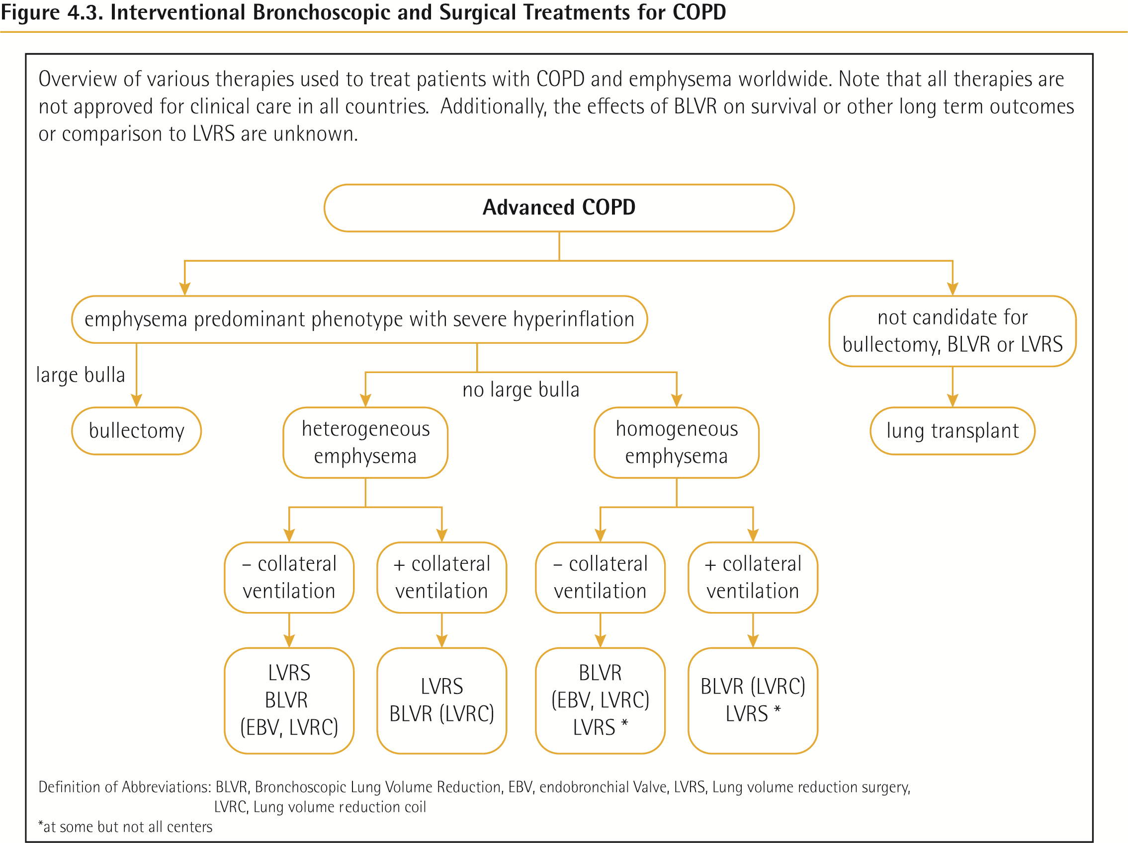
© 2017 Global Initiative for Chronic Obstructive Lung Disease

Slide 84
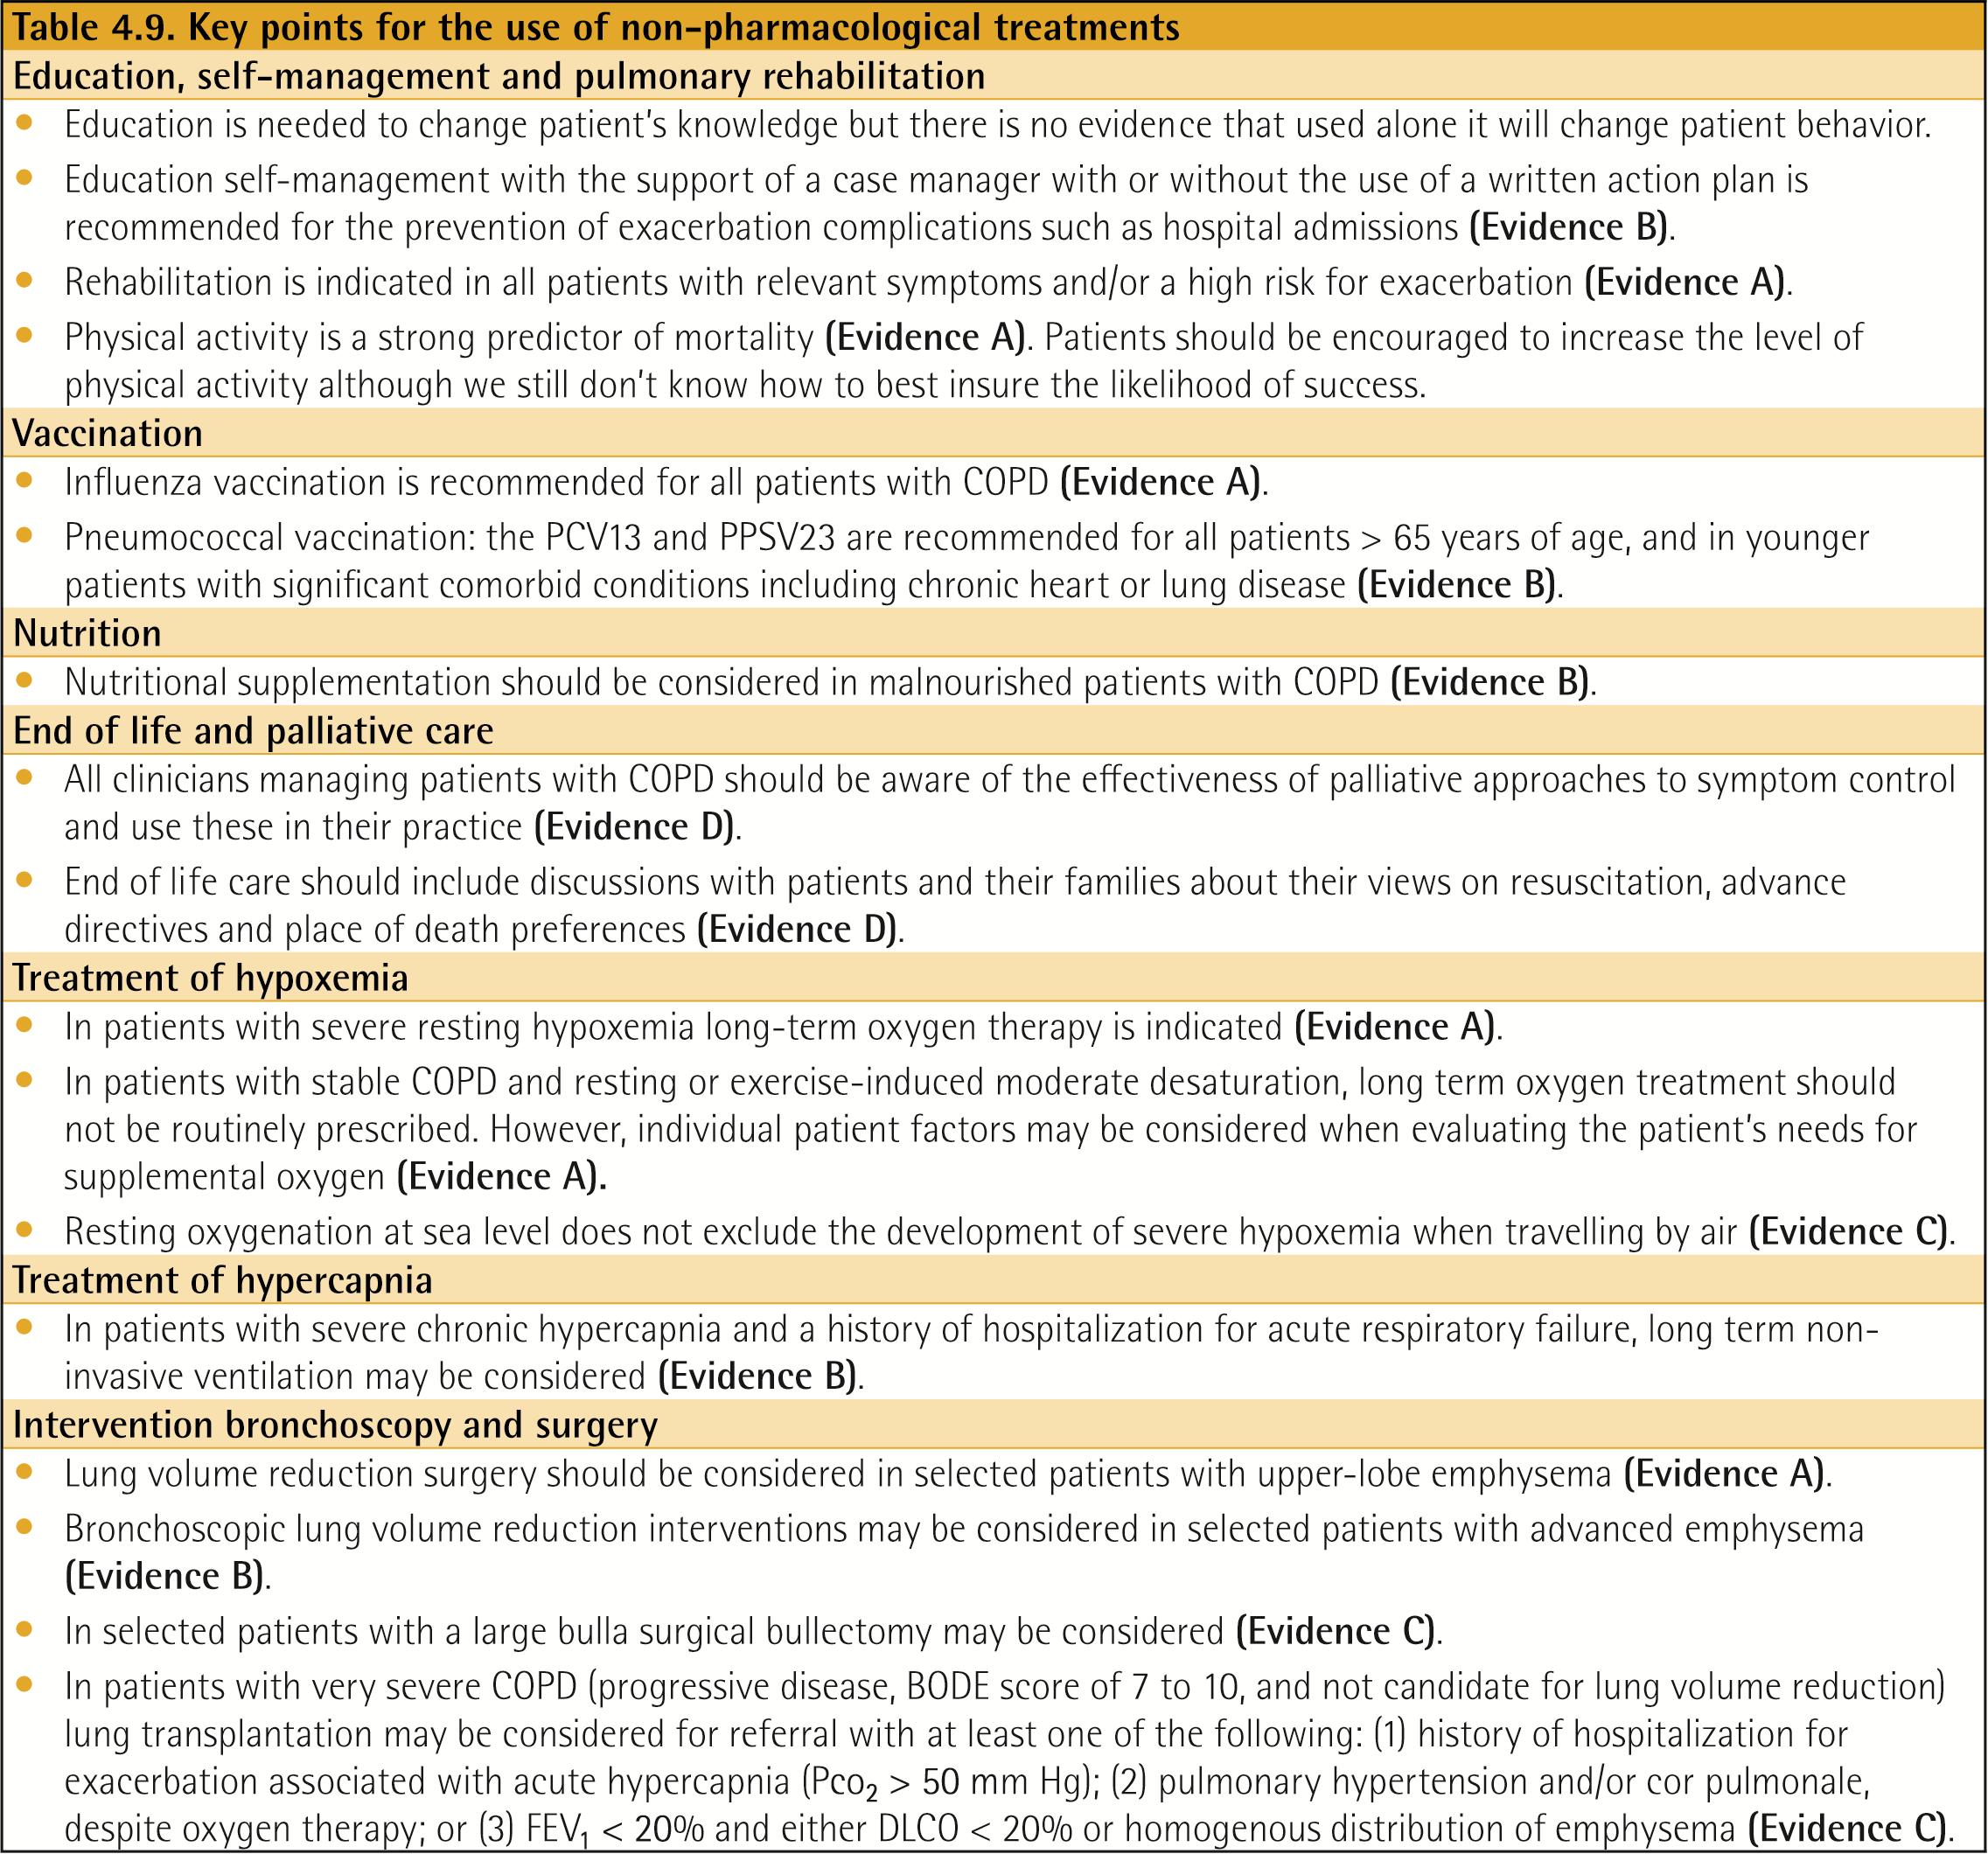
Non-Pharmacologic Treatment - Summary
© 2017 Global Initiative for Chronic Obstructive Lung Disease

Slide 85
Non-Pharmacologic Treatment – Summary (continued)
© 2017 Global Initiative for Chronic Obstructive Lung Disease

Slide 86
Monitoring and Follow-up
Monitoring disease progression and development of complications and/or comorbidities
Measurements. Decline in FEV₁ can be tracked by spirometry performed at least once a year.
Symptoms. At each visit, information on symptoms since the last visit should be collected, including cough and sputum, breathlessness, fatigue, activity limitation, and sleep disturbances.
Exacerbations. The frequency, severity, type and likely causes of all exacerbations should be monitored.
Imaging. If there is a clear worsening of symptoms, imaging may be indicated.
Smoking status. At each visit, the current smoking status and smoke exposure should be determined followed by appropriate action.
© 2017 Global Initiative for Chronic Obstructive Lung Disease

Slide 87
Monitoring and Follow-up
Pharmacotherapy and other medical treatment
In order to adjust therapy appropriately as the disease progresses, each follow-up visit should include a discussion of the current therapeutic regimen.
Monitoring should focus on:
Dosages of prescribed medications.
Adherence to the regimen.
Inhaler technique.
Effectiveness of the current regime.
Side effects.
Treatment modifications should be recommended.
© 2017 Global Initiative for Chronic Obstructive Lung Disease

Slide 88
GOLD 2017 Report: Chapters
Definition and Overview
Diagnosis and Initial Assessment
Evidence Supporting Prevention & Maintenance Therapy
Management of Stable COPD
Management of Exacerbations
COPD and Comorbidities
© 2017 Global Initiative for Chronic Obstructive Lung Disease

Slide 89
Management of Exacerbations
OVERALL KEY POINTS (1 of 3):
An exacerbation of COPD is defined as an acute worsening of respiratory symptoms that results in additional therapy.
Exacerbations of COPD can be precipitated by several factors. The most common causes are respiratory tract infections.
The goal for treatment of COPD exacerbations is to minimize the negative impact of the current exacerbation and to prevent subsequent events.
Short-acting inhaled beta₂-agonists, with or without short-acting anticholinergics, are recommended as the initial bronchodilators to treat an acute exacerbation.
© 2017 Global Initiative for Chronic Obstructive Lung Disease

Slide 90
Management of Exacerbations
OVERALL KEY POINTS (2 of 3):
Maintenance therapy with long-acting bronchodilators should be initiated as soon as possible before hospital discharge.
Systemic corticosteroids can improve lung function (FEV₁), oxygenation and shorten recovery time and hospitalization duration. Duration of therapy should not be more than 5-7 days.
Antibiotics, when indicated, can shorten recovery time, reduce the risk of early relapse, treatment failure, and hospitalization duration. Duration of therapy should be 5-7 days.
Methylxanthines are not recommended due to increased side effect profiles.
© 2017 Global Initiative for Chronic Obstructive Lung Disease

Slide 91
Management of Exacerbations
OVERALL KEY POINTS (3 of 3):
Non-invasive mechanical ventilation should be the first mode of ventilation used in COPD patients with acute respiratory failure who have no absolute contraindication because it improves gas exchange, reduces work of breathing and the need for intubation, decreases hospitalization duration and improves survival.
Following an exacerbation, appropriate measures for exacerbation prevention should be initiated (see GOLD 2017 Chapter 3 and Chapter 4).
© 2017 Global Initiative for Chronic Obstructive Lung Disease

Slide 92
Management of Exacerbations
COPD exacerbations are defined as an acute worsening of respiratory symptoms that result in additional therapy.
They are classified as:
Mild (treated with short acting bronchodilators only, SABDs)
Moderate (treated with SABDs plus antibiotics and/or oral corticosteroids) or
Severe (patient requires hospitalization or visits the emergency room). Severe exacerbations may also be associated with acute respiratory failure.
© 2017 Global Initiative for Chronic Obstructive Lung Disease

Slide 93
Management of Exacerbations
Classification of hospitalized patients
No respiratory failure:
Respiratory rate: 20-30 breaths per minute; no use of accessory respiratory muscles; no changes in mental status; hypoxemia improved with supplemental oxygen given via Venturi mask 28-35% inspired oxygen (FiO₂); no increase in PaCO₂.
© 2017 Global Initiative for Chronic Obstructive Lung Disease

Slide 94
Management of Exacerbations
Classification of hospitalized patients
Acute respiratory failure — non-life-threatening: Respiratory rate: > 30 breaths per minute; using accessory respiratory muscles; no change in mental status; hypoxemia improved with supplemental oxygen via Venturi mask 25-30% FiO₂; hypercarbia i.e., PaCO₂ increased compared with baseline or elevated 50-60 mmHg.
© 2017 Global Initiative for Chronic Obstructive Lung Disease

Slide 95
Management of Exacerbations
Classification of hospitalized patients
Acute respiratory failure — life-threatening:
Respiratory rate: > 30 breaths per minute; using accessory respiratory muscles; acute changes in mental status; hypoxemia not improved with supplemental oxygen via Venturi mask or requiring FiO₂ > 40%; hypercarbia i.e., PaCO₂ increased compared with baseline or elevated > 60 mmHg or the presence of acidosis (pH < 7.25).
© 2017 Global Initiative for Chronic Obstructive Lung Disease

Slide 96
Management of Exacerbations
© 2017 Global Initiative for Chronic Obstructive Lung Disease

Slide 97
Management of Exacerbations
© 2017 Global Initiative for Chronic Obstructive Lung Disease

Slide 98
Management of Exacerbations
- Summary
© 2017 Global Initiative for Chronic Obstructive Lung Disease

Slide 99
Management of Exacerbations
Pharmacologic treatment
The three classes of medications most commonly used for COPD exacerbations are:
Bronchodilators
Although there is no high-quality evidence from RCTs, it is recommended that short-acting inhaled beta₂-agonists, with or without short-acting anticholinergics, are the initial bronchodilators for acute treatment of a COPD exacerbation.
Corticosteroids
Data from studies indicate that systemic glucocorticoids in COPD exacerbations shorten recovery time and improve lung function (FEV1). They also improve oxygenation, the risk of early relapse, treatment failure, and the length of hospitalization.
Antibiotics
© 2017 Global Initiative for Chronic Obstructive Lung Disease

Slide 100
Management of Exacerbations
Respiratory support
© 2017 Global Initiative for Chronic Obstructive Lung Disease

Slide 101
Management of Exacerbations
Respiratory support
© 2017 Global Initiative for Chronic Obstructive Lung Disease

Slide 102
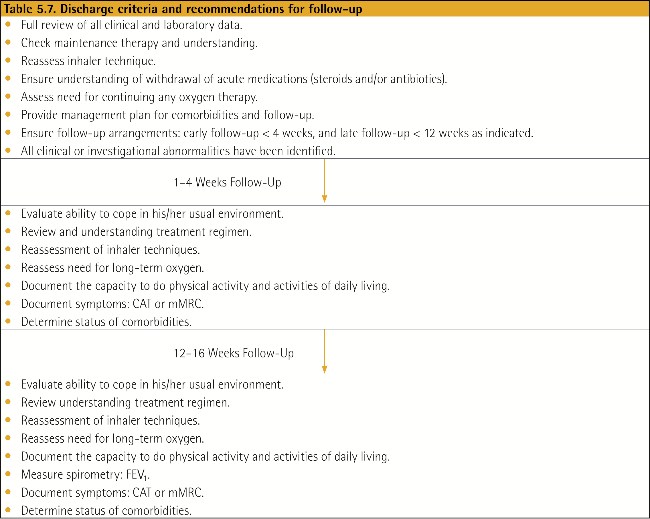
Management of Exacerbations
© 2017 Global Initiative for Chronic Obstructive Lung Disease

Slide 103
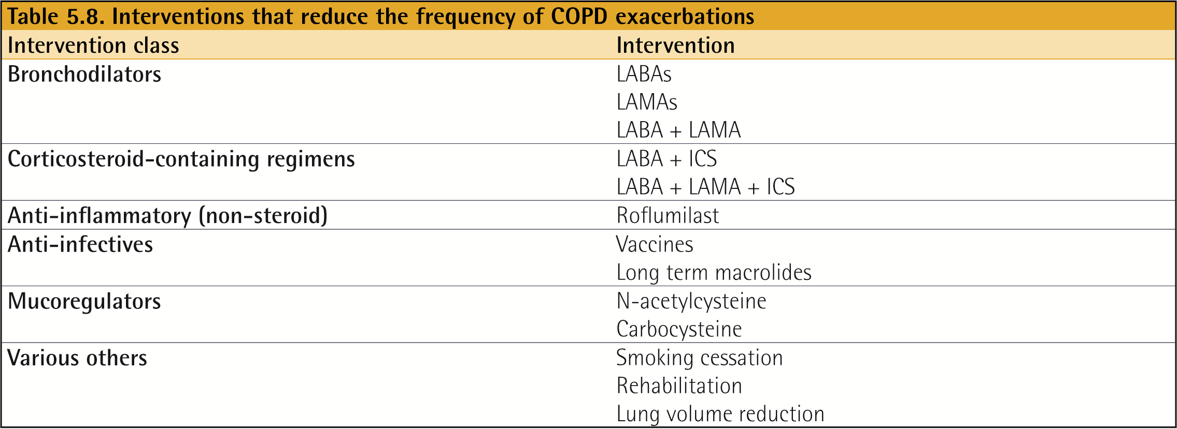
Management of Exacerbations
© 2017 Global Initiative for Chronic Obstructive Lung Disease

Slide 104
GOLD 2017 Report: Chapters
Definition and Overview
Diagnosis and Initial Assessment
Evidence Supporting Prevention & Maintenance Therapy
Management of Stable COPD
Management of Exacerbations
COPD and Comorbidities
© 2017 Global Initiative for Chronic Obstructive Lung Disease

Slide 105
COPD and Comorbidities
OVERALL KEY POINTS (1 of 2):
COPD often coexists with other diseases (comorbidities) that may have a significant impact on disease course.
In general, the presence of comorbidities should not alter COPD treatment and comorbidities should be treated per usual standards regardless of the presence of COPD.
Lung cancer is frequently seen in patients with COPD and is a main cause of death.
Cardiovascular diseases are common and important comorbidities in COPD.
© 2017 Global Initiative for Chronic Obstructive Lung Disease

Slide 106
COPD and Comorbidities
OVERALL KEY POINTS (2 of 2):
Osteoporosis and depression/anxiety are frequent, important comorbidities in COPD, are often under-diagnosed, and are associated with poor health status and prognosis.
Gastroesophageal reflux (GERD) is associated with an increased risk of exacerbations and poorer health status.
When COPD is part of a multimorbidity care plan, attention should be directed to ensure simplicity of treatment and to minimize polypharmacy.
© 2017 Global Initiative for Chronic Obstructive Lung Disease

Slide 107
COPD and Comorbidities
Some common comorbidities occurring in patients with COPD with stable disease include:
Cardiovascular disease (CVD)
Heart failure
Ischaemic heart disease (IHD)
Arrhythmias
Peripheral vascular disease
Hypertension
Osteoporosis
Anxiety and depression
COPD and lung cancer
Metabolic syndrome and diabetes
Gastroesophageal reflux (GERD)
Bronchiectasis
Obstructive sleep apnea
© 2017 Global Initiative for Chronic Obstructive Lung Disease

Slide 108
COPD and Comorbidities
COPD as part of multimorbidity
An increasing number of people in any aging population will suffer from multi-morbidity, defined as the presence of two or more chronic conditions, and COPD is present in the majority of multi-morbid patients.
Multi-morbid patients have symptoms from multiple diseases and thus symptoms and signs are complex and most often attributable to several causes in the chronic state as well as during acute events.
There is no evidence that COPD should be treated differently when part of multi-morbidity; however, it should be kept in mind that most evidence comes from trials in patients with COPD as the only significant disease.
Treatments should be kept simple in the light of the unbearable polypharmacy that these patients are often exposed to.
© 2017 Global Initiative for Chronic Obstructive Lung Disease

Slide 109
GOLD Website
www.goldcopd.org
© 2017 Global Initiative for Chronic Obstructive Lung Disease

Slide 110
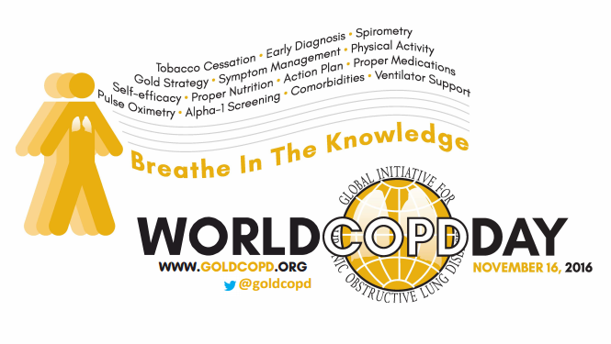
World COPD Day
November, 2016
Keep updated here:
http://goldcopd.org/world-copd-day/
© 2017 Global Initiative for Chronic Obstructive Lung Disease

Slide 111
Journals Publishing the GOLD 2017 Executive Summary
American Journal of Respiratory and Critical Care Medicine
European Respiratory Journal
Respirology
Archivos de Bronconeumología

